Slide 1
Network Project: Ad-blocker on home network
Student name : Maeliosa Leamy
Student number : 20091455

Slide 2

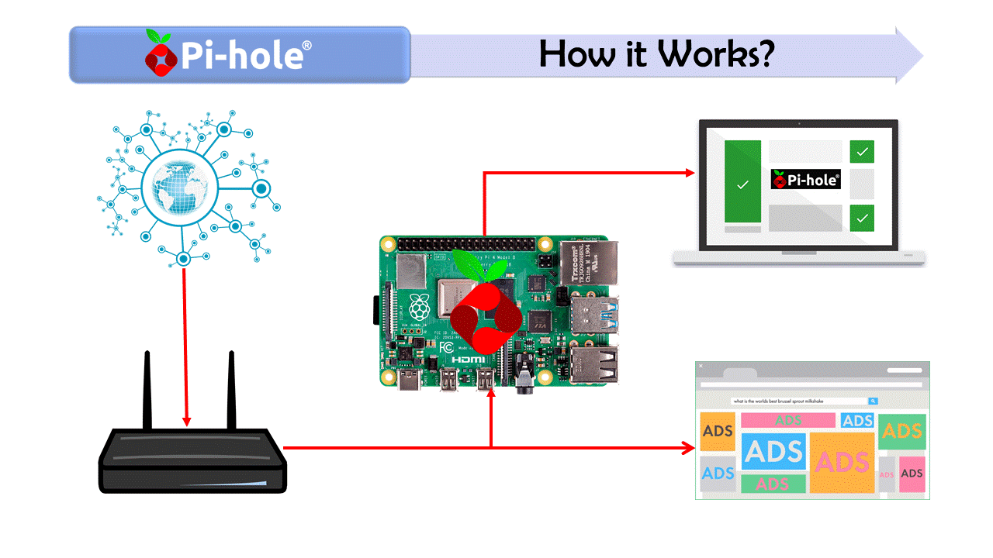
Ad-blocker sits in between router and firewall to block ad’s or domains that are not allowed into this network

Slide 3
Download Pi-hole software
To use my raspberry pi with pi-hole I had to configure my raspberry pi’s IP address from dynamic to static first .

Slide 4
Link to domain using the IP address of Raspberry Pi
Once its all downloaded and installed I navigated to my internet browser and type in the IP address of my Raspberry PI with a forward slash admin.
Type in the assigned password from pi-hole.
Go to group management and configure it what you want, obviously as many ads as you possibly can and also I can customize websites to allowed and blocked.

Slide 5
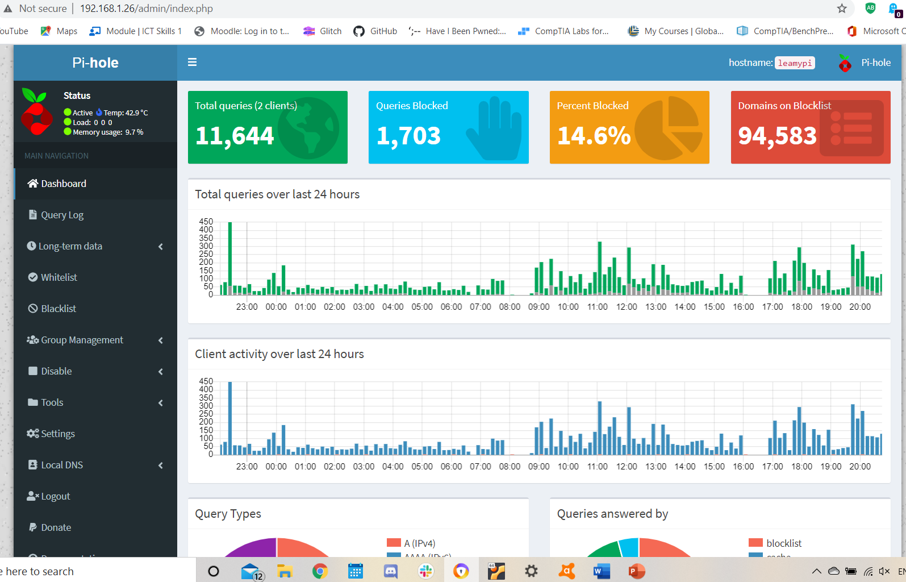
Dashboard displays the amount of queries, how many were blocked

Slide 6
Add domains to the blacklist or to the whitelist so only certain websites are allowed to be viewed on this network
I created 2 bash scripts to block certain websites and then to unblock the again
I then created a python program to turn on the blocked list and then again unblock them with the gpio button and LED.
When you press the button the LED comes on and the websites are blocked.
Then when you press again the domains are unblocked but I wanted to be able to control the blocked list from my phone.

Slide 7
Control the blocking and unblocking of websites from my phone using blynk
I downloaded and set up Blynk, got my Authorisation code.
Added this to my python script on my Raspberry Pi.
In Blynk I created and on/off button to block certain websites, with the use of Pihole on my home Network.

