Slide 1
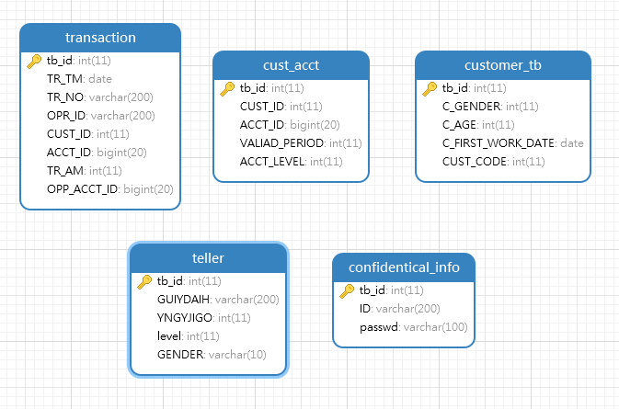

5 original tables
Notes:
Introduction
Basic table: transaction
ODB level

Slide 2
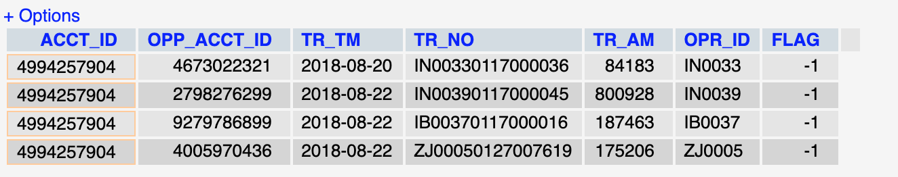
USER
All transaction for this customer
SELECT t.ACCT_ID, OPP_ACCT_ID, TR_TM, TR_NO, TR_AM, OPR_ID, -1 AS FLAG
FROM transaction t, cust_acct ca
WHERE t.CUST_ID = 85888307 AND t.CUST_ID = ca.CUST_ID AND ca.ACCT_ID = t.ACCT_ID
UNION ALL
SELECT t.ACCT_ID, OPP_ACCT_ID, TR_TM, TR_NO, TR_AM, OPR_ID, 1 AS FLAG
FROM transaction t, cust_acct ca
WHERE t.CUST_ID = 85888307 AND t.CUST_ID = ca.CUST_ID AND ca.ACCT_ID = t.OPP_ACCT_ID

Slide 3
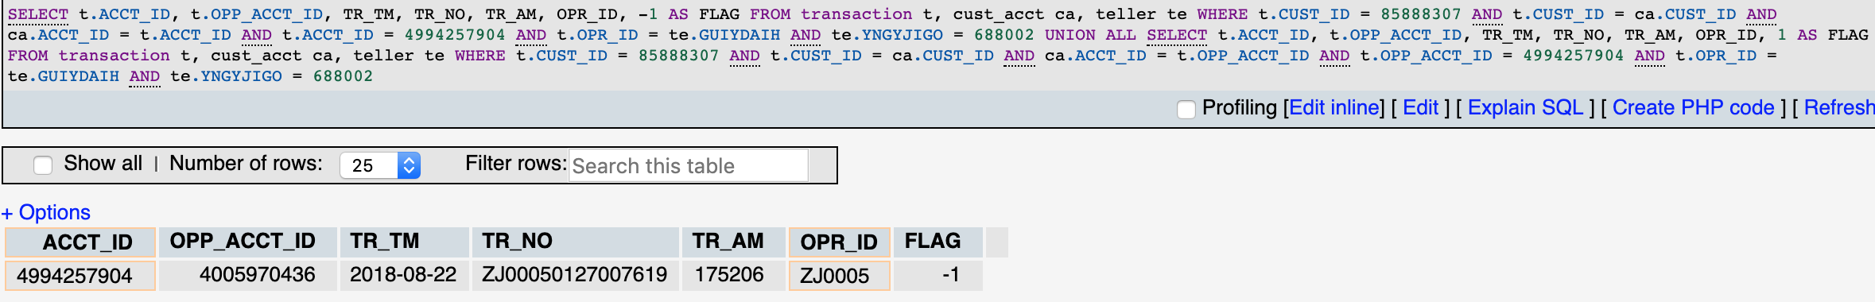
USER
All transaction for a specific institute
SELECT t.ACCT_ID, t.OPP_ACCT_ID, TR_TM, TR_NO, TR_AM, OPR_ID, -1 AS FLAG
FROM transaction t, cust_acct ca, teller te
WHERE t.CUST_ID = 85888307 AND t.CUST_ID = ca.CUST_ID AND ca.ACCT_ID = t.ACCT_ID AND t.ACCT_ID = 4994257904 AND t.OPR_ID = te.GUIYDAIH AND te.YNGYJIGO = 688002
UNION ALL
SELECT t.ACCT_ID, t.OPP_ACCT_ID, TR_TM, TR_NO, TR_AM, OPR_ID, 1 AS FLAG
FROM transaction t, cust_acct ca, teller te WHERE t.CUST_ID = 85888307 AND t.CUST_ID = ca.CUST_ID AND ca.ACCT_ID = t.OPP_ACCT_ID AND t.OPP_ACCT_ID = 4994257904 AND t.OPR_ID = te.GUIYDAIH AND te.YNGYJIGO = 688002

Slide 4
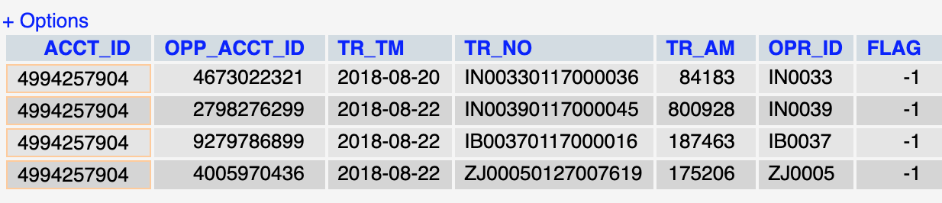
USER
All transaction for a specific card
SELECT t.ACCT_ID, t.OPP_ACCT_ID, TR_TM, TR_NO, TR_AM, OPR_ID, -1 AS FLAG
FROM transaction t, cust_acct ca
WHERE t.CUST_ID = 85888307 AND t.CUST_ID = ca.CUST_ID AND ca.ACCT_ID = t.ACCT_ID AND t.ACCT_ID = 4994257904
UNION ALL
SELECT t.ACCT_ID, t.OPP_ACCT_ID, TR_TM, TR_NO, TR_AM, OPR_ID, 1 AS FLAG
FROM transaction t, cust_acct ca
WHERE t.CUST_ID = 85888307 AND t.CUST_ID = ca.CUST_ID AND ca.ACCT_ID = t.OPP_ACCT_ID AND t.OPP_ACCT_ID = 4994257904

Slide 5
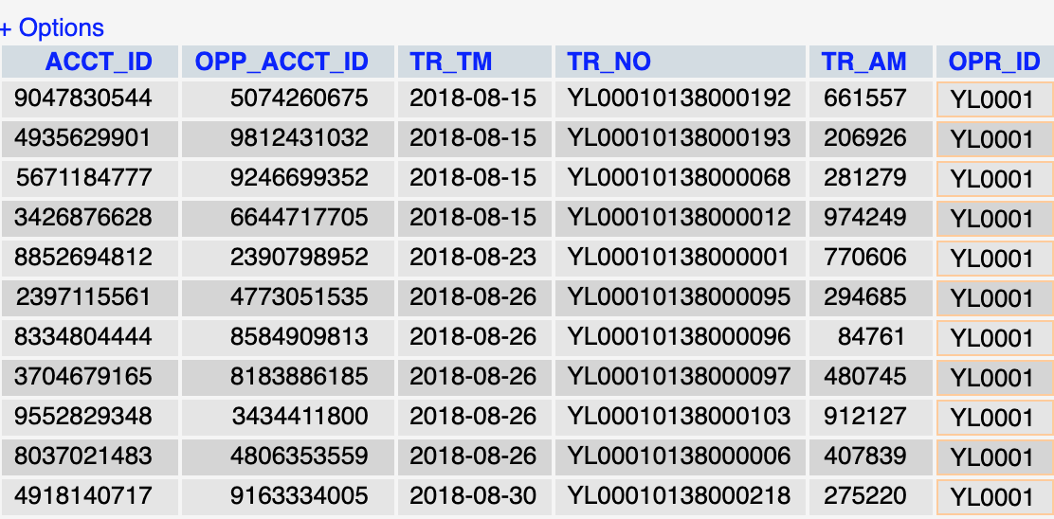
TELLER
All transaction for tellers
SELECT ACCT_ID, OPP_ACCT_ID, TR_TM, TR_NO, TR_AM, OPR_ID
FROM transaction
WHERE OPR_ID = 'YL0001'

Slide 6
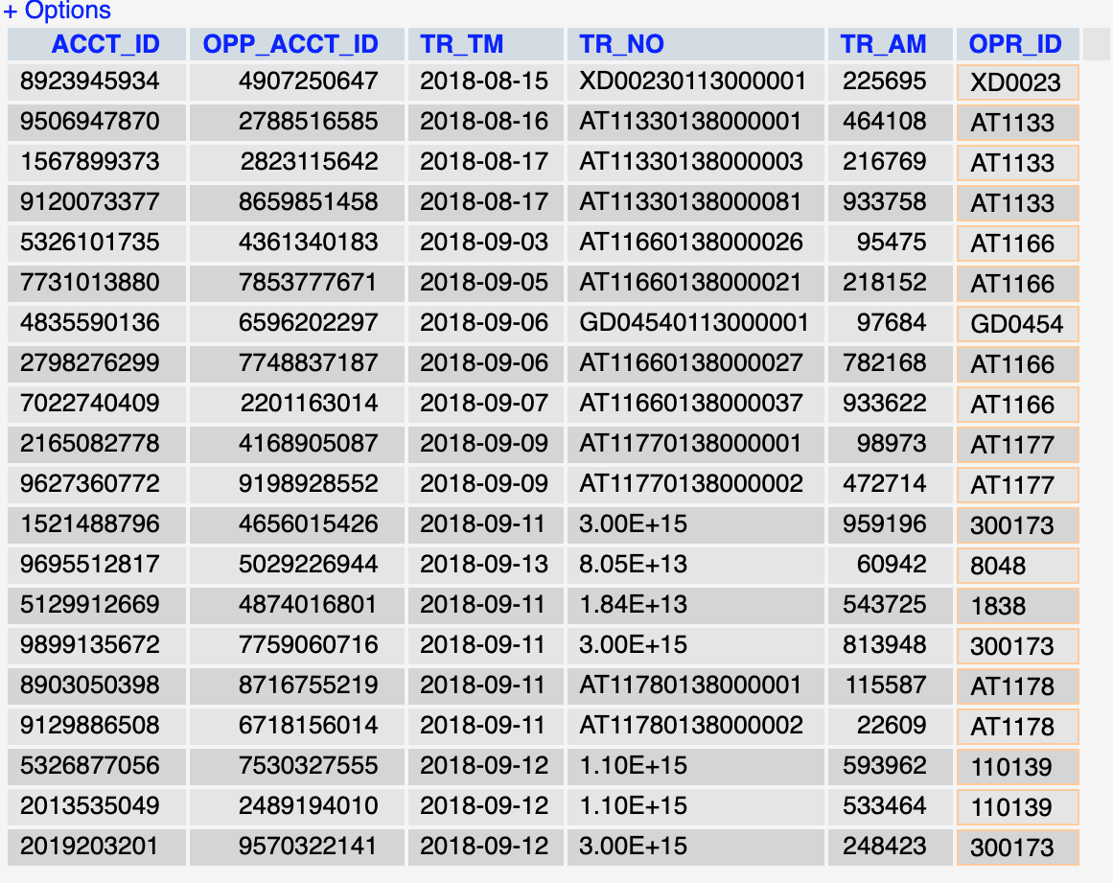
CHIEF
All transaction for corresponding institute
SELECT ACCT_ID, OPP_ACCT_ID, TR_TM, TR_NO, TR_AM, OPR_ID
FROM transaction t, teller te
WHERE t.OPR_ID = te.GUIYDAIH AND te.YNGYJIGO = (SELECT YNGYJIGO
FROM teller
WHERE GUIYDAIH = 1041 AND level = 1)

Slide 7
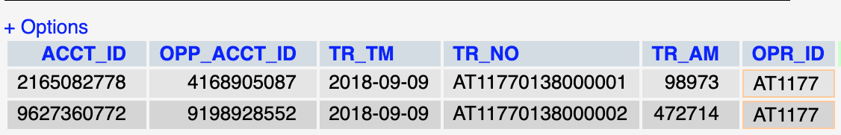
CHIEF
All transaction for a specific teller
SELECT ACCT_ID, OPP_ACCT_ID, TR_TM, TR_NO, TR_AM, OPR_ID
FROM transaction t, teller te
WHERE t.OPR_ID = te.GUIYDAIH AND te.YNGYJIGO = (SELECT YNGYJIGO
FROM teller
WHERE GUIYDAIH = 1041 AND level = 1) AND t.OPR_ID = 'AT1177'

Slide 8
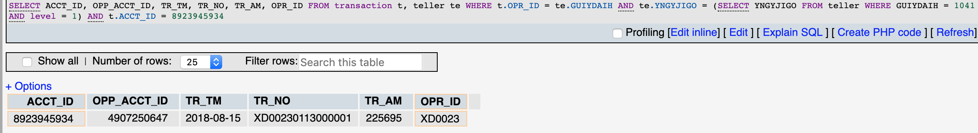
CHIEF
All transaction for a specific account
SELECT ACCT_ID, OPP_ACCT_ID, TR_TM, TR_NO, TR_AM, OPR_ID
FROM transaction t, teller te
WHERE t.OPR_ID = te.GUIYDAIH AND te.YNGYJIGO = (SELECT YNGYJIGO
FROM teller
WHERE GUIYDAIH = 1041 AND level = 1) AND t.ACCT_ID = 8923945934

Slide 9
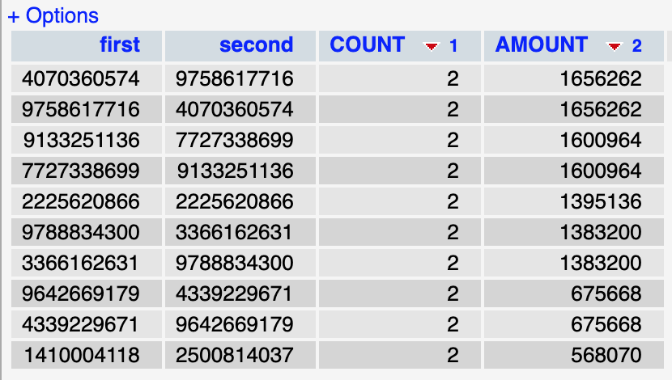
PRESIDENT
President detector
SELECT first, second, sum(COUNT) COUNT, SUM(AMOUNT) AMOUNT
FROM (
SELECT ACCT_ID first, OPP_ACCT_ID second, COUNT(TR_NO) AS COUNT , SUM(TR_AM) AMOUNT
FROM transaction
GROUP BY ACCT_ID, OPP_ACCT_ID
UNION ALL
SELECT OPP_ACCT_ID first, ACCT_ID second, COUNT(TR_NO) AS COUNT , SUM(TR_AM) AMOUNT
FROM transaction
GROUP BY ACCT_ID, OPP_ACCT_ID
) t
GROUP BY first, second
ORDER BY COUNT DESC, AMOUNT DESC
LIMIT 10

Slide 10
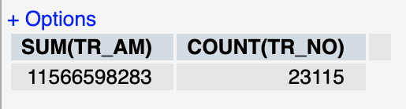
PRESIDENT
President aggregation
SELECT SUM(TR_AM), COUNT(TR_NO)
FROM transaction

Slide 11
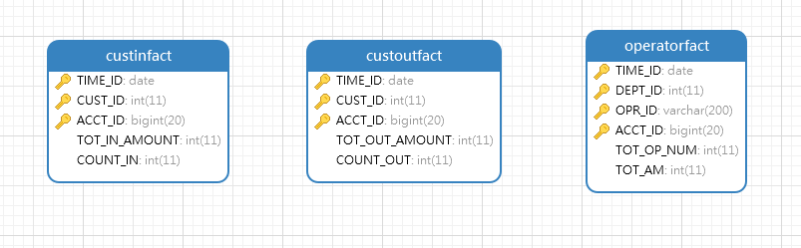
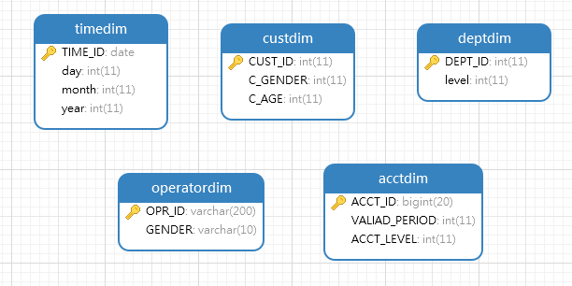
Fact Tables
Dimension Tables
Notes:
ADB level
After basic requirement in our interface display, we construct some ADB level tables to reduce data amount transfer and

Slide 12
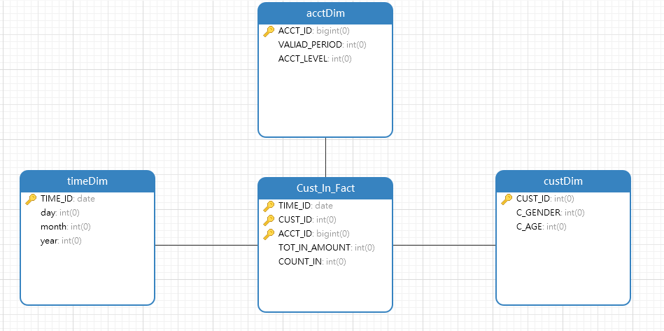
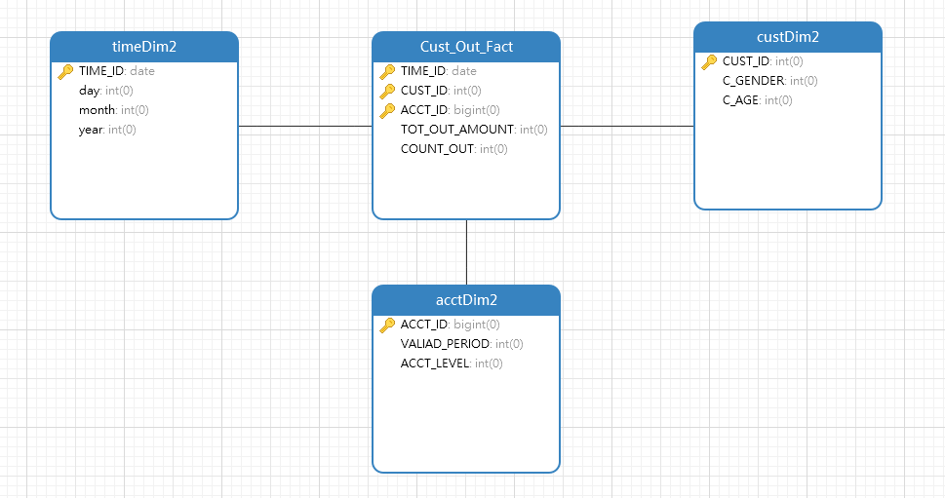
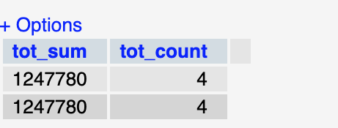
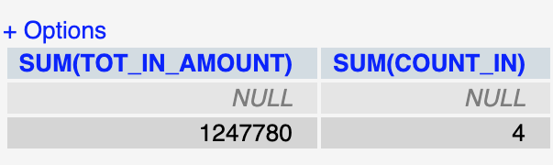
Data Warehouse
SELECT SUM(TOT_IN_AMOUNT), SUM(COUNT_IN)
FROM CustInFact
WHERE CUST_ID = 85888307 AND ACCT_ID = 4994257904
SELECT SUM(TOT_IN_AMOUNT) AS tot_sum, SUM(COUNT_IN) AS tot_count
FROM CustInFact
WHERE CUST_ID = 85888307
Customer Aggregation
Card Aggregation
Notes:
2 fact tables share the dimensions
Because the logic of this is aggregation of account transaction in and out

Slide 13
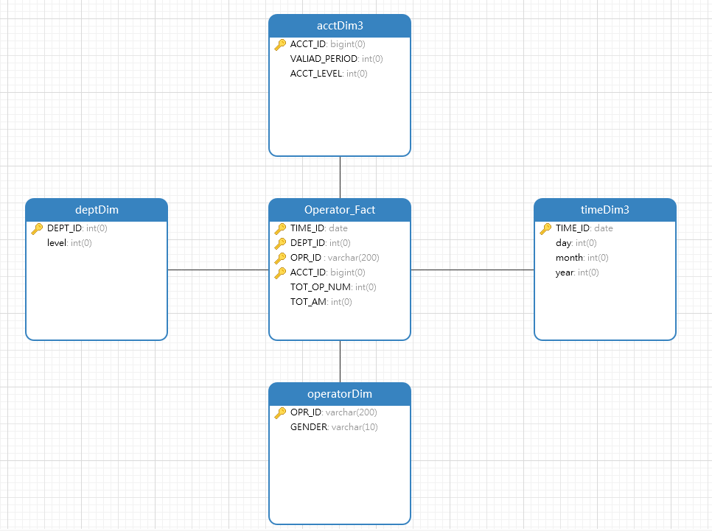

Data Warehouse
Chief institute aggregatioon
SELECT SUM(TOT_AM), SUM(TOT_OP_NUM)
FROM OperatorFact
WHERE DEPT_ID = (SELECT YNGYJIGO
FROM teller
WHERE GUIYDAIH = 1041 AND level = 1)

Slide 14
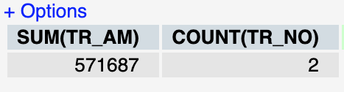
CHIEF
Chief teller aggregatioon
SELECT SUM(TR_AM), COUNT(TR_NO)
FROM transaction t, teller te
WHERE t.OPR_ID = te.GUIYDAIH AND te.YNGYJIGO = (SELECT YNGYJIGO
FROM teller
WHERE GUIYDAIH = 1041 AND level = 1) AND t.OPR_ID = 'AT1177'

Slide 15
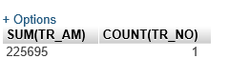
CHIEF
Chief account aggregatioon
SELECT SUM(TR_AM), COUNT(TR_NO)
FROM transaction t, teller te
WHERE t.OPR_ID = te.GUIYDAIH AND te.YNGYJIGO = (SELECT YNGYJIGO
FROM teller
WHERE GUIYDAIH = 1041 AND level = 1) AND t.ACCT_ID = 8923945934

