Slide 1
보행패턴

Slide 2
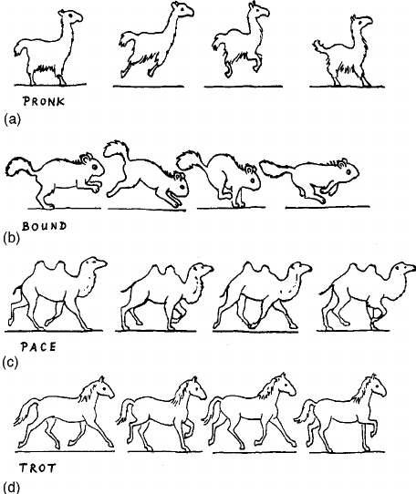
Fig. 16. The four basic gaits, corresponding to the basic modes of our four-pendulum model: ~a! pronk, ~b! bound, ~c! pace ~or rack!, and ~d! trot. The pictures of the latter three are adapted from Ref. 19.
van der Weele, Jacobus P., and Erik J. Banning. "Mode interaction in horses, tea, and other nonlinear oscillators: The universal role of symmetry." American Journal of Physics 69.9 (2001): 953-965.

Slide 3
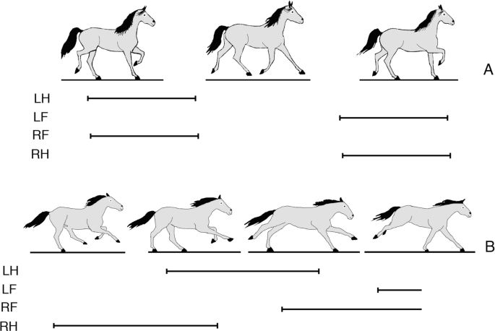
https://youtu.be/OYYl7JmzM4Y?si=EMjdEdYjURvEQ_Sv
트로팅 gait (Trotting gait):
대각선 방향의 두 다리가 쌍을 이루어 번갈아 움직임
무게중심 제어가 용이하여 사족보행로봇에서 자주 사용
gallop ( 갤럽):
말과 같은 대형 동물에서 주로 관찰됩니다.
발의 순서: 왼쪽 뒷발 → 오른쪽 뒷발 → 왼쪽 앞발 → 오른쪽 앞발
https://youtu.be/83ULlgpT1UQ?si=5HH_yTlDumgRCLjK

Slide 4
토픽

Slide 5
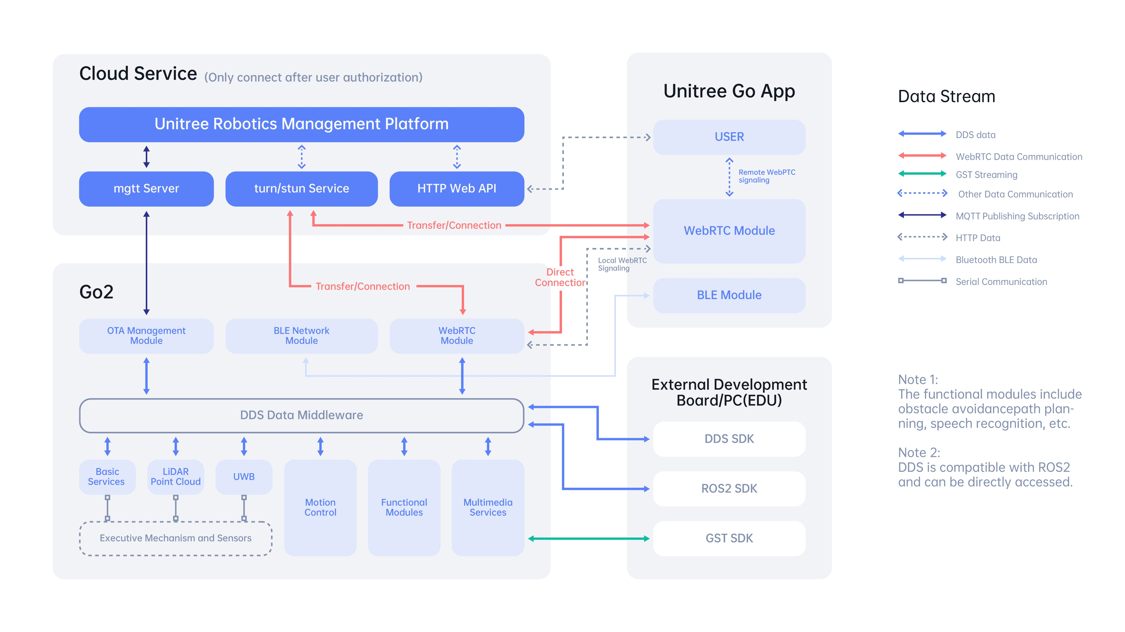

Slide 6
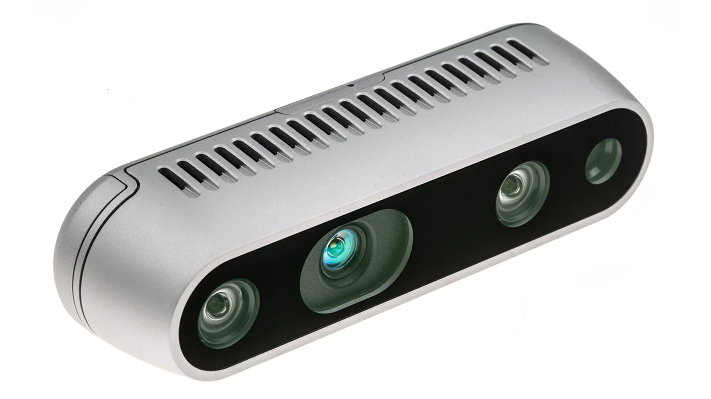
/color/camera_info
/color/image_raw
/color/metadata
/depth/camera_info
/depth/image_rect_raw
/depth/metadata/
/extrinsics/depth_to_color
/imu
Intel D435i
https://github.com/IntelRealSense/realsense-ros

Slide 7
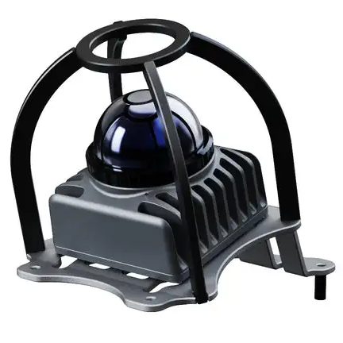
msg/CustomMsg.msg
std_msgs/Header header # ROS standard message header
uint64 timebase # The time of first point
uint32 point_num # Total number of pointclouds
uint8 lidar_id # Lidar device id number
uint8[3] rsvd # Reserved use
CustomPoint[] points # Pointcloud data
msg/CustomPoint.msg
uint32 offset_time # offset time relative to the base time
float32 x # X axis, unit:m
float32 y # Y axis, unit:m
float32 z # Z axis, unit:m
uint8 reflectivity # reflectivity, 0~255
uint8 tag # livox tag
uint8 line # laser number in lidar
Unitree Mid-360
https://github.com/Livox-SDK/livox_ros_driver2

Slide 8
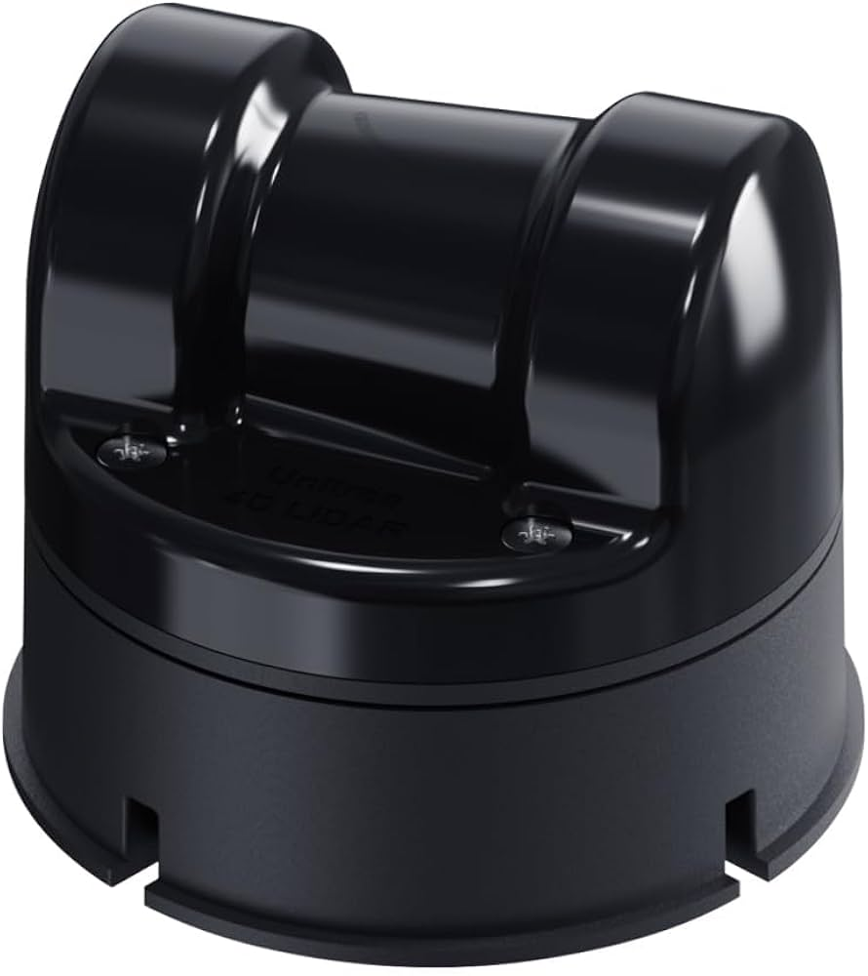
The defalut cloud topic and its frame name is:
topic: "unilidar/cloud"
frame: "unilidar_lidar"
The defalut IMU topic and its frame name is:
topic: "unilidar/imu"
frame: "unilidar_imu"
Unitree 4D Lidar
https://github.com/unitreerobotics/unilidar_sdk?tab=readme-ov-file

Slide 9
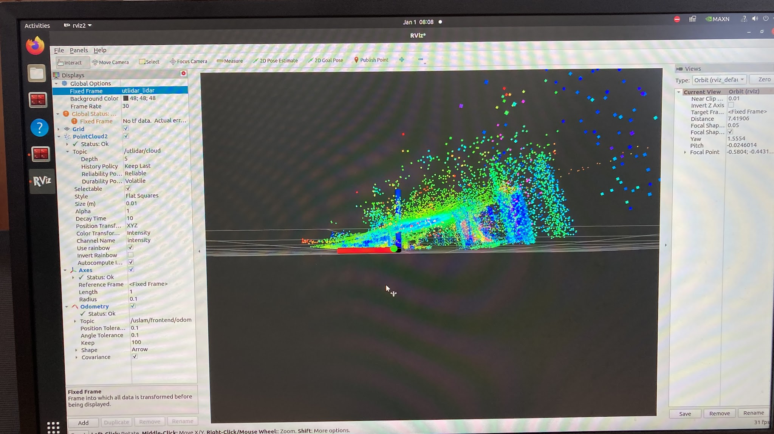
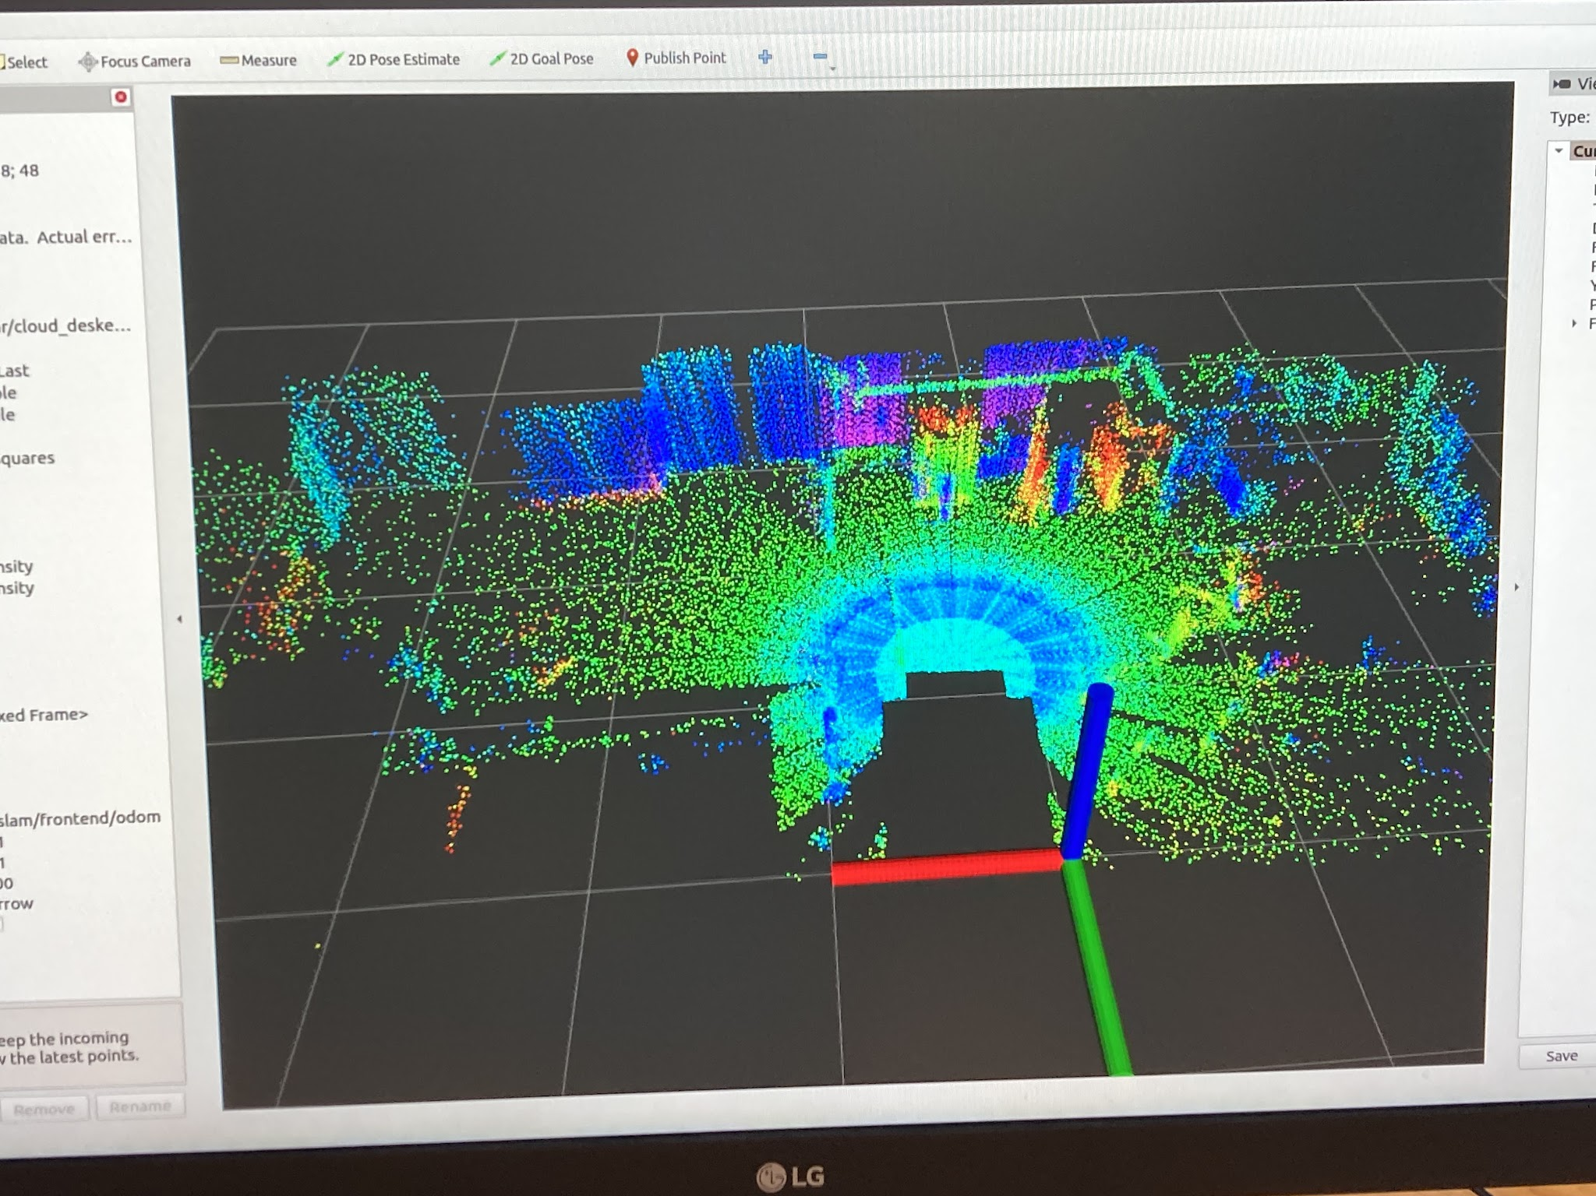
PointCloud2 Visualization

Slide 10
서비스

Slide 11
시나리오 1: 기본 명령어 응답
입력: "sit", "stand", "walk"
출력: 각 명령에 따른 짖는 소리 ("woof", "ruff", "arf")
Client 노드: voice_command_client
Server 노드: dog_response_server
# srv/DogResponse.srv
string command
---
string response
Node A
command
Node B
response
Service Server
Service Client

Slide 12
시나리오 2: 상호작용 응답
입력: "play", "treat", "pat"
출력: 상호작용에 따른 반응 ("excited-bark!", "gentle-woof", "happy-yelp")
Client 노드: interaction_client
Server 노드: dog_behavior_server
# srv/DogResponse.srv
string command
---
string response
Node A
command
Node B
response
Service Server
Service Client

