Slide 1
Module 1
Exploring the Network
By Dr. Percy DIAS
© 2016, Cisco Systems, Inc. All rights reserved.

Slide 2
Number Systems

Slide 3
Computing Measurement Terms
Bits are binary digits. They are either 0s or 1s. In a computer, they are represented by On/Off switches or the presence or absence of electrical impulses, light pulses, or electromagnetic waves.

Slide 4
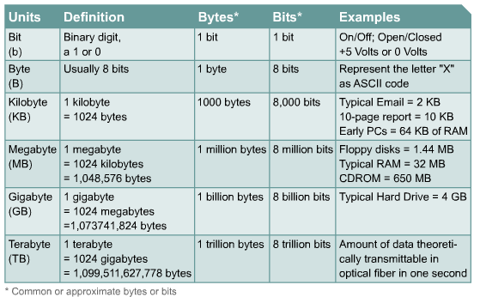
Computing Measurement Terms

Slide 5
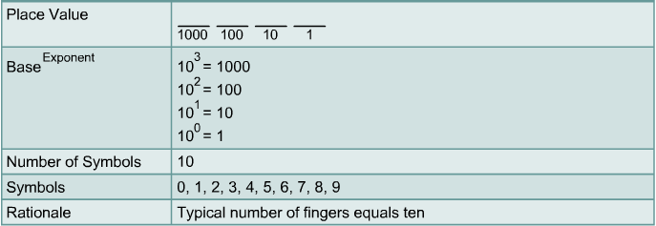
Base 10 (Decimal) Number System

Slide 6
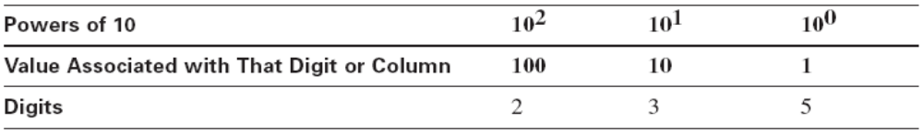
Base 10 (Decimal) Calculations
Should be familiar because you’ve used it since childhood
Example: the number 235 = (2 x 100) + (3 x 10) + (5 x 1)
Because you’ve used it so long, you probably don’t think about it

Slide 7
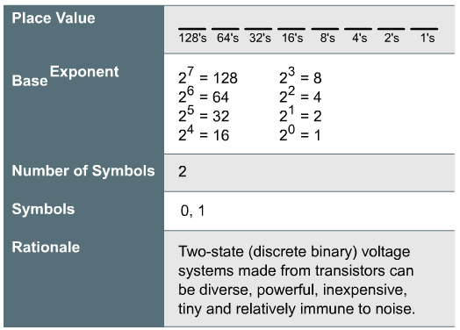
Base 2 (Binary) Numbers

Slide 8
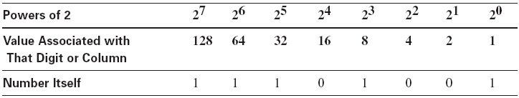
Base 2 (Binary) Numbers
Binary uses just two digits, 0 and 1
Similar to Base 10; differences are in the details
Example: the binary number 11101011 is equivalent to the decimal number 235 – Add the decimal value of each bit to get the decimal number
(1 * 128) + (1 * 64) + (1 * 32) + (0 * 16) + (1 * 8) + (0 * 4) + (1 * 2) + (1 * 1) = 235 decimal
1

Slide 9
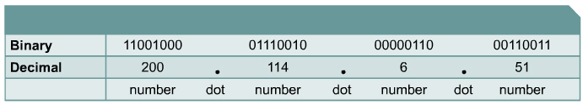
Four-Octet Dotted-decimal Representation of 32-Bit Binary Numbers
Split the binary number into four groups of eight binary digits. Then convert each group of eight bits, also known as an octet into its decimal equivalent.

Slide 10
Converting IP Addresses Between Decimal and Binary
IP addresses are 32-bit binary numbers
Humans find it easier to read decimal numbers, so IP addresses are often expressed in dotted-decimal format
Each decimal number represents 8 binary digits, also know as an “octet”
Each octet can be converted to a decimal number between 0 and 255, inclusive

Slide 11
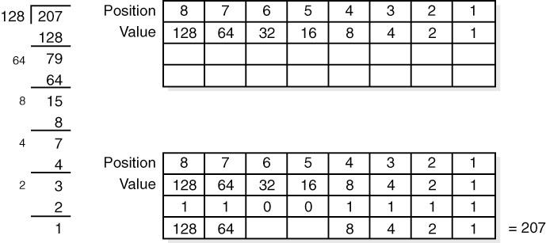
Converting Decimal to Binary
Start by dividing the decimal by the largest number in the Value row that will go.

Slide 12
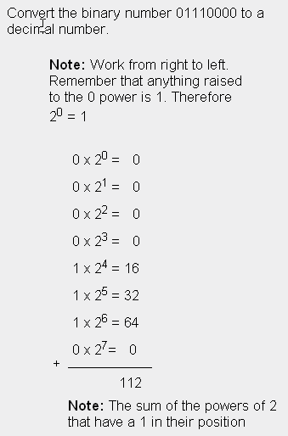
Converting 8-bit Binary Numbers to Decimal Numbers

Slide 13
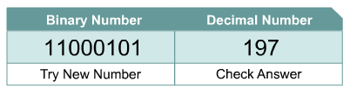
Converting 8-Bit Binary to Decimal
Binary numbers are converted to decimal numbers by multiplying the binary digits by the base number of the system, which is base 2, and raised to the exponent of its position.

Slide 14
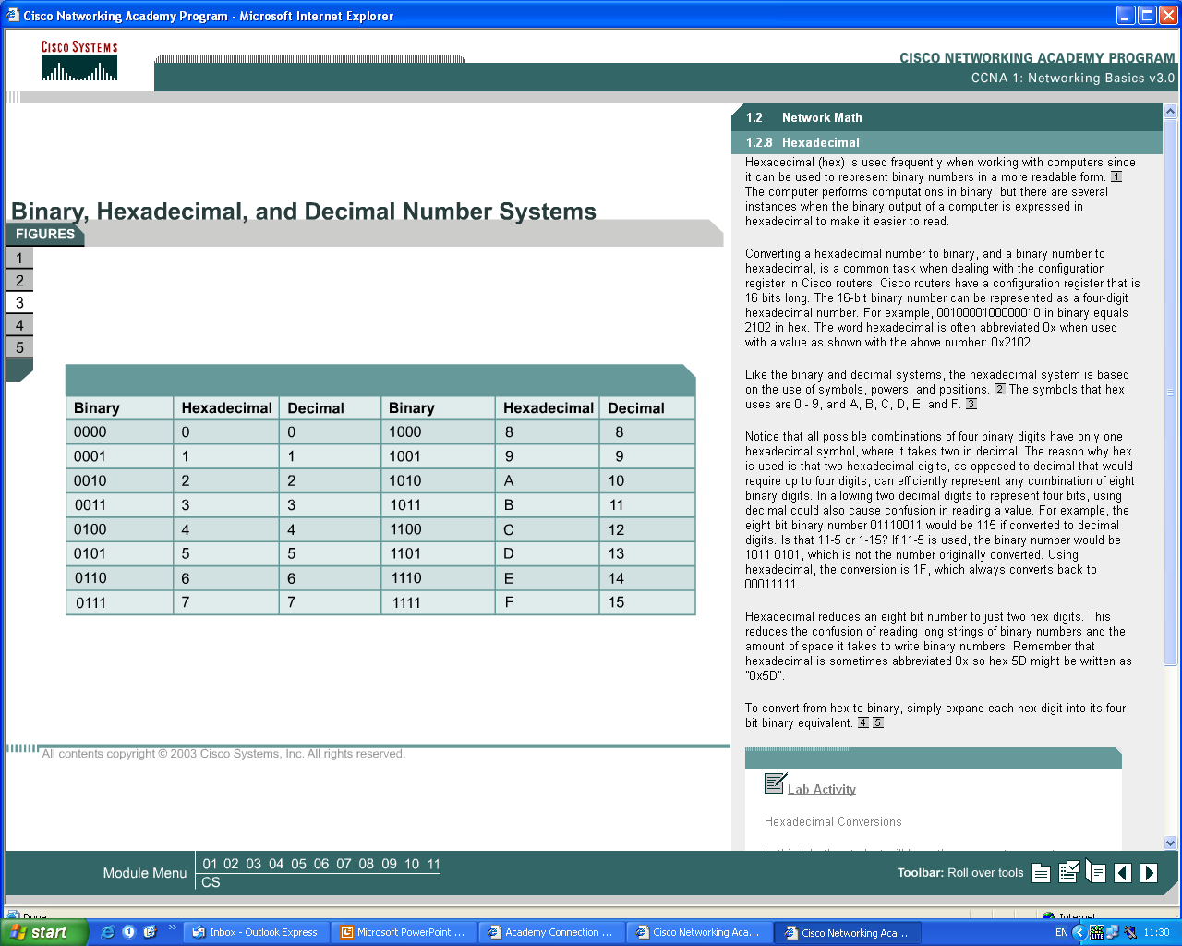
Hexadecimal
The base 16, or hexadecimal (hex), number system is used frequently when working with computers, because it can be used to represent binary numbers in a more readable form.

Slide 15
Hexadecimal
Popularly called “hex”
Each hex digit represents 4 bits
Uses 16 symbols: 0,1,2,3,4,5,6,7,8,9,A,B,C,D,E,F
A = 10, B = 11, C = 12, D = 13, E = 14, F = 15

Slide 16
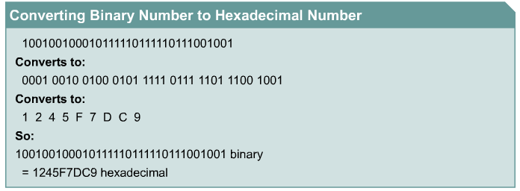
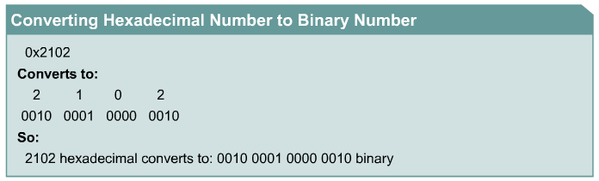
Conversion

Slide 17
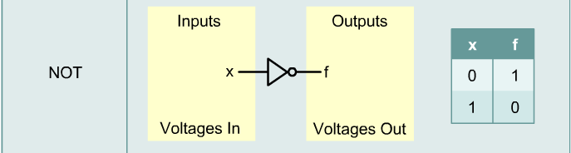
Boolean or Binary Logic
Boolean logic is based on digital circuitry that accepts one or two incoming voltages.
Boolean logic is a binary logic that allows two numbers to be compared and generate a choice based on the two numbers.

Slide 18
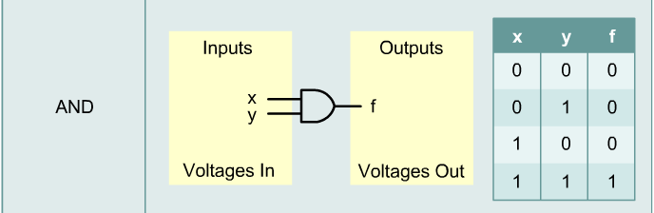
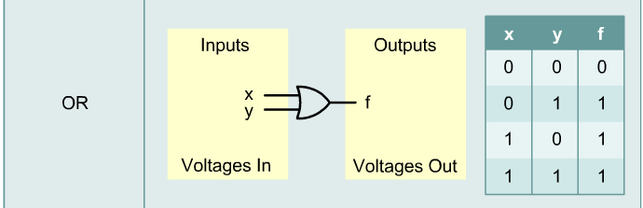
Boolean or Binary Logic

Slide 19
LANs, WANs, and the Internet

Slide 20
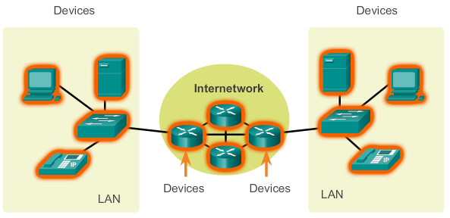
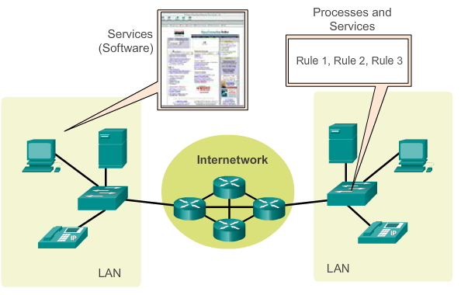
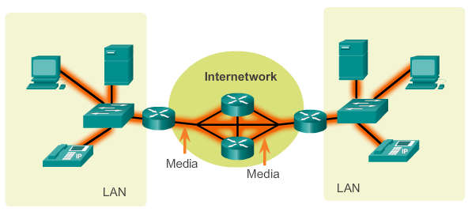
LANs, WANs, and Internets
Components of a Network
There are three categories of network components:
Devices
Media
Services
Notes:
1.2.1.1 Components of the Network

Slide 21
Components of a Network
End Devices
Some examples of end devices are:
Computers (work stations, laptops, file servers, web servers)
Network printers
VoIP phones
TelePresence endpoint
Security cameras
Mobile handheld devices (such as smart phones, tablets, PDAs, and wireless debit / credit card readers and barcode scanners)
Cisco TelePresence TX9000 Series:
New industrial design for greater immersion
Three simultaneous very-high-quality video streams
High-definition, full-motion content sharing for superior video and content collaboration
Excellent lighting and sound with a discreet camera housing and a touchscreen interface
20% less bandwidth requirements, faster installation, and simplified servicing than earlier models
Video
Notes:
1.2.1.2 End Devices

Slide 22
Components of a Network
Network Infrastructure Devices
Examples of intermediary network devices are:
Network Access Devices (switches, and wireless access points)
Internetworking Devices (routers)
Security Devices (firewalls)
Notes:
1.2.1.3 Intermediary Network Devices

Slide 23
Components of a Network
Network Media
Media refers to the various physical environments through which transmission signals pass.
Common network media include twisted-pair, coaxial, fiber-optic cable, and the atmosphere through which wireless transmission occurs.

Slide 24
Components of a Network
Network Media
Media | Example | Encoding
Copper | Twisted-pair cable usually used as LAN media | Electrical pulses
Fiber-optic | Glass or plastic fibers in a vinyl coating usually used for long runs in a LAN as a trunk | Light pulses
Wireless | Connects local users through the air | Electromagnetic waves

Slide 25
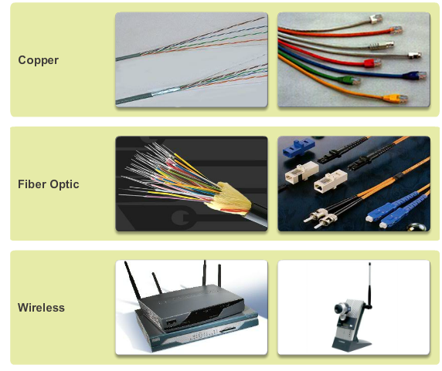
Components of a Network
Network Media
Notes:
1.2.1.4 Network Media

Slide 26
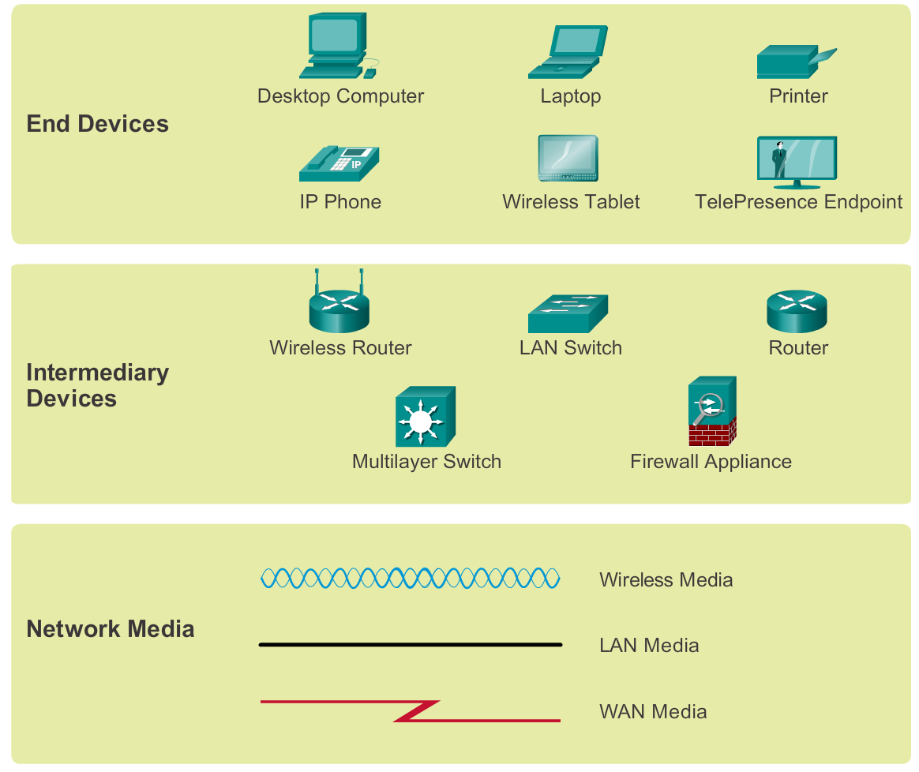
Components of a Network
Network Representations
Notes:
1.2.1.5 Network Representations

Slide 27
LANs and WANs
Types of Networks
The two most common types of network infrastructures are:
Local Area Network (LAN)
Wide Area Network (WAN).
Other types of networks include:
Metropolitan Area Network (MAN)
Wireless LAN (WLAN)
Storage Area Network (SAN)
Notes:
1.2.2.1 Types of Networks

Slide 28
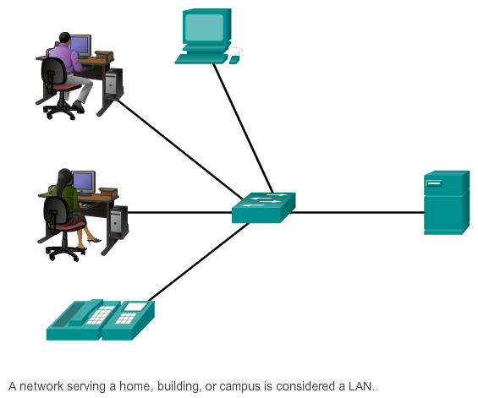
LANs and WANs
Local Area Networks (LAN)
Notes:
1.2.2.2 Local Area Networks

Slide 29
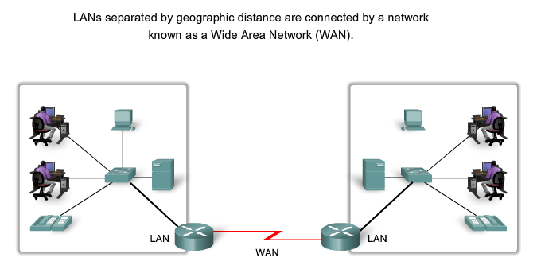

LANs and WANs
Wide Area Networks (WAN)
Notes:
1.2.2.3 Wide Area Networks

Slide 30
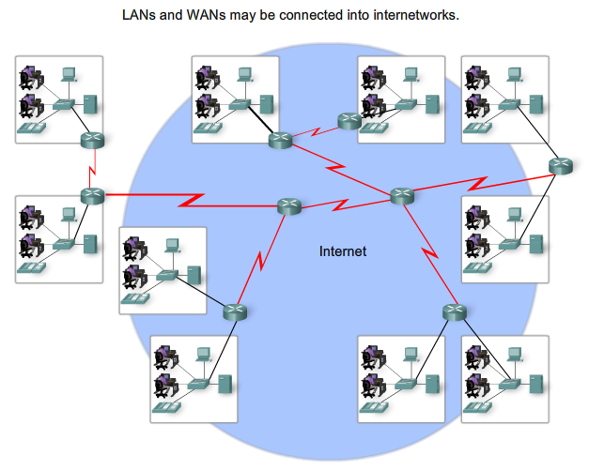
LANs, WANs, and the Internet
The Internet
Notes:
1.2.3.1 The Internet

Slide 31
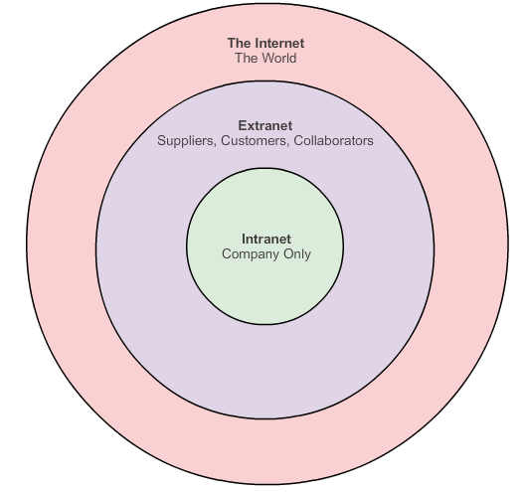
LANs, WANs, and the Internet
Intranet and Extranet
Notes:
1.2.3.2 Intranet and Extranet

Slide 32
Bandwidth

Slide 33
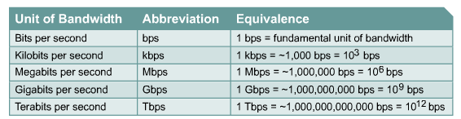
Importance of Bandwidth
Bandwidth is defined as the amount of information that can flow through a network connection in a given period of time

Slide 34
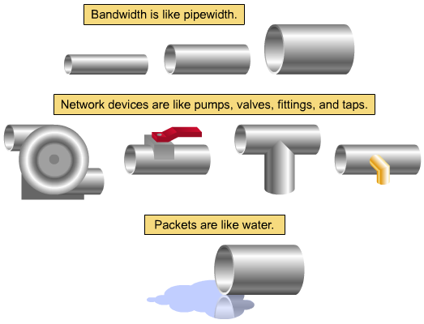
Bandwidth Pipe Analogy

Slide 35
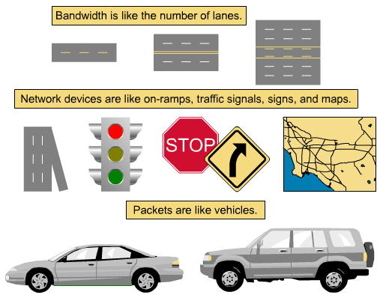
Bandwidth Highway Analogy

Slide 36
Cisco Networking Academy
CCNA Routing and Switching (CCNA5)
Introduction to Networks
Slide No. | Chapter No. | Textbook Page
3 | 1.2.1.3 - 1.2.1.4 | 17
5 - 13 | 8.1.1 | 394 – 400
14 – 16 | 8.2.2.1 | 427 – 428
20 – 31 | 1.2 | 14 – 24
33 – 35 | 4.1.3.2 | 171 – 172

