Slide 1
Module 2
Protocols and Communications
By Dr. Percy DIAS
© 2016, Cisco Systems, Inc. All rights reserved.

Slide 2
Network Protocols
Communication must follow a set of rules
Networking rules are defined by a set of standards and protocols
A single standard or protocol defines what a small part of the network does
The Transmission Control Protocol/Internet Protocol (TCP/IP) suite defines a large set of standards and protocols used to network computers

Slide 3
The Need for Networking Protocols and Standards
1960s to 1980s – Each vendor set its own proprietary protocols and standards
Equipment from different vendors would not interoperate
Eventually, open standards were agreed upon
Open standards allow more competition, which increases speed of development

Slide 4
Using Layers to Describe Data Communication
Data communication is a very complex process.
Difficult to understand this process as a whole.
Solution is to break down the total network communication system into a series of layers.
Each layer is responsible for a specific part of network communication.
These layers interact with the layer above and below.
Two common network models that use layers are Open System Interconnection (OSI) reference model and the TCP/IP reference model.

Slide 5
Creation of Internet, Development of TCP/IP
The first packet switching network and predecessor to today’s Internet was the Advanced Research Projects Agency Network (ARPANET), which came to life in 1969 by connecting mainframe computers at four locations.
ARPANET was funded by the U.S. Department of Defense for use by universities and research laboratories. Bolt, Beranek and Newman (BBN) was the contractor that did much of the initial development of the ARPANET, including creating the first router known as an Interface Message Processor (IMP).
In 1973, Robert Kahn and Vinton Cerf began work on TCP to develop the next generation of the ARPANET. TCP was designed to replace ARPANET’s current Network Control Program (NCP).
In 1978, TCP was divided into two protocols: TCP and IP. Later, other protocols were added to the TCP/IP suite of protocols including Telnet, FTP, DNS, and many others.
Notes:
3.2.2.2 Creation of the Internet and Development of TCP/IP

Slide 6
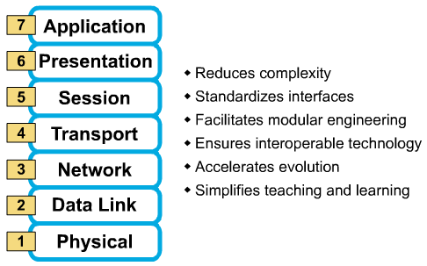
OSI Reference Model

Slide 7
Functions of Layer 7
Application Layer: Network Process to Applications
  Provides network services to the user’s application
  User interface
  Examples – Telnet, HTTP, Web browsers

Slide 8
Functions of Layer 6
Presentation Layer: Data Representation
  Ensures that the information that the application layer of one system sends out is readable by the application layer of another system
  How data is presented
  Special processing, such as data format, compression and encryption

Slide 9
Functions of Layer 5
Session Layer: Interhost Communication
  Establishes, manages, and terminates session between two communication host.

Slide 10
Functions of Layer 4
Transport Layer: End-to-End Connection
  How reliable transport between two hosts is accomplished is the concern of the transport layer.
  Reliable or unreliable delivery
  Examples: TCP, UDP

Slide 11
Functions of Layer 4
TCP breaks large data into segments
TCP marks each data packet with a sequence number
A missing packet can be resent

Slide 12
Functions of Layer 3
Network Layer: Address and Best Path
  Provides connectivity and path selection between two host systems that may be located on geographically separated networks
  Provides logical addressing which routers use for path determination
  Examples: IP

Slide 13
Functions of Layer 2
Data Link Layer: Access to media
  Concerned with physical (as opposed to logical) addressing
  Access to media using MAC address
  Error detection

Slide 14
Functions of Layer 1
Physical Layer: Binary transmission
  Moves bits between devices

Slide 15
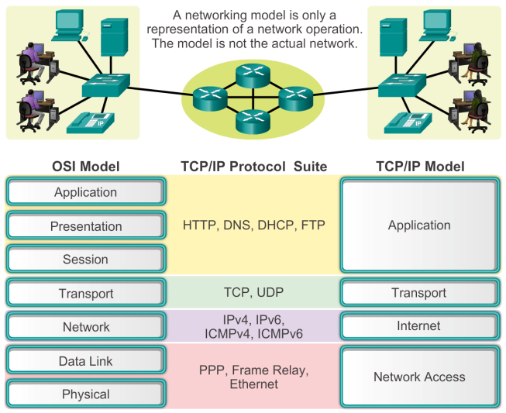
Reference Models
Benefits of Using a Layered Model
Notes:
3.2.4.1 The Benefits of Using a Layered Model

Slide 16
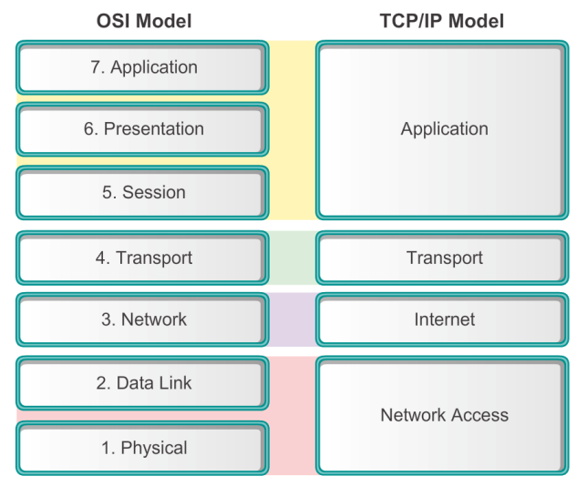
Reference Models
Comparing the OSI and TCP/IP Models
Notes:
3.2.4.4 Comparing the OSI Model with the TCP/IP Model

Slide 17
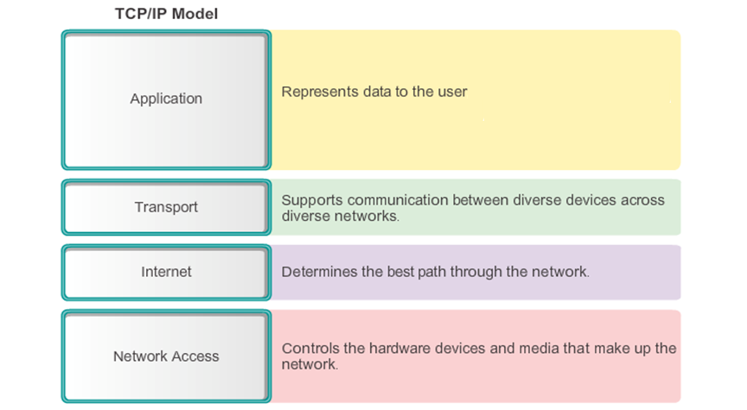
Reference Models
The TCP/IP Reference Model
Notes:
3.2.4.3 The TCP/IP Protocol Model

Slide 18
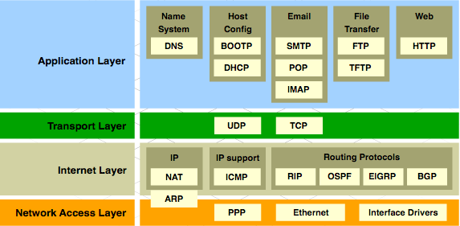
TCP/IP Protocol Suite and Communication
Notes:
3.2.2.3 TCP/IP Protocol Suite and Communication Process

Slide 19
Moving Data in the Network

Slide 20
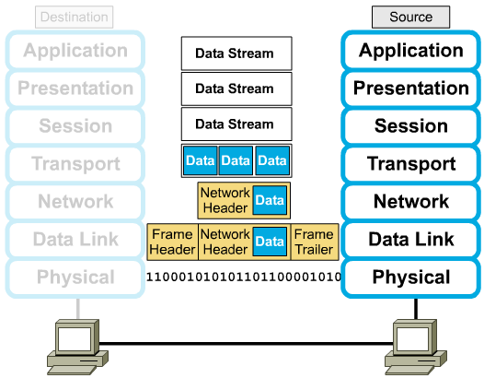
Encapsulation
  The lower layers use encapsulation to put the protocol data unit (PDU) from the upper layer into its data field and to add headers and trailers that the layer can use to perform its function.

Slide 21
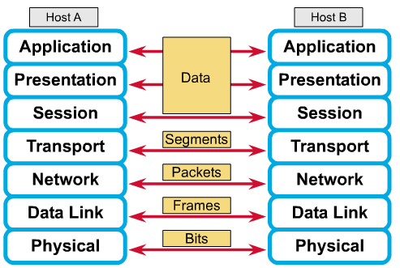
Names for Data at Each Layer

Slide 22
De-Encapsulation
When the data link layer receives the frame, it does the following:
  It reads the physical address and other control information provided by the directly connected peer data link layer.
  It strips the control information

Slide 23
Cisco Networking Academy
CCNA Routing and Switching (CCNA5)
Introduction to Networks
Slide No. | Chapter No. | Textbook Page
2 – 3 | 3.2.1 | 123 – 124
4 – 17 | 3.2.4 | 137 – 143
18 | 3.2.2.3 | 129 - 133
20 - 22 | 3.3.1 | 143 - 146

