Slide 1
Module 3
Ethernet
By Dr. Percy DIAS
© 2016, Cisco Systems, Inc. All rights reserved.

Slide 2
Physical Topology
Physical topology is the actual layout of the wire or media.
Bus
  Connects all the devices using a single cable
  Main cable segment must end with a terminator that absorbs the signal when it reaches the end (data can bounces back)
Star
  Most commonly used in Ethernet LAN
  Central connection point can be a hub, switch or router, and might be desirable for security or restricted access
  If the central device fails, the whole network becomes disconnected

Slide 3
Physical Topology
Ring
  Frame travels around the ring, stopped at each node
  If a node wants to transmit data, it is permitted to add data as well as destination address
Full-mesh
  Connect all devices to each other for redundancy and fault tolerance
Partial-mesh
  At least one device maintains multiple connections to others

Slide 4
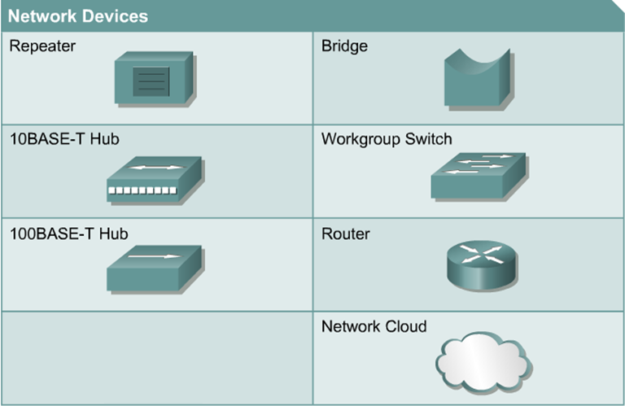
Networking Devices

Slide 5
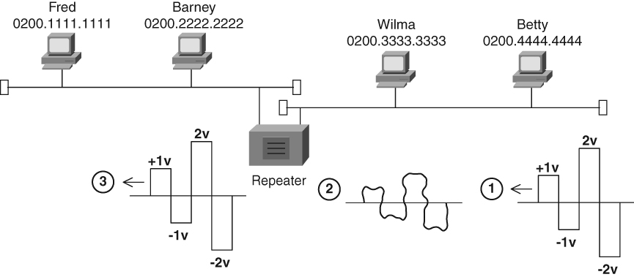
Repeated Ethernet Signal

Slide 6
Repeated Ethernet Signal
Betty sends a clean signal
The signal degrades by the time it reaches the repeater
The repeater regenerates a new, clean signal and sends it out its other port

Slide 7
Repeaters
When a signal is sent over a wire, it degrades
To extend the distance of LANs, repeaters were developed
Typically had two ports connecting two different Ethernet segments
Interpreted the incoming signal on one port as 1’s and 0’s
Sent a regenerated clean signal out the other port

Slide 8
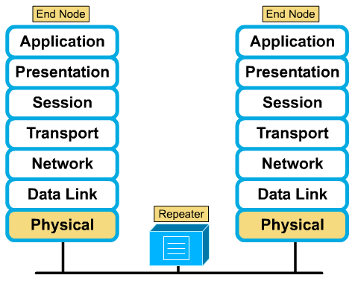
Repeaters: Layer 1

Slide 9
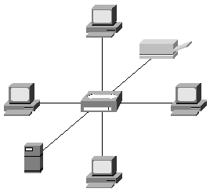
Hubs
Regenerate signals
Used as network concentration points
Multiport repeater
Layer 1 device

Slide 10
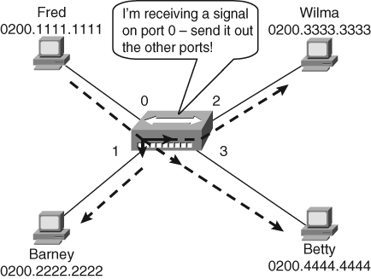
Hub Operation

Slide 11
Network Interface Card
Carries a unique code called a Media Access Control (MAC)
MAC address controls data communication for the host on the network
NICs are considered layer 2 and operate at both layer 1 and 2 (Layer 1: send and receive signals over an attached cable)

Slide 12
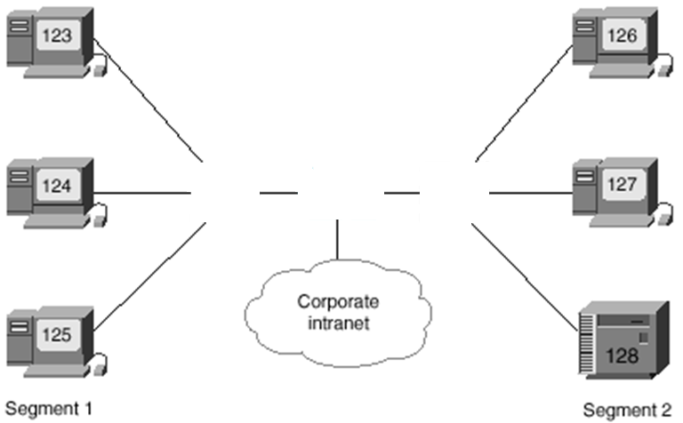


Switches
Switches filter traffic by looking at MAC addresses.
Layer 2 device designed to create two or more LAN segments, each of which is a separate collision domain

Slide 13
Switches
Filter traffic on a LAN to keep local traffic local yet allow connectivity to other parts
Keep track of which MAC addresses are on each side of the switch and makes forwarding decisions based on MAC address table
When a switch receives a frame, the destination MAC address is looked up in the switching table to determine whether to filter, flood or forward the frame onto another segment.

Slide 14
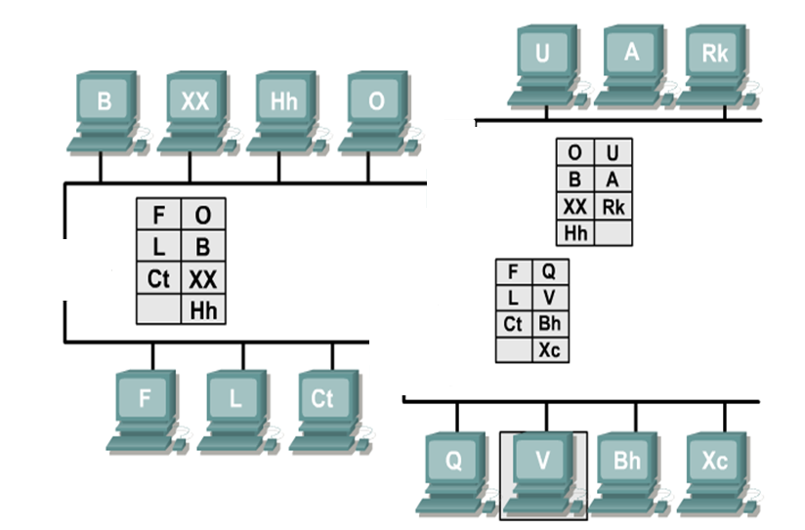

Switches

Slide 15
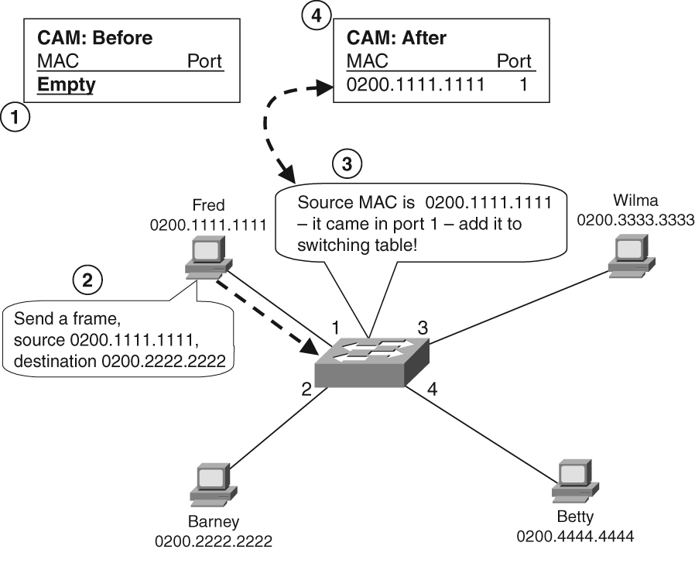
Flooding Unknown Unicasts

Slide 16
Learning Table Entries and Flooding Unknown Unicasts
Switches learn entries in the table dynamically
They use this logic:
  Examine the source MAC address of the frame and the interface on which it was received
  Add that source MAC address and corresponding interface to the table

Slide 17
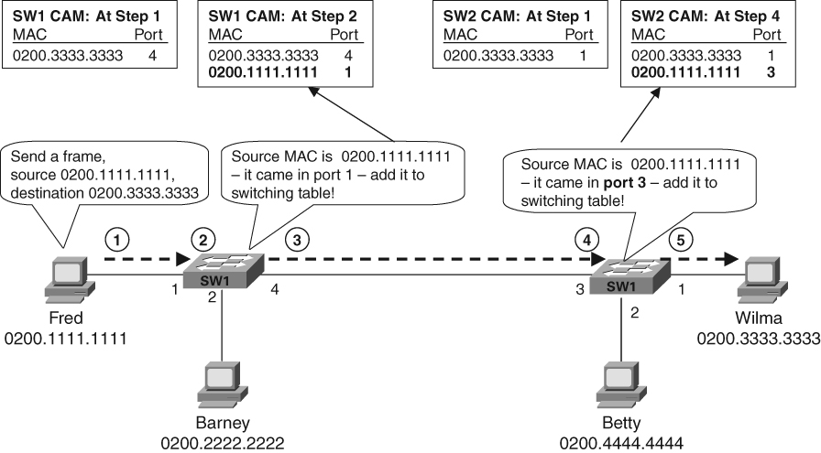
Learning Content Addressable Memory (CAM) Table Entries: Two Switches
SW2

Slide 18
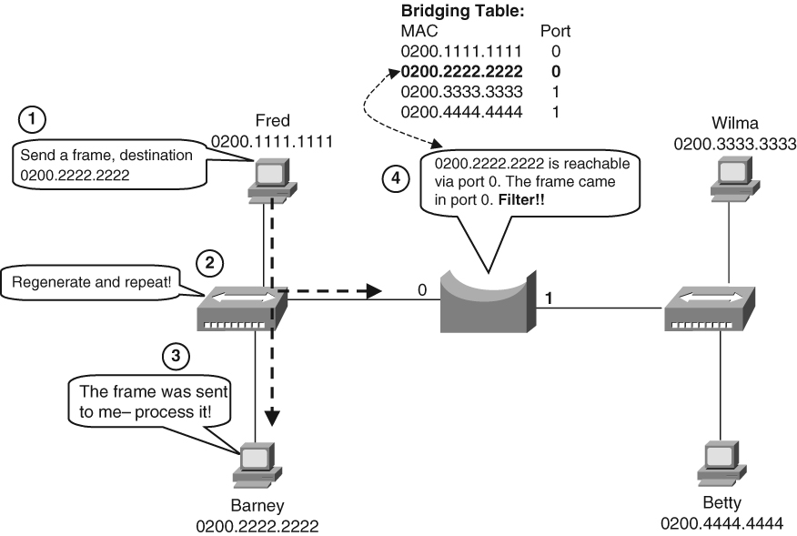
Switch Making Filter Decision
Switch Table:

Slide 19
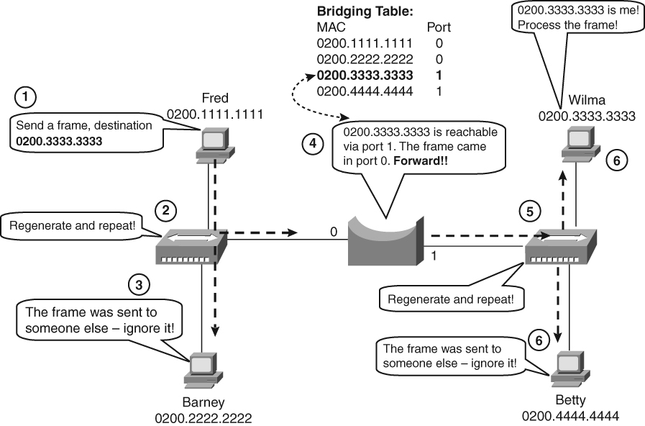
Switch Making a Forwarding Decision
Switch Table:

Slide 20
LAN Switches
Layer 2 device
Use a table of MAC addresses (switching table) to determine the segment on which a frame needs to be transmitted
Cisco switching table sometimes referred to as Content Addressable Memory (CAM).
Give each host the medium’s full bandwidth (microsegmentation)
Improve network performance: speed and bandwidth

Slide 21
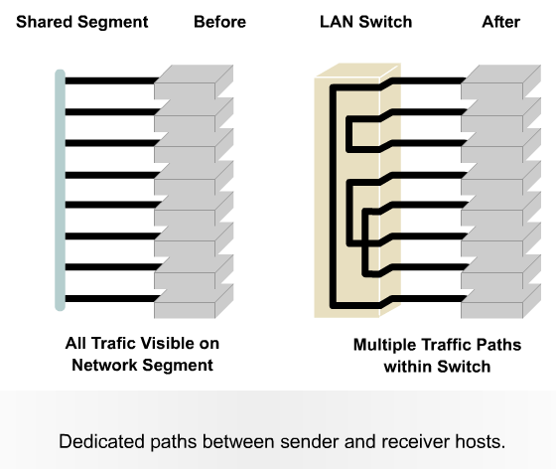

Slide 22
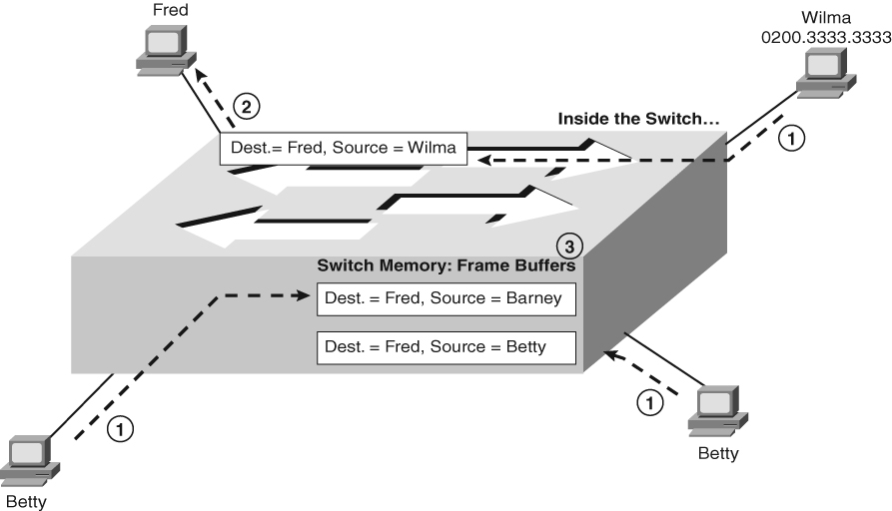
Switch Buffering Example
Barney

Slide 23
Preventing Collisions with Switch Buffering
Switches prevent collisions by buffering frames
If several PCs send frames to the same address at the same time, the switch holds the frames in memory - a process called buffering
The switch then forwards the frames one at a time

Slide 24
Routers
Layer 3 device
Use logical address (network layer address)
Can connect different layer 2 technologies
Examine incoming packet (layer 3 data), choose the best path, and switch them to the proper outgoing port.

Slide 25
Introduction to Ethernet
The success of Ethernet is due to its simplicity and ease of maintenance, as well as its ability to incorporate new technologies, reliability, and low cost of installation and upgrade.

Slide 26
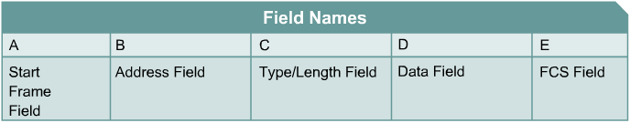
Layer 2 Framing
Framing is the Layer 2 encapsulation process; a frame is the Layer 2 protocol data unit.
Generic Frame Format

Slide 27
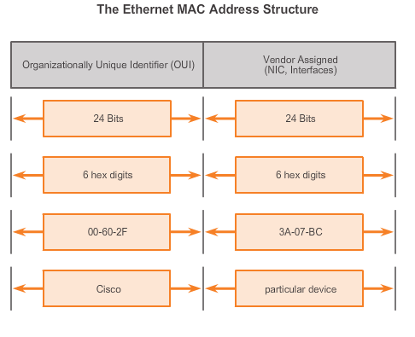
Ethernet Operation
MAC Address: Ethernet Identity
Layer 2 Ethernet MAC address is a 48-bit binary value expressed as 12 hexadecimal digits.
IEEE requires a vendor to follow these rules:
  Must use that vendor's assigned OUI as the first 3 bytes.
  All MAC addresses with the same OUI must be assigned a unique value in the last 3 bytes.
Notes:
5.1.1.4 MAC Address: Ethernet Identity

Slide 28
Ethernet Operation
Frame Processing
MAC addresses assigned to workstations, servers, printers, switches, and routers.
Example MACs:
  00-05-9A-3C-78-00
  00:05:9A:3C:78:00
  0005.9A3C.7800.
When a device is forwarding a message to an Ethernet network, attaches header information to the packet, contains the source and destination MAC address.
Each NIC views information to see if the destination MAC address in the frame matches the device’s physical MAC address stored in RAM.
No match, the device discards the frame.
Matches the destination MAC of the frame, the NIC passes the frame up the OSI layers, where the de-encapsulation process takes place.
Notes:
5.1.1.5 Frame Processing

Slide 29
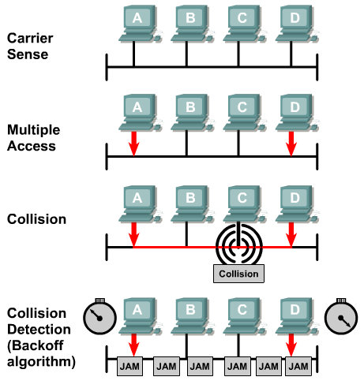
Ethernet - Carrier Sense Multiple Access with Collision Detection (CSMA/CD)

Slide 30
CSMA/CD
The CSMA/CD algorithm in detail:
  Wait until the LAN is silent
  Send a frame
  Transmitting device listens for collisions while transmitting
  If no collisions occur, process is complete
  All devices whose transmitted frames collided send a jamming signal (32 bits of 1s and 0s)
  All devices set semi-random collision back-off timers.
  Once the timer expires, a device can begin the process again

Slide 31
Communication Between Devices in a LAN Network
Unicast – Communication where a frame is sent from one host addressed to a specific destination. In this case, you have just one sender and one receiver. Unicast transmission is still the predominant form of transmission on LANs and within the Internet.

Slide 32
Communication Between Devices in a LAN Network
Broadcast – Communication where a frame is sent from one address to all other devices. In this case, you have just one sender, but the information is sent to all connected receivers by using a universal broadcast address.
Multicast – Communication where a destination addresses is a specific group of devices, or clients.

Slide 33
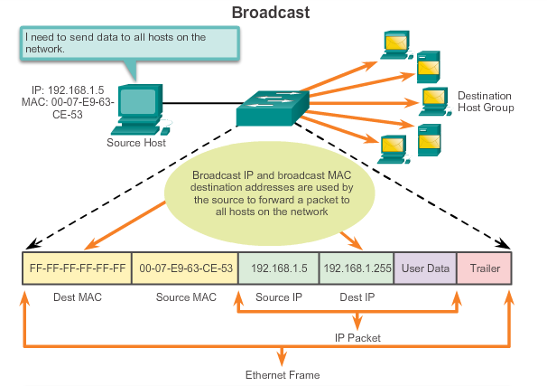
Ethernet MAC
Broadcast MAC Address
Notes:
5.1.3.4 Broadcast MAC Address

Slide 34
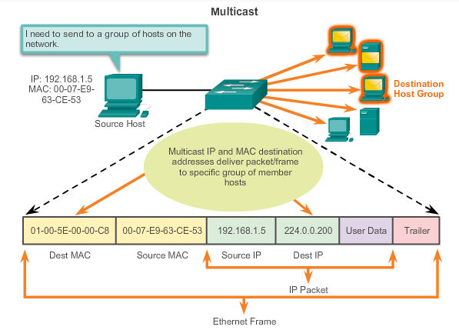
Ethernet MAC
Multicast MAC Address
Multicast MAC address is a special value that begins with 01-00-5E in hexadecimal
Range of IPV4 multicast addresses is 224.0.0.0 to 239.255.255.255
Notes:
5.1.3.5 Multicast MAC Address

Slide 35
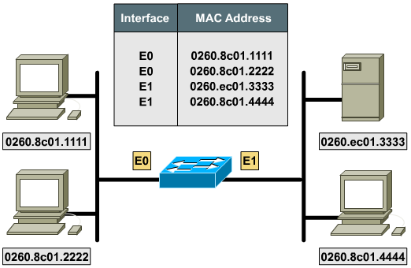
Switch Modes

Slide 36
Switching Frames
A frame is received.
If the destination is a broadcast, forward on all ports except the port in which the frame was received.
If the destination is a Unicast and the address is not in the address table, forward on all ports except the port in which the frame was received.
If the destination is a Unicast and the address is in the address table, and if the associated interface is not the interface in which the frame arrived, forward the frame out the one correct port.
Otherwise, filter (do not forward) the frame.

Slide 37
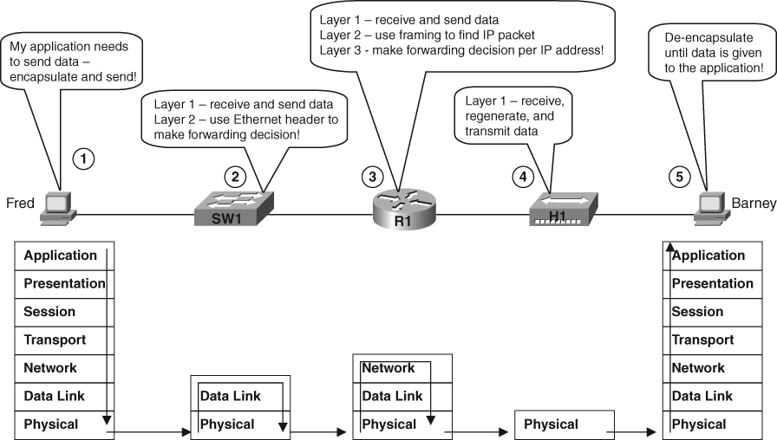
Data Flow Through a Network

Slide 38
Switching Methods
Store-and-forward
  Switch copies the entire frame into its onboard buffers before any forwarding takes place.
  Latency is greater with larger frames.
  Check the entire frame for errors, which allows more error detection.

Slide 39
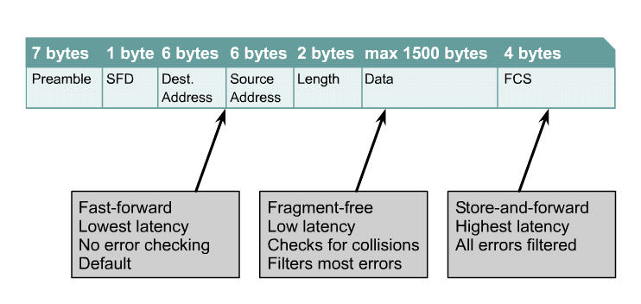
Frame Transmission Modes

Slide 40
Switching Methods
Cut-through
  The lowest level of latency.
  Immediately forwards a packet after reading the source and destination address.
Fragment-free
  Switching waits until the first 64 bytes of the frame is received before forwarding.
  Filters out collision fragments.

Slide 41
Module 3 Ethernet
Cisco Networking Academy
CCNA Routing and Switching (CCNA5)
Introduction to Networks
Slide No. | Chapter No. | Textbook Page
2 – 3 | 4.4.3.1 | 210 - 211
12 - 20 | 5.3.1 | 260 - 264
22 - 23 | 5.3.1.8 | 267
25 | 5.1.1 | 234
26 | 5.1.2.3 | 243
27 - 28 | 5.1.1.4 | 238 – 239
29 – 30 | 5.1.1.3 | 237
31 - 34 | 5.1.3.3 – 5.1.3.5 | 247 - 249
38 - 40 | 5.3.1.6 | 266 - 267

