Slide 1
The 2011 Vancouver Census reported 70.8% of commuters rode to work in single-occupancy vehicles.
With 1.2 million commuters,
That’s 849,600 vehicles on the road every day.

Slide 2

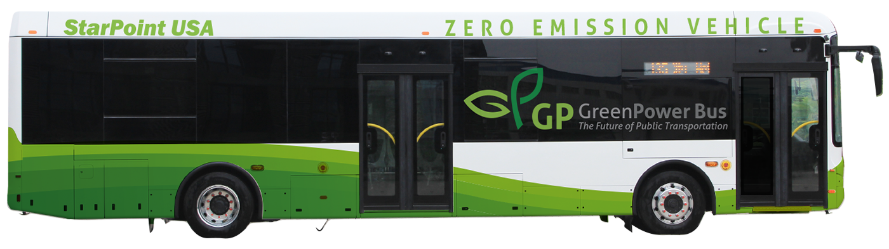
Reducing Emissions in the False Creek Flats & GVA
Presented by Amar Singh, Bryan Chiang, Erikka Ogrodnick, & Samaa Abdalla

Slide 3
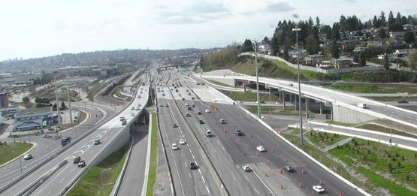
OUR LEARNING JOURNEY
Preliminary Research
Problem: Infrastructure is inefficient
Conducted user interviews
Problem: No easy access to transit
PIVOT
Focused user interviews
Problem: A specific company has issues with parking
PIVOT
Took a step back
Problem: Lack of awareness and accessibility of alternatives
Issue Identification | Our Solution | Business Model | Expo | Revenue & Costs

Slide 4
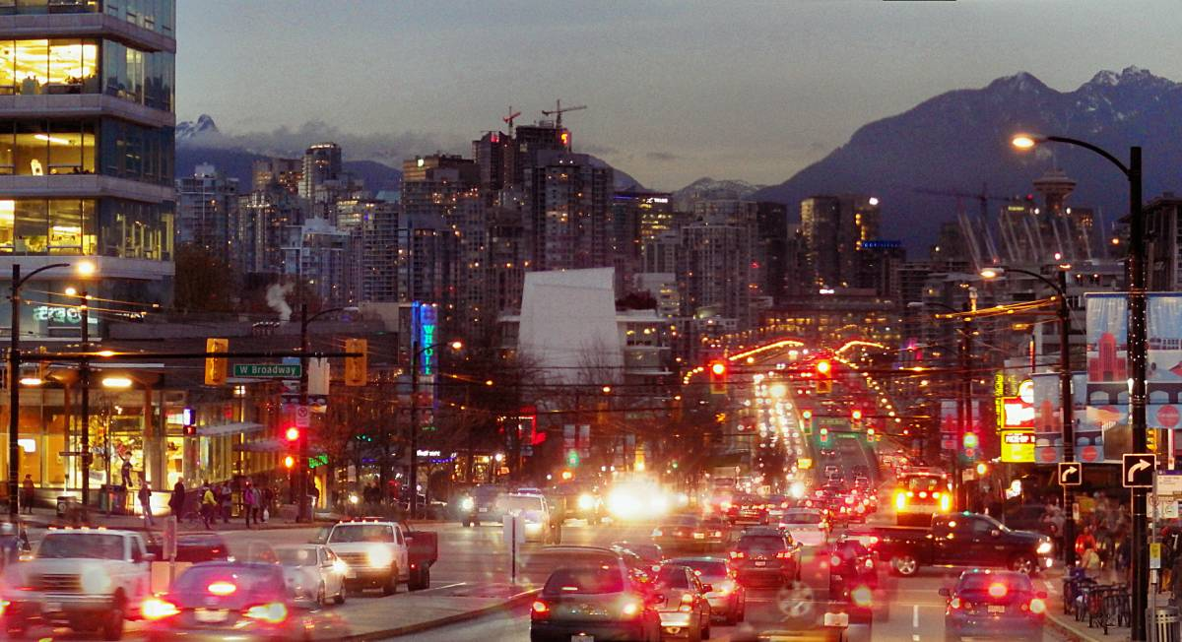

COMMUTER PROFILE I
Name: Derek Carr
Age: 38
Occupation: Sales Representative
Location: Coquitlam
Commuting Status: Drives
MOTIVATIONS
Save time
Retain control
Convenience
FRUSTRATIONS
Traffic and congestion
Lack of Parking
Stress of Commuting
Issue Identification | Our Solution | Business Model | Expo | Revenue & Costs
Notes:
Commuter profile: Derek works at one of the food distribution businesses along Malkin Ave. He has not put much thought into why he drives to work, but knows that public transit would require him to walk about 15-20 min from the nearest stop. He has been driving to work for all his adult life and believes he goes to work to earn money in order to afford his car.

Slide 5
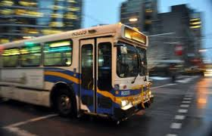

COMMUTER PROFILE II
Name: Angela Buswell
Age: 42
Occupation: Logistics Manager
Location: Port Moody
Commuting Status: Public Transit
MOTIVATIONS
Save money
Avoiding traffic
Non-stressful commute
FRUSTRATIONS
Crowded busses & skytrain
No seats available on busses
Busses not on time
Issue Identification | Our Solution | Business Model | Expo | Revenue & Costs
Notes:
Commuter profile: Angela is a professor at Columbia College and takes a direct bus that brings her from her home in Port Moody to downtown, where she then has to transfer to the millennium line and get off at the Main St. Her and her husband share a car, but he often gets privileges because he works in Squamish. Angela is used to taking public transit, but would ideally like to have a seat and either get some work done or read the news during the 45 min it takes to get from Port Moody.

Slide 6
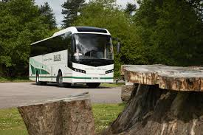
OUR SOLUTION
A Commuter Shuttle offered:
On routes not served well by transit
At times that are convenient for commuters
At a competitive price
2) A Green Transportation Expo that will:
- Showcase sustainable transportation options in Vancouver
- Serve as a platform to launch the EZ Shuttle
Issue Identification | Our Solution | Business Model | Expo | Revenue & Costs

Slide 7
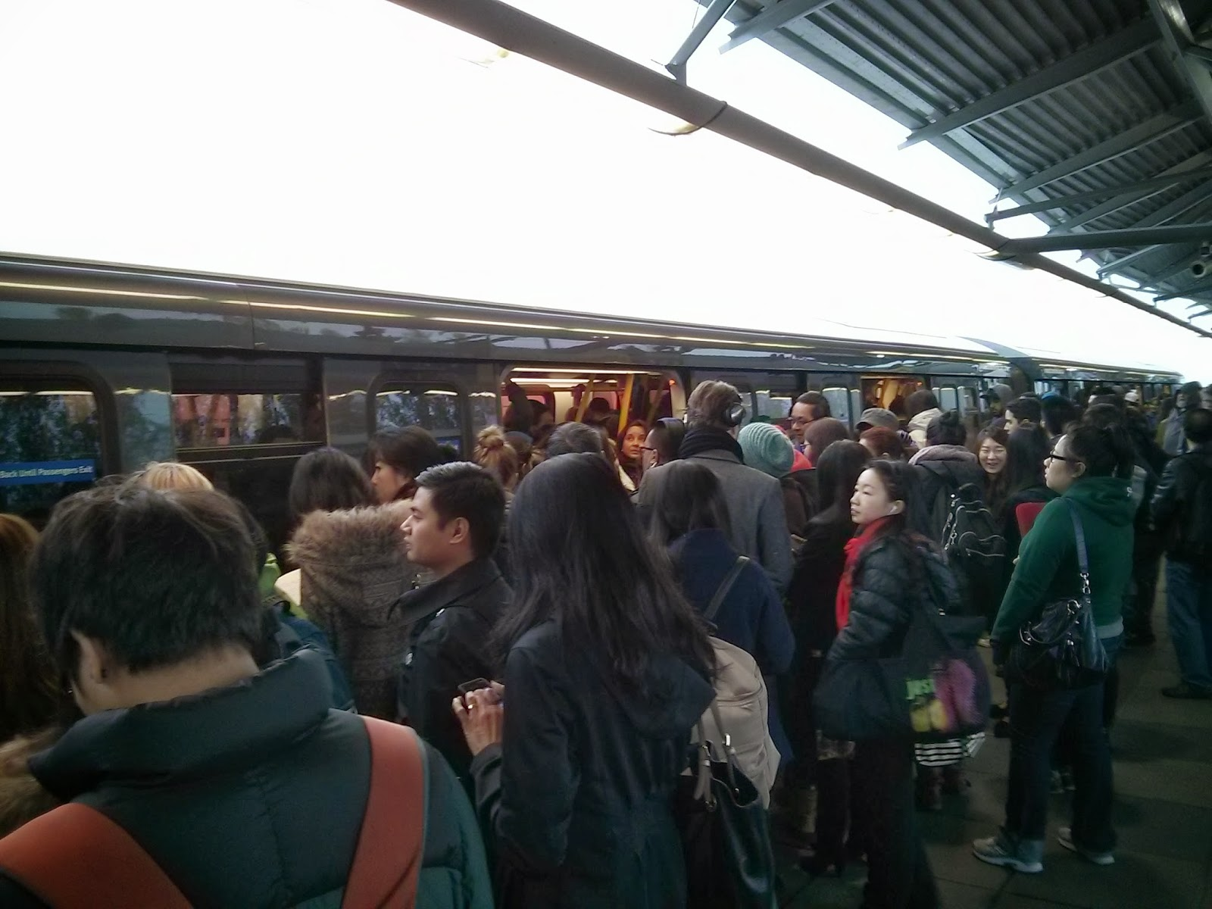
WHY EZ SHUTTLE
Frustrations with Transit:
Crowded - Standing Up
Inefficient - Late
Dirty - Loud
EZ Transport:
Guaranteed Seating
Clean, quiet, and comfortable
Wi-Fi Access
No traffic or parking concerns
Less costly than driving
Reduced Stress
Frustrations with Driving:
Congested - Parking
Stressful - Traffic
Costly - Infrastructure
Issue Identification | Our Solution | Business Model | Expo | Revenue & Costs

Slide 8
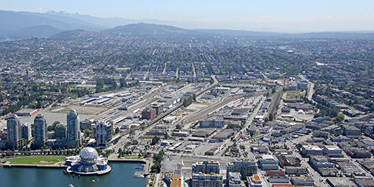
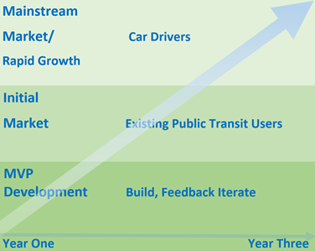
ROADMAP
Issue Identification | Our Solution | Business Model | Expo | Revenue & Costs

Slide 9
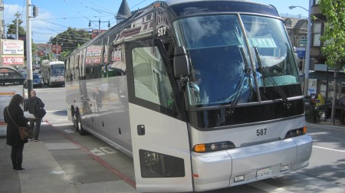
BUSINESS MODEL CANVAS
EZ Transport Shuttle
Customers | Segment à Mass Market
Value Propositions | Customization, Cost Reduction and Productivity
Customer Relationships | Personal Assistance, Dedicated Personal Assistance, Communities and Co-Creation.
Channels | In-Person and Online
Revenue Streams | Subscription Fee, One Time Transactions and Advertisements.
Key Resources | Physical: Facility and Vehicles Human: Employees
Key Activities | Running Shuttle, Marketing and Sales, Route Diagnostics and Product Development
Key Partners | Coach Provider, Internet Provider, Government,
Cost Structure | Fixed Costs and Value Driven Costs
Issue Identification | Our Solution | Business Model | Expo | Revenue & Costs

Slide 10
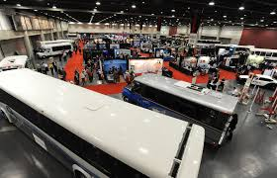





GET GOING GREEN EXPO
When: May/June 2016
Where: Rocky Mountaineer,
False Creek Flats
For Who: Vancouverites, Commuters, Business Owners
Why: To showcase why people should choose sustainable businesses for personal and commercial applications
Interested companies include:
Issue Identification | Our Solution | Business Model | Expo | Revenue & Costs

Slide 11
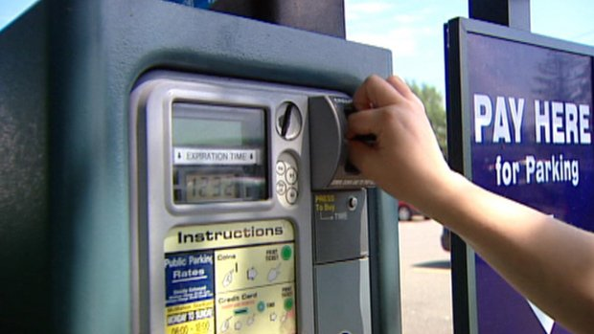
COST & REVENUE: EZ Shuttle
Method | Monthly Price (incl. parking)
Driving | $850
EZ Transport | $ 310
West Coast Express | $ 280
Transit | $ 184
EZ SHUTTLE
75% capacity (42 people)
Cost/month = $11 x 22 days
= $242
Revenue:
Monthly = $255 (5% Margin)
Weekly = $75 ( 27% Margin)
Daily = $17 (35% Margin)
EXPO
Total Sales Revenue $ 9,800
Total Costs 8,900
40 Exhibitors, including 4 Lead Sponsors
Issue Identification | Our Solution | Business Model | Expo | Revenue & Costs

Slide 12
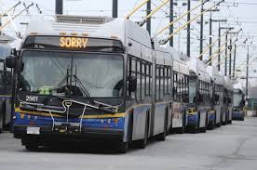
THANK YOU

Slide 13
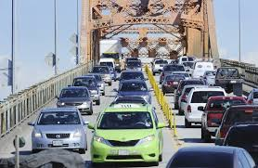
SUMMARY
Objective
To reduce single-occupancy vehicles on the road to limit emissions from transportation
Issue Identification
Cost vs. Convenience
Infrastructure
Awareness
Solution
EZ Shuttle as a sustainable alternative to driving
Expo as a way to improve awareness of environmental impact
Implementation
Launch Expo
Offer EZ Shuttle to Transit-users
Offer EZ Shuttle to drivers
Impact
To reduce annual emissions from commuter vehicles by 3,760 metric tons in 3 years

Slide 14
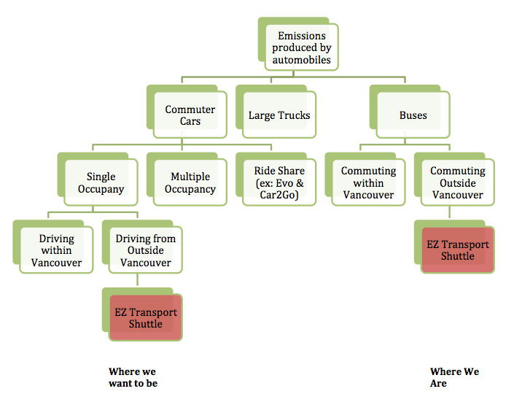
IMPACT MODEL

