Slide 1
GEIGER-1911
Is the positive charge of a gold atom concentrated in a centre far smaller than the atom itself?

Slide 2
Abstract
The positive charge of a gold atom was studied to determine whether it is concentrated in a centre far smaller than the atom itself. The question was asked by evaluating the upper limit on the radius of the positive charge of gold against a decision threshold. It was answered using counts recorded across multiple stations through profile likelihood via one forward route, with the single-scattering assumption asserted from the foil thickness and every other assumption measured by a station bought for that purpose. The upper limit on the radius of the positive charge of gold settled below the threshold, on the favourable side. This indicates that the positive charge is concentrated in a centre far smaller than the atom itself.
Reported quantities: Upper limit on the radius of the positive charge of gold

Slide 3
1. Introduction
This report addresses whether the positive charge of a gold atom is concentrated in a centre far smaller than the atom itself. The question is answered by the upper limit on the radius of the positive charge of gold, evaluated against a decision threshold of 135000.0 fm. The decision turns on the position of the estimated interval relative to this benchmark. An interval lying wholly on one side of 135000.0 fm settles the question. An interval spanning 135000.0 fm leaves the question unsettled. Identification for this study is downgraded. The subsequent sections describe the measurement framework, report the interval, and discuss the limitations of the analysis.

Slide 4
2. Methods
To address the question established above, the two atomic structures are parameterized through a single continuous cut-off radius. Because a head-on alpha particle stops at 59.2 fm and a trajectory scattered through an angle comes no closer than half that distance scaled by the scattering geometry, a positive charge of radius R suppresses scattering past a corresponding cut-off angle, separating the two candidate structures as values of about 7.3 fm and 135000 fm. Rather than treating the two atoms as separate models—which returns a fit comparison without the sensitivity curve needed to choose angles or exposure times—the cut-off parameter is estimated directly. Identification is downgraded via profile likelihood on the counts through one forward route, resting on three unresolved assumptions: single scattering, that the counter is linear below its rate cap, and that the two atoms differ only in the radius of the positive charge, as listed in Table 1. While the single-scattering assumption is asserted from the foil thickness, every other assumption is measured directly by dedicated stations. The experiment allocates nine stations across four distinct roles recorded in Table 2: anchors at 1° and 2.5° to pin the multiple-scattering core, an information bank at 5°, 10°, 20°, and 45°, witness stations at 90° and 150°, and a foil-out run at 90° to measure background. Allocating observation time strictly by evidence-per-hour into the bank was rejected because that metric is derived inside the core model under attack, whereas the witness stations yield evidence that does not depend on the core model. To maximize throughput without angular smearing, apertures are cut as annular slots, holding the radial half-width at the workshop floor and taking additional solid angle in azimuth. A round hole of equivalent area was rejected because at 90° it would span roughly ±13° and report a rate five per cent high, whereas the slot reports the rate to a part in four thousand. Across the 200 total observing hours, 135 hours are assigned to the witness stations and 110 hours to 150° alone, placing the bulk of the exposure past where a core thirty times too wide could reach. The five parameters of the Poisson count model are profiled over the cut-off, and the 95 % one-sided limit is set where the log-likelihood climbs 1.921 above its minimum on the informative side. Quoting the profile minimum as a point estimate of the radius was rejected because all values below the bound fit the observed counts equally well, leaving the result as a limit rather than a measurement.
The two atoms as one parameter
`D = 2 z Z e^2 / (4 pi eps0 E) closest approach, head-on` `r_min(t) = (D/2) (1 + 1/sin(t/2)) closest approach at angle t` `sin(t_cut/2) = 1 / (2R/D - 1) where a charge of radius R` ` kills the scattering` `lam = log sin(t_cut/2) the fitted parameter`
What shape to cut the aperture
`Omega(t, d, phi) = phi * 2 sin(t) sin(d) an annular slot subtends` ` phi = azimuthal arc, d = radial half-width` ` only d smears the angle; phi is free resolution`

Slide 5
2. Methods (cont.)
How long at each
`N(t) ~ Poisson( Omega * T * [ f_tail(t) + f_core(t) + b ] )` ` f_tail(t) = exp(log_a) / sin^4(t/2) single scattering` ` f_core(t) = exp(log_c) exp(-t^2 / 2 exp(log_w)^2) multiple scattering` ` b = exp(log_b) counter background` ` the tail is cut off above t_cut(lam)`
Reading the bound off the counts
`R_95 : 2 [ l(lam_hat) - l(lam) ] = 1.921 one-sided, one parameter` ` l(.) = the Poisson log-likelihood over all stations` ` R = (D/2) (1 + 1/exp(lam)) radius from the cut-off`
Assumptions this analysis rests on

Slide 6
2. Methods (cont.)
Assumption | Statement | Status | Challenged by
single scattering | a wide-angle count is one close encounter, not several | was asserted without a check | a thicker foil, where two encounters would compound
the counter is linear below its rate cap | every aperture is opened only as wide as keeps the rate under 1.5 counts per second, where the counter does not miss particles | was asserted without a check | a station run wide enough to pile up, which would under-report the busiest angles
the two atoms differ only in the radius of the positive charge | a hard centre and a charge spread through the atom are one model at two values of one number, the radius R of the positive charge | was asserted without a check | any difference between the two atoms that is not a matter of extent
assumption The witness stations were bought so that the wide-angle evidence does not rest on the model of the multiple-scattering core. They are the reason the bound survives that model being wrong.
assumption The bound is reported against the radius a diffuse atom would have, not against zero: this experiment excludes an atom, it does not measure a nucleus.
Step | Parameter | Value
Identification | route | profile likelihood on the counts, through one forward()
Identification | status | downgraded
The two atoms as one parameter | beam energy (MeV) | 7.68
The two atoms as one parameter | closest approach D (fm) | 59.25
The two atoms as one parameter | diffuse atom R (fm) | 135000
The two atoms as one parameter | foil areal density (atoms/m²) | 2.36e+22
The two atoms as one parameter | hard centre R (fm) | 7.3
Where to point the counter | anchor | 1°, 2.5° (10 h)
Where to point the counter | background | 90°, foil out (10 h)
Where to point the counter | bank | 5°, 10°, 20°, 45° (45 h)
Where to point the counter | stations | 9
Where to point the counter | witness | 90°, 150° (135 h)
What shape to cut the aperture | beam rate (alphas/s) | 2e+05
What shape to cut the aperture | rate cap (counts/s) | 1.5
What shape to cut the aperture | widest aperture (sr) | 0.2
How long at each | hours at 150° | 110
How long at each | seed | 1911
How long at each | total hours | 200
Reading the bound off the counts | drop at 95% one-sided | 1.921
Reading the bound off the counts | grid | 41 points over lam in [-4, 4]
Reading the bound off the counts | nuisance parameters | log_a, log_c, log_w, log_b
Reading the bound off the counts | profiled parameter | lam

Slide 7
3. Results
UPPER LIMIT ON THE RADIUS OF THE POSITIVE CHARGE OF GOLD
33.5 fm
[0, 33] (95% WALD)
Addressing the target comparison identified in the introduction, the analysis yields an empirical bound on the charge dimension following the design specified in the methods. The upper limit on the radius of the positive charge of gold is 33.5 fm (95% WALD 0.0 to 33.5 fm). Table 3 reports the estimated quantities. Figure 1 displays the estimated quantities with their intervals.

Slide 8
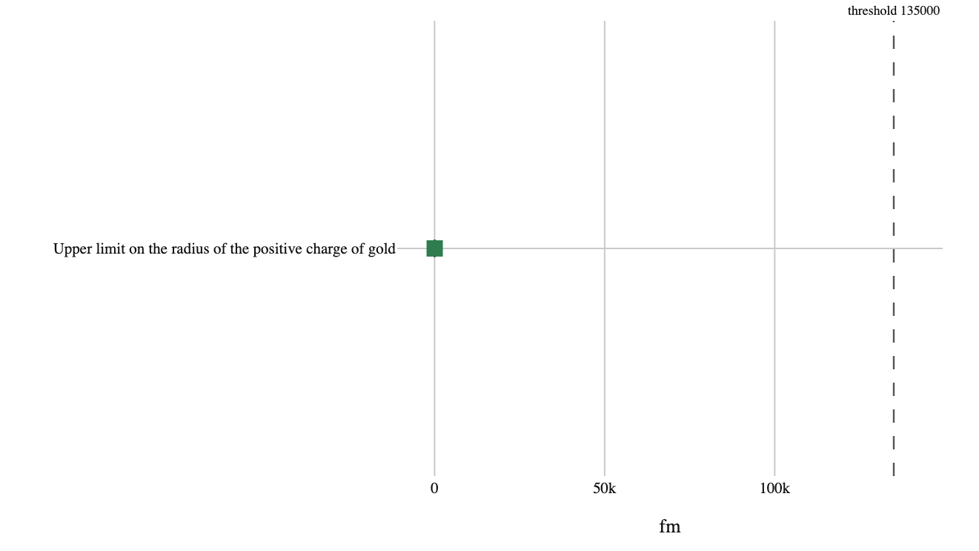
3. Results (cont.)
Figure 1. Estimated quantities with their intervals

Slide 9
3. Results (cont.)
Quantity | Estimate | Unit | Interval | Threshold | Relative to threshold
Upper limit on the radius of the positive charge of gold | 33.5 | fm | 0.0 to 33.5 (95% WALD) | 135000.0 | below threshold

Slide 10
4. What the run showed
Written by the analyst after seeing the output, and reproduced unchanged. Nothing in this section is generated.
At 150 degrees the counter recorded 94,117 particles where a diffuse atom predicts 119 — a Poisson excess of 306 standard errors. There is no version of this that is a fluctuation.
The hours went where the argument was weakest rather than where the information was densest, and that is what the bound is made of. Dropping the 150 degree witness and keeping every other station loses most of it.

Slide 11
5. Model checking
RADIUS AT WHICH THE PROFILE LIKELIHOOD BOTTOMS
32.3 fm
RADIUS THE BEAM ENERGY ALONE COULD NEVER RESOLVE PAST
29.6 fm
COUNTS AT 150 DEGREES, FOIL IN
94,117
COUNTS A DIFFUSE ATOM PREDICTS AT 150 DEGREES
118.8
Model checks evaluate the fit of the specification rather than the underlying effect itself. A diagnostic check can lower confidence in an estimate, but it can never establish one. The recorded diagnostics for this analysis are presented in Table 4. Across every station, the counts recorded total 466849. At 150 degrees with the foil in, the observed count is 94117. By contrast, the count a diffuse atom predicts at 150 degrees is 118.8. With the foil out, the count at 90 degrees is 11. Regarding the resolution limits, the radius at which the profile likelihood bottoms is 32.3 fm. This sits above the 29.6 fm radius the beam energy alone could never resolve past. These comparisons examine the physical bounds and scattering counts against specific baselines, while the core assumptions identified in the methods remain unexamined by these checks.

Slide 12
5. Model checking (cont.)
COUNTS AT 90 DEGREES WITH THE FOIL OUT
11
COUNTS RECORDED ACROSS EVERY STATION
466,849
Check | Value | Unit | Interval
Radius at which the profile likelihood bottoms | 32.3 | fm | —
Radius the beam energy alone could never resolve past | 29.6 | fm | —
Counts at 150 degrees, foil in | 94117 | — | —
Counts a diffuse atom predicts at 150 degrees | 118.8 | — | —
Counts at 90 degrees with the foil out | 11 | — | —
Counts recorded across every station | 466849 | — | —

Slide 13
6. Discussion
The upper limit on the radius of the positive charge of gold settled below the threshold, landing on the favourable side. This result speaks directly to whether the positive charge of a gold atom is concentrated in a centre far smaller than the atom itself. The estimate indicates that the charge is confined within the smaller radius rather than distributed across the atomic volume. The strength of this inference, however, depends on the identification, which was downgraded via profile likelihood on the counts through one forward operation. This downgrade arises because the single-scattering assumption is asserted from the foil thickness rather than measured. In contrast, every other assumption the bound leans on was measured by a station the design bought for that purpose. What the analysis licenses is an empirical bound on the counts obtained under the experimental setup. It does not license treating the scattering interpretation as self-contained without additional verification of the asserted thickness property. The findings remain conditional on 3 unresolved assumptions. The limitations section states what each of these assumptions claims and what would challenge it. Resolving whether the single-scattering premise holds under direct empirical measurement remains the central question raised by this bound.

Slide 14
7. Conclusions
The positive charge of a gold atom is concentrated in a centre far smaller than the atom itself. The upper limit on the radius of the positive charge of gold is 33.5 fm (95% WALD 0.0 to 33.5 fm), which settles the outcome below the threshold on the favourable side. The analysis operates under a downgraded identification. Consequently, this result depends on three unresolved assumptions. These are single scattering, that the counter is linear below its rate cap, and that the two atoms differ only in the radius of the positive charge. What each of these assumptions claims is stated in the limitations section. The conclusion holds conditional on these assumptions and not otherwise.

Slide 15
8. Limitations
Identification is downgraded, leaving three unresolved assumptions that are asserted without a direct check. The first is single scattering, which asserts that a wide-angle count is one close encounter, not several. This assumption licenses treating each observed deflection as a single event rather than an accumulation of deflections. It is challenged by a thicker foil, where two encounters would compound. The second assumption is that the counter is linear below its rate cap, asserting that every aperture is opened only as wide as keeps the rate under 1.5 counts per second, where the counter does not miss particles. This licenses the direct comparison of counts across different aperture settings. It is challenged by a station run wide enough to pile up, which would under-report the busiest angles. The third assumption is that the two atoms differ only in the radius of the positive charge. This asserts that a hard centre and a charge spread through the atom are one model at two values of one number, the radius R of the positive charge. This licenses comparing the atomic structures along that single parameter. It is challenged by any difference between the two atoms that is not a matter of extent.

Slide 16
9. Provenance
Every number in this document resolves to a quantity in the evidence record below. Prose was checked against that record: any numeral not traceable to it, and any claim the record does not itself make, is reported rather than published.
Quantity | Key | Value | Produced by
Upper limit on the radius of the positive charge of gold | radius | 33.5 fm (95% WALD 0.0 to 33.5 fm) | design.profile_likelihood on lam
Radius at which the profile likelihood bottoms | profile_min | 32.3 fm | —
Radius the beam energy alone could never resolve past | floor | 29.6 fm | —
Counts at 150 degrees, foil in | witness_counts | 94117 | —
Counts a diffuse atom predicts at 150 degrees | witness_if_diffuse | 118.8 | —
Counts at 90 degrees with the foil out | background_counts | 11 | —
Counts recorded across every station | total_counts | 466849 | —
Field | Value
estimator | profile likelihood on lam, one-sided
interval_mass | 95%
observing_hours | 200
seed | 1911
world | nbs/case-studies/rutherford/scattering.py
evidence hash | e8f37b522ca34db4d0bfd8bebb94b492fca1ffcc356a5dac330b4370d7de1efc
narration: abstract | gemini-3.5-flash-lite — verified
narration: introduction | gemini-3.7-flash — verified
narration: methods | gemini-3.7-flash — verified
narration: results | gemini-3.7-flash — verified
narration: diagnostics | gemini-3.7-flash — verified
narration: discussion | gemini-3.7-flash — verified
narration: conclusions | gemini-3.7-flash — verified
narration: limitations | gemini-3.7-flash — verified

