Slide 1
HYPER-3
Matthew Reda · axiom

Slide 2
Author Note
The HYPER-3 study evaluates which of three daily doses should go into phase III and whether any dose harms participants. Across the age strata, 400 adults with elevated or stage-1 hypertension were randomized 2:1:1:1 to standard of care or one of three daily doses, with 100 randomized in band age 25 to 35, 160 in band age 36 to 50, and 140 in band age 51 plus. The target effect of arm on change is identified via the backdoor route, yielding pooled contrasts against control of -5.27 mmHg (90% WALD -6.63 to -3.91 mmHg) for 10 mg, -4.80 mmHg (90% WALD -6.17 to -3.44 mmHg) for 20 mg, and -1.53 mmHg (90% WALD -2.97 to -0.10 mmHg) for 40 mg evaluated against a decision threshold of 0.00 mmHg. For the 40 mg dose, the contrast against control is -5.26 mmHg (90% WALD -8.17 to -2.36 mmHg) in band age 25 to 35 and 6.20 mmHg (90% WALD 3.98 to 8.42 mmHg) in band age 51 plus. Across the trial, 372 units contributed to the primary endpoint, and 0.797 of units remained on study at the final week.

Slide 3
Abstract
Four hundred adults with elevated or stage-1 hypertension were randomized to evaluate three daily doses against standard of care. The trial addressed which daily dose should advance to phase III and whether any dose harms the participants. The effect of treatment on blood pressure change is identified via the backdoor route identified in the identification graph. The strongest standing assumption is that dropout is ignorable given baseline. The pooled contrasts for 40 mg, 20 mg, and 10 mg each settled below the decision threshold on the favourable side. For the 40 mg dose in participants aged 51 and older, the contrast settled above the threshold on the unfavourable side at 6.20 mmHg (90% WALD 3.98 to 8.42 mmHg), whereas the same dose settled below the threshold in participants aged 25 to 35. These findings indicate that while pooled estimates support advancing the doses, heterogeneity across age strata reveals an unfavorable increase in blood pressure for older participants on the 40 mg dose.
Reported quantities: 40 mg vs control, pooled; 20 mg vs control, pooled; 10 mg vs control, pooled; 40 mg vs control, age 51+

Slide 4
Introduction
This report addresses which of three daily doses should go into phase III, and whether any of them is harming the people taking it. The analysis answers this question using 40 mg versus control, pooled. The target quantity is identified. The decision turns on a decision threshold of 0.00 mmHg. An interval that falls entirely on one side of 0.00 mmHg settles the comparison. An interval spanning 0.00 mmHg leaves the question unsettled. Such an interval does not mean there is no effect.

Slide 5
Methods
To address the question established in the introduction, 400 adults with elevated or stage-1 hypertension were randomized 2:1:1:1 to standard of care or to one of three daily doses, stratified by age band, with the design parameters recorded in Table 1. The protocol estimates three contrasts against a shared control rather than one dose against another. The target is the effect of arm on change, which is identified via the backdoor route shown in Figure 1. This identification turns on the arrows from adherence to change, age to change, arm to adherence, arm to change, and baseline to change. Seated systolic pressure was measured weekly, and both endpoints average the readings inside a window—weeks 5–8 for safety and weeks 9–12 for the primary endpoint—rather than reading a single visit. Averaging several correlated readings roughly halves the variance of a unit's endpoint, which is the difference between a safety boundary that can fire inside a stratum and one that cannot. Each dose was compared with control by ANCOVA on the change from baseline, adjusting for baseline pressure, and adjusting for age band when the contrast is pooled across bands. Randomization licenses the intent-to-treat contrast and nothing else; adjusting for a pre-randomization covariate buys precision at no cost, whereas adjusting for anything measured afterwards would forfeit the identification the randomization provided. Twelve harm contrasts—each dose against control overall and inside each age band—were monitored at scheduled safety reviews against a posterior-probability boundary with a 2 mmHg clinical margin. Pre-specifying the bands as monitored contrasts makes harm within a single age band visible before the trial ends, which no estimator applied at closeout would have found earlier. The analysis relies on two unresolved assumptions, named dropout is ignorable given baseline and the pooled contrast answers the question. What each of these assumptions claims is stated in the limitations section.
Protocol
`arm_i ~ blocked randomization within age band, allocation 2:1:1:1`
Analysis
`change_i = beta0 + tau * treated_i + beta1 * baseline_i + eps_i` ` pooled, add: + sum_b gamma_b * 1[age_band_i = b]` ` change_i = mean(SBP_i, weeks 9-12) - SBP_i(baseline)` ` tau = the contrast reported; treated_i = 1 for the dose arm`

Slide 6
Methods (cont.)
Safety monitoring
`stop for harm at look k when` ` P(tau_g > delta | data_k) > b_k for any monitored contrast g` ` delta = the clinical margin; b_k = the boundary at look k`
The identification graph
From | Arrow | To | Kind
adherence | → | change | direct effect
age | → | change | direct effect
arm | → | adherence | direct effect
arm | → | change | direct effect
baseline | → | change | direct effect
Assumptions this analysis rests on

Slide 7
Methods (cont.)
Assumption | Statement | Status | Challenged by
dropout is ignorable given baseline | units who left the study differ from those who stayed only through what was measured before randomization | is assumed and has not been checked | a tipping-point analysis over plausible departures from ignorability
the pooled contrast answers the question | a single number over all age bands describes the effect the decision is about | is known to fail | heterogeneity across the pre-specified strata
assumption Adherence was not adjusted for: it lies on the path from arm to outcome, and conditioning on it would break the randomization.
assumption The pooled 40 mg contrast is reported alongside the per-band contrasts, never instead of them.

Slide 8
Results
40 MG VS CONTROL, POOLED
-1.53 mmHg
[-3.0, -0.1] (90% WALD)
20 MG VS CONTROL, POOLED
-4.80 mmHg
[-6.2, -3.4] (90% WALD)
10 MG VS CONTROL, POOLED
-5.27 mmHg
[-6.6, -3.9] (90% WALD)
40 MG VS CONTROL, AGE 51+
6.20 mmHg
[4.0, 8.4] (90% WALD)
The comparison of active doses against control addresses the question and decision threshold specified in the introduction under the identification strategy from the methods. For 10 mg versus control, the pooled estimate is -5.27 mmHg (90% WALD -6.63 to -3.91 mmHg). For 20 mg versus control, the pooled estimate is -4.80 mmHg (90% WALD -6.17 to -3.44 mmHg). For 40 mg versus control, the pooled estimate is -1.53 mmHg (90% WALD -2.97 to -0.10 mmHg). These estimated quantities appear alongside their intervals and thresholds in Table 2. When evaluated within age categories, the estimate for 40 mg versus control in the age 25-35 group is -5.26 mmHg (90% WALD -8.17 to -2.36 mmHg). For 40 mg versus control in the age 51+ group, the estimate is 6.20 mmHg (90% WALD 3.98 to 8.42 mmHg). These estimated quantities and their intervals are displayed in Figure 2 relative to the decision threshold.

Slide 9
Results (cont.)
40 MG VS CONTROL, AGE 25-35
-5.26 mmHg
[-8.2, -2.4] (90% WALD)

Slide 10
Model checking
UNITS STILL ON STUDY AT THE FINAL WEEK
0.797
UNITS CONTRIBUTING TO THE PRIMARY ENDPOINT
372
UNITS RANDOMIZED IN BAND AGE 25 35
100
UNITS RANDOMIZED IN BAND AGE 36 50
160
Diagnostic checks assess the behavior of the sample and model fit rather than the estimated effect. A check of this kind can lower confidence in an estimate and can never establish one. The recorded diagnostics for HYPER-3 are reported in Table 3. The fraction of units still on study at the final week was 0.797. The study includes 372 units contributing to the primary endpoint. Across age categories, there were 100 units randomized in band age 25 35. There were 160 units randomized in band age 36 50. The study recorded 140 units randomized in band age 51 plus. These metrics examine observed retention and sample partitions, whereas the broader assumptions specified in the methods remain unexamined by these diagnostic counts.

Slide 11
Model checking (cont.)
UNITS RANDOMIZED IN BAND AGE 51 PLUS
140

Slide 12
Discussion
For 40 mg vs control in the age 51+ group, the estimate settled above the threshold on the unfavourable side, marking the primary divergence in these data. This result contrasts with the younger cohort, where 40 mg vs control for ages 25-35 settled below the threshold on the favourable side. The pooled comparisons mask this age variation: 40 mg vs control, 20 mg vs control, and 10 mg vs control each settled below the threshold on the favourable side when pooled. That divergence at 40 mg indicates that the favourable pooled finding does not extend to older participants. Because the analysis relies on the backdoor identification route established in the methods, these findings license reading the estimates as effects of the treatments rather than simple associations. They do not license inferences beyond what that identification structure supports. All interpretations remain conditional on 2 unresolved assumptions. The limitations section details what each of those assumptions claims. What was found is that while younger cohorts and lower pooled doses yield favourable outcomes, the highest dose produces an unfavourable outcome in older participants, raising the question of how phase III dose selection should manage age-specific risks.

Slide 13
Conclusions
No single daily dose can be recommended for phase III across all groups, as the 40 mg dose harms older participants. For participants aged 51 and older, the 40 mg versus control contrast settled on the unfavourable side of the decision threshold at 6.20 mmHg (90% WALD 3.98 to 8.42 mmHg). Conversely, the pooled comparisons for 10 mg, 20 mg, and 40 mg versus control each settled on the favourable side of the threshold. The subgroup contrast for 40 mg versus control among participants aged 25 to 35 likewise settled on the favourable side. Because the subgroup results diverge across age brackets, a pooled figure averages benefit with harm. The effect is identified following the structure established in the methods. This answer is conditional on 2 unresolved assumptions stated in the limitations section. Specifically, the conclusions hold provided that dropout is ignorable given baseline and that the pooled contrast answers the question.

Slide 14
Limitations
The analysis relies on standing assumptions, beginning with one that is violated. The assumption that the pooled contrast answers the question claims that a single number over all age bands describes the effect the decision is about. This assumption licenses using an aggregate contrast to address the decision problem set out in the introduction. That claim is challenged by heterogeneity across the pre-specified strata. In addition, the assumption that dropout is ignorable given baseline remains unverified. This assumption claims that units who left the study differ from those who stayed only through what was measured before randomization. It licenses the identified effect despite subject attrition under the design described in the methods. This condition is challenged by a tipping-point analysis over plausible departures from ignorability.

Slide 15
Provenance
Every number in this document resolves to a quantity in the evidence record below. Prose was checked against that record: any numeral not traceable to it, and any claim the record does not itself make, is reported rather than published.
Quantity | Key | Value | Produced by
40 mg vs control, pooled | pooled_40 | -1.53 mmHg (90% WALD -2.97 to -0.10 mmHg) | identify.ols (ANCOVA)
20 mg vs control, pooled | pooled_20 | -4.80 mmHg (90% WALD -6.17 to -3.44 mmHg) | identify.ols (ANCOVA)
10 mg vs control, pooled | pooled_10 | -5.27 mmHg (90% WALD -6.63 to -3.91 mmHg) | identify.ols (ANCOVA)
40 mg vs control, age 51+ | oldest_40 | 6.20 mmHg (90% WALD 3.98 to 8.42 mmHg) | identify.ols (ANCOVA)
40 mg vs control, age 25-35 | youngest_40 | -5.26 mmHg (90% WALD -8.17 to -2.36 mmHg) | identify.ols (ANCOVA)
Units still on study at the final week | retention | 0.797 | —
Units contributing to the primary endpoint | analysed | 372 | —
Units randomized in band age 25 35 | n_age_25_35 | 100 | —
Units randomized in band age 36 50 | n_age_36_50 | 160 | —
Units randomized in band age 51 plus | n_age_51_plus | 140 | —
Field | Value
endpoint | mean change, weeks 9-12
interval_mass | 90%
seed | 20260821
world | nbs/case-studies/hypertension/hyper3.py
evidence hash | f6c953a837c79459cb14b031868abf7f0b1adb6e235b32abca19246ffd9d5ecc
narration: abstract | gemini-3.5-flash-lite — verified
narration: title_page | gemini-3.7-flash — verified
narration: introduction | gemini-3.7-flash — verified
narration: methods | gemini-3.7-flash — verified
narration: results | gemini-3.7-flash — verified
narration: diagnostics | gemini-3.7-flash — verified
narration: discussion | gemini-3.7-flash — verified
narration: conclusions | gemini-3.7-flash — verified
narration: limitations | gemini-3.7-flash — verified

Slide 16
Tables
*Table 1*. The design, as recorded parameters.
Step | Parameter | Value
Identification | graph | adherence -> change, age -> change, arm -> adherence, arm -> change, baseline -> change
Identification | graph hash | d02f82660e65
Identification | route | backdoor
Identification | status | identified
Protocol | allocation | 2:1:1:1
Protocol | arms | standard_of_care, dose_10, dose_20, dose_40
Protocol | enrollment weeks | 16
Protocol | follow-up weeks | 24
Protocol | primary endpoint week | 12
Protocol | strata | age_25_35, age_36_50, age_51_plus
Protocol | units randomized | 400
Measurement | minimum visits in window | 3
Measurement | retention at final week | 79.8%
Analysis | estimator | ANCOVA (OLS on change, baseline-adjusted)
Analysis | interval mass | 90%
Analysis | pooled covariates | baseline_centred, is_age_36_50, is_age_51_plus
Analysis | within-stratum covariates | baseline_centred
Safety monitoring | clinical margin (mmHg) | 2
Safety monitoring | monitored contrasts | 12

Slide 17
Tables (cont.)
*Table 2*. Estimated quantities with their intervals and thresholds.
Quantity | Estimate | Unit | Interval | Threshold | Relative to threshold
40 mg vs control, pooled | -1.53 | mmHg | -2.97 to -0.10 (90% WALD) | 0.00 | below threshold
20 mg vs control, pooled | -4.80 | mmHg | -6.17 to -3.44 (90% WALD) | 0.00 | below threshold
10 mg vs control, pooled | -5.27 | mmHg | -6.63 to -3.91 (90% WALD) | 0.00 | below threshold
40 mg vs control, age 51+ | 6.20 | mmHg | 3.98 to 8.42 (90% WALD) | 0.00 | above threshold
40 mg vs control, age 25-35 | -5.26 | mmHg | -8.17 to -2.36 (90% WALD) | 0.00 | below threshold

Slide 18
Tables (cont.)
*Table 3*. Recorded diagnostics.
Check | Value | Unit | Interval
Units still on study at the final week | 0.797 | — | —
Units contributing to the primary endpoint | 372 | — | —
Units randomized in band age 25 35 | 100 | — | —
Units randomized in band age 36 50 | 160 | — | —
Units randomized in band age 51 plus | 140 | — | —

Slide 19
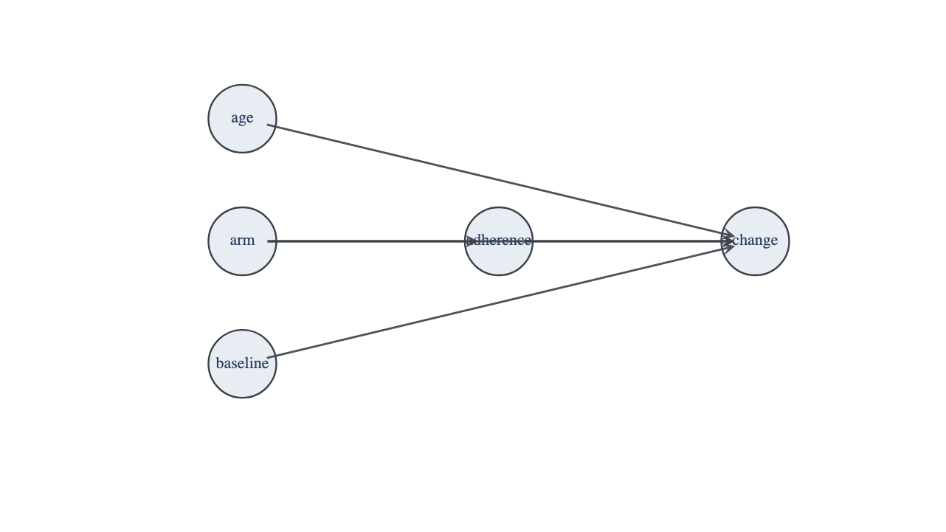
Figures
*Figure 1*. The identification graph. A hollow node was not measured and a dashed edge is an unmeasured common cause.

Slide 20
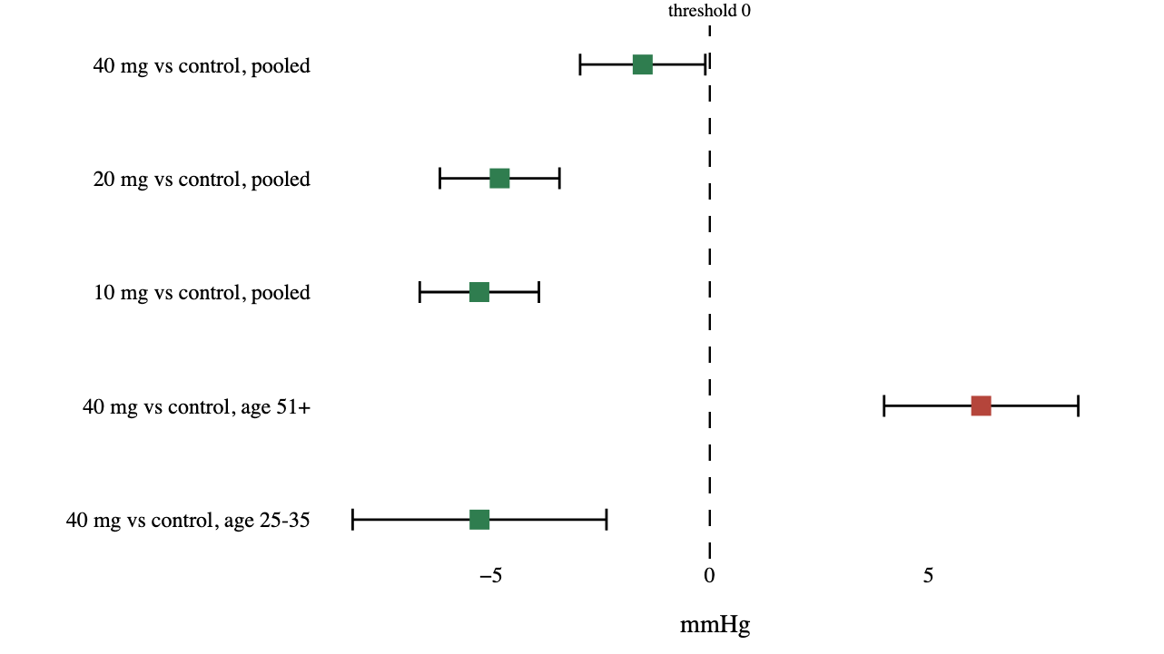
Figures (cont.)
*Figure 2*. Estimated quantities with their intervals. The dashed rule marks the decision threshold; a row whose interval crosses it is unsettled rather than null.

