Slide 1
HYPER-3
Which of three daily doses should go into phase III, and is any of them harming the people taking it?

Slide 2
Abstract
Four hundred adults with elevated or stage-1 hypertension were randomized to evaluate three daily doses against standard of care. The trial addressed which daily dose should advance to phase III and whether any dose harms the participants. The target effect of treatment on change is identified via the backdoor route, under the strongest assumption that dropout is ignorable given baseline. Each dose was compared with control by ANCOVA on the change from baseline, adjusting for baseline pressure and age band for pooled contrasts. The pooled contrasts for 40 mg, 20 mg, and 10 mg against control all settled below the threshold on the favourable side, while the 40 mg contrast in the 51-and-older age band settled above the threshold on the unfavourable side at 6.20 mmHg (90% WALD 3.98 to 8.42 mmHg) and the 40 mg contrast in the 25-35 age band settled below the threshold on the favourable side. These findings indicate that while the pooled doses favour advancement, age-specific heterogeneity reveals harm in the oldest subgroup.
Reported quantities: 40 mg vs control, pooled; 20 mg vs control, pooled; 10 mg vs control, pooled; 40 mg vs control, age 51+

Slide 3
1. Introduction
This report addresses which of three daily doses should go into phase III, and whether any of them is harming the people taking it. The quantity needed to answer the question is identified. The question is answered by 40 mg vs control, pooled. The decision turns on a threshold of 0.00 mmHg. An interval lying wholly on one side of 0.00 mmHg settles the question. An interval that spans 0.00 mmHg leaves the question unsettled rather than indicating that there is no effect.

Slide 4
2. Methods
To address the question set out in the introduction, 400 adults with elevated or stage-1 hypertension were randomized 2:1:1:1 to standard of care or to one of three daily doses, stratified by age band. Because the goal is to decide which dose to take forward, the design estimates three contrasts against a shared control rather than one against another, with protocol parameters recorded in Table 3. Seated systolic pressure was measured weekly, and endpoints average the readings inside a window—weeks 5–8 for safety and 9–12 for the primary—rather than reading a single visit. Averaging several correlated readings roughly halves the variance of a unit's endpoint, which is the difference between a safety boundary that can fire inside a stratum and one that cannot. The target of the analysis is the effect of arm on change, which is identified via the backdoor route. The graph turns on the arrows adherence -> change, age -> change, arm -> adherence, arm -> change, and baseline -> change, as reported in Table 1 and displayed in Figure 1, where a hollow node was not measured and a dashed edge is an unmeasured common cause. Each dose was compared with control by ANCOVA on the change from baseline, adjusting for baseline pressure, and for age band when the contrast is pooled across bands. Randomization licenses the intent-to-treat contrast and nothing else. Adjusting for a pre-randomization covariate costs nothing and buys precision, whereas adjusting for anything measured afterwards would forfeit the identification the randomization provided. Twelve harm contrasts—each dose against control overall and inside each age band—were monitored at scheduled safety reviews against a posterior-probability boundary with a 2 mmHg clinical margin. A dose that helps on average can still harm one band, and pre-specifying the bands as monitored contrasts makes that visible before the trial ends, whereas no estimator applied at closeout would have found it earlier. The design relies on two unresolved standing assumptions listed in Table 2, named dropout is ignorable given baseline and the pooled contrast answers the question.
Protocol
`arm_i ~ blocked randomization within age band, allocation 2:1:1:1`
Analysis
`change_i = beta0 + tau * treated_i + beta1 * baseline_i + eps_i` ` pooled, add: + sum_b gamma_b * 1[age_band_i = b]` ` change_i = mean(SBP_i, weeks 9-12) - SBP_i(baseline)` ` tau = the contrast reported; treated_i = 1 for the dose arm`

Slide 5
2. Methods (cont.)
Safety monitoring
`stop for harm at look k when` ` P(tau_g > delta | data_k) > b_k for any monitored contrast g` ` delta = the clinical margin; b_k = the boundary at look k`
The identification graph
From | Arrow | To | Kind
adherence | → | change | direct effect
age | → | change | direct effect
arm | → | adherence | direct effect
arm | → | change | direct effect
baseline | → | change | direct effect
Assumptions this analysis rests on

Slide 6
2. Methods (cont.)
Assumption | Statement | Status | Challenged by
dropout is ignorable given baseline | units who left the study differ from those who stayed only through what was measured before randomization | is assumed and has not been checked | a tipping-point analysis over plausible departures from ignorability
the pooled contrast answers the question | a single number over all age bands describes the effect the decision is about | is known to fail | heterogeneity across the pre-specified strata
assumption Adherence was not adjusted for: it lies on the path from arm to outcome, and conditioning on it would break the randomization.
assumption The pooled 40 mg contrast is reported alongside the per-band contrasts, never instead of them.

Slide 7
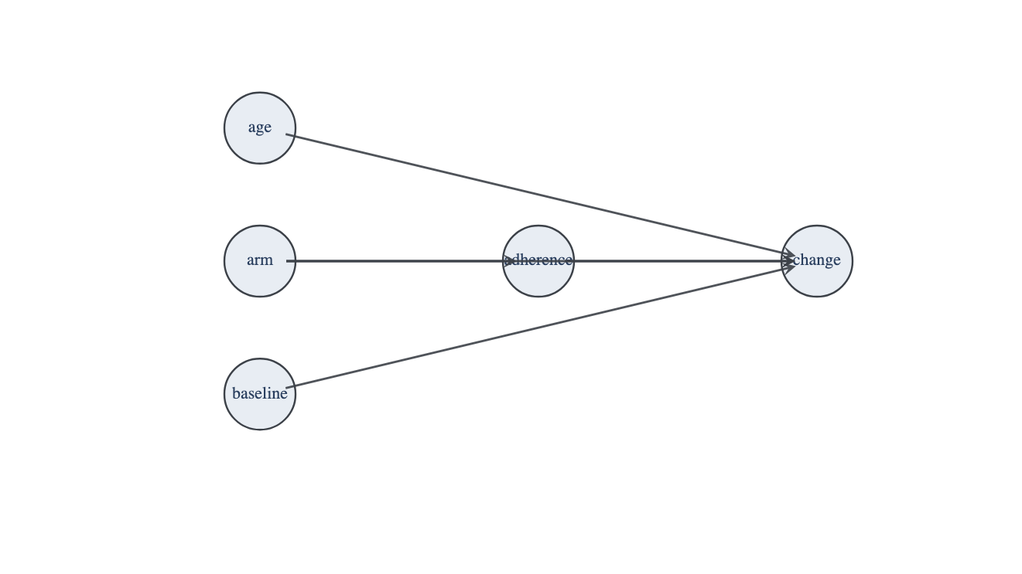
2. Methods (cont.)
Figure 1. The identification graph. A hollow node was not measured and a dashed edge is an unmeasured common cause; those two are what decide whether the effect is identifiable at all

Slide 8
2. Methods (cont.)
Step | Parameter | Value
Identification | graph | adherence -> change, age -> change, arm -> adherence, arm -> change, baseline -> change
Identification | graph hash | d02f82660e65
Identification | route | backdoor
Identification | status | identified
Protocol | allocation | 2:1:1:1
Protocol | arms | standard_of_care, dose_10, dose_20, dose_40
Protocol | enrollment weeks | 16
Protocol | follow-up weeks | 24
Protocol | primary endpoint week | 12
Protocol | strata | age_25_35, age_36_50, age_51_plus
Protocol | units randomized | 400
Measurement | minimum visits in window | 3
Measurement | retention at final week | 79.8%
Analysis | estimator | ANCOVA (OLS on change, baseline-adjusted)
Analysis | interval mass | 90%
Analysis | pooled covariates | baseline_centred, is_age_36_50, is_age_51_plus
Analysis | within-stratum covariates | baseline_centred
Safety monitoring | clinical margin (mmHg) | 2
Safety monitoring | monitored contrasts | 12

Slide 9
3. Results
40 MG VS CONTROL, POOLED
-1.53 mmHg
[-3.0, -0.1] (90% WALD)
20 MG VS CONTROL, POOLED
-4.80 mmHg
[-6.2, -3.4] (90% WALD)
10 MG VS CONTROL, POOLED
-5.27 mmHg
[-6.6, -3.9] (90% WALD)
40 MG VS CONTROL, AGE 51+
6.20 mmHg
[4.0, 8.4] (90% WALD)
The HYPER-3 results evaluate the dose comparisons relative to control under the identification strategy established in the methods. The estimated quantities are presented in Table 4. For 40 mg vs control, the pooled estimate is -1.53 mmHg (90% WALD -2.97 to -0.10 mmHg). For 20 mg vs control, the pooled estimate is -4.80 mmHg (90% WALD -6.17 to -3.44 mmHg). For 10 mg vs control, the pooled estimate is -5.27 mmHg (90% WALD -6.63 to -3.91 mmHg). The analysis of the 40 mg dose also reports estimates by age stratum. For 40 mg vs control, age 51+, the estimate is 6.20 mmHg (90% WALD 3.98 to 8.42 mmHg). For 40 mg vs control, age 25-35, the estimate is -5.26 mmHg (90% WALD -8.17 to -2.36 mmHg). The estimated quantities with their intervals are shown in Figure 2.

Slide 10
3. Results (cont.)
40 MG VS CONTROL, AGE 25-35
-5.26 mmHg
[-8.2, -2.4] (90% WALD)

Slide 11
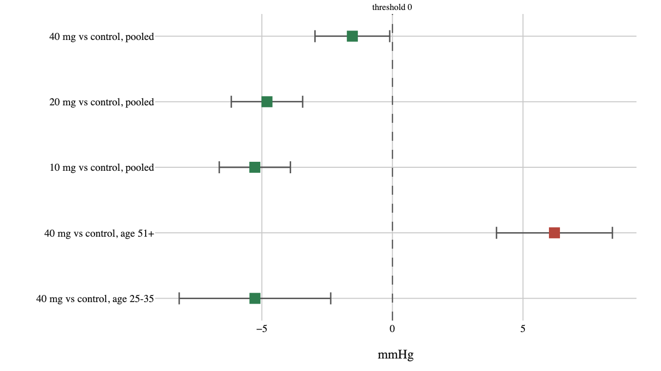
3. Results (cont.)
Figure 2. Estimated quantities with their intervals

Slide 12
3. Results (cont.)
Quantity | Estimate | Unit | Interval | Threshold | Relative to threshold
40 mg vs control, pooled | -1.53 | mmHg | -2.97 to -0.10 (90% WALD) | 0.00 | below threshold
20 mg vs control, pooled | -4.80 | mmHg | -6.17 to -3.44 (90% WALD) | 0.00 | below threshold
10 mg vs control, pooled | -5.27 | mmHg | -6.63 to -3.91 (90% WALD) | 0.00 | below threshold
40 mg vs control, age 51+ | 6.20 | mmHg | 3.98 to 8.42 (90% WALD) | 0.00 | above threshold
40 mg vs control, age 25-35 | -5.26 | mmHg | -8.17 to -2.36 (90% WALD) | 0.00 | below threshold

Slide 13
4. Model checking
UNITS STILL ON STUDY AT THE FINAL WEEK
0.797
UNITS CONTRIBUTING TO THE PRIMARY ENDPOINT
372
UNITS RANDOMIZED IN BAND AGE 25 35
100
UNITS RANDOMIZED IN BAND AGE 36 50
160
Diagnostic checks assess sample retention and age distribution across the study. A check of this kind can lower confidence in an estimate and can never establish one. Recorded diagnostics for HYPER-3 are reported in Table 5. The units still on study at the final week is 0.797. The units contributing to the primary endpoint is 372. Across the age groupings, the units randomized in band age 25 35 is 100. The units randomized in band age 36 50 is 160. The units randomized in band age 51 plus is 140. These measures examine sample retention and cohort allocation, leaving identification conditions unexamined by these numbers.

Slide 14
4. Model checking (cont.)
UNITS RANDOMIZED IN BAND AGE 51 PLUS
140
Check | Value | Unit | Interval
Units still on study at the final week | 0.797 | — | —
Units contributing to the primary endpoint | 372 | — | —
Units randomized in band age 25 35 | 100 | — | —
Units randomized in band age 36 50 | 160 | — | —
Units randomized in band age 51 plus | 140 | — | —

Slide 15
5. Discussion
For 40 mg vs control, age 51+, the estimate settled above the threshold, on the unfavourable side. This contrasts with the pooled estimates for 40 mg vs control, 20 mg vs control, and 10 mg vs control, each of which settled below the threshold, on the favourable side. The estimate for 40 mg vs control, age 25-35, likewise settled below the threshold on the favourable side. While the pooled comparisons for all three daily doses agree in falling on the favourable side of the decision boundary, the age-stratified results reveal a clear split at the highest dose. The pooled estimate for 40 mg conceals the unfavourable direction observed specifically in the older cohort. This divergence raises the question of whether the 40 mg dose poses a risk to older participants even as younger cohorts show favourable outcomes. Through the backdoor route identified in the methods, the results license reading these quantities as treatment effects rather than unadjusted associations. They do not license inferences beyond the conditions specified by that identification strategy. Finally, these interpretations remain subject to 2 unresolved assumptions, the details and challenges of which are stated in the limitations section.

Slide 16
6. Conclusions
The choice of a daily dose for phase III must account for evidence of harm at the highest dose within older age groups. Across the pooled analyses, the 10 mg, 20 mg, and 40 mg doses versus control all settled below the decision threshold on the favourable side. The 40 mg dose versus control also settled on the favourable side for participants aged 25 to 35. For participants aged 51 and older, however, the 40 mg dose versus control settled on the unfavourable side of the threshold at 6.20 mmHg (90% WALD 3.98 to 8.42 mmHg). A phase III recommendation therefore cannot rely on the pooled results without addressing this subgroup harm. The identified effects follow the identification strategy established in the methods. These conclusions remain conditional on two unresolved assumptions: that dropout is ignorable given baseline, and that the pooled contrast answers the question. What each assumption claims is detailed in the limitations section.

Slide 17
7. Limitations
The analysis relies on two structural assumptions, the first of which is known to fail: that the pooled contrast answers the question. This assumption claims that a single number over all age bands describes the effect the decision is about, licensing an aggregate summary across the entire sample. It is challenged by heterogeneity across the pre-specified strata. Second, the analysis leaves unverified the assumption that dropout is ignorable given baseline. That assumption claims that units who left the study differ from those who stayed only through what was measured before randomization, licensing the identification of the effect despite study attrition. This ignorability condition would be challenged by a tipping-point analysis over plausible departures from ignorability. These two conditions define where the empirical framework holds and what specific evidence would challenge it.

Slide 18
8. Provenance
Every number in this document resolves to a quantity in the evidence record below. Prose was checked against that record: any numeral not traceable to it, and any claim the record does not itself make, is reported rather than published.
Quantity | Key | Value | Produced by
40 mg vs control, pooled | pooled_40 | -1.53 mmHg (90% WALD -2.97 to -0.10 mmHg) | identify.ols (ANCOVA)
20 mg vs control, pooled | pooled_20 | -4.80 mmHg (90% WALD -6.17 to -3.44 mmHg) | identify.ols (ANCOVA)
10 mg vs control, pooled | pooled_10 | -5.27 mmHg (90% WALD -6.63 to -3.91 mmHg) | identify.ols (ANCOVA)
40 mg vs control, age 51+ | oldest_40 | 6.20 mmHg (90% WALD 3.98 to 8.42 mmHg) | identify.ols (ANCOVA)
40 mg vs control, age 25-35 | youngest_40 | -5.26 mmHg (90% WALD -8.17 to -2.36 mmHg) | identify.ols (ANCOVA)
Units still on study at the final week | retention | 0.797 | —
Units contributing to the primary endpoint | analysed | 372 | —
Units randomized in band age 25 35 | n_age_25_35 | 100 | —
Units randomized in band age 36 50 | n_age_36_50 | 160 | —
Units randomized in band age 51 plus | n_age_51_plus | 140 | —
Field | Value
endpoint | mean change, weeks 9-12
interval_mass | 90%
seed | 20260821
world | nbs/case-studies/hypertension/hyper3.py
evidence hash | f6c953a837c79459cb14b031868abf7f0b1adb6e235b32abca19246ffd9d5ecc
narration: abstract | gemini-3.5-flash-lite — verified
narration: introduction | gemini-3.7-flash — verified
narration: methods | gemini-3.7-flash — verified
narration: results | gemini-3.7-flash — verified
narration: diagnostics | gemini-3.7-flash — verified
narration: discussion | gemini-3.7-flash — verified
narration: conclusions | gemini-3.7-flash — verified
narration: limitations | gemini-3.7-flash — verified

