Slide 1
TUTOR-60
Matthew Reda · axiom

Slide 2
Author Note
In a trial randomizing 120 schools to different dose allocations, the analysis addresses whether buying fewer tutoring minutes for every eligible student yields higher gains than the pilot allocation of ninety weekly minutes. With the effect of tutoring on gain identified via the backdoor route, a spline response model evaluated over 4000 posterior draws shows that the recommended allocation costing 745 USD per student reaches 12000 students, whereas the pilot allocation reaches 4878 students. Relative to the pilot allocation, the recommended allocation delivers an estimated 13838 cohort reading points per year over the pilot allocation (90% HDI 6163 to 22036 points/year) against a decision threshold of 0 points/year. The posterior probability that the recommendation beats the pilot is 0.997. At the department's valuation, the value of the difference is 19372837 USD (90% HDI 8627873 to 30850017 USD).

Slide 3
Abstract
The study examined whether buying fewer tutoring minutes for every eligible student beats buying the pilot allocation for the fraction of them the budget reaches. The question is answered by cohort reading points over the pilot allocation, against a decision threshold of 0 points/year. The effect is identified via the backdoor route as described in the methods. A randomized trial of 120 schools provided the panel data for fitting spline responses through PyMC. The comparison yielded cohort reading points over the pilot allocation of 13838 points/year (90% HDI 6163 to 22036 points/year). The value of the difference at the department's own valuation settled above the threshold, on the favourable side. The strongest standing assumption is that a reading point has the value the state assigns it, which is asserted. Spreading a fixed budget across more students by reducing per-student intensity delivers larger total cohort gains than concentrating resources at the pilot level.
Reported quantities: Cohort reading points over the pilot allocation; Value of the difference at the department's own valuation

Slide 4
Introduction
This report addresses whether buying fewer tutoring minutes for every eligible student beats buying the pilot's ninety weekly minutes for the fraction of them the budget reaches. The question is answered by cohort reading points over the pilot allocation. This quantity is identified. The decision turns against a threshold of 0 points/year. An interval estimate lying wholly on one side of 0 points/year settles the question. An interval that spans 0 points/year leaves the question unsettled. A spanning interval does not indicate an absence of an effect.

Slide 5
Methods
To evaluate the question identified in the introduction, the analysis targets the effect of tutoring on gain, which is identified via the backdoor route. The identification graph includes arrows from poverty share to gain, resources to gain, resources to poverty share, and tutoring to gain, where resources are unmeasured, as shown in Figure 1. With 9,000,000 USD for one school year across 12,000 students reading two or more grade levels behind, or 750 USD per student if all are reached, both treatments are dosed in dollars per eligible student per year, setting 20 USD per weekly tutoring minute and 9 USD per weekly caregiver message up to a cap of 5 messages. Dosing tutoring in minutes and messaging in messages was considered and rejected because the two cannot then be traded against one another under the budget constraint. The trial randomized 120 schools to allocations drawn from a lattice over the two doses, with 3 messaging levels and tutoring spread across the decision range, as recorded in Table 1. Randomizing schools removes the arrows from poverty share to tutoring and resources to tutoring that downgrade observational records from 240 schools, while spreading allocations captures the shape of the response curve rather than conducting a two-arm trial at 90 minutes. A penalized spline response in each dose was fitted to the school-level panel through PyMC across 4,000 posterior draws. Within each draw, the per-student gain was multiplied by the number of students served at that allocation price to calculate total cohort reading points. Reporting the per-student response alone was rejected because multiplying post hoc drops the covariance across posterior draws and misstates the interval. The allocation that maximizes expected cohort points is compared with funding the pilot's 90 weekly minutes for the 4,878 students reached by that budget, pairing the comparison inside each draw to report the distribution of the difference rather than comparing against a baseline of no program. The procedure relies on two unresolved assumptions, named that a reading point has the value the state assigns it and that the cohort average answers the question.
Planning the trial
`assignment: (tutoring_s, messaging_s) ~ Uniform(lattice) per school s` `observational graph : poverty_share -> gain, poverty_share -> tutoring, resources -> gain, resources -> poverty_share, resources -> tutoring, tutoring -> gain` ` status downgraded - requires the unmeasured node` `randomized graph : poverty_share -> gain, resources -> gain, resources -> poverty_share, tutoring -> gain` ` status identified via backdoor`
Estimating the response
`gain_s = f(tutoring_s) + g(messaging_s) + eps_s` ` f, g = penalised splines, one per dose, on the school-level panel` `effect(a) = E[gain | dose = a] - E[gain | dose = 0] within each draw` `served(a) = min(N_eligible, Budget / cost(a))` `cohort(a) = served(a) * effect(a) the objective` `cost(a) = a_tutoring + a_messaging (USD per eligible student-year)`

Slide 6
Methods (cont.)
Choosing the allocation
`a* = argmax_a mean_draws cohort(a)` `Delta = cohort(a*) - cohort(a_pilot) paired inside each draw` `P = Pr(Delta > 0)` `value = Delta * VALUE_PER_POINT`
The identification graph
From | Arrow | To | Kind
poverty_share | → | gain | direct effect
resources | → | gain | direct effect
resources | → | poverty_share | direct effect
tutoring | → | gain | direct effect
resources |  |  | unmeasured node
Assumptions this analysis rests on

Slide 7
Methods (cont.)
Assumption | Statement | Status | Challenged by
a reading point has the value the state assigns it | a reading point is valued at 1,400 USD; the recommendation does not depend on this number, only on whether to fund at all | was asserted without a check | a valuation low enough to make the whole program not worth funding
the cohort average answers the question | the recommendation is made on the cohort average; the grade-band breakdown the program office asked for is not estimable from a school-randomized trial | is assumed and has not been checked | a response that differs across grade bands enough to change the allocation
identification Schools were randomized to allocations; the adjustment set is empty.
estimand The recommendation is over assigned allocations. Schools delivered 93% of assigned minutes, and that shortfall is inside the estimate rather than corrected out of it.
interval Every figure and quantity at 90% over 4,000 posterior draws.
limitation The grade-band breakdown the program office asked for is not estimable from a school-randomized trial, and is not reported.

Slide 8
Results
COHORT READING POINTS OVER THE PILOT ALLOCATION
13,838 points/year
[6,200, 22,000] (90% HDI)
VALUE OF THE DIFFERENCE AT THE DEPARTMENT'S OWN VALUATION
19,372,837 USD
[9,000,000, 3.1e+07] (90% HDI)
The analysis evaluates TUTOR-60 relative to the pilot allocation using the design and identification assumptions established in the methods. Table 2 reports the estimated quantities with their intervals and thresholds. Cohort reading points over the pilot allocation are 13838 points/year (90% HDI 6163 to 22036 points/year). This outcome measures performance against the pilot allocation rather than an absence of tutoring. The value of the difference at the department's own valuation is 19372837 USD (90% HDI 8627873 to 30850017 USD). This economic measure reflects the decision value introduced earlier in the report. The estimated quantities with their intervals are shown in Figure 2. The dashed rule in Figure 2 marks the decision threshold, where any interval crossing the line represents an unsettled result rather than a null effect.

Slide 9
What the run showed
Written by the analyst after seeing the output, and reproduced unchanged. Nothing in this section is generated.
The recommendation is flat between 700 and 750 USD — 35 to 38 weekly minutes are all within two per cent of the best. The decision that matters is not the exact figure, it is not funding 90 minutes.
For the pilot to be the better buy, the advantage would have to be overstated by 100% of itself — that is, essentially the whole of it would have to be an artefact of the fit rather than a real difference between the two allocations.
The reason the recommendation is not 90 minutes is not that 90 minutes fails. It is that the response is steep at the bottom, the budget is fixed, and every extra dollar a student is a student not served.

Slide 10
Model checking
POSTERIOR PROBABILITY THE RECOMMENDATION BEATS THE PILOT
0.997
STUDENTS THE RECOMMENDATION REACHES
12,000
STUDENTS THE PILOT ALLOCATION WOULD REACH
4,878
COST OF THE RECOMMENDED ALLOCATION PER STUDENT
745 USD
Model diagnostics describe the computational performance and sample properties of the fitted procedure. A check of this kind can lower confidence in an estimate, but it can never establish one. The estimation was conducted using 4000 posterior draws. Across the experimental design, 120 schools were randomized. The resulting posterior probability that the recommendation beats the pilot is 0.997. Under the recommended policy, the intervention reaches 12000 students, whereas the pilot allocation would reach 4878 students. The cost of the recommended allocation is 745 USD per student. Table 3 lists these recorded diagnostics. These metrics examine numerical behavior and policy coverage within the sample, leaving the broader identification assumptions from the methods unexamined.

Slide 11
Model checking (cont.)
SCHOOLS RANDOMIZED
120
POSTERIOR DRAWS
4,000

Slide 12
Discussion
Both the value of the difference at the department's own valuation and cohort reading points over the pilot allocation settled above the threshold, on the favourable side. Because the findings agree, both measures indicate that distributing tutoring minutes across all eligible students improves outcomes relative to the pilot allocation. Because the analysis is identified via the backdoor route detailed in the methods, these estimates license an interpretation of policy effects rather than mere associations. This interpretation holds under the structure of that design and extends no further. The findings remain conditional on 2 unresolved assumptions. What each one claims is stated in the limitations section.

Slide 13
Conclusions
Buying fewer tutoring minutes for every eligible student beats buying the pilot's ninety weekly minutes for the fraction of students the budget reaches. The cohort reading points over the pilot allocation is 13838 points/year (90% HDI 6163 to 22036 points/year), which is settled above the threshold on the favourable side. The value of the difference at the department's own valuation is also settled above the threshold on the favourable side. Because the effect is identified, these findings support shifting resources to cover all eligible students. This conclusion remains conditional on 2 unresolved assumptions: that a reading point has the value the state assigns it, and that the cohort average answers the question. What each assumption claims is stated in the limitations section.

Slide 14
Limitations
Two unresolved assumptions carry aspects of the analysis that the data does not settle. First, the analysis asserts that a reading point has the value the state assigns it, valuing a reading point at 1,400 USD. This assumption licenses the recommendation to turn not on this specific dollar figure, but only on whether to fund the program at all. That stance would be challenged by a valuation low enough to make the whole program not worth funding. Second, the analysis relies on the unverified assumption that the cohort average answers the question. This licenses making the recommendation on the cohort average, because the grade-band breakdown requested by the program office is not estimable from a school-randomized trial. This second assumption would be challenged by a response that differs across grade bands enough to change the allocation.

Slide 15
Provenance
Every number in this document resolves to a quantity in the evidence record below. Prose was checked against that record: any numeral not traceable to it, and any claim the record does not itself make, is reported rather than published.
Quantity | Key | Value | Produced by
Cohort reading points over the pilot allocation | advantage | 13838 points/year (90% HDI 6163 to 22036 points/year) | paired posterior comparison over the allocation grid
Value of the difference at the department's own valuation | advantage_value | 19372837 USD (90% HDI 8627873 to 30850017 USD) | the same draws, priced
Posterior probability the recommendation beats the pilot | probability_better | 0.997 | —
Students the recommendation reaches | students_reached | 12000 | —
Students the pilot allocation would reach | pilot_reached | 4878 | —
Cost of the recommended allocation per student | cost_per_student | 745 USD | —
Schools randomized | schools | 120 | —
Posterior draws | draws | 4000 | —
Field | Value
estimator | spline response surface, PyMC via nutpie
fit_hash | c878161a12a5
interval_mass | 90%
seed | 0
world | nbs/case-studies/tutoring/tutoring.py
evidence hash | 7bc9d4b50db1c7e7d179ec9a8af11003732629bc0189790cf210b75d82f12a52
narration: abstract | gemini-3.5-flash-lite — verified
narration: title_page | gemini-3.7-flash — verified
narration: introduction | gemini-3.7-flash — verified
narration: methods | gemini-3.7-flash — verified
narration: results | gemini-3.7-flash — verified
narration: diagnostics | gemini-3.7-flash — verified
narration: discussion | gemini-3.7-flash — verified
narration: conclusions | gemini-3.7-flash — verified
narration: limitations | gemini-3.7-flash — verified

Slide 16
Tables
*Table 1*. The design, as recorded parameters.
Step | Parameter | Value
Identification | graph | poverty_share -> gain, resources -> gain, resources -> poverty_share, tutoring -> gain
Identification | graph hash | 488a01d83085
Identification | route | backdoor
Identification | status | identified
Identification | unmeasured nodes | resources
The decision as arithmetic | budget (USD) | 9,000,000
The decision as arithmetic | eligible students | 12,000
The decision as arithmetic | messaging dose range (USD) | 0 to 45
The decision as arithmetic | per student if all are reached (USD) | 750
The decision as arithmetic | tutoring dose range (USD) | 0 to 3,000
Planning the trial | eligible per school | 35–65
Planning the trial | messaging levels | 0, 18, 45
Planning the trial | schools | 120
Planning the trial | unit of assignment | school
Estimating the response | fit hash | c878161a12a5
Estimating the response | interval mass | 90%
Estimating the response | posterior draws | 4,000
Estimating the response | response family | spline in both doses
Estimating the response | sampler | PyMC via nutpie
Choosing the allocation | allocate() at the budget | tutoring 705, messaging 45 (converged)
Choosing the allocation | messages a week | 5
Choosing the allocation | recommended messaging (USD) | 45
Choosing the allocation | recommended tutoring (USD) | 700
Choosing the allocation | students reached | 12,000
Choosing the allocation | weekly minutes | 35
Choosing the allocation | within 2% of the best (USD) | 700 to 750

Slide 17
Tables (cont.)
*Table 2*. Estimated quantities with their intervals and thresholds.
Quantity | Estimate | Unit | Interval | Threshold | Relative to threshold
Cohort reading points over the pilot allocation | 13838 | points/year | 6163 to 22036 (90% HDI) | 0 | above threshold
Value of the difference at the department's own valuation | 19372837 | USD | 8627873 to 30850017 (90% HDI) | 0 | above threshold

Slide 18
Tables (cont.)
*Table 3*. Recorded diagnostics.
Check | Value | Unit | Interval
Posterior probability the recommendation beats the pilot | 0.997 | — | —
Students the recommendation reaches | 12000 | — | —
Students the pilot allocation would reach | 4878 | — | —
Cost of the recommended allocation per student | 745 | USD | —
Schools randomized | 120 | — | —
Posterior draws | 4000 | — | —

Slide 19
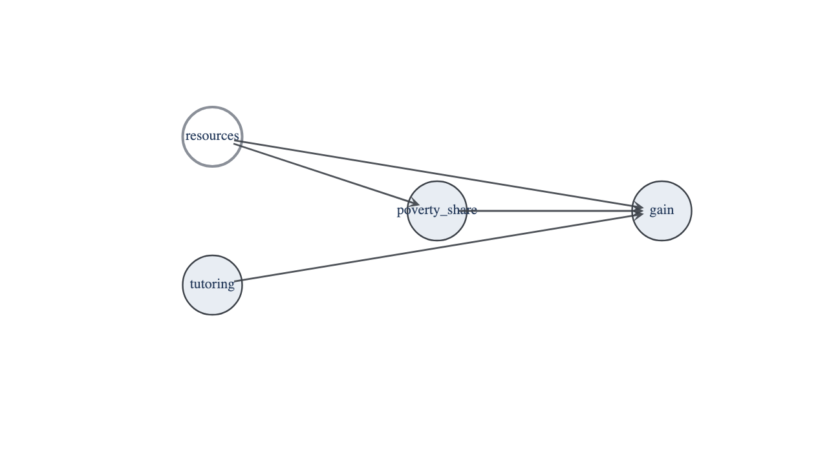
Figures
*Figure 1*. The identification graph. A hollow node was not measured and a dashed edge is an unmeasured common cause.

Slide 20
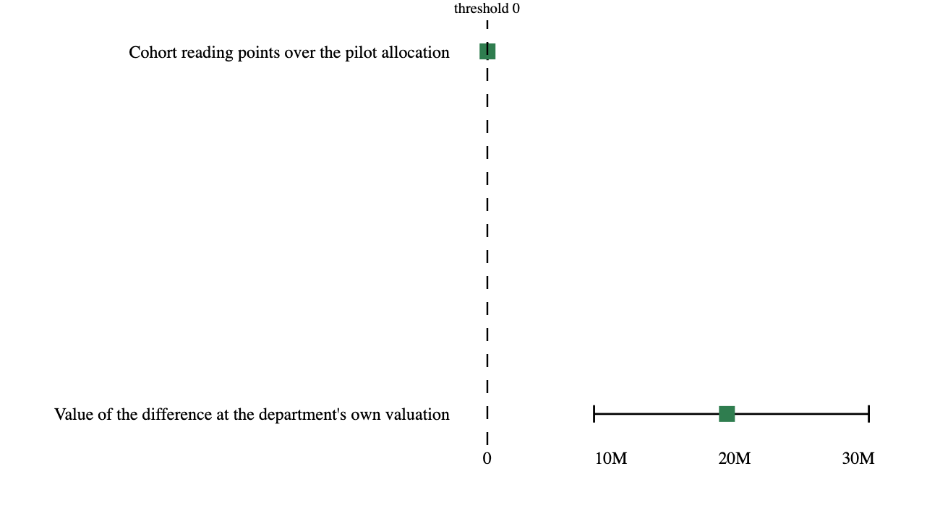
Figures (cont.)
*Figure 2*. Estimated quantities with their intervals. The dashed rule marks the decision threshold; a row whose interval crosses it is unsettled rather than null.

