Slide 1
TUTOR-60
Does buying fewer tutoring minutes for every eligible student beat buying the pilot's ninety weekly minutes for the fraction of them the budget reaches?

Slide 2
Abstract
This study examined the allocation of tutoring minutes under a fixed budget for eligible students. The question asked was whether buying fewer tutoring minutes for every eligible student beats buying the pilot allocation's ninety weekly minutes for the fraction of them the budget reaches. This was answered by comparing cohort reading points over the pilot allocation against a decision threshold of zero points per year. The effect of tutoring on gain is identified via the backdoor route in the randomization design. The analysis found that cohort reading points over the pilot allocation settled above the threshold on the favourable side at 13838 points per year with a 90% HDI from 6163 to 22036 points per year. The value of the difference at the department's own valuation also settled above the threshold on the favourable side. These findings depend on the unverified assumption that the cohort average answers the question. The results indicate that spreading a lower dose across all eligible students delivers more total cohort reading points than funding a high dose for a smaller fraction of the students.
Reported quantities: Cohort reading points over the pilot allocation; Value of the difference at the department's own valuation

Slide 3
1. Introduction
This report addresses whether buying fewer tutoring minutes for every eligible student beats buying the pilot's ninety weekly minutes for the fraction of them the budget reaches. The target quantity is identified. The question is answered by cohort reading points over the pilot allocation, evaluated against a decision threshold of 0 points/year. An interval that lies entirely on one side of 0 points/year settles the question. An interval strictly above 0 points/year indicates that allocating fewer minutes to every eligible student yields higher cohort reading points than the pilot allocation. An interval strictly below 0 points/year indicates that the pilot allocation yields higher cohort reading points. An interval spanning 0 points/year leaves the comparison unsettled.

Slide 4
2. Methods
To address the question introduced earlier, the target is the effect of tutoring on gain, identified via the backdoor route. The graph consists of poverty_share -> gain, resources -> gain, resources -> poverty_share, and tutoring -> gain, where resources are unmeasured, as shown in Table 1 and Figure 1. The trial design parameters are shown in Table 3. Across that design, 120 schools were randomized to allocations drawn from a lattice over the two doses, with 3 messaging levels and tutoring spread across the decision range, leaving the adjustment set empty. Relying on state records on 240 schools was considered instead, but in that graph poverty_share -> gain, poverty_share -> tutoring, resources -> gain, resources -> poverty_share, resources -> tutoring, and tutoring -> gain, which downgrades the effect because resources are unmeasured. A two-arm trial at the pilot's 90 minutes was also considered and rejected because it would only answer whether tutoring works rather than the shape of the response. Treatments are dosed in dollars per eligible student per year—where 20 USD buys a weekly tutoring minute and 9 USD buys a weekly caregiver message capped at 5—under a budget of 9,000,000 USD for one school year across 12,000 students reading two or more grade levels behind, equaling 750 USD a student if every one is reached. Dosing tutoring in minutes and messaging in messages was considered and rejected because the two
Planning the trial
`assignment: (tutoring_s, messaging_s) ~ Uniform(lattice) per school s` `observational graph : poverty_share -> gain, poverty_share -> tutoring, resources -> gain, resources -> poverty_share, resources -> tutoring, tutoring -> gain` ` status downgraded - requires the unmeasured node` `randomized graph : poverty_share -> gain, resources -> gain, resources -> poverty_share, tutoring -> gain` ` status identified via backdoor`
Estimating the response
`gain_s = f(tutoring_s) + g(messaging_s) + eps_s` ` f, g = penalised splines, one per dose, on the school-level panel` `effect(a) = E[gain | dose = a] - E[gain | dose = 0] within each draw` `served(a) = min(N_eligible, Budget / cost(a))` `cohort(a) = served(a) * effect(a) the objective` `cost(a) = a_tutoring + a_messaging (USD per eligible student-year)`

Slide 5
2. Methods (cont.)
Choosing the allocation
`a* = argmax_a mean_draws cohort(a)` `Delta = cohort(a*) - cohort(a_pilot) paired inside each draw` `P = Pr(Delta > 0)` `value = Delta * VALUE_PER_POINT`
The identification graph
From | Arrow | To | Kind
poverty_share | → | gain | direct effect
resources | → | gain | direct effect
resources | → | poverty_share | direct effect
tutoring | → | gain | direct effect
resources |  |  | unmeasured node
Assumptions this analysis rests on

Slide 6
2. Methods (cont.)
Assumption | Statement | Status | Challenged by
a reading point has the value the state assigns it | a reading point is valued at 1,400 USD; the recommendation does not depend on this number, only on whether to fund at all | was asserted without a check | a valuation low enough to make the whole program not worth funding
the cohort average answers the question | the recommendation is made on the cohort average; the grade-band breakdown the program office asked for is not estimable from a school-randomized trial | is assumed and has not been checked | a response that differs across grade bands enough to change the allocation
identification Schools were randomized to allocations; the adjustment set is empty.
estimand The recommendation is over assigned allocations. Schools delivered 93% of assigned minutes, and that shortfall is inside the estimate rather than corrected out of it.
interval Every figure and quantity at 90% over 4,000 posterior draws.
limitation The grade-band breakdown the program office asked for is not estimable from a school-randomized trial, and is not reported.

Slide 7
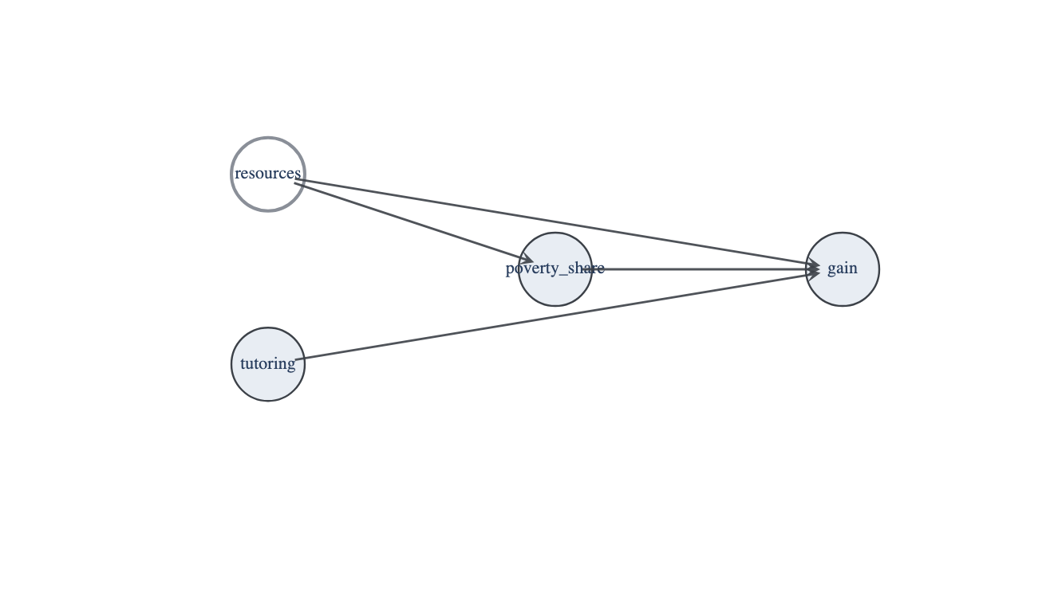
2. Methods (cont.)
Figure 1. The identification graph. A hollow node was not measured and a dashed edge is an unmeasured common cause; those two are what decide whether the effect is identifiable at all

Slide 8
2. Methods (cont.)
Step | Parameter | Value
Identification | graph | poverty_share -> gain, resources -> gain, resources -> poverty_share, tutoring -> gain
Identification | graph hash | 488a01d83085
Identification | route | backdoor
Identification | status | identified
Identification | unmeasured nodes | resources
The decision as arithmetic | budget (USD) | 9,000,000
The decision as arithmetic | eligible students | 12,000
The decision as arithmetic | messaging dose range (USD) | 0 to 45
The decision as arithmetic | per student if all are reached (USD) | 750
The decision as arithmetic | tutoring dose range (USD) | 0 to 3,000
Planning the trial | eligible per school | 35–65
Planning the trial | messaging levels | 0, 18, 45
Planning the trial | schools | 120
Planning the trial | unit of assignment | school
Estimating the response | fit hash | c878161a12a5
Estimating the response | interval mass | 90%
Estimating the response | posterior draws | 4,000
Estimating the response | response family | spline in both doses
Estimating the response | sampler | PyMC via nutpie
Choosing the allocation | allocate() at the budget | tutoring 705, messaging 45 (converged)
Choosing the allocation | messages a week | 5
Choosing the allocation | recommended messaging (USD) | 45
Choosing the allocation | recommended tutoring (USD) | 700
Choosing the allocation | students reached | 12,000
Choosing the allocation | weekly minutes | 35
Choosing the allocation | within 2% of the best (USD) | 700 to 750

Slide 9
3. Results
COHORT READING POINTS OVER THE PILOT ALLOCATION
13,838 points/year
[6,200, 22,000] (90% HDI)
VALUE OF THE DIFFERENCE AT THE DEPARTMENT'S OWN VALUATION
19,372,837 USD
[9,000,000, 3.1e+07] (90% HDI)
The results address the comparison between the program allocation and the pilot allocation for the decision values established in the introduction. Following the design and model assumptions outlined in the methods, the analysis provides estimates for the primary outcomes. The cohort reading points over the pilot allocation is 13838 points/year (90% HDI 6163 to 22036 points/year). The value of the difference at the department's own valuation is 19372837 USD (90% HDI 8627873 to 30850017 USD). The estimated quantities are reported in Table 4. The estimated quantities with their intervals are displayed in Figure 2.

Slide 10
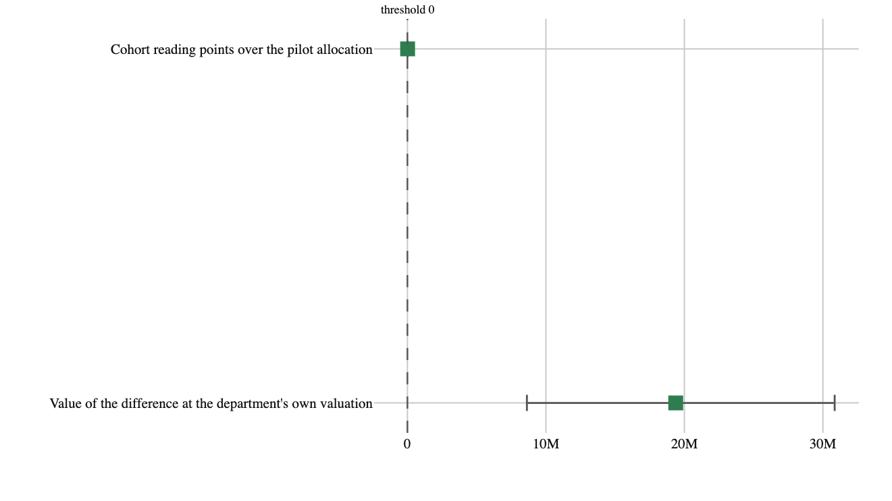
3. Results (cont.)
Figure 2. Estimated quantities with their intervals

Slide 11
3. Results (cont.)
Quantity | Estimate | Unit | Interval | Threshold | Relative to threshold
Cohort reading points over the pilot allocation | 13838 | points/year | 6163 to 22036 (90% HDI) | 0 | above threshold
Value of the difference at the department's own valuation | 19372837 | USD | 8627873 to 30850017 (90% HDI) | 0 | above threshold

Slide 12
4. What the run showed
Written by the analyst after seeing the output, and reproduced unchanged. Nothing in this section is generated.
The recommendation is flat between 700 and 750 USD — 35 to 38 weekly minutes are all within two per cent of the best. The decision that matters is not the exact figure, it is not funding 90 minutes.
For the pilot to be the better buy, the advantage would have to be overstated by 100% of itself — that is, essentially the whole of it would have to be an artefact of the fit rather than a real difference between the two allocations.
The reason the recommendation is not 90 minutes is not that 90 minutes fails. It is that the response is steep at the bottom, the budget is fixed, and every extra dollar a student is a student not served.

Slide 13
5. Model checking
POSTERIOR PROBABILITY THE RECOMMENDATION BEATS THE PILOT
0.997
STUDENTS THE RECOMMENDATION REACHES
12,000
STUDENTS THE PILOT ALLOCATION WOULD REACH
4,878
COST OF THE RECOMMENDED ALLOCATION PER STUDENT
745 USD
Diagnostic checks evaluate the fit and can lower confidence in an estimate, but they can never establish one. The estimation relies on 4000 posterior draws across the 120 randomized schools. The posterior probability that the recommendation beats the pilot is 0.997. Under the recommended allocation, the intervention reaches 12000 students. By contrast, the pilot allocation would reach 4878 students. The cost of the recommended allocation is 745 USD per student. Recorded diagnostics are presented in Table 5. This evaluation examines the sampling performance and the reach quantities generated by the model. It leaves unexamined the structural and identification conditions detailed in the methods. Diagnostic consistency reflects computational stability without verifying the broader foundational assumptions of the design.

Slide 14
5. Model checking (cont.)
SCHOOLS RANDOMIZED
120
POSTERIOR DRAWS
4,000
Check | Value | Unit | Interval
Posterior probability the recommendation beats the pilot | 0.997 | — | —
Students the recommendation reaches | 12000 | — | —
Students the pilot allocation would reach | 4878 | — | —
Cost of the recommended allocation per student | 745 | USD | —
Schools randomized | 120 | — | —
Posterior draws | 4000 | — | —

Slide 15
6. Discussion
Both key findings agree and settle above the threshold on the favourable side. Specifically, the value of the difference at the department's own valuation and the cohort reading points over the pilot allocation each lie on the side favoring the broader distribution of tutoring minutes over the pilot allocation. Because the analysis relies on the backdoor route identified in the methods, these estimates can be read as effects of the allocation choice rather than baseline associations. That reading holds under the identification strategy but remains conditional on 2 unresolved assumptions. The limitations section states what each of those assumptions claims and what would challenge it.

Slide 16
7. Conclusions
Buying fewer tutoring minutes for every eligible student beats buying the pilot's ninety weekly minutes for the fraction of students reached by the budget. Cohort reading points over the pilot allocation settle on the favourable side of the decision threshold at 13838 points/year (90% HDI 6163 to 22036 points/year). The value of the difference at the department's own valuation also settles on the favourable side of the threshold. This finding follows from the identification set out earlier in the report. The conclusion is conditional on 2 unresolved assumptions: a reading point has the value the state assigns it, and the cohort average answers the question. What each assumption claims is stated in the limitations section. The policy answer holds under these conditions.

Slide 17
8. Limitations
Two unresolved assumptions support the analysis beyond what the data supply. First, the analysis asserts that a reading point has the value the state assigns it. Under this claim, a reading point is valued at 1,400 USD. This licenses the recommendation because the decision does not depend on this number, only on whether to fund at all. The assertion would be challenged by a valuation low enough to make the whole program not worth funding. Second, the analysis leaves unverified the assumption that the cohort average answers the question. This licenses basing the recommendation on the cohort average, as the grade-band breakdown the program office asked for is not estimable from a school-randomized trial. This assumption would be challenged by a response that differs across grade bands enough to change the allocation.

Slide 18
9. Provenance
Every number in this document resolves to a quantity in the evidence record below. Prose was checked against that record: any numeral not traceable to it, and any claim the record does not itself make, is reported rather than published.
Quantity | Key | Value | Produced by
Cohort reading points over the pilot allocation | advantage | 13838 points/year (90% HDI 6163 to 22036 points/year) | paired posterior comparison over the allocation grid
Value of the difference at the department's own valuation | advantage_value | 19372837 USD (90% HDI 8627873 to 30850017 USD) | the same draws, priced
Posterior probability the recommendation beats the pilot | probability_better | 0.997 | —
Students the recommendation reaches | students_reached | 12000 | —
Students the pilot allocation would reach | pilot_reached | 4878 | —
Cost of the recommended allocation per student | cost_per_student | 745 USD | —
Schools randomized | schools | 120 | —
Posterior draws | draws | 4000 | —
Field | Value
estimator | spline response surface, PyMC via nutpie
fit_hash | c878161a12a5
interval_mass | 90%
seed | 0
world | nbs/case-studies/tutoring/tutoring.py
evidence hash | 7bc9d4b50db1c7e7d179ec9a8af11003732629bc0189790cf210b75d82f12a52
narration: abstract | gemini-3.5-flash-lite — verified
narration: introduction | gemini-3.7-flash — verified
narration: methods | gemini-3.7-flash — verified
narration: results | gemini-3.7-flash — verified
narration: diagnostics | gemini-3.7-flash — verified
narration: discussion | gemini-3.7-flash — verified
narration: conclusions | gemini-3.7-flash — verified
narration: limitations | gemini-3.7-flash — verified

