Slide 1
Distributed Database Systems

Slide 2
Semantic Data Control
Involves:
View management
Security control
Integrity control
Objective :
Ensure that authorized users perform correct operations on the database, contributing to the maintenance of the database integrity.

Slide 3
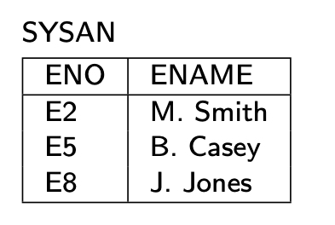
View Management
View – virtual relation
generated from base relation(s) by a query
not stored as base relations
Example :
CREATE VIEW SYSAN(ENO,ENAME)
AS SELECT ENO,ENAME
FROM EMP
WHERE TITLE= "Syst. Anal."
EMP
ENO
ENAME
TITLE
E1
J. Doe
Elect. Eng
E2
M. Smith
Syst. Anal.
E3
A. Lee
Mech. Eng.
E4
J. Miller
Programmer
E5
B. Casey
Syst. Anal.
E6
L. Chu
Elect. Eng.
E7
R. Davis
Mech. Eng.
E8
J. Jones
Syst. Anal.

Slide 4
View Management
Views can be manipulated as base relations
Example :
SELECT ENAME, PNO, RESP
FROM SYSAN, ASG
WHERE SYSAN.ENO = ASG.ENO

Slide 5
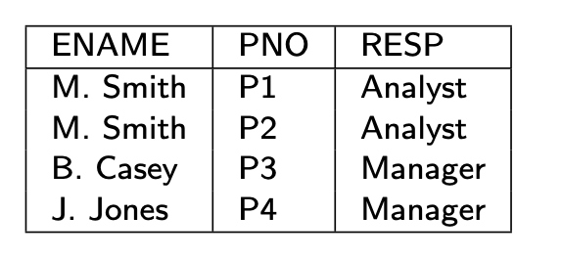
Query Modification
Queries expressed on views
Queries expressed on base relations
Example :
SELECT ENAME, PNO, RESP
FROM SYSAN, ASG
WHERE SYSAN.ENO = ASG.ENO
SELECT ENAME,PNO,RESP
FROM EMP, ASG
WHERE EMP.ENO = ASG.ENO
AND TITLE = "Syst. Anal."

Slide 6
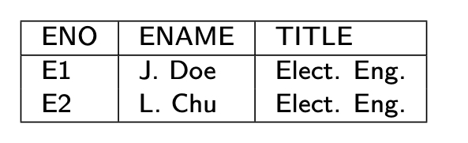
View Management
To restrict access
CREATE VIEW ESAME
AS SELECT *
FROM EMP E1, EMP E2
WHERE E1.TITLE = E2.TITLE
AND E1.ENO = USER
Query
SELECT *
FROM ESAME

Slide 7
View Updates
Updatable
CREATE VIEW SYSAN(ENO,ENAME)
AS SELECT ENO,ENAME
FROM EMP
WHERE TITLE="Syst. Anal."
Non-updatable
CREATE VIEW EG(ENAME,RESP)
AS SELECT ENAME,RESP
FROM EMP, ASG
WHERE EMP.ENO=ASG.ENO

Slide 8
View Management in Distributed DBMS
Views might be derived from fragments.
View definition storage should be treated as database storage
Query modification results in a distributed query
View evaluations might be costly if base relations are distributed
Use materialized views

Slide 9
Materialized View
Origin: snapshot in the 1980’s
Static copy of the view, avoid view derivation for each query
But periodic recomputing of the view may be expensive
Actual version of a view
Stored as a database relation, possibly with indices
Used much in practice
DDBMS: No need to access remote, base relations
Data warehouse: to speed up OLAP
Use aggregate (SUM, COUNT, etc.) and GROUP BY

Slide 10
Materialized View Maintenance
Process of updating (refreshing) the view to reflect changes to base data
Resembles data replication but there are differences
View expressions typically more complex
Replication configurations more general
View maintenance policy to specify:
When to refresh
How to refresh

Slide 11
When to Refresh a View
Immediate mode
As part of the updating transaction, e.g. through 2PC
View always consistent with base data and fast queries
But increased transaction time to update base data
Deferred mode (preferred in practice)
Through separate refresh transactions
No penalty on the updating transactions
Triggered at different times with different trade-offs
Lazily: just before evaluating a query on the view
Periodically: every hour, every day, etc.
Forcedly: after a number of predefined updates

Slide 12
How to Refresh a View
Full computing from base data
Efficient if there has been many changes
Incremental computing by applying only the changes to the view
Better if a small subset has been changed
Uses differential relations which reflect updated data only

Slide 13
Differential Relations
Given relation R and update u
R⁺ contains tuples inserted by u
R⁻ contains tuples deleted by u
Type of u
insert R⁻ empty
delete R⁺ empty
modify R⁺ ∪ (R – R⁻ )
Refreshing a view V is then done by computing
V⁺ ∪ (V – V⁻ )
computing V⁺ and V⁻ may require accessing base data

Slide 14
Example
EG = SELECT DISTINCT ENAME, RESP
FROM EMP, ASG
WHERE EMP.ENO=ASG.ENO
EG⁺= (SELECT DISTINCT ENAME, RESP
FROM EMP, ASG⁺
WHERE EMP.ENO=ASG⁺.ENO) UNION
(SELECT DISTINCT ENAME, RESP
FROM EMP⁺, ASG
WHERE EMP⁺.ENO=ASG.ENO) UNION
(SELECT DISTINCT ENAME, RESP
FROM EMP⁺, ASG⁺
WHERE EMP⁺.ENO=ASG⁺.ENO)

Slide 15
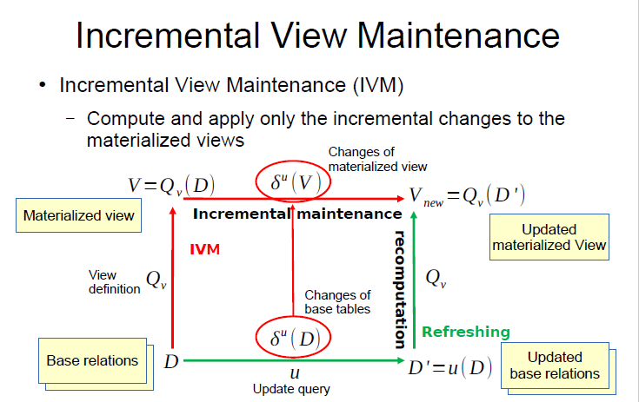

Slide 16
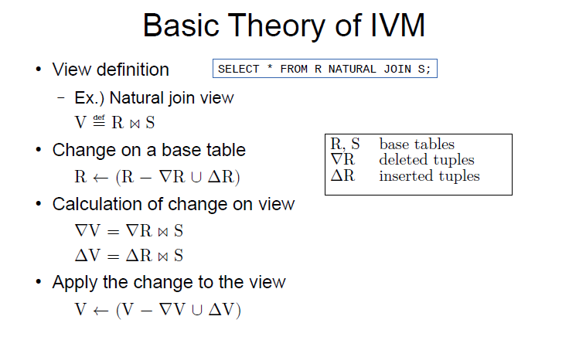

Slide 17
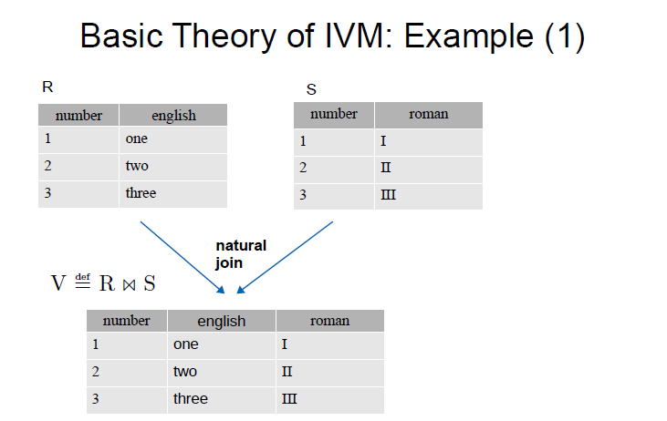

Slide 18
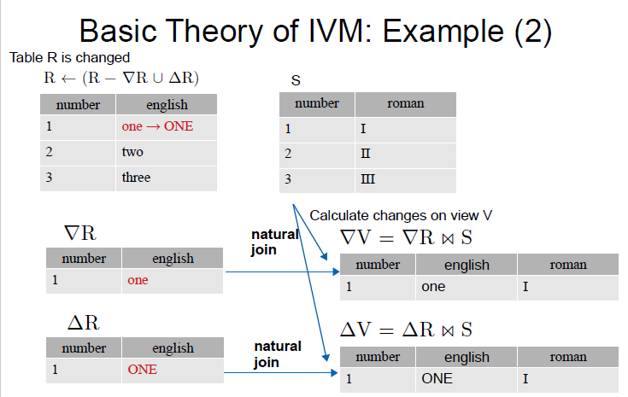

Slide 19
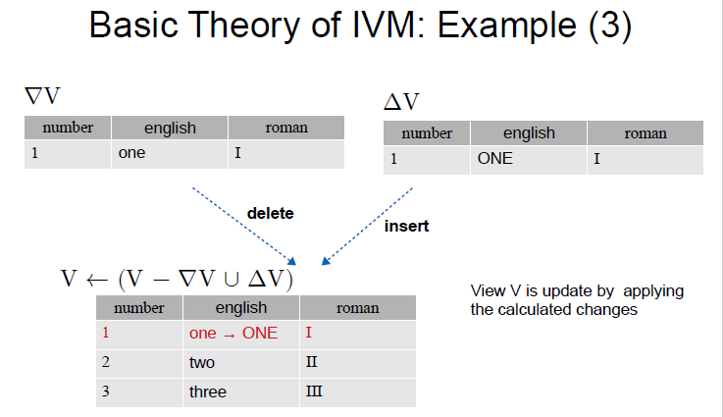

Slide 20
Counting Algorithm
Basic idea
Maintain a count of the number of derivations for each tuple in the view
Increment (resp. decrement) tuple counts based on insertions (resp. deletions)
A tuple in the view whose count is zero can be deleted
Algorithm
Compute V⁺ and V⁻ using V, base relations and diff. relations
Compute positive in V⁺ and negative counts in V⁻
Compute V⁺ ∪ (V – V⁻ ), deleting each tuple in V with count=0
Optimal: computes exactly the view tuples that are inserted or deleted

