Slide 1

Docker Workshop
By Redapt, Inc.
Agenda
Morning
Docker intro (Christoph)
What is Docker
Theory behind containers vs VMs vs applications
What you need to run Docker containers
Docker compose (Christoph)
Building applications in containers
Afternoon
Lab
Build an application in a container
Nvidia Docker (Bryan)
Life cycle management (Christoph)
Code management
Building/testing local, deploying on the DGX
Advanced Docker topics (Christoph)
Q&A

Slide 2
Introduction to Docker
By Redapt, Inc.
Docker is an open-source project that automates the deployment of applications inside software containers.
“Docker containers wrap up a piece of software in a complete filesystem that contains everything it needs to run: code, runtime, system tools, system libraries – anything you can install on a server. This guarantees that it will always run the same, regardless of the environment it is running in.” – Docker, Inc.

Slide 3
Introduction to Docker
By Redapt, Inc.
A container image is a lightweight, stand-alone, executable package of a piece of software that includes everything needed to run it: code, runtime, system tools, system libraries, settings.
Available for both Linux and Windows based apps, containerized software will always run the same, regardless of the environment.
Containers isolate software from its surroundings, for example differences between development and staging environments and help reduce conflicts between teams running different software on the same infrastructure.

Slide 4
Introduction to Docker
By Redapt, Inc.
Lightweight
Docker containers running on a single machine share that machine's operating system kernel; they start instantly and use less compute and RAM. Images are constructed from filesystem layers and share common files. This minimizes disk usage and image downloads are much faster.

Slide 5
Introduction to Docker
By Redapt, Inc.
Lightweight
Docker containers running on a single machine share that machine's operating system kernel; they start instantly and use less compute and RAM. Images are constructed from filesystem layers and share common files. This minimizes disk usage and image downloads are much faster.
Standard
Docker containers are based on open standards and run on all major Linux distributions, Microsoft Windows, and on any infrastructure including VMs, bare-metal and in the cloud.

Slide 6
Introduction to Docker
By Redapt, Inc.
Lightweight
Docker containers running on a single machine share that machine's operating system kernel; they start instantly and use less compute and RAM. Images are constructed from filesystem layers and share common files. This minimizes disk usage and image downloads are much faster.
Standard
Docker containers are based on open standards and run on all major Linux distributions, Microsoft Windows, and on any infrastructure including VMs, bare-metal and in the cloud.
Secure
Docker containers isolate applications from one another and from the underlying infrastructure. Docker provides the strongest default isolation to limit app issues to a single container instead of the entire machine.

Slide 7
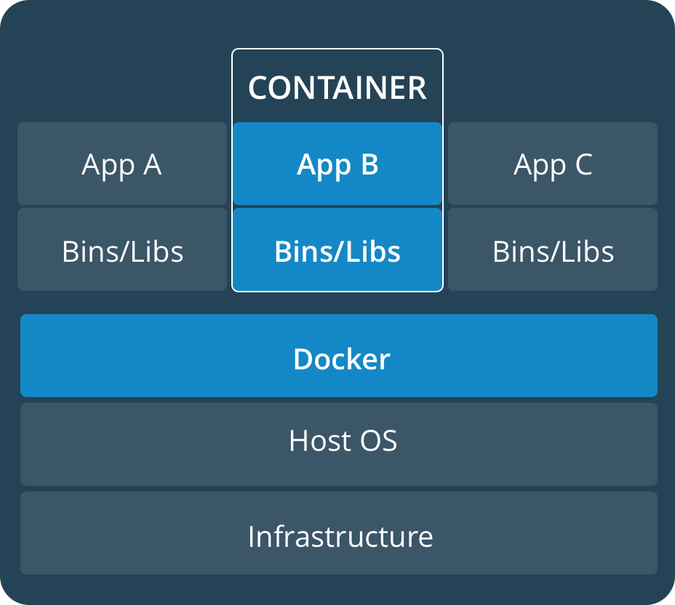
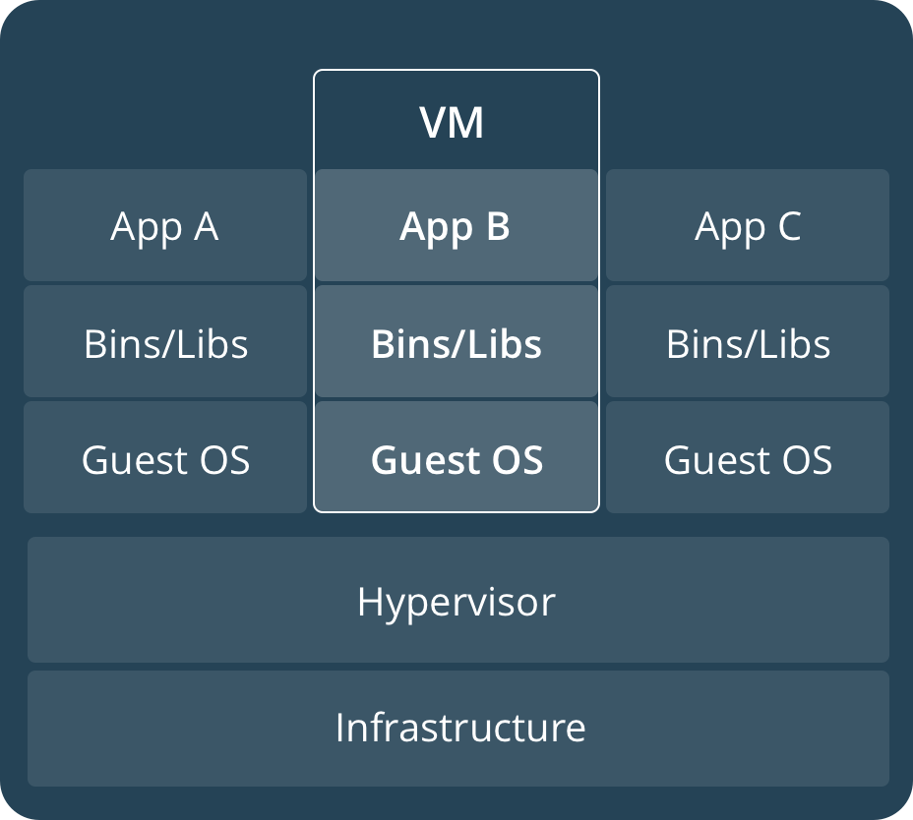
Comparing Containers and Virtual Machines
By Redapt, Inc.
Containers and virtual machines have similar resource isolation and allocation benefits, but function differently because containers virtualize the operating system instead of hardware. Containers are more portable and efficient.

Slide 8
Comparing Containers and Virtual Machines
By Redapt, Inc.
Virtual Machines
Virtual machines (VMs) are an abstraction of physical hardware turning one server into many servers. The hypervisor allows multiple VMs to run on a single machine. Each VM includes a full copy of an operating system, one or more apps, necessary binaries and libraries - taking up tens of GBs. VMs can also be slow to boot.
Containers
Containers are an abstraction at the app layer that packages code and dependencies together. Multiple containers can run on the same machine and share the OS kernel with other containers, each running as isolated processes in user space. Containers take up less space than VMs (container images are typically tens of MBs in size), and start almost instantly.

Slide 9
The Components of Docker
By Redapt, Inc.
The Docker software as a service offering consists of three components.
#1 Software
The Docker daemon, called "dockerd" is a persistent process that manages Docker containers and handles container objects.
The daemon listens for API requests sent by the Docker Engine API.
The Docker client, which identifies itself as "docker", allows users to interact with Docker through the CLI. It uses the Docker REST API to communicate with one or more Docker daemons.

Slide 10
The Components of Docker
By Redapt, Inc.
The Docker software as a service offering consists of three components.
#2 Objects
Docker objects refer to different entities used to assemble an application in Docker. The main Docker objects are images, containers, and services.
A Docker container is a standardized, encapsulated environment that runs applications. A container is managed using the Docker API or CLI.

Slide 11
The Components of Docker
By Redapt, Inc.
The Docker software as a service offering consists of three components.
#2 Objects
Docker objects refer to different entities used to assemble an application in Docker. The main Docker objects are images, containers, and services.
A Docker container is a standardized, encapsulated environment that runs applications. A container is managed using the Docker API or CLI.
A Docker image is a read-only template used to build containers. Images are used to store and ship applications.

Slide 12
The Components of Docker
By Redapt, Inc.
The Docker software as a service offering consists of three components.
#2 Objects
Docker objects refer to different entities used to assemble an application in Docker. The main Docker objects are images, containers, and services.
A Docker container is a standardized, encapsulated environment that runs applications. A container is managed using the Docker API or CLI.
A Docker image is a read-only template used to build containers. Images are used to store and ship applications.
A Docker service allows containers to be scaled across multiple Docker daemons. The result is known as a "swarm", cooperating daemons that communicate through the Docker API.

Slide 13
The Components of Docker
By Redapt, Inc.
The Docker software as a service offering consists of three components.
#3 Registries
A Docker registry is a repository for Docker images.
Docker clients connect to registries to download ("pull") images for use or upload ("push") images that they have built.
Registries can be public or private.
The two main public registries are Docker Hub and Docker Cloud.
Docker Hub is the default registry where Docker looks for images.

Slide 14
Basic Docker Commands
By Redapt, Inc.
The following are the most common Docker commands (i.e., the ones you will most likely use the most day-to-day):
Show all currently running containers:
$ docker ps
Show all containers (including stopped and failed ones):
$ docker ps –a
Show all images in your local repository:
$ docker images
Create an image based on the instructions found in a Dockerfile:
$ docker build
Start a container from an image (either local or from a remote repository, like Docker Hub):
$ docker run
[BONUS] Remove/delete all stopped/failed containers (leaving running containers alone):
$ docker rm $(docker ps –a –q)

Slide 15
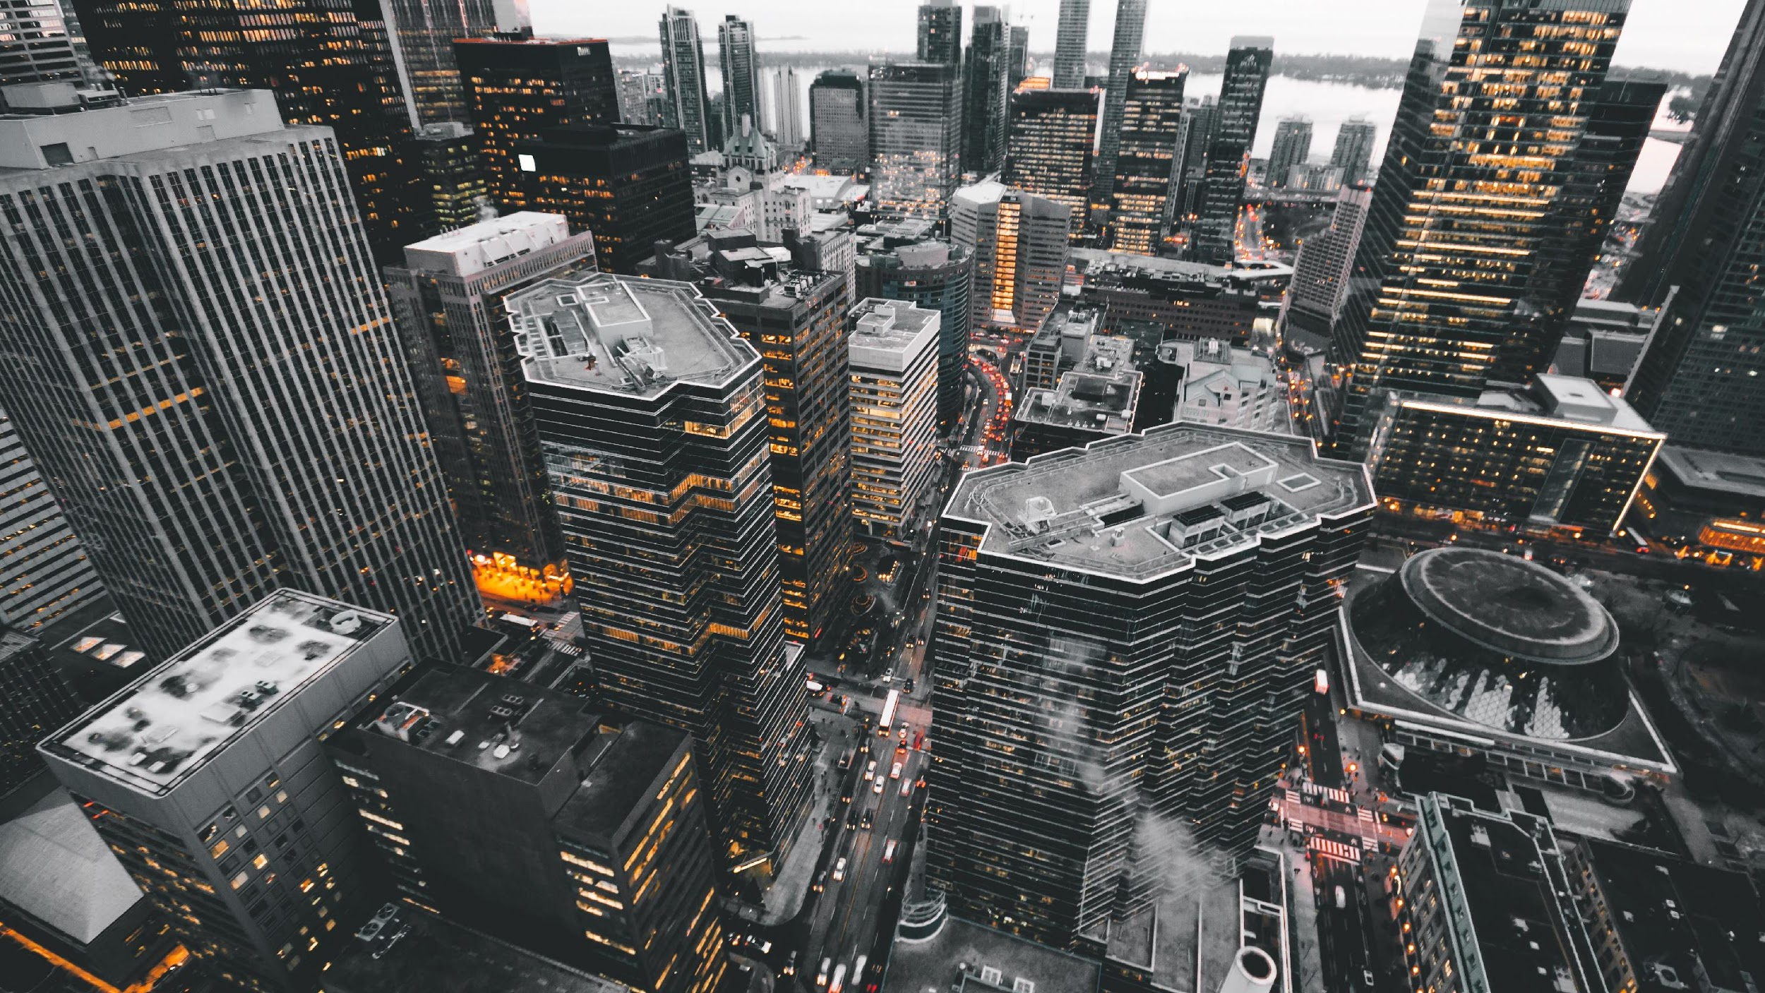
Thank You

Slide 16
Advanced Docker Topics
By Redapt, Inc.
Lifecycle management
Persistent storage
Networking
Orchestration (e.g., Kubernetes)

