Slide 1
Kubernetes security
CNCF

Slide 2
K8s Security Plane
Host OS Level
Infrastructure Level
Kubernetes Level
Application level

Slide 3
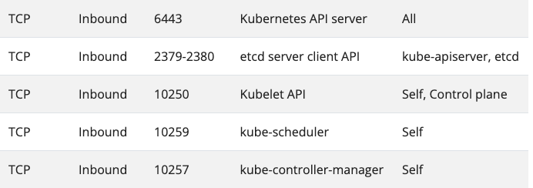
Network Level security
Control plane

Slide 4
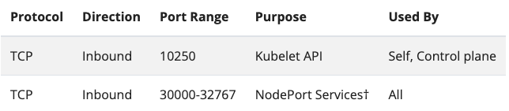
Data plane Network security

Slide 5
Understanding Security Standards and Benchmarks
For any Level of security we have some standard
Standard can be different as per organization level
So set test and set benchmarks some standard by many vendors has been created
CIS Benchmark

Slide 6
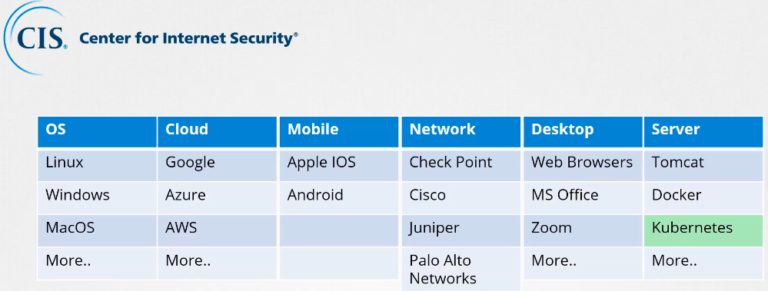
CIS {Center OF Internet security}

Slide 7
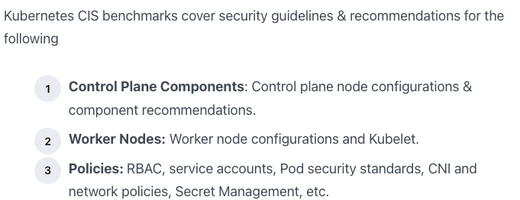
Kube-bench : CIS tool

Slide 8
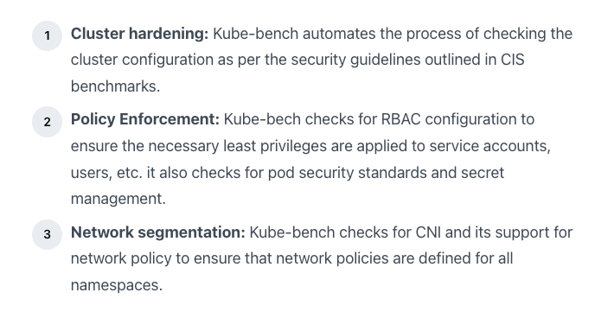
Kube-bench : can Help

Slide 9
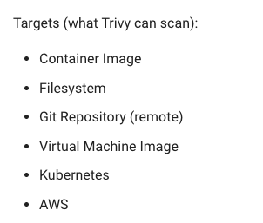
Trivy

Slide 10
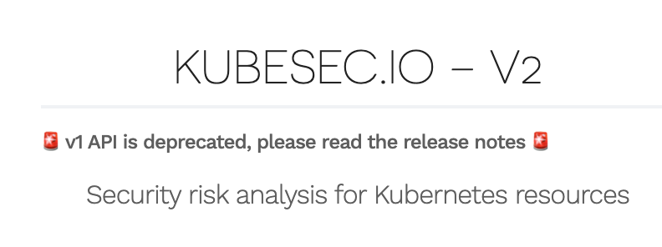
KubeSec

Slide 11
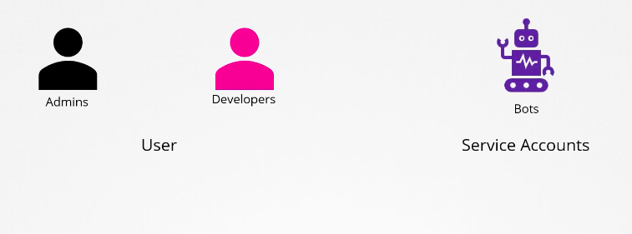
Security Primitives {Authentication}

Slide 12
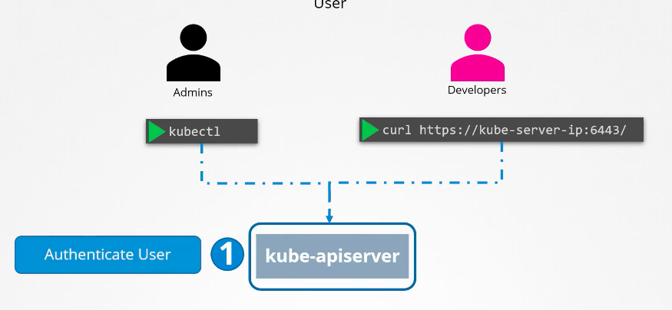
Kube-apiServer

Slide 13
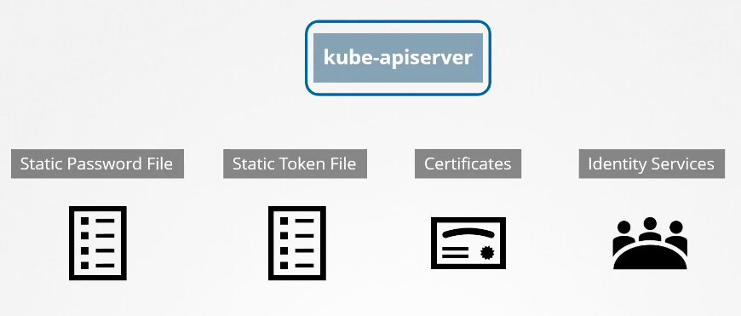
Authentication methods

Slide 14
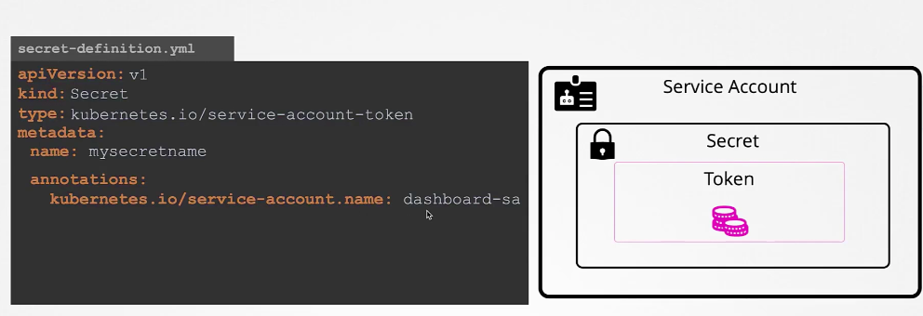
K8s 1.24 {Service account changes}

Slide 15
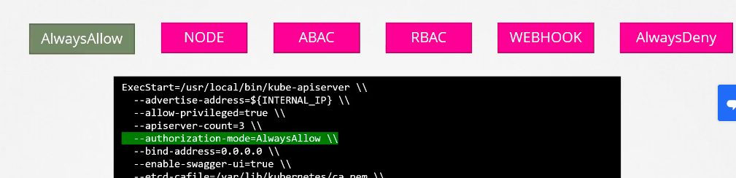
RBAC {Authorization}

Slide 16
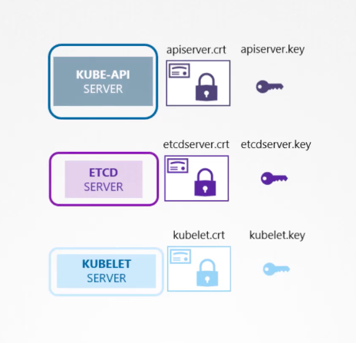
TLS in kubernetes

Slide 17
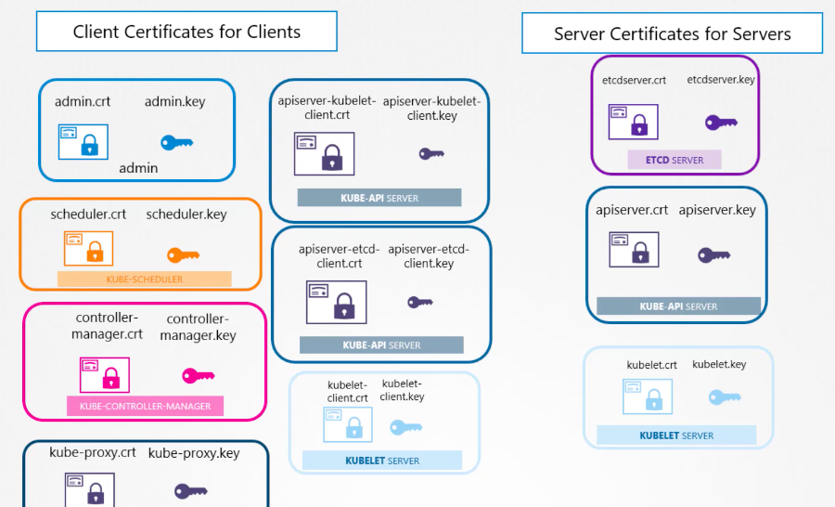
Overall Certificates

Slide 18
Kernel harding
We already know about
Namespace
Cgroups

Slide 19
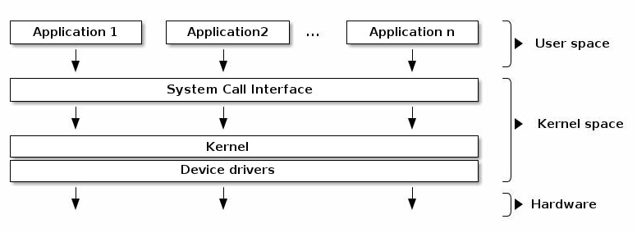
User & Kernel Space
APP | LIbs
curl | glibc
Getpid() Reboot()

Slide 20
Now Kernel harding
User Space
SecComp & Apparmor
Kernel Space

Slide 21
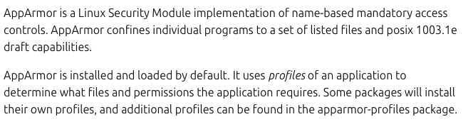
AppArmor

Slide 22
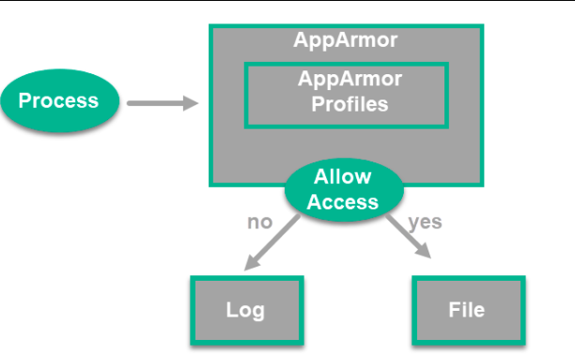
One more look

Slide 23
Profile Modes
Unconfined
Complained
Enforced

Slide 24
Demo

