Slide 1
And what if we treat this like the tradition of matching original song to someone else’s poetry, and vice versa. This drawing is my song; the text can be shape note text from the experience of that day/meeting.

Slide 3
x
x
x
x
x
x
x
x
x
x
x
x

Slide 4
“ ”
x
x
x
x
x
x
x
x
x
x
x
x
x

Slide 10
Overlay of religious iconography
Let’s be bad and have this frame stream like a video…and old-stye grainy/jerky…and let’s have flashes where the walls go pink…and other colors…and let’s have flashes where elements from the Buddhist alters show up…or other religious iconography…oh-oh, art in the meetinghouse.
There was that beautiful wood table with a vase and flowers in the meetinghouse in Baltimore, take from that.

Slide 11
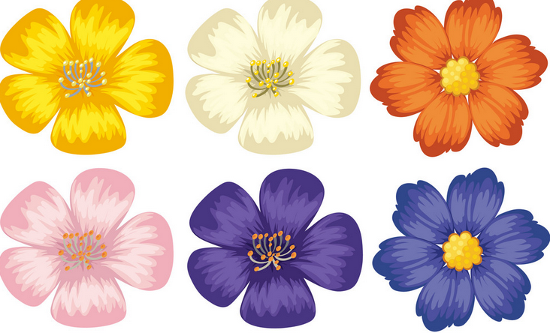
Flowers: https://www.vectorstock.com/royalty-free-vector/colorful-flowers-on-isolated-white-background-vector-18048163

Slide 12
12 is a jpeg…ignore this slide…

Slide 13
[ dealing with the doors and their various states ]

Slide 16
Wadena County

