Slide 1
MessagePack(msgpack): A Compact and Fast Serialization Library
Takatoshi Kondo
Notes:
Good evening. I’m Taka.
I'd like to talk a little about MessagePack.

Slide 2
About me
Taka (Takatoshi Kondo)
from TOKYO, JAPAN
OGIS-RI Co., Ltd.
Developing Pub/Sub IoT Platform using MessagePack
A committer on the msgpack-c OSS project
Other experience: Wrote the “Boost.MSM Guide”
http://redboltz.wikidot.com/boost-msm-guide
Notes:
Before I do that though, let me introduce myself.
I'm from TOKYO, JAPAN.
I'm developing publish/subscribe style IoT, Internet of Things platform, based on websockets using MessagePack.
I'm a committer on the msgpack-c open source project.
msgpack-c is a C and C++ implementation of the MessagePack specification.
The C++ version is a native implementation. Not just a wrapper on the C version.
I have some other related experience.
I wrote the Boost Meta State Machine Guide.
Let's move on to MessagePack.

Slide 3
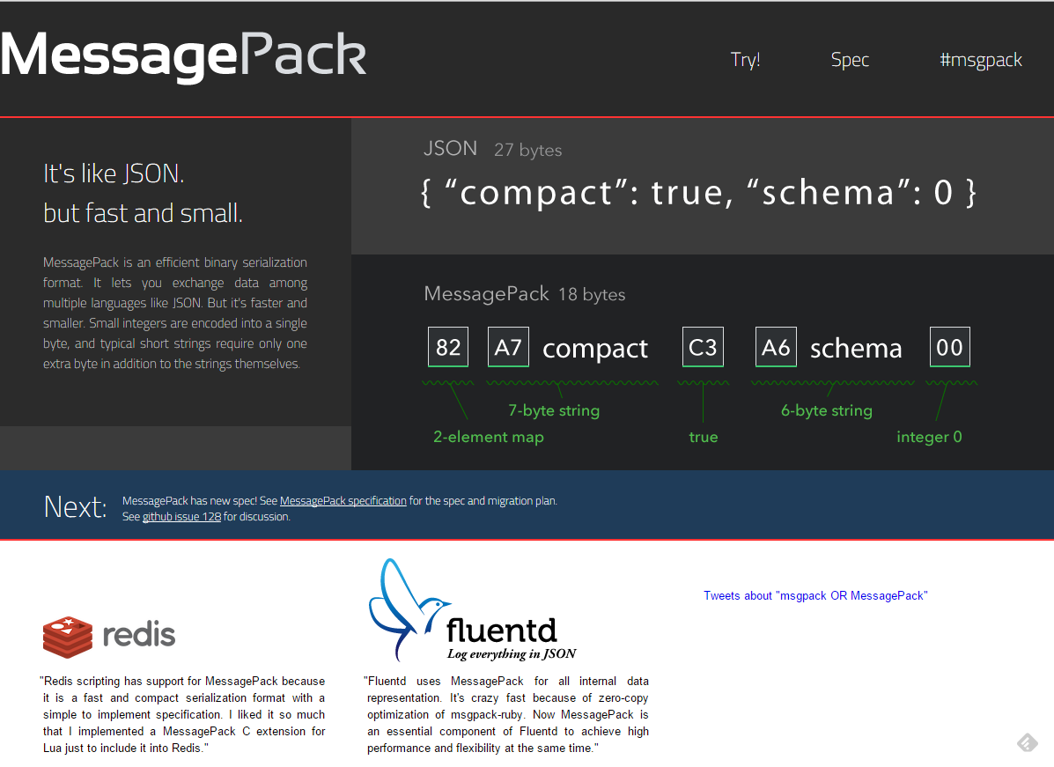

What is MessagePack?
Notes:
MessagePack is a binary data format. It's like JSON. This is an example of some JSON data and this is the equivalent MessagePack data.
MessagePack is used by redis, fluentd, Facebook Messenger, and others.

Slide 4
MessagePack vs. JSON
Same as JSON
Portable
Contain basic type information
For example, map, array, string, boolean...
Composite data structure
Different from JSON
Smaller size
Binary coded
Can handle binary data without text encoding such as Base64
Easier to parse, requires less computing power
Notes:
Which MessagePack features are the same as JSON?
Both are portable, both contain basic type information. They are a composite data structure.

Slide 5
MessagePack vs. JSON
Same as JSON
Portable
Contain basic type information
For example, map, array, string, boolean...
Composite data structure
Different from JSON
Smaller size
Binary coded
Can handle binary data without text encoding such as Base64
Easier to parse, requires less computing power
msgpack::object
*
key
val
nil
boolean
u64
i64
f64
object_kv
*
double, float
str
bin
ext
array
map
Notes:
Which MessagePack features are the same as JSON?
Both are portable, both contain basic type information. They are a composite data structure.
A composite data structure means that arrays and maps can contain msgpack objects.
The differences between JSON and MessagePack are ...
MessagePack is more compact than JSON.
MessagePack is binary coded. So it can handle binary data without text encoding such as Base64.
MessagePack is easier to parse, it requires less computing power.

Slide 6
MessagePack/Boost.Serialization
The goals of the msgpack and the Boost.Serialization are different.
msgpack: Interexchange the data with different programming languages.
Boost.Serialization: Serialize every data and relations. e.g.) shared_ptr
msgpack can be used as a portable binary archive of the Boost.Serialization.
https://github.com/redboltz/rui/tree/support_boost_1_57_0
Forked from Norihisa Fujita’s implementation
ruby
msgpack
C++
python
shared_ptr
42
shared_ptr
Boost.Serialization
format
42
shared_ptr
Notes:
You may be interested in the difference between MessagePack and Boost Serialization.
The goals of MessagePack and Boost Serialization are different.
MessagePack's goal is interexchange data with different programming languages.
Boost serialization's goal is serializing and deserializing every C++ data including their relations.
For example, these three shared pointers point to the objects that have value 42, but the first two shared pointers are sharing the same object.
Boost serialization can serialize and deserialize these kinds of relations.
MessagePack can be used as a portable binary archive of Boost Serialization.
You can get the code of msgpack archive for Boost Serialization from my github.
The original version is written by Norihisa.

Slide 7
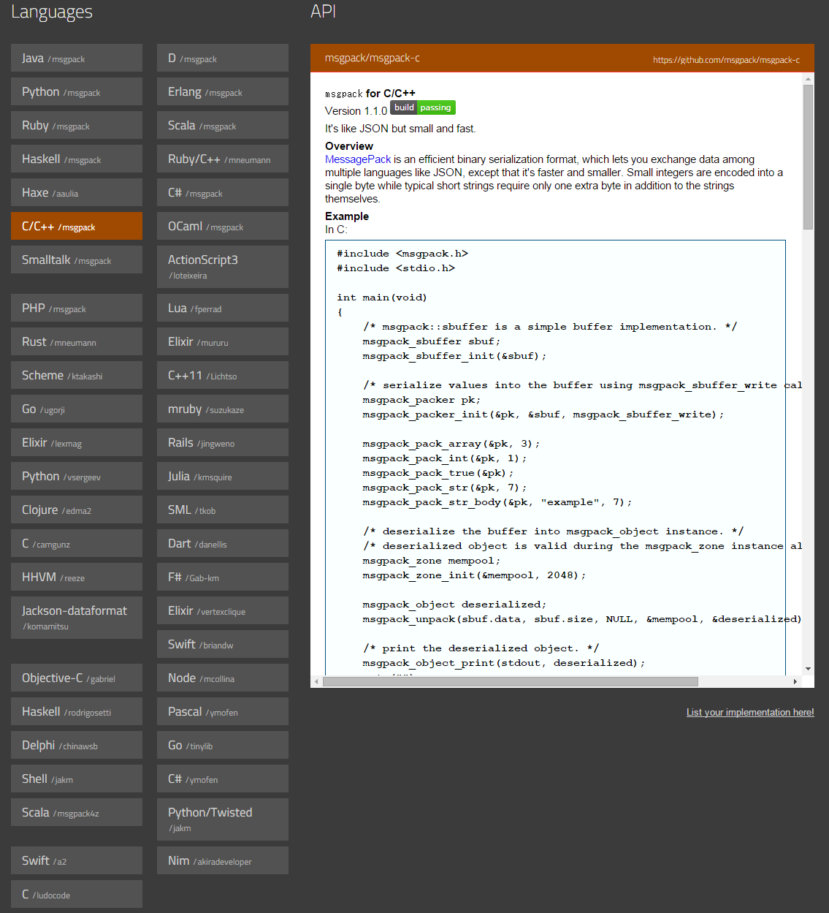
Supported Programming Languages
Notes:
Here is a list of programming languages that support MessagePack.

Slide 8
Pack/Unpack
#include <tuple>
#include <string>
#include <sstream>
#include <msgpack.hpp>
int main() {
auto t1 = std::make_tuple("hello", true, 42, 12.3);
std::stringstream ss;
msgpack::pack(ss, t1);
msgpack::unpacked unpacked
= msgpack::unpack(ss.str().data(), ss.str().size());
msgpack::object obj = unpacked.get();
auto t2 = obj.as<std::tuple<std::string, bool, int, double>>();
assert(t1 == t2);
}
packing
You can use any types that have the member function write(const char*, std::size_t);
unpacking
convering
Notes:
Let's look at a code example.
The client needs to include msgpack.hpp. A C++ version of Msgpack is a header only library.
The top part of the code example demonstrates how to pack a tuple. We can generate a byte stream that is MessagePack format using the 'pack‘ function.
The first argument of the pack function is a stream. A stream is an object of any type that has a write member function.
The middle part of the code example demonstrates how to unpack. We can generate a MessagePack object from a byte stream using the ‘unpack’ function.
A MessagePack object is a simple variant type. It is implemented using a union.
Although we can use a MessagePack object directly, it is usually more useful to convert to C++ types.
The last part of the code example demonstrates how to convert from a msgpack object to C++ types.
Using the ‘as’ member function template, we can convert to any C++ types that is adapted MessagePack.

Slide 9
Stream Deserialization
class unpacker {
public:
// Constructor is omitted in this presentation
void reserve_buffer(std::size_t size);
char* buffer();
void buffer_consumed(std::size_t size);
bool next(unpacked& result);
};
Notes:
MessagePack also provids a stream deserializer named unpacker.
It has four member functions. reserve_buffer, buffer, buffer_consumed, and next.
Let's look at some client code.

Slide 10
Stream Deserialization
std::size_t const try_read_size = 100;
msgpack::unpacker unp;
while (/* block until input becomes readable */) {
unp.reserve_buffer(try_read_size);
std::size_t actual_read_size = input.readsome(
unp.buffer(), try_read_size);
unp.buffer_consumed(actual_read_size);
msgpack::unpacked result;
// MessagePack data loop
while(unp.next(result)) {
msgpack::object obj(result.get());
}
}
Notes:
These four member functions are used in the client code.
This code is a part of the packet receiving function.
Let's say the client tries to read 100 bytes at a time.
This is a packet receiving loop.
When a packet is arrived, the client calls the reserve_buffer function.
The unpacker prepares buffer memory internally, similar to the std::vector's reserve.
And then, the client copies the data it receives to the prepared buffer. In order to access the internal buffer, the client calls the buffer() function.
Then, the client notifies the unpacker the actual read size using the buffer_consumed() function.
The inner while loop generates MessagePack objects that are wrapped in the type named msgpak::unpacked.
For each msgpack object in the buffer, the ‘next’ function returns true and sets the variable result.
If the msgpack object is empty, then the ‘next’ function returns false.
Even if the function 'next' returns false, the unpacker preserves the context so that the unpacker can continue parsing when the 'next‘ function will call again.

Slide 11
Stream Deserialization
std::size_t const try_read_size = 100;
msgpack::unpacker unp;
while (/* block until input becomes readable */) {
unp.reserve_buffer(try_read_size);
std::size_t actual_read_size = input.readsome(
unp.buffer(), try_read_size);
unp.buffer_consumed(actual_read_size);
msgpack::unpacked result;
// MessagePack data loop
while(unp.next(result)) {
msgpack::object obj(result.get());
}
}
The size may decided by receive performance, transmit layer's protocol and so on.
Notes:
These four member functions are used in the client code.
This code is a part of the packet receiving function.
Let's say the client tries to read 100 bytes at a time.
This is a packet receiving loop.
When a packet is arrived, the client calls the reserve_buffer function.
The unpacker prepares buffer memory internally, similar to the std::vector's reserve.
And then, the client copies the data it receives to the prepared buffer. In order to access the internal buffer, the client calls the buffer() function.
Then, the client notifies the unpacker the actual read size using the buffer_consumed() function.
The inner while loop generates MessagePack objects that are wrapped in msgpak::unpacked.
For each msgpack object in the buffer, the ‘next’ function returns true and sets the result.
If the msgpack object is empty, then the ‘next’ function returns false.
Even if the function 'next' returns false, the unpacker preserves the context so that the unpacker can continue parsing when the 'next‘ function will call again.

Slide 12
Stream Deserialization
std::size_t const try_read_size = 100;
msgpack::unpacker unp;
while (/* block until input becomes readable */) {
unp.reserve_buffer(try_read_size);
std::size_t actual_read_size = input.readsome(
unp.buffer(), try_read_size);
unp.buffer_consumed(actual_read_size);
msgpack::unpacked result;
// MessagePack data loop
while(unp.next(result)) {
msgpack::object obj(result.get());
}
}
The size may decided by receive performance, transmit layer's protocol and so on.
unp has at least try_read_size buffer on this point.
Notes:
These four member functions are used in the client code.
This code is a part of the packet receiving function.
Let's say the client tries to read 100 bytes at a time.
This is a packet receiving loop.
When a packet is arrived, the client calls the reserve_buffer function.
The unpacker prepares buffer memory internally, similar to the std::vector's reserve.
And then, the client copies the data it receives to the prepared buffer. In order to access the internal buffer, the client calls the buffer() function.
Then, the client notifies the unpacker the actual read size using the buffer_consumed() function.
The inner while loop generates MessagePack objects that are wrapped in msgpak::unpacked.
For each msgpack object in the buffer, the ‘next’ function returns true and sets the result.
If the msgpack object is empty, then the ‘next’ function returns false.
Even if the function 'next' returns false, the unpacker preserves the context so that the unpacker can continue parsing when the 'next‘ function will call again.

Slide 13
Stream Deserialization
std::size_t const try_read_size = 100;
msgpack::unpacker unp;
while (/* block until input becomes readable */) {
unp.reserve_buffer(try_read_size);
std::size_t actual_read_size = input.readsome(
unp.buffer(), try_read_size);
unp.buffer_consumed(actual_read_size);
msgpack::unpacked result;
// MessagePack data loop
while(unp.next(result)) {
msgpack::object obj(result.get());
}
}
The size may decided by receive performance, transmit layer's protocol and so on.
unp has at least try_read_size buffer on this point.
input is a kind of I/O library object.
read message to msgpack::unpacker's internal buffer directly.
Notes:
These four member functions are used in the client code.
This code is a part of the packet receiving function.
Let's say the client tries to read 100 bytes at a time.
This is a packet receiving loop.
When a packet is arrived, the client calls the reserve_buffer function.
The unpacker prepares buffer memory internally, similar to the std::vector's reserve.
And then, the client copies the data it receives to the prepared buffer. In order to access the internal buffer, the client calls the buffer() function.
Then, the client notifies the unpacker the actual read size using the buffer_consumed() function.
The inner while loop generates MessagePack objects that are wrapped in msgpak::unpacked.
For each msgpack object in the buffer, the ‘next’ function returns true and sets the result.
If the msgpack object is empty, then the ‘next’ function returns false.
Even if the function 'next' returns false, the unpacker preserves the context so that the unpacker can continue parsing when the 'next‘ function will call again.

Slide 14
Stream Deserialization
std::size_t const try_read_size = 100;
msgpack::unpacker unp;
while (/* block until input becomes readable */) {
unp.reserve_buffer(try_read_size);
std::size_t actual_read_size = input.readsome(
unp.buffer(), try_read_size);
unp.buffer_consumed(actual_read_size);
msgpack::unpacked result;
// MessagePack data loop
while(unp.next(result)) {
msgpack::object obj(result.get());
}
}
The size may decided by receive performance, transmit layer's protocol and so on.
unp has at least try_read_size buffer on this point.
input is a kind of I/O library object.
read message to msgpack::unpacker's internal buffer directly.
notify msgpack::unpacker actual consumed size.
Notes:
These four member functions are used in the client code.
This code is a part of the packet receiving function.
Let's say the client tries to read 100 bytes at a time.
This is a packet receiving loop.
When a packet is arrived, the client calls the reserve_buffer function.
The unpacker prepares buffer memory internally, similar to the std::vector's reserve.
And then, the client copies the data it receives to the prepared buffer. In order to access the internal buffer, the client calls the buffer() function.
Then, the client notifies the unpacker the actual read size using the buffer_consumed() function.
The inner while loop generates MessagePack objects that are wrapped in msgpak::unpacked.
For each msgpack object in the buffer, the ‘next’ function returns true and sets the result.
If the msgpack object is empty, then the ‘next’ function returns false.
Even if the function 'next' returns false, the unpacker preserves the context so that the unpacker can continue parsing when the 'next‘ function will call again.

Slide 15
Stream Deserialization
std::size_t const try_read_size = 100;
msgpack::unpacker unp;
while (/* block until input becomes readable */) {
unp.reserve_buffer(try_read_size);
std::size_t actual_read_size = input.readsome(
unp.buffer(), try_read_size);
unp.buffer_consumed(actual_read_size);
msgpack::unpacked result;
// MessagePack data loop
while(unp.next(result)) {
msgpack::object obj(result.get());
}
}
The size may decided by receive performance, transmit layer's protocol and so on.
unp has at least try_read_size buffer on this point.
input is a kind of I/O library object.
read message to msgpack::unpacker's internal buffer directly.
notify msgpack::unpacker actual consumed size.
Use obj. convert to C++ types
All complete msgpack message is processed at this point,
then continue to read addtional message.
Notes:
These four member functions are used in the client code.
This code is a part of the packet receiving function.
Let's say the client tries to read 100 bytes at a time.
This is a packet receiving loop.
When a packet is arrived, the client calls the reserve_buffer function.
The unpacker prepares buffer memory internally, similar to the std::vector's reserve.
And then, the client copies the data it receives to the prepared buffer. In order to access the internal buffer, the client calls the buffer() function.
Then, the client notifies the unpacker the actual read size using the buffer_consumed() function.
The inner while loop generates MessagePack objects that are wrapped in msgpak::unpacked.
For each msgpack object in the buffer, the ‘next’ function returns true and sets the result.
If the msgpack object is empty, then the ‘next’ function returns false.
Even if the function 'next' returns false, the unpacker preserves the context so that the unpacker can continue parsing when the 'next‘ function will call again.

Slide 16
Zero-Copy Deserialization
client memory
msgpack memory
header
payload
header
payload
unpacker buffer
array
int
string
bin
Notes:
Another characteristic of MessagePack C++ is zero-copy deserialization.
Here is an example of an unpacker buffer.
It contains an array that has three elements.

Slide 17
Zero copy deserialization
unpacked
object
(array)
client memory
msgpack memory
header
payload
header
payload
unpacker buffer
array
int
string
bin
(msgpack format)
via.str.ptr
via.bin.ptr
copy or reference is selectable
via.array.ptr
object
(int)
object
(string)
object
(bin)
managed using reference counter
Flyweights
zone
chunk_list
chunk
finalizer_array
Flyweight pattern
Flyweight factory
Notes:
After unpacking the buffer, the client accesses the object named unpacked. The unpacked object contains an msgpack::object, and the object contains three sub objects.
Those objects are implemented using flyweight pattern. The objects are allocated on the memory from flyweight factory named zone.
When the type of object is string or bin, the objects refer to unpacker buffer. Strictly speaking, you can choose reference or copy. Let's say we choose a reference.
So far, no copies are occurred.

Slide 18
Zero copy deserialization
Convert to any types that adapts MessagePack
unpacked
convert
std::tuple<int, boost::string_ref, std::vector<char>>
object
(array)
ref
copy
client memory
msgpack memory
header
payload
header
payload
unpacker buffer
array
int
string
bin
(msgpack format)
via.str.ptr
via.bin.ptr
copy or reference is selectable
via.array.ptr
object
(int)
object
(string)
object
(bin)
managed using reference counter
Flyweights
zone
chunk_list
chunk
finalizer_array
Flyweight pattern
Flyweight factory
Notes:
The client might convert from the msgpack::object to C++ types. If you choose a reference type such as boost string_ref, no copies are occurred.
You can also choose a copy operation. For example converting to a std::vector. The data is copied to the vector.

Slide 19
MessagePack Adaptors
C++ type | msgpack::object type
bool | bool
char* | str
std::deque | array
char | positive/negative integer
signed ints *1 | positive/negative integer
unsigned ints *2 | positive integer
std::list | array
std::map | array
std::pair | array
std::set | array
std::string | str
std::vector | array
std::vector<char> | bin
C++11 type | msgpack::object type
std::array | array
std::array<char> | bin
std::forward_list | array
std::tuple | array
std::array | array
std::unordered_map | array
std::unordered_set | array
boost type | msgpack::object type
boost::optional<T> | T
boost::string_ref | str
*1 signed ints signed char, signed short, signed int, signed long, signed long long
*2 unsigned ints unsigned char, unsigned short, unsigned int, signed long, signed long long
https://github.com/msgpack/msgpack-c/wiki/v1_1_cpp_adaptor
Notes:
MessagePack provides adaptors for basic C++ types and containers.
Now, we just started to support boost types.

Slide 20
MessagePack Adaptors
#include <msgpack.hpp>
struct your_class : base1, base2 {
int a;
std::string b;
// You can choose any order.
// It is represented to the msgpack array elements order.
MSGPACK_DEFINE(a, b, MSGPACK_BASE(base1), MSGPACK_BASE(base2));
};
https://github.com/msgpack/msgpack-c/wiki/v1_1_cpp_adaptor
Notes:
You can also adapt your class to MessagePack using MSGPACK_DEFINE macro.
The base classes can adapt using MSGPACK_BASE macro.
This is an intrusive approach. MessagePack also provides a non-intrusive approach.
You can see that the URL on the slide.

Slide 21
Thank you
If you have questions, feel free to contact me :)
Takatoshi Kondo
redboltz@gmail.com
twitter: redboltz

Slide 22
Extra Slides

Slide 23
MessagePack Formats
Format name | first byte (in binary) | first byte (in hex)
positive fixint | 0xxxxxxx | 0x00 - 0x7f
fixmap | 1000xxxx | 0x80 - 0x8f
fixarray | 1001xxxx | 0x90 - 0x9f
fixstr | 101xxxxx | 0xa0 - 0xbf
nil | 11000000 | 0xc0
(never used) | 11000001 | 0xc1
false | 11000010 | 0xc2
true | 11000011 | 0xc3
bin 8 | 11000100 | 0xc4
bin 16 | 11000101 | 0xc5
bin 32 | 11000110 | 0xc6
ext 8 | 11000111 | 0xc7
ext 16 | 11001000 | 0xc8
ext 32 | 11001001 | 0xc9
float 32 | 11001010 | 0xca
float 64 | 11001011 | 0xcb
uint 8 | 11001100 | 0xcc
uint 16 | 11001101 | 0xcd
uint 32 | 11001110 | 0xce
uint 64 | 11001111 | 0xcf
Format name | first byte (in binary) | first byte (in hex)
int 8 | 11010000 | 0xd0
int 16 | 11010001 | 0xd1
int 32 | 11010010 | 0xd2
int 64 | 11010011 | 0xd3
fixext 1 | 11010100 | 0xd4
fixext 2 | 11010101 | 0xd5
fixext 4 | 11010110 | 0xd6
fixext 8 | 11010111 | 0xd7
fixext 16 | 11011000 | 0xd8
str 8 | 11011001 | 0xd9
str 16 | 11011010 | 0xda
str 32 | 11011011 | 0xdb
array 16 | 11011100 | 0xdc
array 32 | 11011101 | 0xdd
map 16 | 11011110 | 0xde
map 32 | 11011111 | 0xdf
negative fixint | 111xxxxx | 0xe0 - 0xff
https://github.com/msgpack/msgpack/blob/master/spec.md
Notes:
Let's look at the various kinds of MessagePack header bytes.
MessagePack supports JSON types and binary types.

Slide 24
MessagePack Formats
Format name | first byte (in binary) | first byte (in hex)
positive fixint | 0xxxxxxx | 0x00 - 0x7f
fixmap | 1000xxxx | 0x80 - 0x8f
fixarray | 1001xxxx | 0x90 - 0x9f
fixstr | 101xxxxx | 0xa0 - 0xbf
nil | 11000000 | 0xc0
(never used) | 11000001 | 0xc1
false | 11000010 | 0xc2
true | 11000011 | 0xc3
bin 8 | 11000100 | 0xc4
bin 16 | 11000101 | 0xc5
bin 32 | 11000110 | 0xc6
https://github.com/msgpack/msgpack/blob/master/spec.md
Notes:
Let's look at the beginning part of the table.
The symbol 'x' in the table means user data. The types that are frequently used are mapped to headers of one to a few bits in length. Static Huffman coding uses similar strategy.
For more information, see the URL on the slide.

Slide 25
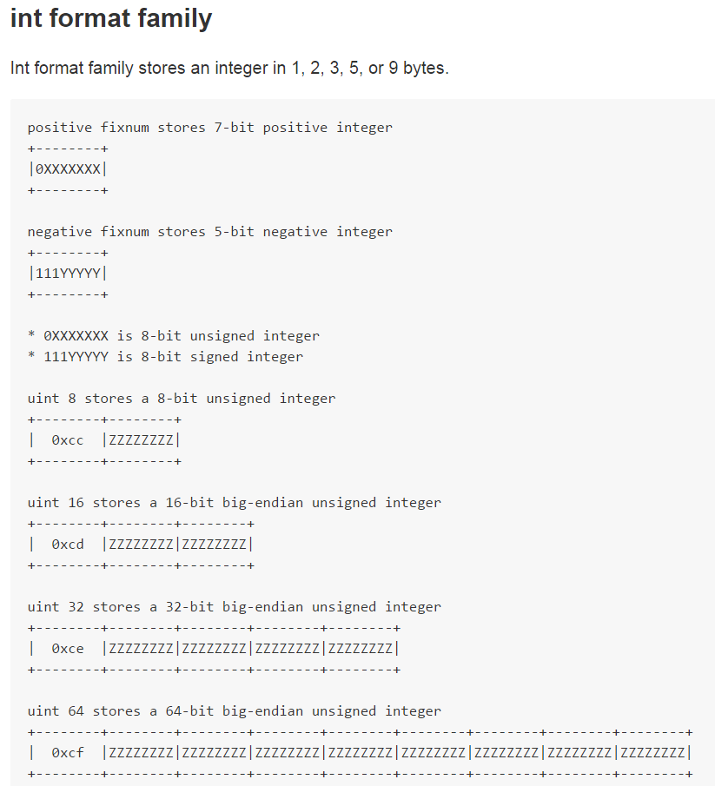
MessagePack Format
https://github.com/msgpack/msgpack/blob/master/spec.md#int-format-family
Notes:
Let's look at the integer format. MessagePack can express an integer of up to 7 bits positive and up to 5 bits negative in a single byte.
The rest of the integers up to 8 bits require 2 bytes.
Similarly, integers between 8 and 16bits require 3 bytes, between 16 and 32bits require 5 bytes, between 32 and 64 bits require 9 bytes.
The value are expressed as a big endian.

Slide 26
MessagepPack format
Notes:
Let's look at the integer format. MessagePack can express an integer of up to 7 bits positive and up to 5 bits negative in a single byte.
The rest of the integers up to 8 bits require 2 bytes.
Similarly, integers between 8 and 16bits require 3 bytes, between 16 and 32bits require 5 bytes, between 32 and 64 bits require 9 bytes.
The value are expressed as a big endian.

Slide 27
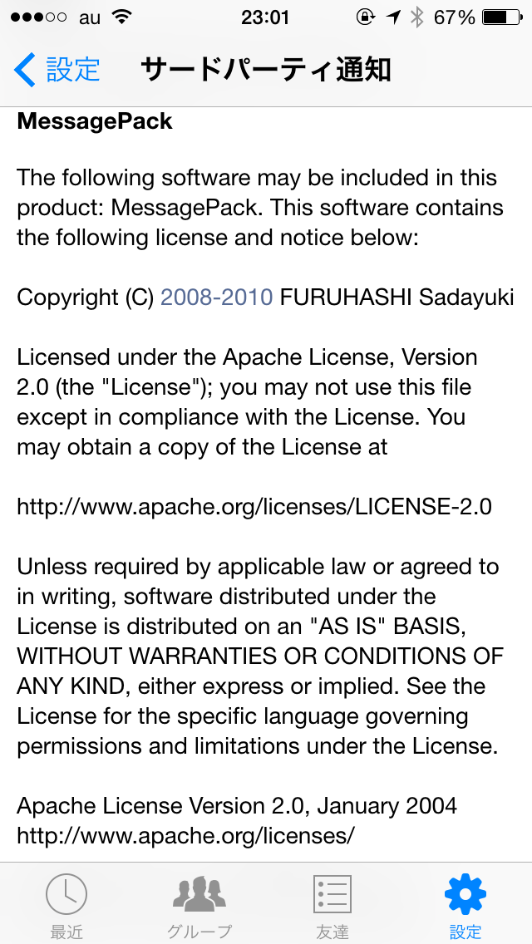
What is MessagePack?
Notes:
MessagePack is a binary data format. It's like JSON. This is an example of some JSON data and this is the equivalent MessagePack data.
MessagePack is used by redis, fluentd, Facebook Messenger, and others.

