Slide 1
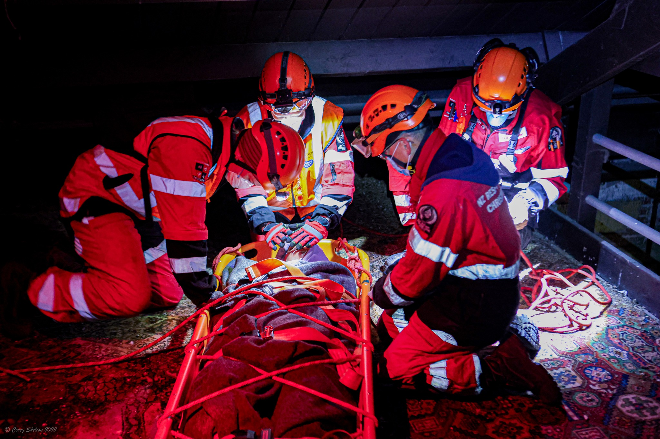

REFERENCE GUIDE
MANUAL ON KNOTS
CDEM Response Team NZ-RT11
Version 1.0

Slide 2
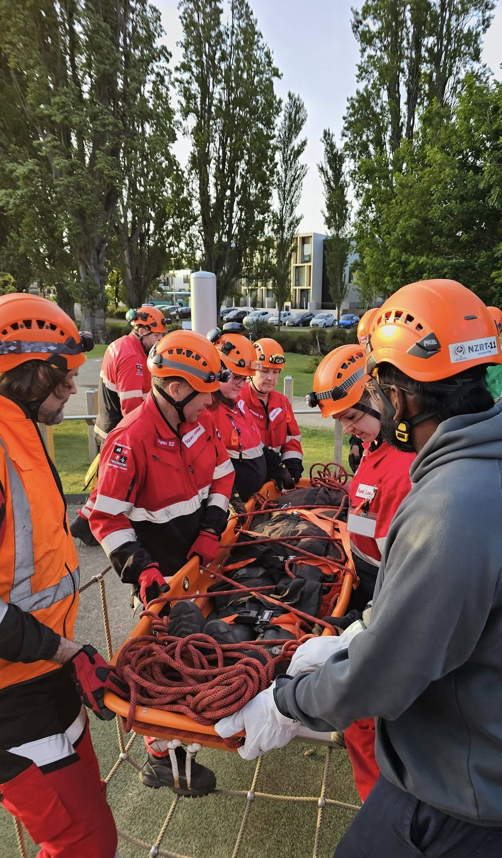



CONTENTS
Figure 8 Knot
Figure 8 (on a Bight)
Rethreaded Figure 8
Joining Figure 8
Industrial Figure 8
Round Turn & Two Half Hitches
Alpine Butterfly
Alpine Butterfly (Alternative tying Methods)
Double Fisherman’s Bend
Prussik Knot
Tape Knot
Munter Hitch
Vertical Lift Knot

Slide 3
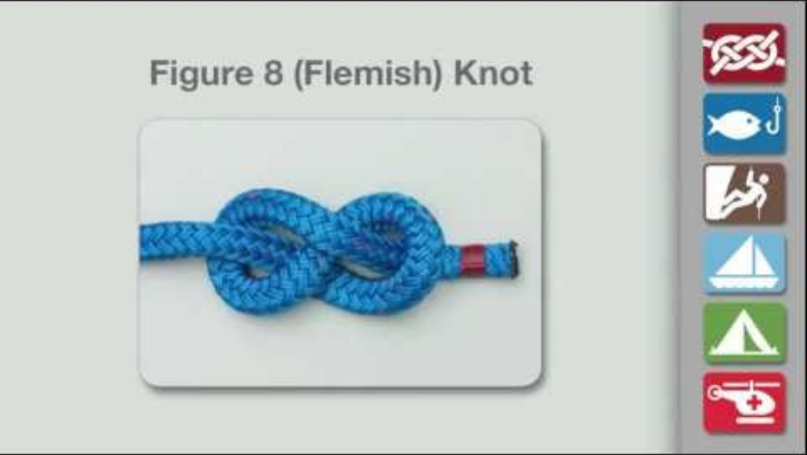

FIGURE 8 KNOT
Uses: The standard stopper and end-of-line knot in kernmantle rope. Stops a rope end running through a pulley or fraying and is the base shape every other knot in this section builds from. Easier to untie than a plain thumb knot after loading.
Cons: The Figure 8 Knot can fall undone and then has to be retied.
CDEM Response Team Applications:
  Stopper knot
  End-of-line knot
Credit: Figure 8 Knot | How to tie a Figure 8 Knot using Step-by-Step Animations | Animated Knots by Grog. (2019, May 14). Animated Knots by Grog. https://www.animatedknots.com/figure-8-knot.
CLASSIFICATION:
LOOP

Slide 4
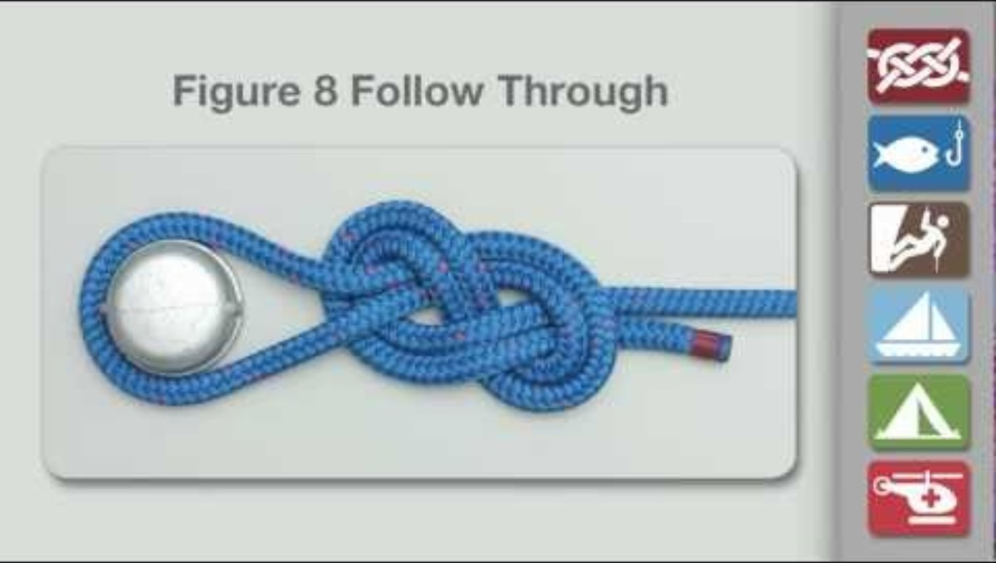
RETHREADED FIGURE 8
Uses: Forms a non-slip loop directly around an object you can't drop a pre-tied loop over — a bar, a stretcher rail, a hand-hold.
Warning: For the Animation, the knot is shown with a short tail. The tail should be at least a fist width or the length of the knot itself.
CDEM Response Team Applications:
  Tag lines.
  The end of safety lines.
  Finishing lowering lines.
CLASSIFICATION:
Credit: Figure 8 Follow Through Loop | How to tie a Figure 8 Follow Through Loop using Step-by-Step Animations | Animated Knots by Grog. (2021, April 11). Animated Knots by Grog. https://www.animatedknots.com/figure-8-follow-through-loop-knot
LOOP

Slide 5
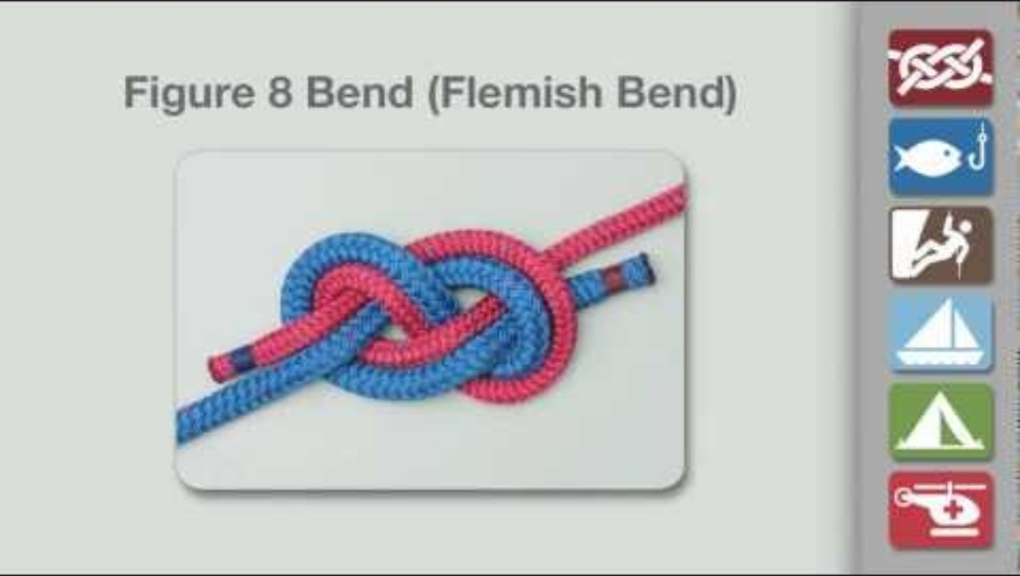
JOINING FIGURE 8
Uses: The preferred way to join two synthetic kernmantle ropes of the same diameter end to end.
Safety: For critical loads, e.g., yourself (!), the joining Figure 8, should not be used with ropes that differ much in size and for safety the ends should be longer.
Warning: For the Animation, the knot is shown with a short tail. The tail should be at least a fist width or the length of the knot itself.
Pros and Cons: The advantage of Figure 8 Bend is that even after considerable strain it remains relatively easy to undo.
CDEM Response Team Applications:
  Joining two ropes together of the same diameter.
CLASSIFICATION:
Credit: Figure 8 Bend | How to tie a Figure 8 Bend using Step-by-Step Animations | Animated Knots by Grog. (2019, May 8). Animated Knots by Grog. https://www.animatedknots.com/figure-8-bend-knot
BEND

Slide 6
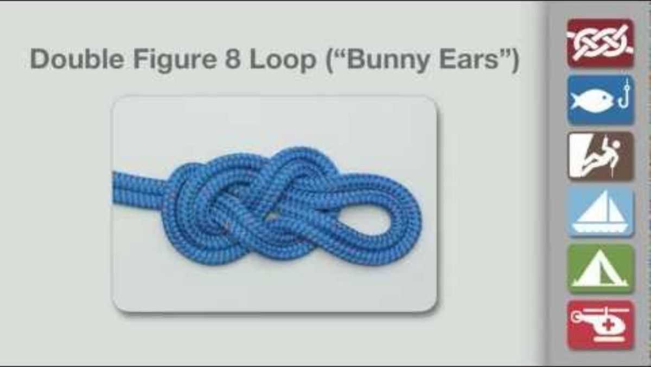
INDUSTRIAL FIGURE 8
Other Names: The Industrial Figure 8 is also known as the Double Figure 8 Loop, Bunny Ears, Anchor 8, or Dog-eared loop.
Uses: An exceptionally strong knot producing two independently adjustable loops at a rope end - each loop can be clipped to a separate anchor point.
Loop Size: In the animation the two loops have been made small. In practice they are usually much larger.
CDEM Response Team Applications:
  In conjunction with the vertical lift knot.
CLASSIFICATION:
Credit: Figure 8 Double Loop | How to tie a Figure 8 Double Loop using Step-by-Step Animations | Animated Knots by Grog. (2020, July 14). Animated Knots by Grog. https://www.animatedknots.com/figure-8-double-loop-knot
LOOP

Slide 7
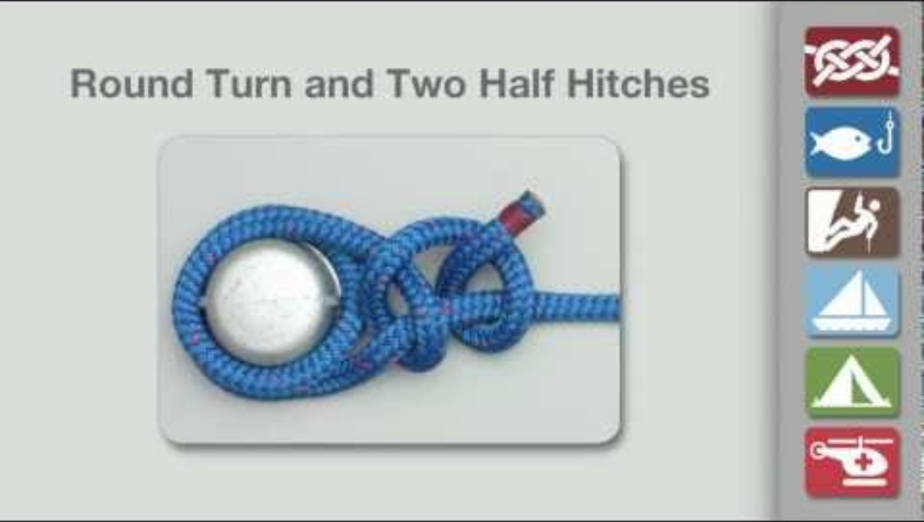
ROUND TURN AND TWO HALF HITCHES
Uses: Secures a rope's running end to a spar or ring — and, unlike most hitches, it can be tied while the line is already under tension.
  Round Turn: A round turn uses multiple passes of a line around a post to handle and control heavy loads or strain while the rest of a knot is tied.
    Two Half Hitches. The two Half Hitches actually form a clove hitch round the standing end.
Direction: Always tie the Half Hitches in the same ‘direction’. If you start the first Half Hitch with the tail passing away from you above the rope, then do the same with the next (and the next).
CDEM Response Team Applications:
  Stretcher Lashings
CLASSIFICATION:
Credit: Round Turn & Two Half Hitches | How to tie a Round Turn & Two Half Hitches using Step-by-Step Animations | Animated Knots by Grog. (2019, May 16). Animated Knots by Grog. https://www.animatedknots.com/round-turn-two-half-hitches-knot
HITCH

Slide 8
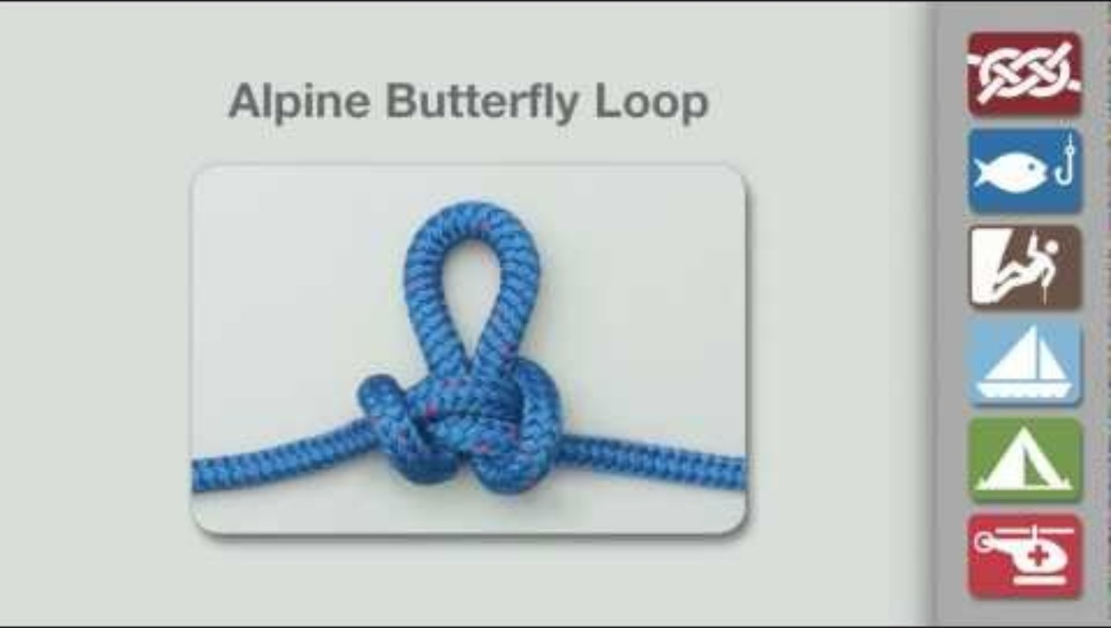
ALPINE BUTTERFLY
Uses: A strong, locked loop tied anywhere along the length of a rope — not just at the ends. Holds well when loaded from either direction.
Tying it: There are several methods for tying the Alpine Butterfly Loop.
Advantages: The Alpine Butterfly spreads load evenly on its two legs, allowing the isolation of the rope within the loop.
CDEM Response Team Applications:
  Roofing Systems.
CLASSIFICATION:
Credit: Alpine Butterfly Loop | How to tie a Alpine Butterfly Loop using Step-by-Step Animations | Animated Knots by Grog. (2019, October 10). Animated Knots by Grog. https://www.animatedknots.com/alpine-butterfly-loop-knot
LOOP

Slide 9
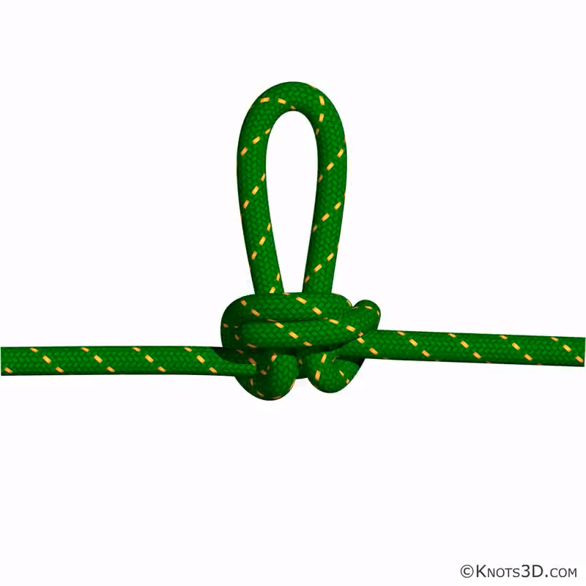
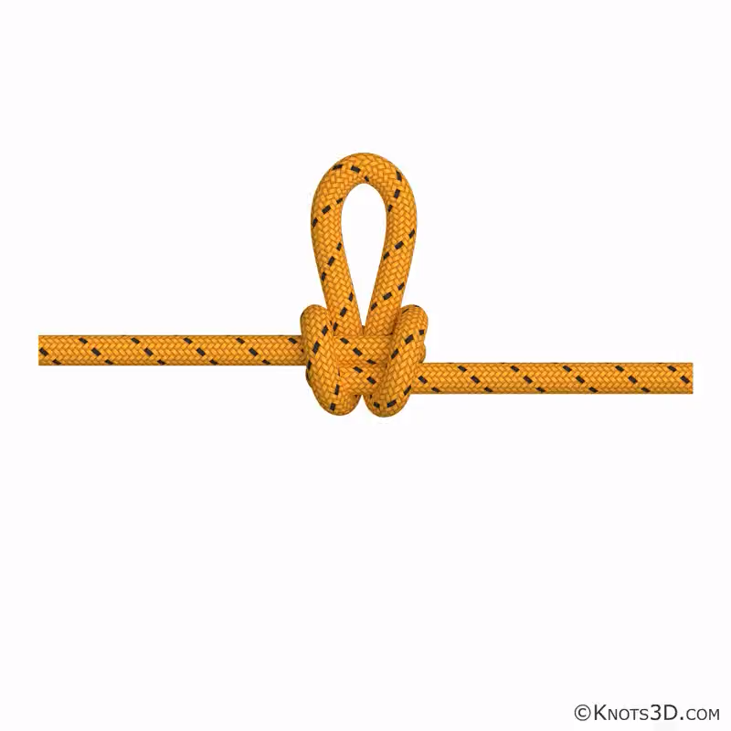
ALPINE BUTTERFLY
Credit: Alpine Butterfly. (N.D.). Nynix llc. https://knots3d.Com/en/alpine-butterfly-knot
Credit: Alpine Butterfly (Hand Method). (N.D.). Nynix llc. https://knots3d.com/en/alpine-butterfly-hand-method-knot

Slide 10
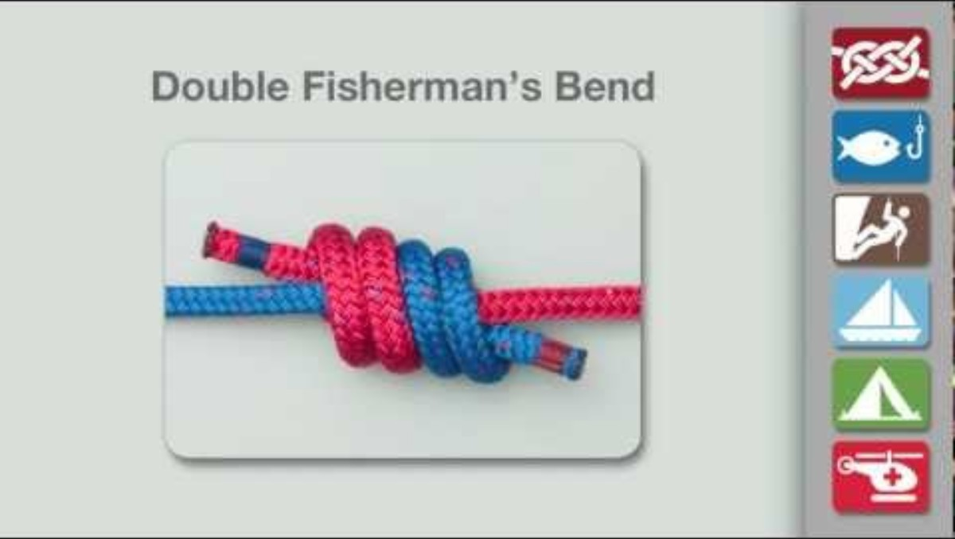
DOUBLE FISHERMANS
Uses: The go-to knot for joining two rope ends permanently into a loop — most often used to close a Prusik sling. Very strong, but hard to untie once loaded.
Pros: The Double Fisherman’s is a well known, reliable, compact knot suitable for use when retrieving an abseil.
Cons: The Double Fisherman can lock up so tightly that it is effectively welded.
Warning: For the Animation, the ends were left short. For critical loads, the ends must be left much longer.
CDEM Response Team Applications:
  Tying two lengths of rope together
CLASSIFICATION:
Credit: Double Fisherman’s Bend | How to tie a Double Fisherman’s Bend using Step-by-Step Animations | Animated Knots by Grog. (2019, May 8). Animated Knots by Grog. https://www.animatedknots.com/double-fishermans-bend-knot
BEND

Slide 11
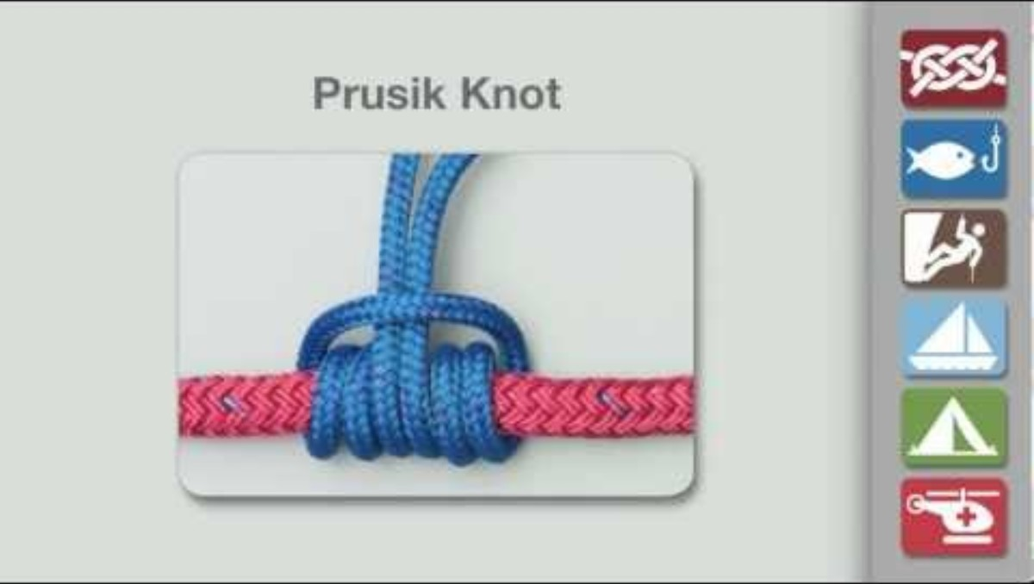
PRUSIK
KNOT
Uses: Attaches a cord sling to a rope as an adjustable friction grip — slides freely under no load, and locks under load. The cord must be at least 3mm smaller in diameter than the main rope for it to work.
Making Prusik Loops: Prusik loops may be constructed by joining together the two ends of an accessory cord (5 or 6 mm) using a Double Fisherman’s Bend.
Warning: Must never be shock loaded.
CDEM Response Team Applications:
  …. Abseiling?
CLASSIFICATION:
Credit: Prusik Knot | How to tie a Prusik Knot using Step-by-Step Animations | Animated Knots by Grog. (2019, May 16). Animated Knots by Grog. https://www.animatedknots.com/prusik-knot
LOOP

Slide 12
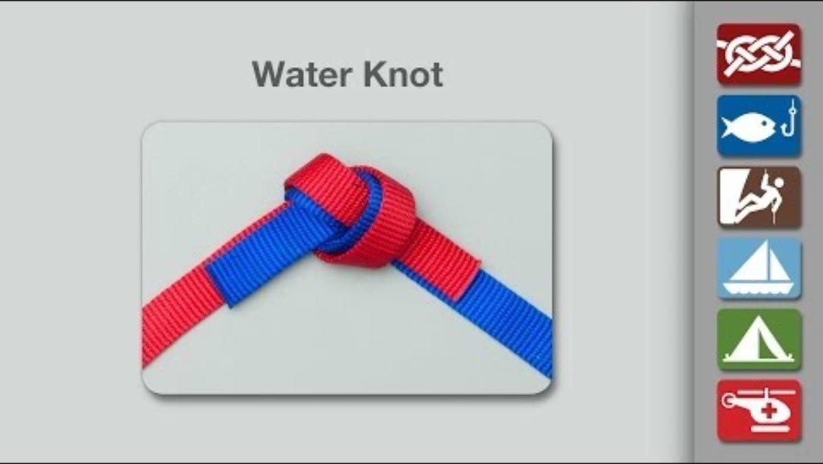
TAPE
KNOT
Other Names: The Tape Knot is also known by various other names including: Water Knot, Ring Bend, Grass Knot, and Overhand Follow-Through.
Uses: Joins two pieces of webbing strapping by re-threading.
Warning: For the Animation, the ends were left short. For critical loads, the ends must be left much longer.
CDEM Response Team Applications:
  Anchors
CLASSIFICATION:
Credit: Water Knot | How to tie a Water Knot using Step-by-Step Animations | Animated Knots by Grog. (2019, May 9). Animated Knots by Grog. https://www.animatedknots.com/water-knot
BEND

Slide 13
MUNTER HITCH
Uses: Creates controllable friction directly on a karabiner for lowering or raising a line - no separate belay device needed.
Requirements: Use a carabiner large enough to allow the Munter Hitch Knot to be inverted through the carabiner when pulled.
Advantages: The greatest advantage of the Munter is that it can be used with minimum equipment – just a locking carabiner.
Disadvantages: The Munter Hitch Knot kinks the rope, imparts a twist to it during descent, and also makes the rope fuzzy if used often.
CDEM Response Team Applications:
  Roofing Systems
CLASSIFICATION:
Credit: Munter Hitch. (N.D.). Nynix llc. https://knots3d.com/en/munter-hitch-knot
HITCH

Slide 14
VERTICAL LIFT KNOT
Uses: A full-body harness tied directly into the bight of a rope — no hardware, no ends used — for raising or lowering a casualty in a vertical shaft. Originally developed for sewer rescues. Because it's tied in the bight, both rope ends stay free to haul on and to keep the casualty centred, and there's no free knot that can slip undone.
Warning: Ropes must not cross between the legs. Both sides must be tied the same way — don't mix tying methods. Limited to walking-wounded casualties: this rig gives little protection and can worsen injuries.
CDEM Response Team Applications:
  Improvised harness
How to tie it
Take the bight of the rope behind the casualty's neck, run it down their front, between their legs (front to rear), then back up their sides to the front and over the shoulders — running ends nearer the arms.
On each side, pass a loop of the running end under the first rope so the casualty's arm can go through the loop.
Adjust the ropes and padding on both sides, starting at the neck, so the fit is secure and even.
Tie a figure 8 on a bight, using both ropes together, behind the casualty's neck to complete the knot.
Attach the lowering line to the tails with a rethreaded figure 8. Spare tail can be used as guide-lines or secured out of the way.
CLASSIFICATION:
RESCUE

Slide 15
SOURCES AND DOCUMENT INFORMATION
SOURCES & REFERENCES
VERSION HISTORY
Animated Knots by Grog — animatedknots.com (step photos & video demonstrations)
Knots3D by Nynix LLC — knots3d.com (3D reference renders)
Cover photograph © Corey Shelton, 2023 — NZ-RT11 field training exercise
Ver. | Date | Notes
1.0 | 25 Sep 2026 | First version finalised.
DOCUMENT METADATA
Owner
CDEM Response Team NZ-RT11
This is provided for training reference. Always practice new knots under supervision before relying on them in live rope-rescue operations.
Parent Agency
National Emergency Management Agency (NEMA)
Created
September 25, 2026
Current Version
1.0
Review Cycle
Annual, or after major content changes
MANUAL ON KNOTS — CDEM RESPONSE TEAM NZ-RT11

