Slide 1
Workplace Strategy Decision Deck
Leadership evaluation of remote and hybrid options

Slide 2
Key Project Parameters and Constraints
30 people
Team Size
Total headcount affected by the decision
2026-11-15
Decision Deadline
Date by which leadership must choose
The evaluation encompasses a team of 30 people.
A final decision is required by November 15, 2026.
Notes:
We are evaluating our workplace strategy for our 30-person team with a decision needed by November 15, 2026.

Slide 3
Option Costs Vary from $9,500 to $24,000
Option B (fully remote) is the lowest cost at $9,500.
Option C (office only) is the highest cost at $24,000.
Option A (hybrid) costs $18,000.
Internal project estimates
Notes:
Here we see the cost breakdown across the three options, ranging from $9,500 for fully remote up to $24,000 for office only.

Slide 4
Comprehensive Comparison of All Three Options
Option | Description | Cost | Timeline | Risk
Option A | Hybrid, 3 office days | $18,000 | 12 weeks | Low
Option B | Fully remote | $9,500 | 12 weeks | Medium
Option C | Office only | $24,000 | 12 weeks | Low
All options share the same 12-week timeline.
Option B carries a medium risk while A and C have low risk.
Notes:
Comparing all three options side by side shows identical 12-week timelines, varying costs, and risks ranging from low to medium.

Slide 5
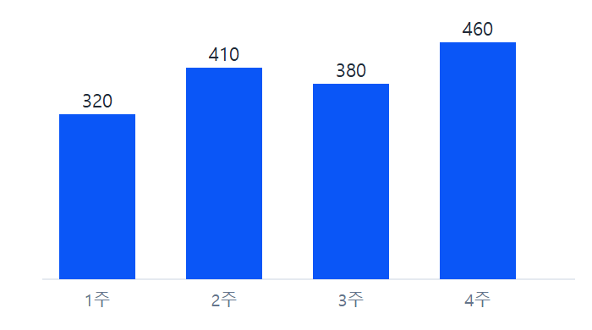
Operational Workflow and Weekly Processing Volume
Reviewing weekly processing volume to support the decision.
Operational context for the 30-person team.
Weekly processing volume overview
Notes:
This visual outlines our weekly processing volume to help inform the leadership decision.

Slide 6
Recommendation and Next Steps for Leadership
Review the cost, risk, and timeline trade-offs for the 30-person team.
Select between Option A, Option B, and Option C before the deadline.
Finalize the choice no later than 2026-11-15.
Notes:
Leadership should review these details and select an option before our November 15, 2026 deadline.

