Slide 1
Workplace Strategy Decision Deck
Leadership briefing for team size of 30 people and 2026-11-15 decision deadline

Slide 2
Key Figures for the Workplace Strategy Decision
30
Team Size
Total team members affected
2026-11-15
Decision Deadline
Required date for final choice
Overview of the team size and decision timeline.
Key parameters guiding the evaluation of all options.
Notes:
Here are the key figures for our decision, including our team size of 30 people and the requirement to reach a decision by November 15, 2026.

Slide 3
Option Costs Comparison
Visualizing the financial investment required for each strategy.
Option B has the lowest cost while Option C is the highest.
Provided option costs
Notes:
This chart displays the cost for each of the three options, ranging from $9,500 for Option B up to $24,000 for Option C.

Slide 4
Comprehensive Comparison of All Options
Option | Cost | Timeline | Risk
Option A (hybrid, 3 office days) | $18,000 | 12 weeks | Low
Option B (fully remote) | $9,500 | 12 weeks | Medium
Option C (office only) | $24,000 | 12 weeks | Low
Comparing costs, timelines, and risk levels side by side.
All options share the same 12-week duration.
Notes:
This table compares the three choices across cost, timeline, and risk. All options take 12 weeks, but they vary in cost and risk level.

Slide 5
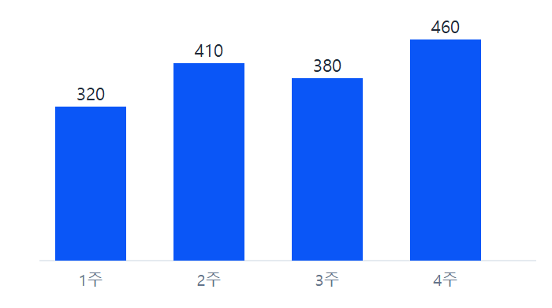
Weekly Processing Count Reference
Reference visual provided for context.
Shows the weekly processing counts.
주간 처리 건수 막대그래프
Notes:
This slide includes the reference image provided for the presentation, labeled as 주간 처리 건수 막대그래프.

Slide 6
Summary and Next Steps for Leadership
Evaluate Option A for a balanced hybrid approach with low risk.
Consider Option B for the lowest cost with medium risk.
Review Option C if an office-only environment is preferred despite higher cost.
Finalize the decision before November 15, 2026.
Notes:
To summarize, leadership must weigh the costs, risks, and work models of Option A, Option B, and Option C before the November 15, 2026 deadline.

