Slide 1
Workplace Strategy Decision Deck
Evaluation of options for leadership review

Slide 2
Key Project Parameters for the Decision
30
Team Size
Total team members
2026-11-15
Decision Date
Deadline for choice
The team size is established at 30 people.
A final decision is required by November 15, 2026.
Notes:
We are evaluating the workplace strategy for our team of 30 people. Leadership needs to make and finalize this decision by November 15, 2026.

Slide 3
Cost Comparison Across the Three Options
Option B is the lowest cost at $9,500.
Option C is the highest cost at $24,000.
Internal project budget estimates
Notes:
This chart compares the financial costs of the three alternatives. Option B requires $9,500, Option A requires $18,000, and Option C requires $24,000.

Slide 4
Comprehensive Option Comparison Matrix
Option | Cost | Duration | Risk
Option A (hybrid, 3 office days) | $18,000 | 12 weeks | Low
Option B (fully remote) | $9,500 | 12 weeks | Medium
Option C (office only) | $24,000 | 12 weeks | Low
All options share a duration of 12 weeks.
Risk levels vary between Low and Medium.
Notes:
The comparison table lays out cost, duration, and risk side by side. Every option spans 12 weeks, while risks and costs differ.

Slide 5
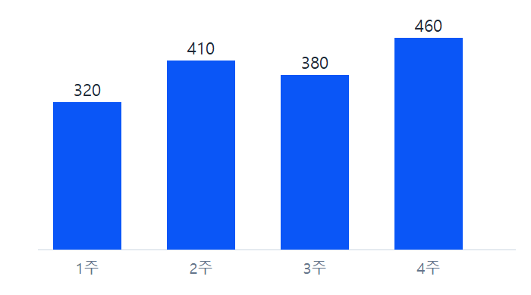
Weekly Processing Volume Overview
Reference data visualization for workflow considerations.
주간 처리 건수 막대그래프
Notes:
This slide displays the weekly processing volume bar chart to provide additional operational context for the review.

Slide 6
Summary of Findings and Next Steps
Option B offers the lowest cost at $9,500 with medium risk.
Options A and C carry low risk but higher costs of $18,000 and $24,000 respectively.
All three alternatives run for a duration of 12 weeks.
Leadership must select an approach for the 30-person team before November 15, 2026.
Notes:
To summarize, we have three viable paths for our 30-person team, all lasting 12 weeks. Leadership should weigh the cost savings of Option B against its medium risk, or choose the low-risk profiles of Options A and C before the November 15, 2026 deadline.

