Slide 1
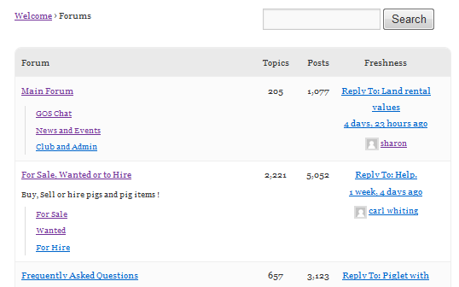
1
5
4
17
3
3
3
2
3
3
5
6
9
13
14
1
7
11
10
8
1
12
2
15

Slide 2
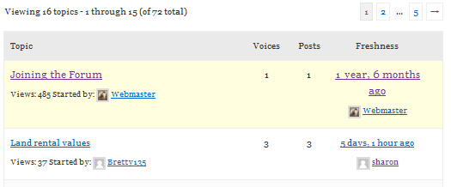


2
21
2
2
2
12
10
11
1
13
13
13
13
15
3
4
9
2
2
20
8
21
14
17
7
18
19
5
6
7
16
6
22

Slide 3
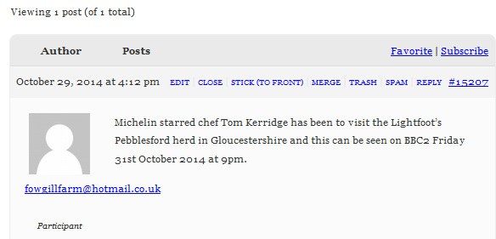


This box is styled in Topics Index 10, 11 & 12
10
10
5
2
11
17
18
8
19
16
6
23
1
7
15
3
9
12
4
13
14
21
22
20

Slide 4


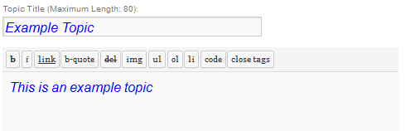
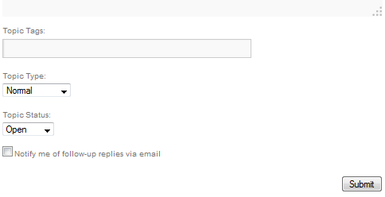
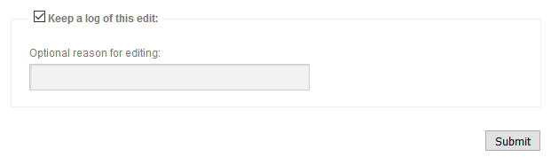
10
12
16
1
3
2
4
2
9
3
2
1
3
18
11
2
1
1
6
1
7
8
5

Slide 5

19
20
21

Slide 6
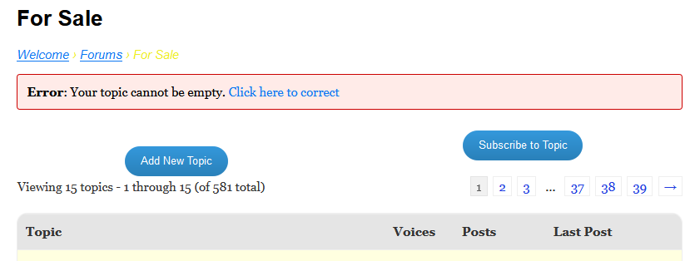
17

Slide 7
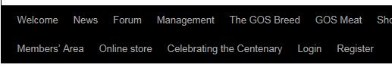


Slide 8
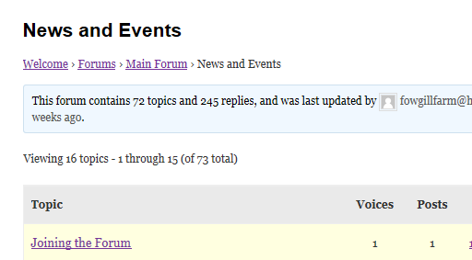
Home
Root
Current
Breadcrumbs

Slide 9
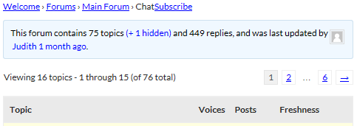


Slide 10
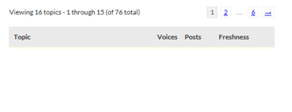

Slide 11




Slide 12

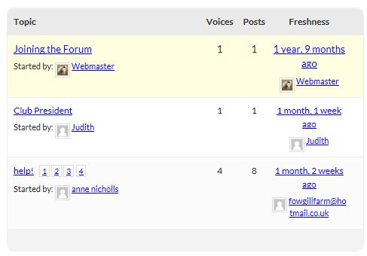

Slide 13
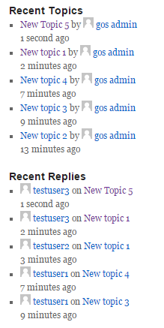
Original topic author always shown
Repeated topics for multiple replies

Slide 14


Slide 16

1
2
3
4
5
3
6
7
8

Slide 17
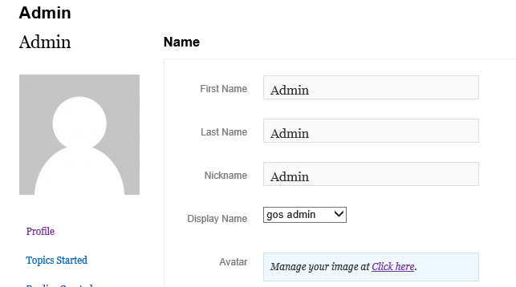
1
2
4
3
The url this links to

Slide 18
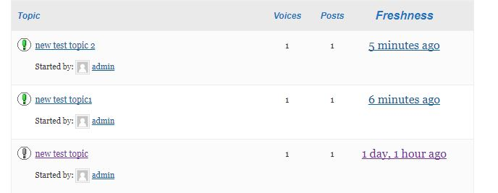
1
2

Slide 19
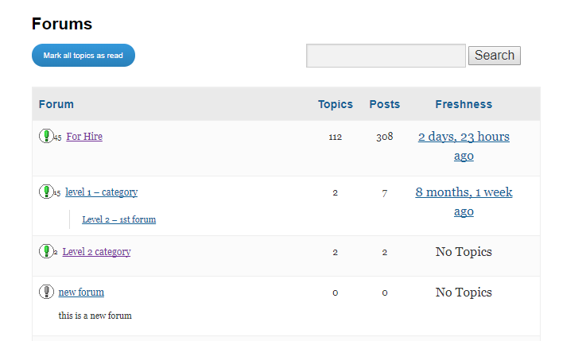
4
3
1
2

Slide 20
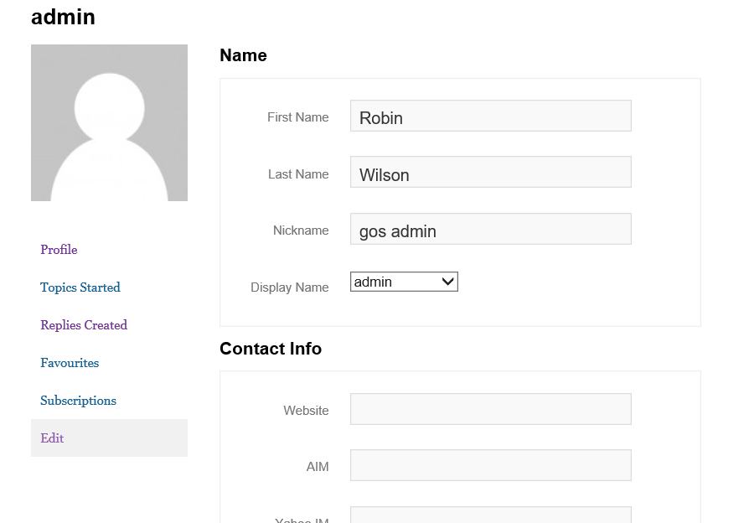
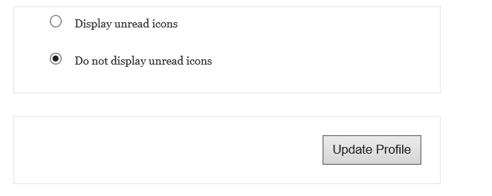
5

Slide 21
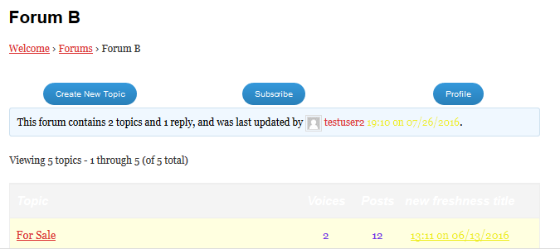

Slide 22
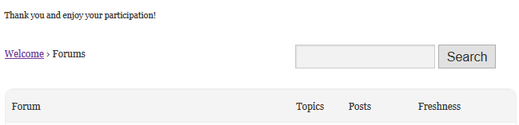


Slide 23


Slide 24


1
2
4
5
3
6
7

Slide 25
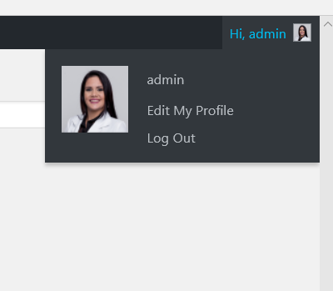
6

Slide 26
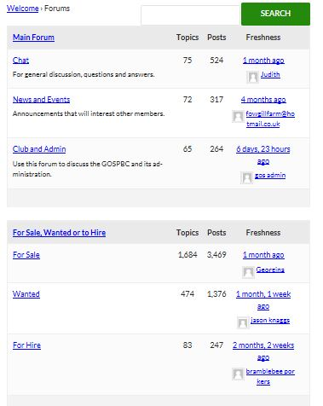
Category
Forums with
above category as parent

Slide 27
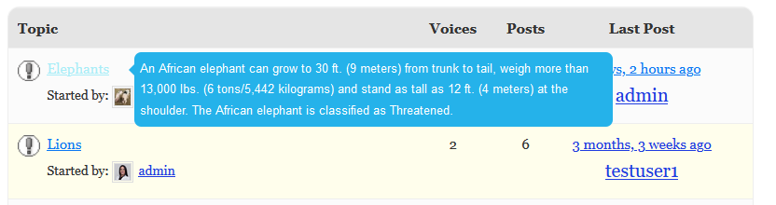
Cursor hover on title
Topic content appears

Slide 28
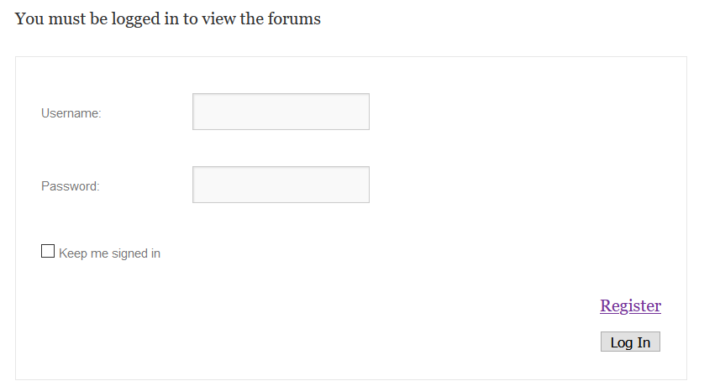
Message
Not Logged in
Logged in

Slide 29
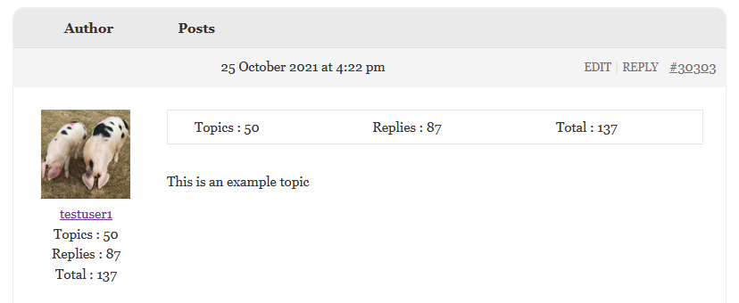
In Reply Content
In Author Details

Slide 30
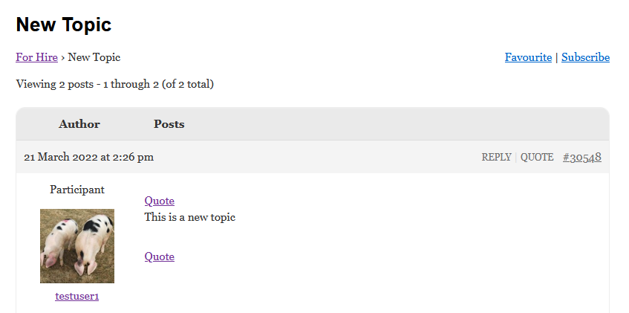
2
2
2

Slide 31

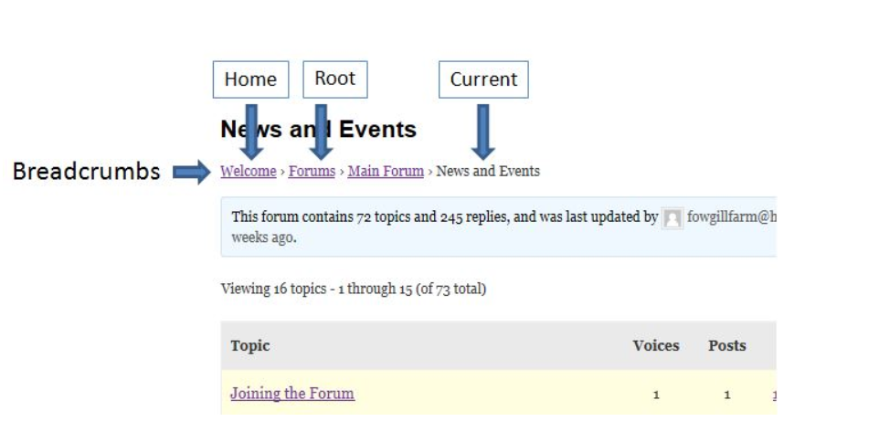
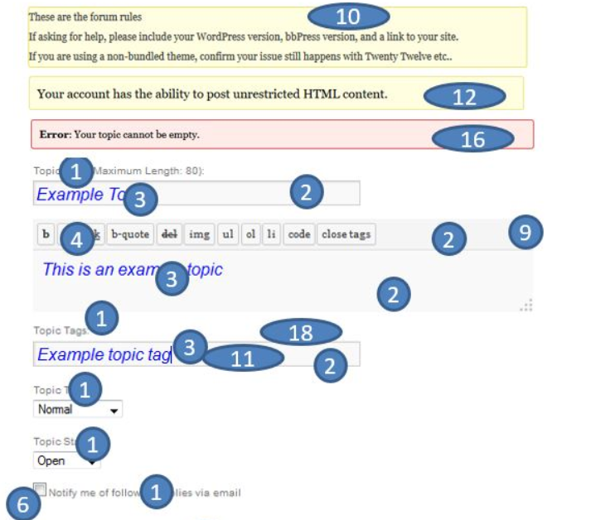
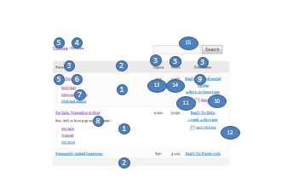
Style bbPress easily
Add lots of useful features
Change the look and feel of bbPress

Slide 32

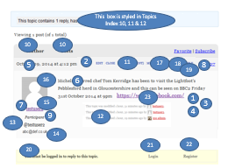
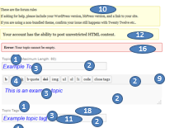

Style bbPress easily
Add lots of useful features
Change the look and feel of bbPress
This is the one for the 722*250 jpg
I’ve also saved it as the bigger one
This is the 128 logo
This is the 256 logo

Slide 33
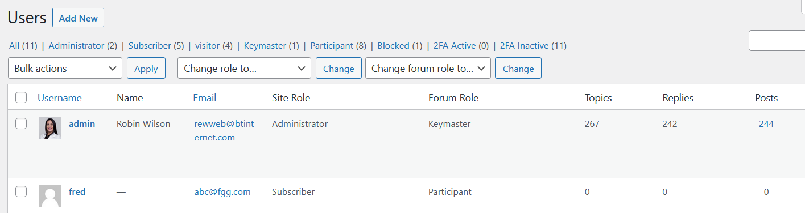


Slide 34
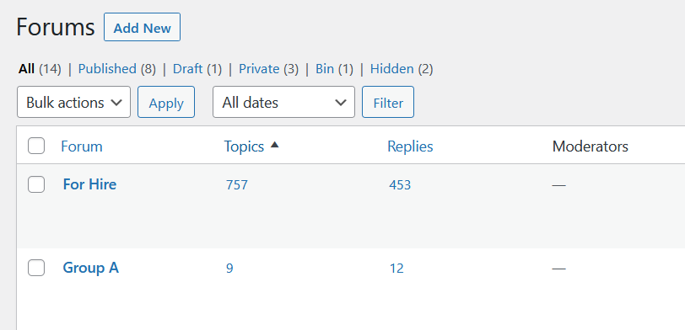

1
2

Slide 35
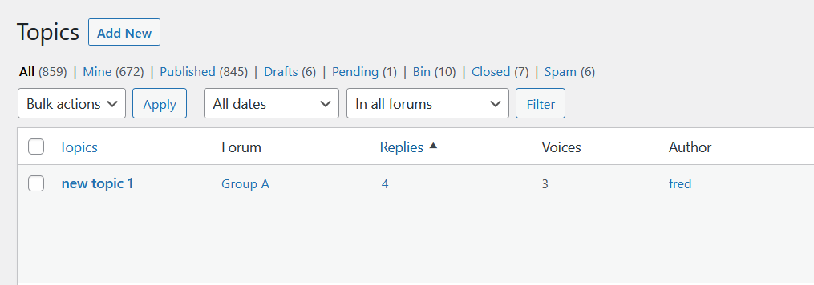

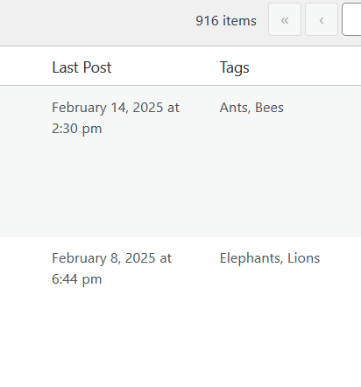
3
5
4
Snip tool used to copy and paste to next page

Slide 36
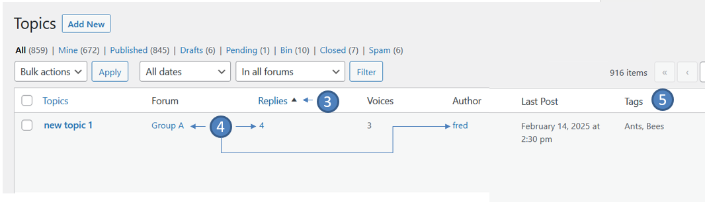
5
Copied from previous slide

Slide 37
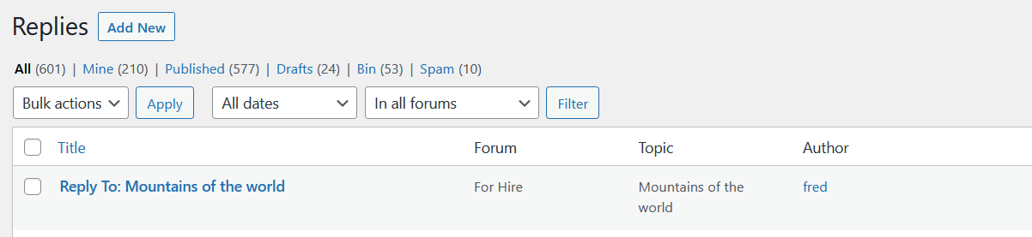
6

Slide 38
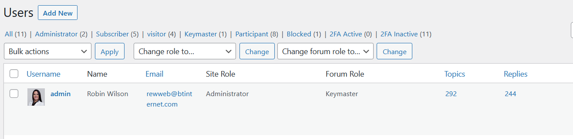

7
8
9

Slide 39
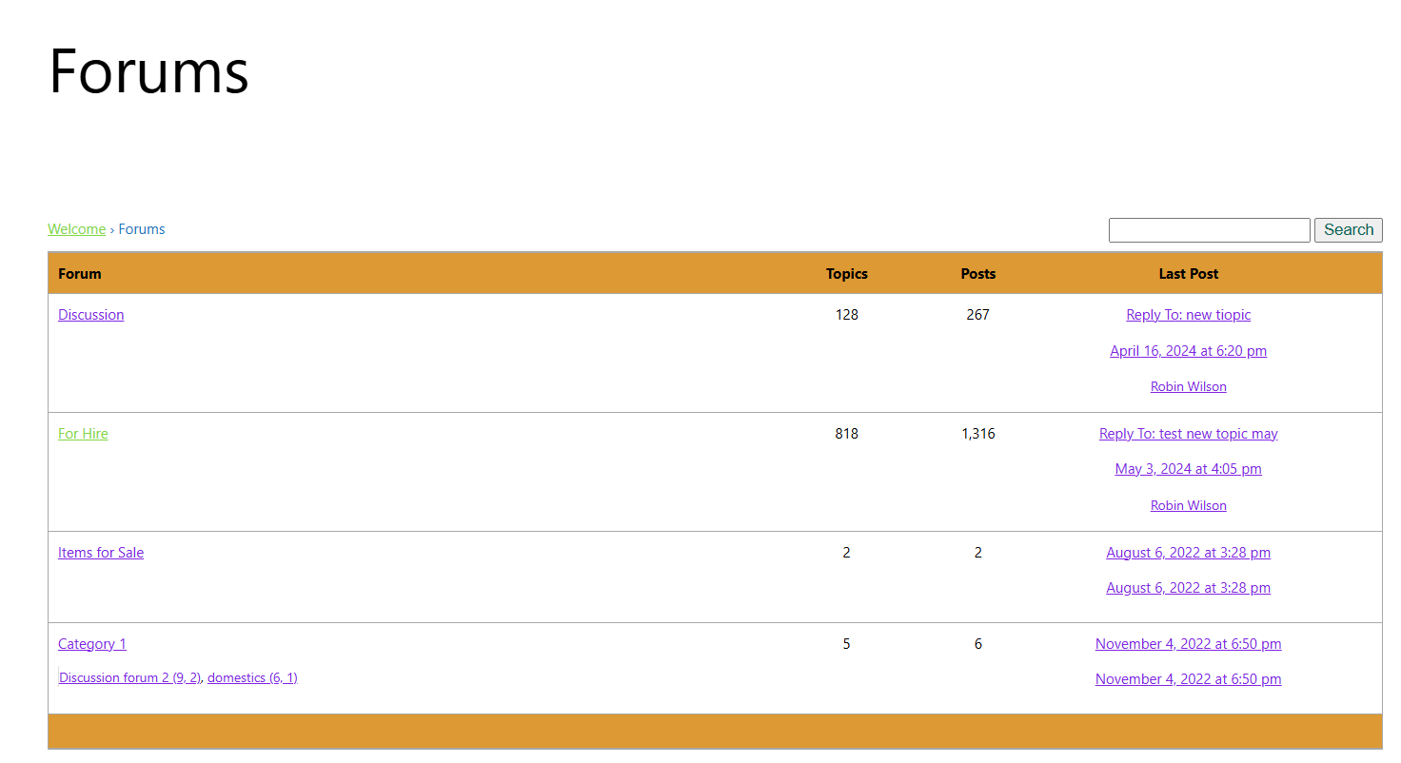

Slide 40
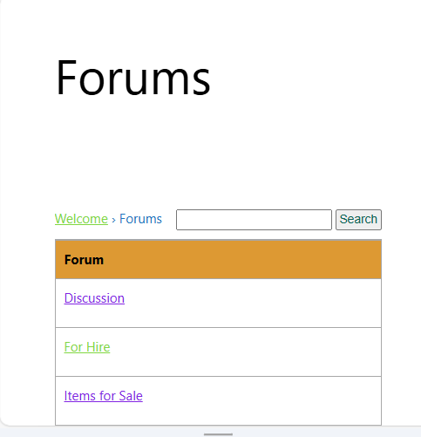

Slide 41
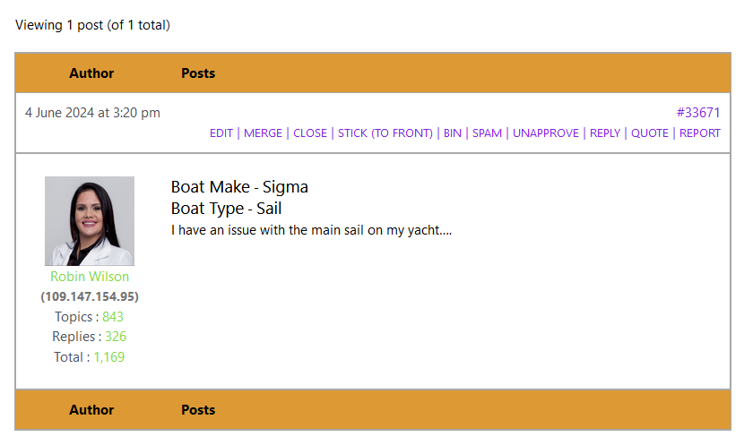


Slide 42
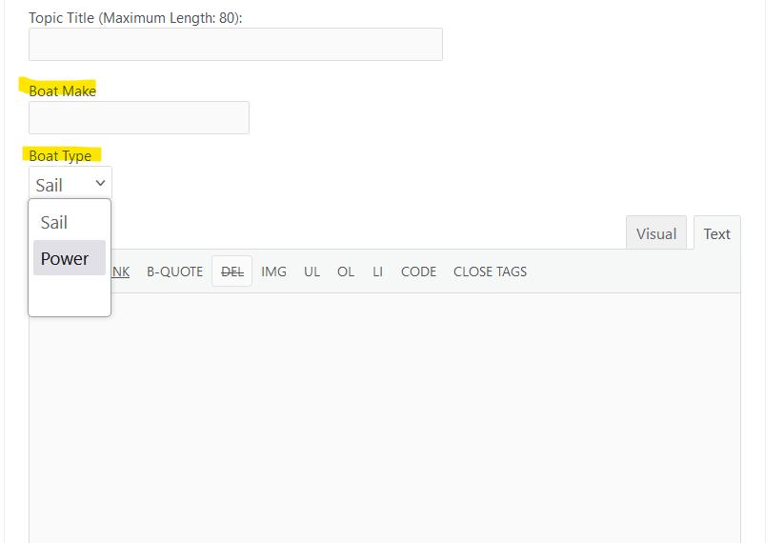


Slide 43

Example:

