Slide 1
Event Driven Programming
Joseph Darwin Co

Slide 2
User Input
Python allows for user input.
That means we are able to ask
the user for input.
username = input("Enter username:")
print("Username is: " + username)

Slide 3
List
Lists are used to store multiple items in a single variable.
Lists are one of 4 built-in data types in Python used to store collections of data, the other 3 are Tuple, Set, and Dictionary, all with different qualities and usage.
Lists are created using square brackets:

Slide 4

List

Slide 5

List Items
List items are ordered, changeable, and allow duplicate values.
List items are indexed, the first item
has index [0], the second item
has index [1], etc.
Since lists are indexed, lists can have items with the same value

Slide 6

List Length
To determine how many items a list has, use the len() function:

Slide 7
List Items - Data Types
List items can be of any data type:
list1 = ["Abaddon", "Faceless Void", "Rylai"]
list2 = [1, 5, 7, 9, 3]
list3 = [True, False, False]
list4 = ["abc", 34, True, 40, "male"]

Slide 8

type()
From Python's perspective, lists are defined as objects with the data type 'list’:

Slide 9
The list() Constructor
It is also possible to use the list() constructor when creating a new list.

Slide 10
Python Collections (Arrays)
There are four collection data types in the Python programming language:
List is a collection which is ordered and changeable. Allows duplicate members.
Tuple is a collection which is ordered and unchangeable. Allows duplicate members.
Set is a collection which is unordered, unchangeable, and unindexed. No duplicate members.
Dictionary is a collection which is ordered and changeable. No duplicate members.

Slide 11

Tuple
Tuples are used to store multiple items in a single variable.

Slide 12

Set
Sets are used to store multiple items in a single variable.

Slide 13
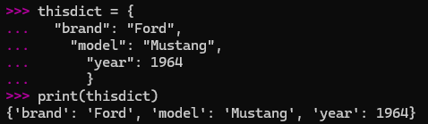
Python Dictionaries
Dictionaries are used to store data values in key:value pairs.

Slide 14
If ... Else
An "if statement" is written by using the if keyword. Remember to indent!
a = 33
b = 200
if b > a:
print("b is greater than a")

Slide 15
Elif
a = 33
b = 33
if b > a:
print("b is greater than a")
elif a == b:
print("a and b are equal")

Slide 16
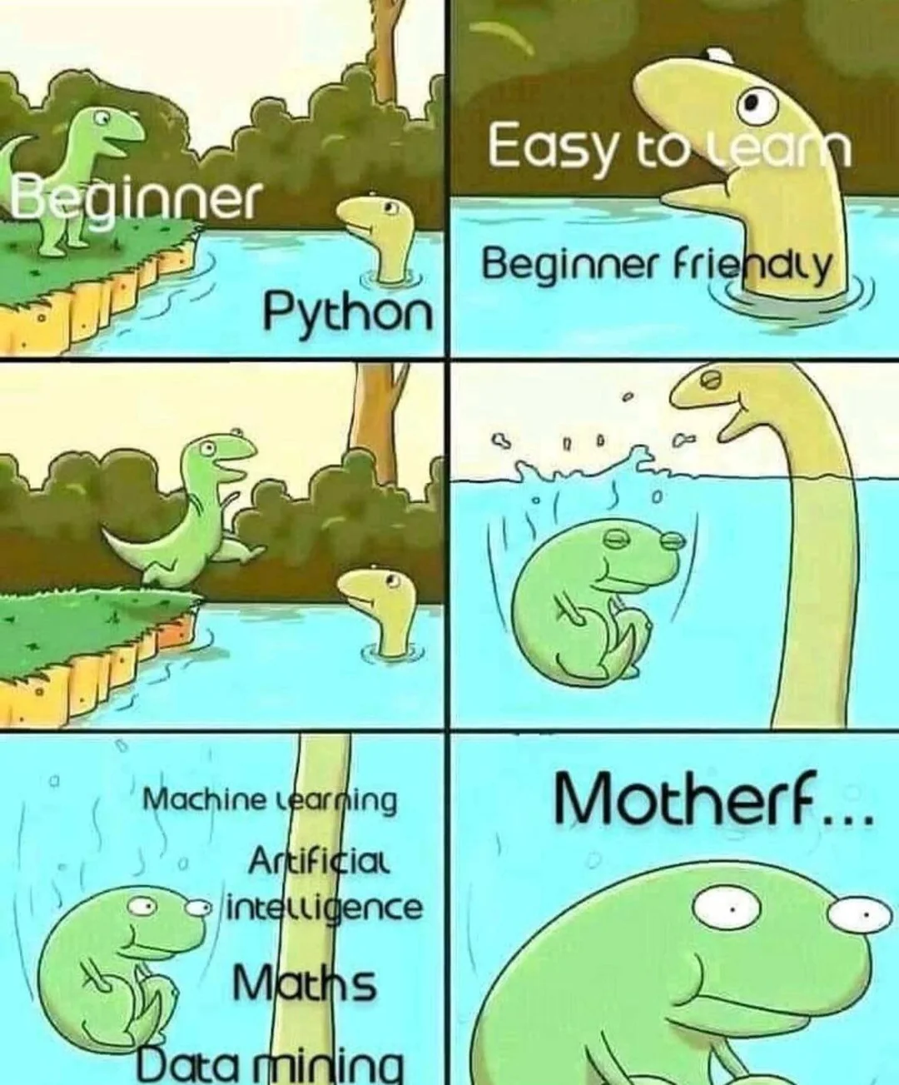
Else
a = 200
b = 33
if b > a:
print("b is greater than a")
elif a == b:
print("a and b are equal")
else:
print("a is greater than b")

Slide 17
Short Hand If
if a > b: print("a is greater than b")
a = 2
b = 330
print("A") if a > b else print("B")

Slide 18
Python Loops
Python has two primitive loop commands:
while loops
for loops

Slide 19
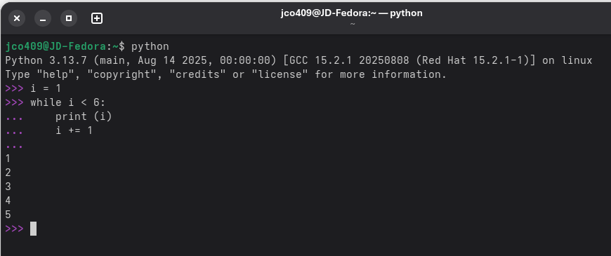
The While Loop

Slide 20
Break
i = 1
while i < 6:
print(i)
if i == 3:
break
i += 1

Slide 21
Continue
i = 0
while i < 6:
i += 1
if i == 3:
continue
print(i)

Slide 22
The else Statement
i = 1
while i < 6:
print(i)
i += 1
else:
print("i is no longer less than 6")

Slide 23
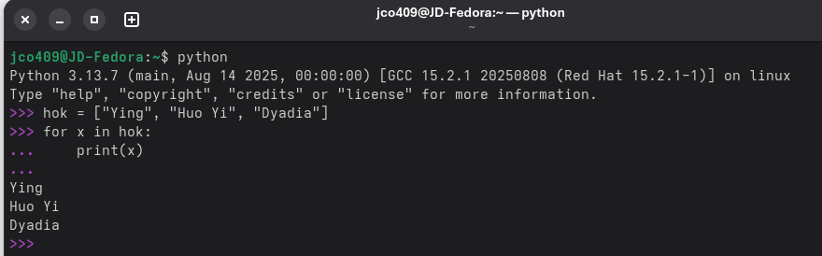
For Loop

Slide 24
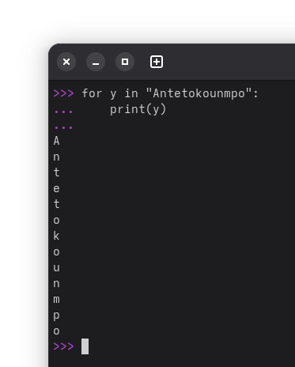
Looping through a String
for x in "Antetokounmpo":
print(x)

Slide 25
The break Statement
fruits = ["apple", "banana", "cherry"]
for x in fruits:
print(x)
if x == "banana":
break

Slide 26
The break Statement
fruits = ["apple", "banana", "cherry"]
for x in fruits:
if x == "banana":
break
print(x)

Slide 27
The continue Statement
fruits = ["apple", "banana", "cherry"]
for x in fruits:
if x == "banana":
continue
print(x)

Slide 28
Else in For Loop
for x in range(10):
print(x)
else:
print("Finally finished!")

Slide 29
Nested Loops
adj = ["red", "big", "tasty"]
fruits = ["apple", "banana", "cherry"]
for x in adj:
for y in fruits:
print(x, y)

Slide 30
The pass Statement
for loops cannot be empty, but if you for some reason have a for loop with no content, put in the pass statement to avoid getting an error.
for x in [0, 1, 2]:
pass

Slide 31
String Format
We cannot combine strings and numbers.
But we can combine strings and numbers by using f-strings or the format() method.

Slide 32
F-Strings
F-Strings or formatted string literals was introduced in Python 3.6, and is now the preferred way of formatting strings.
To specify a string as an f-string, put an f in front of the string literal, and add curly brackets {} as placeholders for variables and other operations.

Slide 33
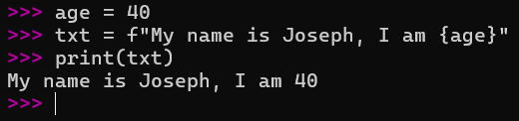
F-Strings
age = 40
txt = f"My name is Joseph, I am {age}"
print(txt)

Slide 34
Placeholders and Modifiers
A placeholder can contain variables, operations, functions, and modifiers to format the value.
price = 59
txt = f"The price is {price} dollars"
print(txt)

Slide 35
Placeholders and Modifiers
A placeholder can include a modifier to format the value.
A modifier is included by adding a colon : followed by a legal formatting type, like .2f which means fixed point number with 2 decimals:

Slide 36
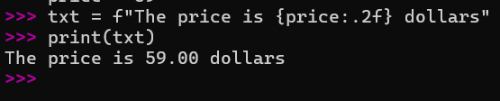
Placeholders and Modifiers
price = 59
txt = f"The price is {price:.2f} dollars"
print(txt)

Slide 37

A placeholder can contain Python code, like math operations
txt = f"The price is {49 * 58} dollars"
print(txt)

Slide 38
Lambda
A lambda function is a small anonymous function.
A lambda function can take any number of arguments, but can only have one expression.

Slide 39

Lambda
x = lambda a : a + 10
print(x(5))

Slide 40
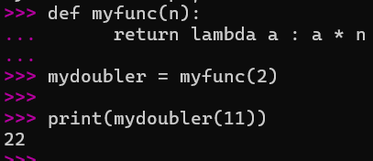
Lambda
def myfunc(n):
return lambda a : a * n
mydoubler = myfunc(2)
print(mydoubler(11))

Slide 41
Python Classes/Objects
Python is an object oriented programming language.
Almost everything in Python is an object, with its properties and methods.
A Class is like an object constructor, or a "blueprint" for creating objects.

Slide 42
Create a Class and object
class MyClass:
x = 5
p1 = MyClass()
print(p1.x)

Slide 43
The __init__() Function
To understand the meaning of classes we have to understand the built-in __init__() function.
All classes have a function called __init__(), which is always executed when the class is being initiated.
Use the __init__() function to assign values to object properties, or other operations that are necessary to do when the object is being created:

Slide 44
The __init__() Function
class Person:
def __init__(self, name, age):
self.name = name
self.age = age
p1 = Person("Joseph", 40)
print(p1.name)
print(p1.age)

Slide 45
The __str__() Function
The __str__() function controls what should be returned when the class object is represented as a string.
If the __str__() function is not set, the string representation of the object is returned:

Slide 46
The __str__() Function
class Person:
def __init__(self, name, age):
self.name = name
self.age = age
def __str__(self):
return f"{self.name}({self.age})"
p1 = Person("Joseph", 40)
print(p1)

Slide 47
Object Methods
Objects can also contain methods. Methods in objects are functions that belong to the object.

Slide 48
Object Methods
class Person:
def __init__(self, name, age):
self.name = name
self.age = age
def myfunc(self):
print("Hello my name is " + self.name)
p1 = Person("Joseph", 40)
p1.myfunc()

Slide 49
The self Parameter
The self parameter is a reference to the current instance of the class, and is used to access variables that belong to the class.
It does not have to be named self, you can call it whatever you like, but it has to be the first parameter of any function in the class:

Slide 50
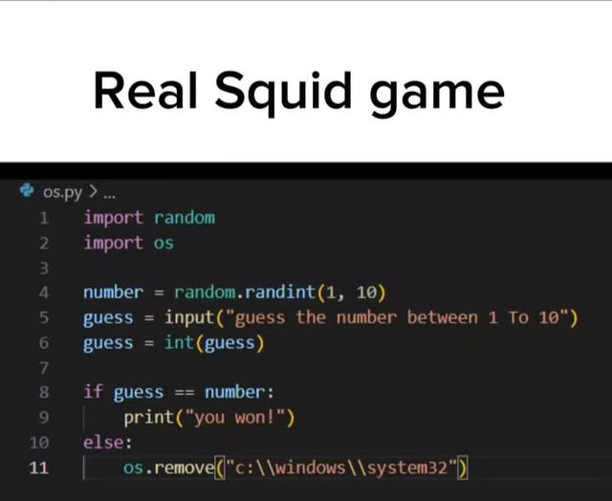
The self Parameter
class Person:
def __init__(mysillyobject, name, age):
mysillyobject.name = name
mysillyobject.age = age
def myfunc(abc):
print("Hello my name is " + abc.name)
p1 = Person("Joseph", 40)
p1.myfunc()

Slide 51
Modify and Delete Object Properties
Modify - p1.age = 40
Delete Object Properties - del p1.age
Delete Object - del p1
The pass Statement - class definitions cannot be empty, but if you for some reason have a class definition with no content, put in the pass statement to avoid getting an error.
class Person:
pass

Slide 52
Activity 1 : Simple Banking System
Create a Python program that simulates a basic banking system where the user can:
✅ Check their balance
✅ Deposit money
✅ Withdraw money
✅ Exit the program

Slide 53
Activity 2 - Student Grade Manager
Create a Student Grade Manager where:
✅ A Student class stores the student’s name and grades.
✅ A method calculates the average grade.
✅ A lambda function determines the grade category (A, B, C, etc.).
✅ f-strings are used for formatting output.

