Slide 1

Event Driven Programming - Python
Joseph Darwin Co

Slide 2
Inheritance
Inheritance allows us to define a class that inherits all the methods and properties from another class.
Parent class is the class being inherited from, also called base class.
Child class is the class that inherits from another class, also called derived class.

Slide 3
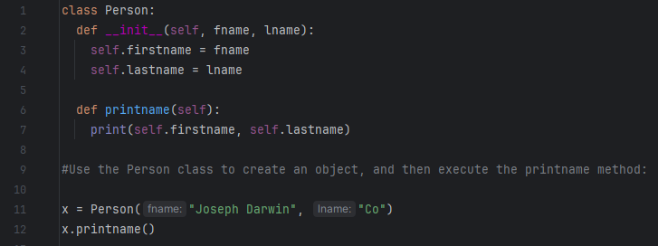
Create a Parent Class
Any class can be a parent class, so the syntax is the same as creating any other class.

Slide 4
Create a Child class
To create a class that inherits the functionality from another class, send the parent class as a parameter when creating the child class.
class Student(Person):
pass
#Use the pass keyword when you do not want to add any other properties or methods to the class.

Slide 5
Create a Child class
Use the Student class to create an object, and then execute the printname method
x = Student(“JD", “Co")
x.printname()

Slide 6
Add the __init__() Function
Remember: The __init__() function is called automatically every time the class is being used to create a new object.
class Student(Person):
def __init__(self, fname, lname):
#add properties etc.
Reminders: When you add the __init__() function, the child class will no longer inherit the parent's __init__() function.
The child's __init__() function overrides the inheritance of the parent's __init__() function.

Slide 7
What if we want to keep the parent’s?
To keep the inheritance of the parent's __init__() function, add a call to the parent's __init__() function.
class Student(Person):
def __init__(self, fname, lname):
Person.__init__(self, fname, lname)

Slide 8
Use the super() Function
Python also has a super() function that will make the child class inherit all the methods and properties from its parent.
class Student(Person):
def __init__(self, fname, lname):
super().__init__(fname, lname)

Slide 9
Add Properties
class Student(Person):
def __init__(self, fname, lname):
super().__init__(fname, lname)
self.graduationyear = 2013

Slide 10
Add Properties
In the example below, the year 2013 should be a variable, and passed into the Student class when creating student objects. To do so, add another parameter in the __init__() function:
class Student(Person):
def __init__(self, fname, lname, year):
super().__init__(fname, lname)
self.graduationyear = year
x = Student(“Joseph Darwin", “Co", 2013)

Slide 11
Add Methods
class Student(Person):
def __init__(self, fname, lname, year):
super().__init__(fname, lname)
self.graduationyear = year
def welcome(self):
print("Welcome", self.firstname, self.lastname, "to the class of", self.graduationyear)

Slide 12
Python Iterators
An iterator is an object that contains a countable number of values.
An iterator is an object that can be iterated upon, meaning that you can traverse through all the values.
Technically, in Python, an iterator is an object which implements the iterator protocol, which consist of the methods __iter__() and __next__().

Slide 13
Iterator vs Iterable
Lists, tuples, dictionaries, and sets are all iterable objects. They are iterable containers which you can get an iterator from.
All these objects have a iter() method which is used to get an iterator:

Slide 14
Iterator vs Iterable
mytuple = (“Eudora", “Nana", “Valir")
myit = iter(mytuple)
print(next(myit))
print(next(myit))
print(next(myit))

Slide 15
Even strings are iterable objects, and can return an iterator
mystr = “Xavier"
myit = iter(mystr)
print(next(myit))
print(next(myit))
print(next(myit))
print(next(myit))
print(next(myit))
print(next(myit))

Slide 16
Looping Through an Iterator
We can also use a for loop to iterate through an iterable object.
mytuple = (“Cecilion", “Kagura", “Vale")
for x in mytuple:
print(x)

Slide 17
Create an Iterator
To create an object/class as an iterator you have to implement the methods __iter__() and __next__() to your object.
The __iter__() method acts similar, you can do operations (initializing etc.), but must always return the iterator object itself.
The __next__() method also allows you to do operations, and must return the next item in the sequence.

Slide 18
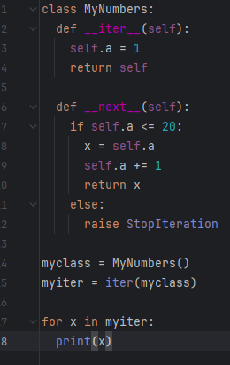
StopIteration
To prevent the iteration from going on forever,
we can use the StopIteration statement.
In the __next__() method, we can add a terminating condition
to raise an error if the iteration is done a specified number of times:

Slide 19

PIP
What is PIP?

Slide 20
What is PIP?
PIP is a package manager for Python packages, or modules if you like.
Note: If you have Python version 3.4 or later, PIP is included by default.

Slide 21
What is a Package?
A package contains all the files you need for a module.
Modules are Python code libraries you can include in your project.
Check if PIP is Installed
Launch CMD and type pip --version

Slide 22
Install PIP
If you do not have PIP installed, you can download and install it from this page: https://pypi.org/project/pip/
Download and Test a Package
Open the command line interface and tell PIP to download the package you want.
Navigate your command line to the location of Python's script directory, and type the following:
python -m pip install mysql-connector-python #to test type below
import mysql.connector #You know the next topic by now. =)

Slide 23
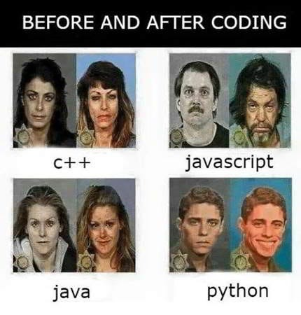
Find Packages
Find more packages at
https://pypi.org/.

Slide 24
Python MySQL - Create Connection
import mysql.connector mydb = mysql.connector.connect( host="localhost", user="yourusername", password="yourpassword" ) print(mydb)

Slide 25
Creating a Database
import mysql.connector mydb = mysql.connector.connect( host="localhost", user="yourusername", password="yourpassword" ) mycursor = mydb.cursor() mycursor.execute("CREATE DATABASE mydatabase")

Slide 26
Check if Database Exists
import mysql.connector mydb = mysql.connector.connect( host="localhost", user="yourusername", password="yourpassword" ) mycursor = mydb.cursor() mycursor.execute("SHOW DATABASES") for x in mycursor: print(x)

Slide 27
Check if Database Exists
import mysql.connector mydb = mysql.connector.connect( host="localhost", user="yourusername", password="yourpassword", database="mydatabase" )

Slide 28
Creating a Table
import mysql.connector mydb = mysql.connector.connect( host="localhost", user="yourusername", password="yourpassword", database="mydatabase" ) mycursor = mydb.cursor() mycursor.execute("CREATE TABLE customers (name VARCHAR(255), address VARCHAR(255))")

Slide 29
Check if Table Exists
import mysql.connector mydb = mysql.connector.connect( host="localhost", user="yourusername", password="yourpassword", database="mydatabase" ) mycursor = mydb.cursor() mycursor.execute("SHOW TABLES") for x in mycursor: print(x)

Slide 30
Primary Key
import mysql.connector mydb = mysql.connector.connect( host="localhost", user="yourusername", password="yourpassword", database="mydatabase" ) mycursor = mydb.cursor() mycursor.execute("CREATE TABLE customers (id INT AUTO_INCREMENT PRIMARY KEY, name VARCHAR(255), address VARCHAR(255))")

Slide 31
If the table already exists, use the ALTER TABLE keyword
import mysql.connector mydb = mysql.connector.connect( host="localhost", user="yourusername", password="yourpassword", database="mydatabase" ) mycursor = mydb.cursor() mycursor.execute("ALTER TABLE customers ADD COLUMN id INT AUTO_INCREMENT PRIMARY KEY")

Slide 32
Insert Into Table
import mysql.connector mydb = mysql.connector.connect( host="localhost", user="yourusername", password="yourpassword", database="mydatabase" ) mycursor = mydb.cursor() sql = "INSERT INTO customers (name, address) VALUES (%s, %s)" val = ("John", "Highway 21") mycursor.execute(sql, val) mydb.commit() print(mycursor.rowcount, "record inserted.")

Slide 33
Insert Multiple Rows
sql = "INSERT INTO customers (name, address) VALUES (%s, %s)" val = [ ('Peter', 'Lowstreet 4'), ('Amy', 'Apple st 652'), ('Hannah', 'Mountain 21'), ('Michael', 'Valley 345'), ('Sandy', 'Ocean blvd 2'), ('Betty', 'Green Grass 1'), ('Richard', 'Sky st 331'), ('Susan', 'One way 98'), ('Vicky', 'Yellow Garden 2'), ('Ben', 'Park Lane 38'), ('William', 'Central st 954'), ('Chuck', 'Main Road 989'), ('Viola', 'Sideway 1633') ] mycursor.executemany(sql, val) mydb.commit() print(mycursor.rowcount, "was inserted.")

Slide 34
Get Inserted ID
sql = "INSERT INTO customers (name, address) VALUES (%s, %s)" val = ("Michelle", "Blue Village") mycursor.execute(sql, val) mydb.commit() print("1 record inserted, ID:", mycursor.lastrowid)

Slide 35
Select From a Table
mycursor = mydb.cursor() mycursor.execute("SELECT * FROM customers") myresult = mycursor.fetchall() for x in myresult: print(x)

Slide 36
Selecting Columns
mycursor = mydb.cursor() mycursor.execute("SELECT name, address FROM customers") myresult = mycursor.fetchall() for x in myresult: print(x)

Slide 37
Where
mycursor = mydb.cursor() sql = "SELECT * FROM customers WHERE address ='Park Lane 38'" mycursor.execute(sql) myresult = mycursor.fetchall() for x in myresult: print(x)

Slide 38
Prevent SQL Injection
mycursor = mydb.cursor() sql = "SELECT * FROM customers WHERE address = %s" adr = ("Yellow Garden 2", ) mycursor.execute(sql, adr) myresult = mycursor.fetchall() for x in myresult: print(x)
Notes:
The mysql.connector module uses the placeholder %s to escape values.

Slide 39
Sort the Result
mycursor = mydb.cursor() sql = "SELECT * FROM customers ORDER BY name" #you can add desc mycursor.execute(sql) myresult = mycursor.fetchall() for x in myresult: print(x)

Slide 40
Delete Record
sql = "DELETE FROM customers WHERE address = 'Mountain 21'" mycursor.execute(sql) mydb.commit() ''''It is required to make the changes, otherwise no changes are made to the table.''' print(mycursor.rowcount, "record(s) deleted")
Notes:
Notice the statement: mydb.commit(). It is required to make the changes, otherwise no changes are made to the table.

Slide 41
Drop Table
mycursor = mydb.cursor() sql = "DROP TABLE customers" mycursor.execute(sql)

Slide 42
Update Table
sql = "UPDATE customers SET address = 'Canyon 123' WHERE address = 'Valley 345'" mycursor.execute(sql) mydb.commit() print(mycursor.rowcount, "record(s) affected")

Slide 43
Limit
mycursor = mydb.cursor() mycursor.execute("SELECT * FROM customers LIMIT 5") myresult = mycursor.fetchall() for x in myresult: print(x)

Slide 44
Start From Another Position
mycursor = mydb.cursor() mycursor.execute("SELECT * FROM customers LIMIT 5 OFFSET 2") myresult = mycursor.fetchall() for x in myresult: print(x)

Slide 45
Join Two or More Tables
mycursor = mydb.cursor() sql = "SELECT \ users.name AS user, \ products.name AS favorite \ FROM users \ INNER JOIN products ON users.fav = products.id" mycursor.execute(sql) myresult = mycursor.fetchall() for x in myresult: print(x)

Slide 46

Q&A

Slide 47


Slide 48
Challenge 1: The Book Blueprint (Class)
Create a Python class named Book.
It should have an __init__ method that accepts title, author, and isbn as arguments and stores them as attributes.
It should also have a __str__ method that returns a nicely formatted string representing the book. For example: "The Hobbit by J.R.R. Tolkien (ISBN: 12345)".

Slide 49
Challenge 2: The Ebook Specialty (Inheritance)
Create a new class named Ebook that inherits from your Book class.
In addition to the attributes from Book, the Ebook class should also have a file_format attribute (e.g., 'PDF', 'EPUB').
The __init__ method should accept title, author, isbn, and file_format.
Override the __str__ method to include the file format in the output. For example: "Dune by Frank Herbert (ISBN: 67890) - Format: EPUB".

Slide 50
Challenge 3: The Library Collection (Iterator)
Create a class named Library.
The __init__ method should initialize an empty list to hold book objects.
Create a method add_book(self, book) that adds a Book or Ebook object to this list.
Make the Library class iterable. This means you need to implement the iterator protocol (__iter__ and __next__) so you can loop through the books in the library directly using a for loop.

Slide 51
Challenge 4: The Database Memory (MySQL)
Create a DatabaseManager class to handle all communication with your MySQL database.
SQL First: Write the SQL CREATE TABLE statement for a books table. It should have columns for title, author, isbn, file_format. The file_format should be allowed to be NULL for physical books.
Python Class: The DatabaseManager class should have:
An __init__ method to store database connection details (host, user, password, database name) and establish a connection.
A save_book(self, book) method that takes a Book or Ebook object and inserts its data into the books table.
A load_books(self) method that fetches all records from the books table, creates the appropriate Book or Ebook objects, and returns them in a list.

