Slide 1
CICD- Continuous integration and continuous delivery
What it mean
CI/CD is a method to continuolsy deliver apps to Users with automation into the stages of app development. The main concepts attributed to CI/CD are continuous integration, continuous delivery, and continuous deployment. CI/CD is a solution to the problems integrating new code can cause for development and operations teams

Slide 2
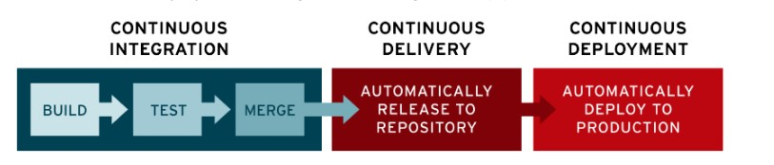
CICD Pipeline

Slide 3
CICD Benefits
CI/CD code changes are easy
Fault detection is easy and quick. Detecting the root
Easy troubleshooting of the fault is one of the most proclaimed benefits of CI/CD.
A CI/CD pipeline enables developers to integrate their code into a common repository in smaller batches.
Through this repository, developers can share their builds with the entire team rather than working in
isolation.
Now, the whole team can collaborate for
thorough detection and fixation of the most severe bugs
and also the roll back mechanism is well defined

