Slide 1
KD Tree Path Tracer Optimization
Rony Edde
Shooting rays through a complex scene with a large number of polygons can be heavy and exponentially slow even on the GPU. Axis Aligned Bounding boxes help improve performance, hover this still doesn't solve the problem when rays intersect a complex object with millions of triangles.

Slide 2
KD Tree Path Tracer Optimization
Rony Edde
Using a K-D Tree to represent the triangles reduces the overall complexity of the lookup and the time needed to find the intersecting triangles. There is a cost of computation for generating the KD-Tree but in most cases the scene is mostly static geometry which should benefit from this data structure.

Slide 3
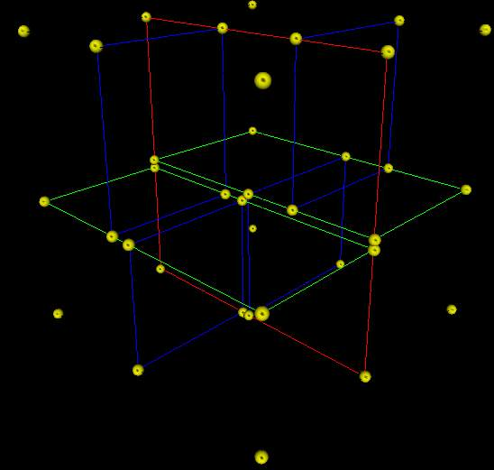
KD Tree Path Tracer Optimization
Rony Edde
A KD-Tree is a data structure
that can help solve this problem
by dividing the space into sub-
spaces and checking for
intersections within the
subdivided regions instead
of the entire geometry.
(image from of Wikipedia)

Slide 4
KD Tree Path Tracer Optimization
Rony Edde
Concept.
In order to build a KD-Tree, I start by generating a bounding box that encompasses all elements (triangles in our case). I then split on one axis. Every consecutive level will be split on the second axis. In 2D there are 2 axis splits, 3 in 3D. Every split divides the space in 2 sections with new bounds. Triangles that belong to the left side are moved to the left node, right otherwise. This partitions the space into a tree that can then be traversed by only checking if I have a hit with the boundary. This makes a KD-Tree efficient for complex geometry.

Slide 5
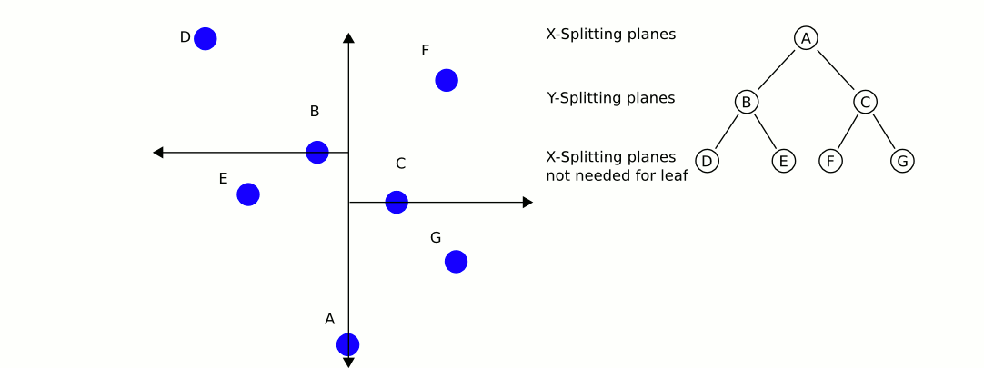
KD Tree Path Tracer Optimization
Rony Edde
Concept.
An illustration of a 2D KD-Tree in progress with points.

Slide 6
KD Tree Path Tracer Optimization
Rony Edde
A few problems to solve
1- GPU memory limit.
2- Streaming solution?
3- No support for recursion in CUDA.
4- Very tight schedule...

Slide 7
KD Tree Path Tracer Optimization
Rony Edde
A few problems to solve
1- GPU memory limit.
GPUs don't have enough memory to compete with CPUs and a typical path tracer loading millions of triangles can easily crash the graphics card. Just accessing the entire geometry without an optimized data structure can be close to impossible without resorting to optimizations. Just accessing the entire geometry without an optimized data structure can be close to impossible without resorting to optimizations. However, even after optimizations, this can remain a major issue with high risks of overwhelming the GPU memory and resulting in a crash.

Slide 8
KD Tree Path Tracer Optimization
Rony Edde
A few problems to solve
2- Streaming solution?
In order to solve the memory limitation, we can resort to streaming. If the object loaded has 1 million triangles, it would require 192MB of GPU memory on a 64 bit machine. In today's applications and games 1 million polygons is considered low resolution. We can see how this quickly becomes an issue.

Slide 9
KD Tree Path Tracer Optimization
Rony Edde
A few problems to solve
2- Streaming solution?
Streaming alone, however presents additional complexities for optimization. KD-Trees will need to be adaptive and fast in order to account for this. Another option is to split the complexity in sub-trees in order to fit in memory, thus reducing the impact caused by streaming. This could have an impact on the benefit of using KD-Trees and can also present issues when rendering double sided geometry.

Slide 10
KD Tree Path Tracer Optimization
Rony Edde
A few problems to solve
3- No support for recursion in CUDA.
The lack of recursion support in CUDA presents a major challenge for any tree like data structure. The most efficient and clean implementation for a tree data structure is recursive.

Slide 11
KD Tree Path Tracer Optimization
Rony Edde
Solving the lack of recursion
Implementing the KD-Tree without recursion involves a serious rewrite. The initial implementation was made recursively. Once the tree was built and the data is correctly generated, I run tests to make sure that everything works.

Slide 12
KD Tree Path Tracer Optimization
Rony Edde
Solving the lack of recursion
Testing the tree using print statements is tricky so I've resorted to using Houdini to help prototype and display the KD-Tree before having enough GPU binding to test.
The following slide shows a Houdini tool that was developed for this purpose

Slide 13
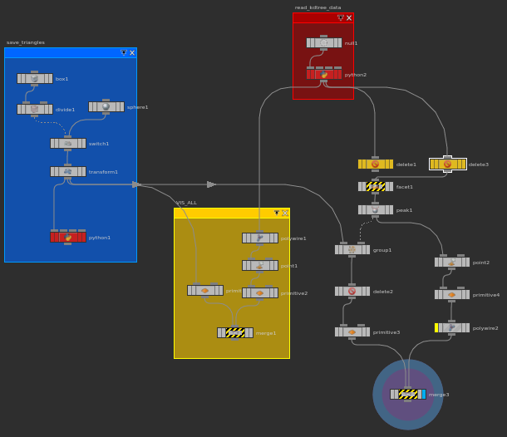
KD Tree Path Tracer Optimization
Rony Edde
Solving the lack of recursion
Houdini to the rescue.

Slide 14
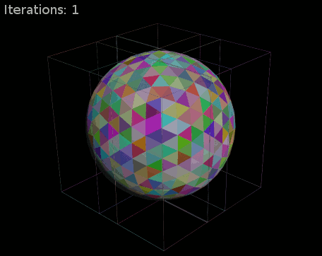
KD Tree Path Tracer Optimization
Rony Edde
Solving the lack of recursion
Initial results

Slide 15
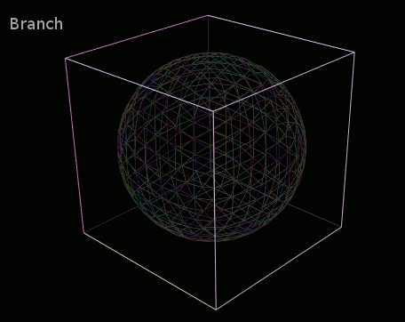
KD Tree Path Tracer Optimization
Rony Edde
Solving the lack of recursion
Initial results

Slide 16
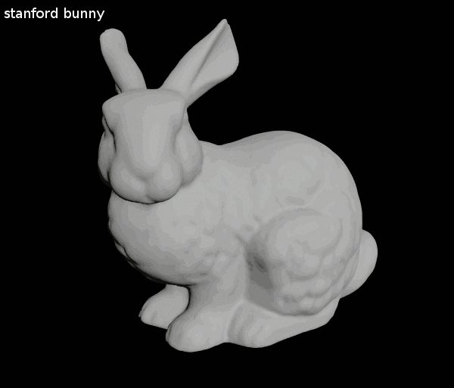
KD Tree Path Tracer Optimization
Rony Edde
Solving the lack of recursion
Initial results

Slide 17
KD Tree Path Tracer Optimization
Rony Edde
Solving the lack of recursion
Now that I have a semi working data structure, I start the flattening of the data so that I can traverse the tree without using recursion.

Slide 18
KD Tree Path Tracer Optimization
Rony Edde
Solving the lack of recursion
Traversing the tree was initially done using attributes that were stored in the node. Visited was a variable added to the nodes that, once a node is visited, is set to true.
This presented problems because it wasn't thread safe and the node data could get modified by other threads creating a race condition.

Slide 19
KD Tree Path Tracer Optimization
Rony Edde
Solving the lack of recursion
The solution was to flatten the nodes and the triangles that belonged to the leafs and using indexing in order to traverse the tree.
The following slide illustrates this.

Slide 20
KD Tree Path Tracer Optimization
Rony Edde
Solving the lack of recursion
1- create the KD-Tree.
2- save parent / left and right child indices.
3- save all triangles into a new array and keep offset stored.
4- save all nodes into a new array.
5- use index mapping to track visited nodes.

Slide 21
KD Tree Path Tracer Optimization
Rony Edde
Solving the lack of recursion
Ray hit tracking:
1- set a visited array for all nodes. Set all values to false.
2- Using a while loop, we check if the ray hit the root.
3- If we hit, we set the node index lookup to true.
else we set the current node to the parent
4- If we reached a leaf, check collision with its triangles.
and update hit distance.
5- repeat until node parent is -1 or all nodes are visited.

Slide 22
KD Tree Path Tracer Optimization
Rony Edde
Implementation issues.
While this implementation works and has been tested, the GPU implementation failed initially due to one main problem.
CUDA's memory management is rigid, meaning that one cannot simply allocate on the GPU without a major performance hit.
KD-Tree storage must be hidden and only the data can be visible to CUDA. The algorithms must be able to handle dynamic sizes without crashing.

Slide 23
KD Tree Path Tracer Optimization
Rony Edde
Implementation issues.
After several attempts that ended up crashing the GPU, the final solution was to lock the KD-Tree into the scene description and rewrite the geometry intersection algorithm while only exposing 2 types. KDnode and KDtriangle. This solved most of the problems that were crashing the GPU.
Solving the non dynamic accessing of the data and the varying sizes was slightly less problematic. The final decision was to resort to a fixed size representation of the indexing that was both small enough not to hinder performance and large enough to contain all the indices.

Slide 24
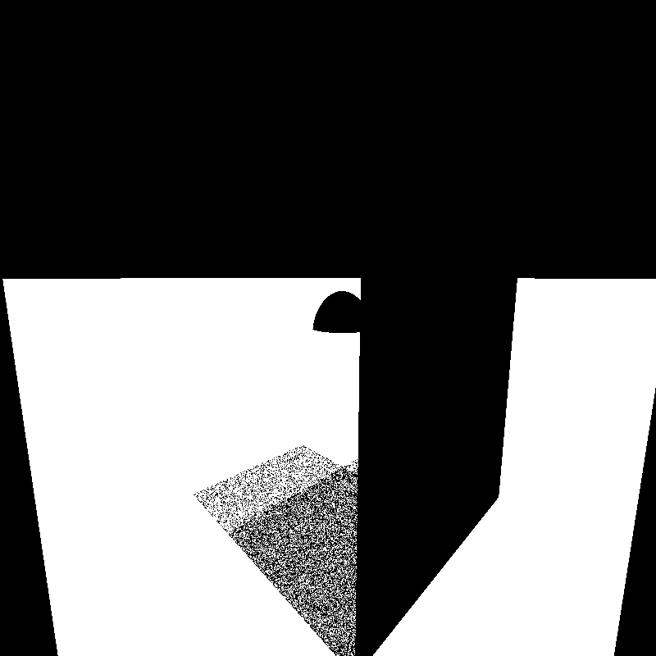
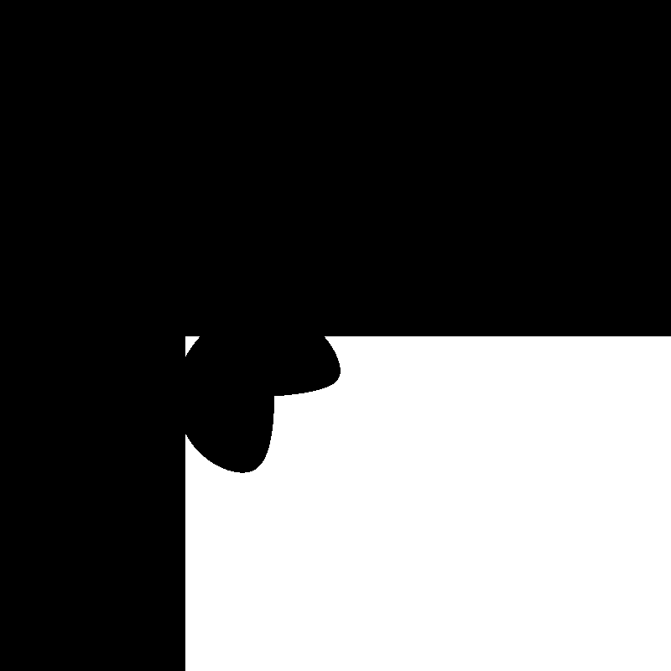
KD Tree Path Tracer Optimization
Rony Edde
Implementation issues.
The last results I got might not look promising but we can clearly see the intersections of the bounding boxes of the tree and the sections of the polygons represented by the sphere.
Note that without the KD-Tree I get 1fps, this was around 30.

Slide 25
KD Tree Path Tracer Optimization
Rony Edde
The nasty bug
CUDA makes debugging quite challenging sometimes. Nsight sometimes skips breakpoints and exits. This is when the GPU crashes. Printing things out was the only way to track some of the crashing bugs but CUDA can also crash when printing too many lines so tracking the indexing bug was the biggest hurdle.

Slide 26
KD Tree Path Tracer Optimization
Rony Edde
What next?
The next milestone will be to try fixing the collisions and using the correct colors3 for correctly bouncing rays.

Slide 27
KD Tree Path Tracer Optimization
Rony Edde
Update 2
Initial kd implementation working at this point. Started optimizations using short stack hybrid solution.

Slide 28
KD Tree Path Tracer Optimization
Rony Edde
The working naïve traversal approach.
The naive traversal approach works well. It is definitely an improvement over a brute force check across all the geometry or a bounding box approach.

Slide 29
KD Tree Path Tracer Optimization
Rony Edde
Checking for collision is done naïvely by traversing all the nodes that collide with the ray. This is considered brute force because it's not always necessary to traverse all the nodes that might intersect the boxes. This could lead to an overhead when traversing more nodes that are aligned.

Slide 30
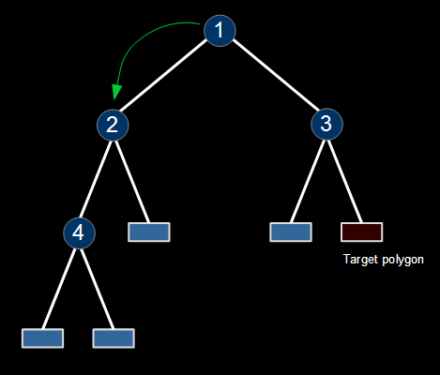
KD Tree Path Tracer Optimization
Rony Edde
Naive algorithm:
Check if the ray collides with the root node.
If it does check the left child.

Slide 31
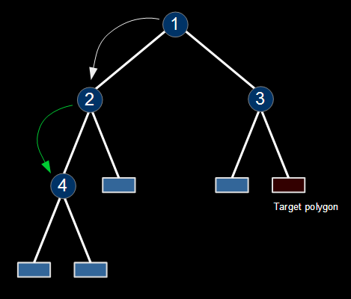
KD Tree Path Tracer Optimization
Rony Edde
Naive algorithm:
Check again for collision.
If ray collides, check left child.

Slide 32
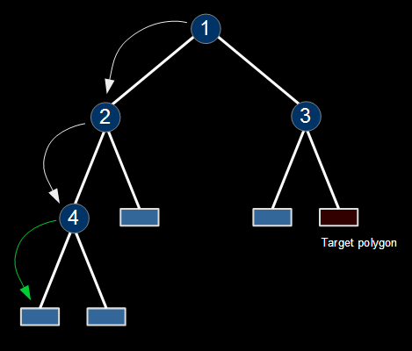
KD Tree Path Tracer Optimization
Rony Edde
Naive algorithm:
Check again for collision.
If ray collides, check left child.

Slide 33
KD Tree Path Tracer Optimization
Rony Edde
Naive algorithm:
Child is a leaf, so we check for collisions with geometry.
If the geometry doesn't collide,
Step back.

Slide 34
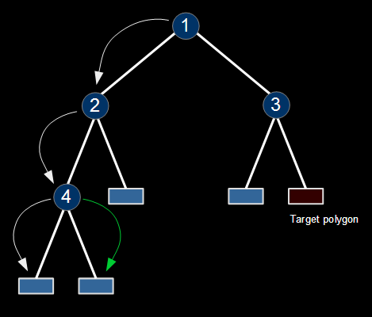
KD Tree Path Tracer Optimization
Rony Edde
Naive algorithm:
After stepping back we check the remaining child.
In this case it's the right node.

Slide 35
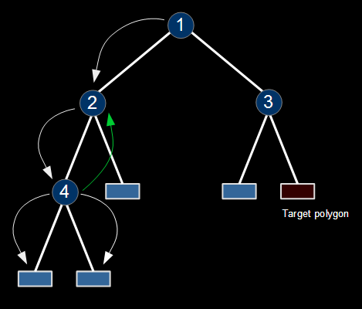
KD Tree Path Tracer Optimization
Rony Edde
Naive algorithm:
No polygons hit so we back track.

Slide 36
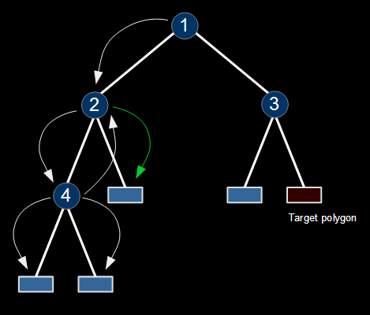
KD Tree Path Tracer Optimization
Rony Edde
Naive algorithm:
Now we check the right child.

Slide 37
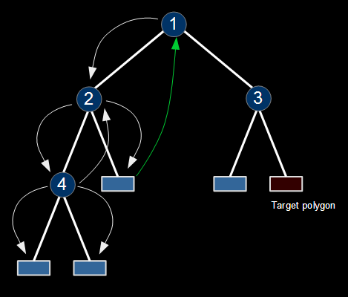
KD Tree Path Tracer Optimization
Rony Edde
Naive algorithm:
We might have collided but we need to check the remaining nodes, so we backtrack.
Our hit might not be the closest.

Slide 38
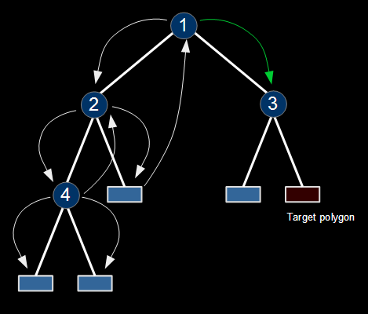
KD Tree Path Tracer Optimization
Rony Edde
Naive algorithm:
We are back at the root node but we still haven't checked the remaining nodes.
We check the right side.

Slide 39
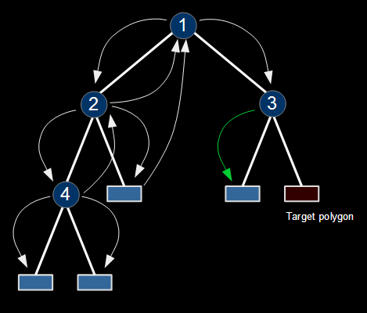
KD Tree Path Tracer Optimization
Rony Edde
Naive algorithm:
There are 2 remaining nodes to check. We check the left and get no collision.
No need to collide with geometry.
We step back.

Slide 40
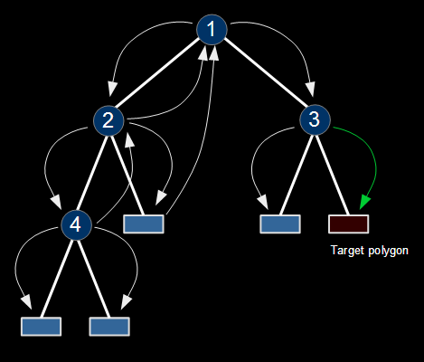
KD Tree Path Tracer Optimization
Rony Edde
Naive algorithm:
For the last leaf node our ray hits the bounds so we check the geometry.
We get a hit that is closer.
All nodes have been visited.
Return collision point geometry.

Slide 41
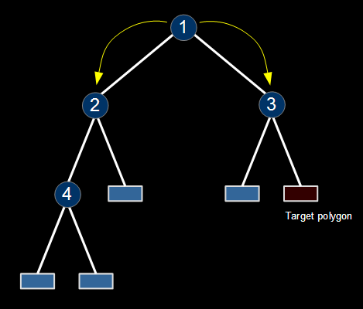
KD Tree Path Tracer Optimization
Rony Edde
Short-stack algorithm:
Instead of traversing all nodes, we still start at the root but we check for the closest splitting plane.
By comparing the axis distance, we start looking at the closest node.

Slide 42
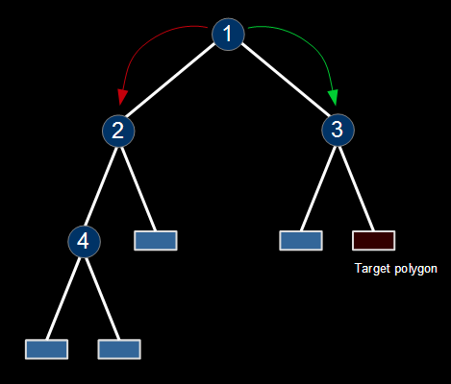
KD Tree Path Tracer Optimization
Rony Edde
Short-stack algorithm:
We look at the splitting plane axis and compare the splitting plane with node 2 and node 3 to determine which one to start traversing.
Node 3 is the closest so we start with it and put node 2 in the stack to revisit.

Slide 43
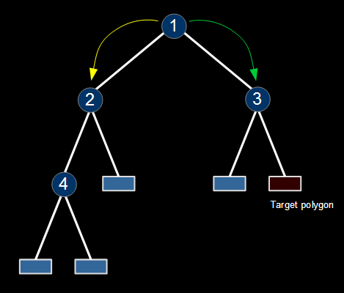
KD Tree Path Tracer Optimization
Rony Edde
Short-stack algorithm:
Now that node2 is pushed, we check for collision with node 3's bounds.

Slide 44
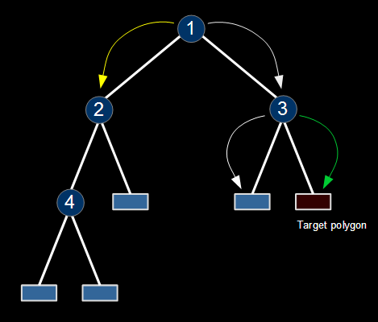
KD Tree Path Tracer Optimization
Rony Edde
Short-stack algorithm:
Node 3 collides with the ray so we check the closest node on the current axis. It's determined that it's the right node, so we check collision with the right node. We get a collision and so can determine that we have collided with the closest possible polygon.

Slide 45
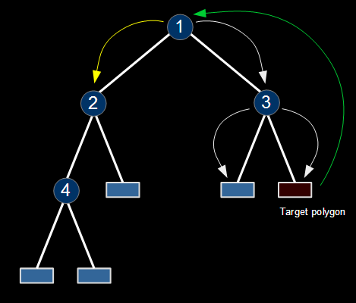
KD Tree Path Tracer Optimization
Rony Edde
Short-stack algorithm:
We step back to check the remaining nodes. In this case it's node 2.

Slide 46
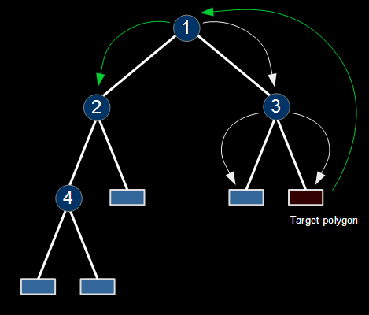
KD Tree Path Tracer Optimization
Rony Edde
Short-stack algorithm:
Node 2 collides father away and it's the only node on the stack so we are done and can return.

