Slide 1


第三部分
语用——培养核心素养

Slide 2
语言的输出，写作是最重要的一种表达方式。如何提高语用能力，表达语言文字，高质量地完成写作，必须先了解写作文体及其要求。新高考英语写作题型有两种：应用文写作和读后续写。应用文写作要求写一篇80词左右的短文；读后续写要求先读一段350词以内的语言材料，再根据材料内容、所给两段的开头语对该材料进行150词左右的续写。让我们一起探究新写作的奥秘。

Slide 3
一、应用文写作

Slide 4
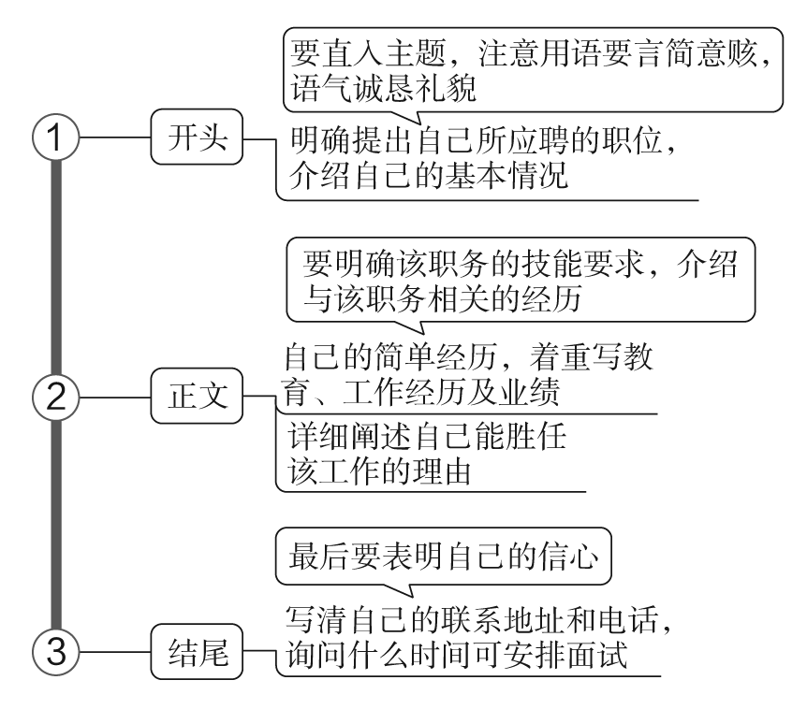
申请信
1 技法一点通

Slide 5
2 吸引读者的句式
(1)开头常用句
I'm writing this letter to apply for the position as a tour guide advertised in your website. 我写信申请你们网站上刊登的导游一职。
I am seeking an opportunity to work in Microsoft as a Computer Systems Manager. 我在寻找机会到微软公司担任计算机系统部经理一职。
My professional experience and my awareness of your high reputation and great achievements have led me to want to work for Xiaomi Corporation. 我专业的经验以及对贵公司声望卓著、成绩斐然的了解驱使我愿意为小米科技有限责任公司效劳。

Slide 6
(2)正文常用句
In my opinion, not only can being a tour guide broaden my horizon but it can also allow me to spread our culture to the whole world. 我认为，担任导游不仅能使我拓宽视野，而且可以传播我们的文化到世界各地。
I feel I'm competent to meet the requirements you listed. 我觉得我有能力满足你们所列的要求。
Great passion for the job paves the way for me to be determined to make it. 我对这份工作强烈的热情使我决心完成它。
My experience of such kind of jobs lays a solid foundation for my success. 我在这方面的工作经验为我的成功奠定了坚实的基础。

Slide 7
Moreover, I am easy to get along with, which is especially necessary for a volunteer. 而且，我很容易与人相处，这对志愿者来说很有必要。
In addition, I'm outgoing, which makes it possible for me to get along well with others. 另外，我很开朗，这使我可以与他人友好相处。
Additional experience in this field adds my value to your company. 在该领域其他的经验也增加了我对于贵公司的价值。
Last but not least, I am good at English and it will be useful while I am working. 最后但同样重要的是，我擅长英语，在我的工作中它会很有用。

Slide 8
(3)结尾常用句
Can we arrange an interview at your earliest convenience? 在您最方便的时候，我们能安排一次面试吗？
Thank you for considering my application, and I'm looking forward to your reply. 谢谢您考虑我的申请，期待您的回复。
I'd appreciate it if you could take my application into consideration. 如果您能考虑我的申请，我将感激不尽。

Slide 9
3 经典例文回放
假如你是李华，冬奥会组委会正在招聘志愿者，请你写一封申请信，内容包括：
1．申请理由；
2．你的优势；
3．希望获准。
注意：1.写作词数应为80左右；
2．开头和结尾已给出，不计入总词数。

Slide 10
Dear Sir/Madam,
_________________________________________________________________________________________________________________________________________________________________________________________________________________________________________________________________________________________________________________________________
Yours,
Li Hua

Slide 11
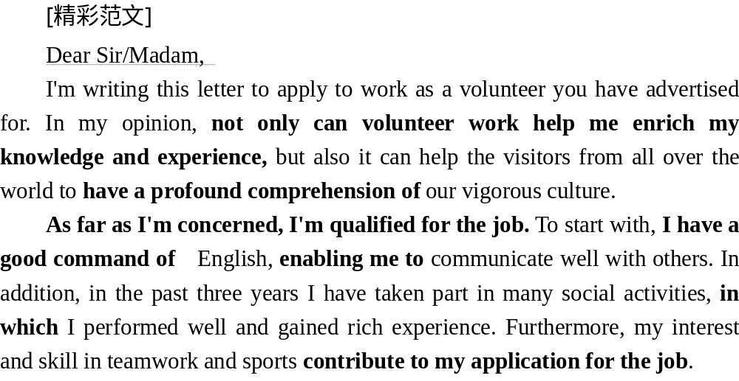

答案

Slide 12
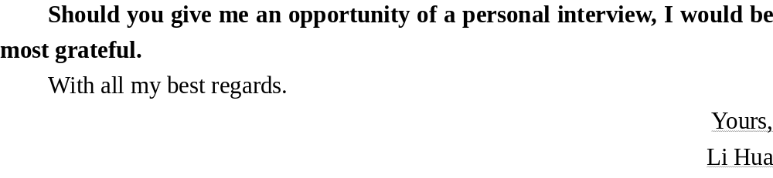
答案

Slide 13
4 实用写作模板
Dear ××，
I am writing this letter to apply for the position that you have advertised in ________ (报纸或网站名称) of ________ (广告发布时间)．
I am ________ (自我介绍) from ________ (来自哪里). As a(n) ________ (个人身份), I have been ________ (简述自己的优势1). Besides, I won ________ in ________ (简述自己的优势2). If you consider me appropriate for the job, please call me at ________ (联系方式)．
I would appreciate it very much if you could give me an early reply./Thank you for considering my application, and I am looking forward to meeting you.
Yours sincerely,
××

Slide 14
5 仿写演练助提升
(2021·山东省日照市高三下学期5月校际联合考试)假定你是李华，你所在的城市将举办“国际旅游博览会”，计划招募志愿者，你想报名参加。请你用英语写一封申请信，内容包括：
1．表达意愿；
2．你的优势。
注意：1.写作词数应为80左右；
2．可以适当增加细节，以使行文连贯。
参考词汇：国际旅游博览会the International Tourism Fair
_______________________________________________________________________________________________________________________________________________________________________________________________

Slide 15

[精彩范文]
Dear Sir or Madam，
I have seen your recruitment information for volunteers on the newspaper. I'd like to apply to be one.
First of all, I'm willing to provide service for the public.The International Tourism Fair is an important event to be held in our city. I'd feel honored if I have a chance to do voluntary work for the guests from all over the world.Secondly, I speak English fluently, which enables me to communicate well with foreigners. Last but not least, I have the experience of doing voluntary work.
答案

Slide 16
Please take my application into consideration and I'm looking forward to your early reply.
Yours，
Li Hua
答案

Slide 17
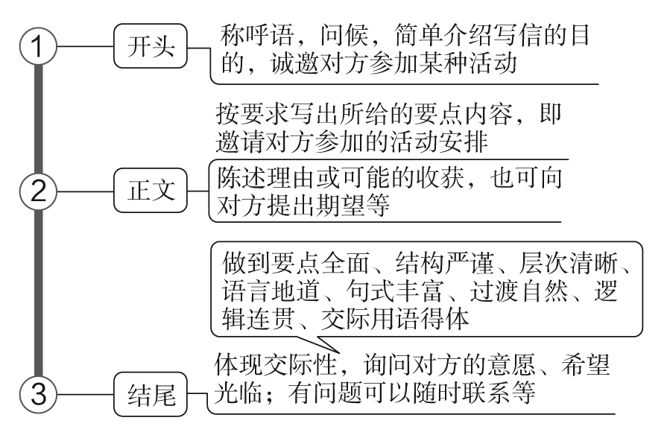
邀请信
1 技法一点通

Slide 18
2 吸引读者的句式
(1)开头常用句
Learning that you're interested in traditional Chinese culture, I'm writing to sincerely invite you to attend the Chinese Character Dictation Contest to be held in our school. 获悉您对中国传统文化感兴趣，我写信诚邀您参加我们学校举办的汉字听写大赛。
On behalf of our school, I have the honor to invite you to be a judge of our English Speaking Contest. 我代表我们学校，荣幸地邀请您担任英语演讲比赛的评委。

Slide 19
(2)正文常用句
As scheduled, the activity is supposed to take place at 2：00 pm in the school auditorium this Friday afternoon. 按照计划，活动于本周五下午两点在学校礼堂举行。
There will be a variety of activities, such as reading poems, performing plays and so on. 将会有各种不同的活动，例如诗朗诵、戏剧表演等等。
Twelve students are expected to deliver their brilliant speeches on the given topic “Chinese Dream”. 预计12名同学会就关于“中国梦”这一特定主题发表精彩演讲。

Slide 20
(3)结尾常用句
My family and I would feel honored if you could come. 如果您能来，我和家人会感到很荣幸的。
I'd appreciate it if you could come at your earliest convenience. 如果您能在方便的时候尽早来，我会很感激的。
If you do not have any prior appointment on July 1, we're looking forward to the pleasure of your company. 如果七月一日您没有其他重要安排，我们期待您的光临。

Slide 21
3 经典例文回放
假如你是李华，你校将于下周五晚八点在体育馆举行一场中国功夫(kung fu)的表演。你想邀请外教Michael一起观看演出。请给他写一封邮件，内容包括：
1．演出时间、地点；
2．中国功夫简介。
注意：1.写作词数应为80左右；
2．可以适当增加细节，以使行文连贯；
3．开头和结尾已给出，不计入总词数。

Slide 22
Dear Michael，
_________________________________________________________________________________________________________________________________________________________________________________________________________________________________________________________________________________________________________________________________
I'm looking forward to hearing from you.
Yours sincerely，
Li Hua

Slide 23
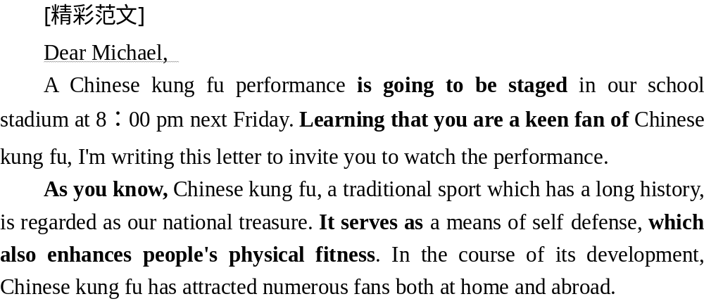
答案

Slide 24
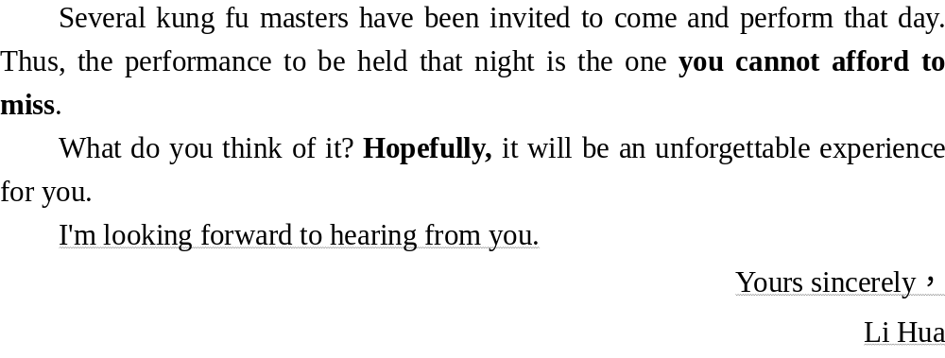
答案

Slide 25
4 实用写作模板
Dear ××，
How's everything with you? I'm writing to tell you that there will be a ________ (活动) at/in ________ (地点) on ________ (时间). I wonder whether you'd like to go with me (发出邀请)．
The occasion will start at ________ (具体时间). This will be followed by a ________ (进一步的安排). At around ________ (时间), ________ (另一个安排)．

Slide 26
If you are interested in it, let me know. Hope to meet you at the ________ (约定见面的时间). I really hope you can make it (再次邀请). My phone number is ________ (电话号码). Looking forward to ________ (再次表达希望)．
Yours，
××

Slide 27
5 仿写演练助提升
(2021·湖北省高三第三次模拟考试)假如你是李华，周末有一场中国民间音乐会，你打算邀请在华留学朋友Susan一起去欣赏，请写一封邮件。内容包括：
1．写信目的；
2．音乐会简介；
3．碰面时间、地点。
注意：1.写作词数应为80左右；
2．可以适当增加细节，以使行文连贯。

Slide 28
Dear Susan，
_________________________________________________________________________________________________________________________________________________________________________________________________________________________________________________________________________________________________________________________________
Yours，
Li Hua

Slide 29
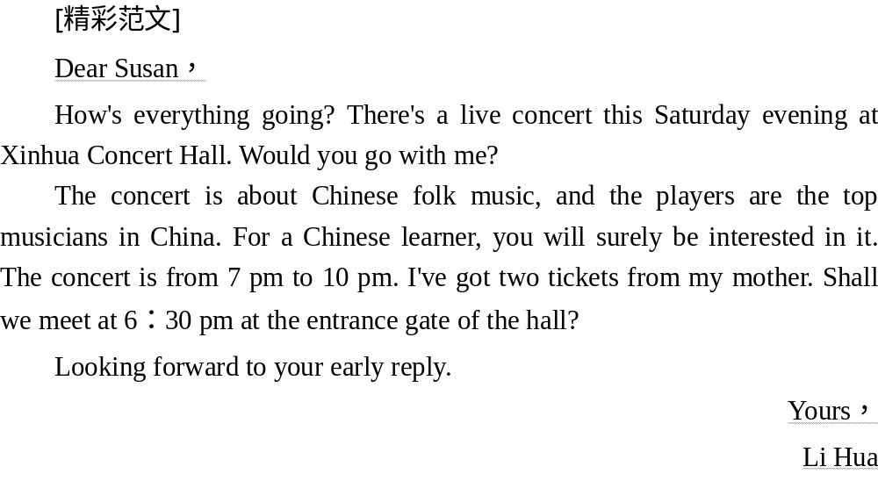
答案

Slide 30
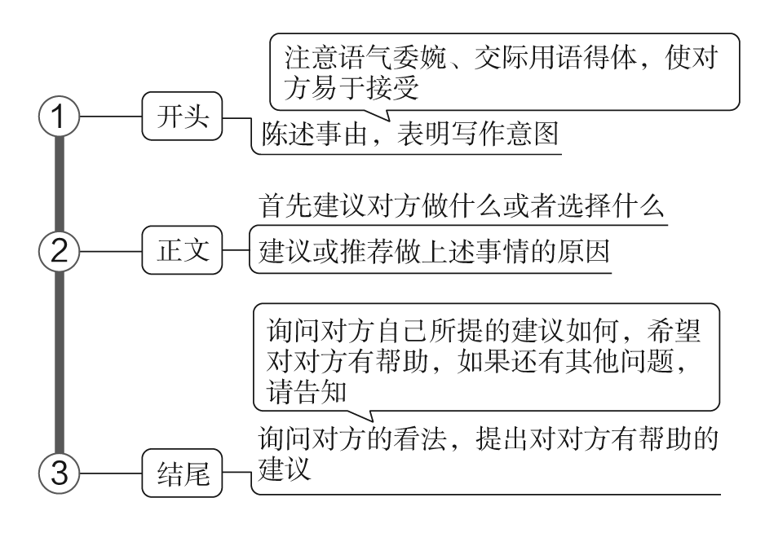
建议信
1 技法一点通

Slide 31
2 吸引读者的句式
(1)开头常用句
I've heard from you, learning that you're worried about your driving test. I'd like to share some of my ideas as follows. 收到来信，获悉你担心驾照考试。我想分享如下看法。
Learning your keen interest in traveling, I suggest you visit the Yangtze River, one of the longest rivers in China. 了解到你喜欢旅游，我建议你游览长江，中国最长的河流之一。

Slide 32
(2)正文常用句
As for my point of view, to start with, you'd better do more reading. 至于我的观点，首先，你最好多阅读。
To be honest, nothing is more thrilling than rowing the dragon boat in a team. 说实话，没有什么比和队友一起划龙舟更刺激的了。
In addition, it's a good idea to prepare your lessons in advance. 另外，提前准备功课是个好主意。
Last but not least, it would help if you could stay calm when in trouble. 最后，遇到问题的时候保持冷静也大有裨益。

Slide 33
(3)结尾常用句
What do you think of my suggestions? 你认为我的建议如何？
Hopefully, my suggestions will be of some help to you. 希望我的建议对你有所帮助。
If there's anything else I can help with, please don't hesitate/feel free to contact me. 如果你还有其他我能帮助到的地方，请尽管和我联系。

Slide 34
3 经典例文回放
假定你是李华，你的朋友Michael要作为交换生代表参加学校即将举行的“中国传统文化知识大赛”，约你陪他一起练习并征求备赛建议。请你就此给他回一封电子邮件，内容包括：
1．表示同意；
2．备赛建议；
3．约定见面的时间和地点。
注意：1.写作词数应为80左右；
2．可以适当增加细节，以使行文连贯。
____________________________________________________________________________________________________________________________________________________________________________________________

Slide 35
[精彩范文]
Dear Michael，
I'm more than delighted to learn that you are to participate in the Traditional Chinese Culture Competition. I'm willing to give you a hand and offer some practical suggestions at your request. To begin with, it is necessary for you to consult some books concerning traditional Chinese culture, thus broadening your horizons and well equipping you for the coming competition. Secondly, why not watch some video clips? You are bound to get some inspiration from them as well. As for when and where to meet, can we make it at 4：00 this Friday afternoon in your classroom? If it's not convenient for you, please let me know what time is suitable for you in advance.
答案

Slide 36
If you have any other questions, please don't hesitate to contact me.
Yours，
Li Hua
答案

Slide 37
4 实用写作模板
Dear ××，
I was glad to receive your letter asking for my advice on ________ (别人的求助内容), and I will try to make some suggestions here.
In my opinion, you would be wise to take the following actions. First, it is important to ________ (建议一), as you'll ________ (相应的理由). Then, it also helps if you ________ (建议二), because ________ (相应的理由). Besides, it should be a good idea to ________ (建议三). I'm sure that ________ (相应的理由)．

Slide 38
I hope you will find these proposals useful, and I would be ready to discuss this matter with you to further details. Good luck with your ________ (祝愿)．
Yours sincerely，
××

Slide 39
5 仿写演练助提升
(2022·广东省普通高中高三9月阶段性质量检测)假定你是李华，你的表妹Alice在市区的一所高中上学。由于离家很远，她很不适应离开父母后的生活，于是向你写信求助。请你给她回封信，内容包括：
1．给予安慰；
2．分析现状；
3．提出建议。
注意：1.写作词数应为80左右；
2．开头和结尾已给出，不计入总词数。

Slide 40
Dear Alice,
I am so sorry to hear from you that you have some trouble in your new life.
_________________________________________________________________________________________________________________________________________________________________________________________________________________________________________________________________________________________________________________________________
Wish you happy every day!
Yours,
Li Hua

Slide 41
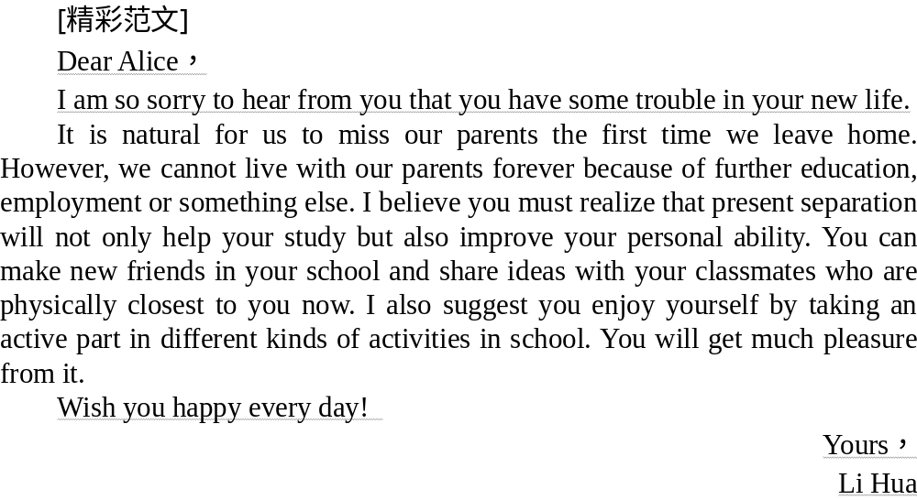
答案

Slide 42
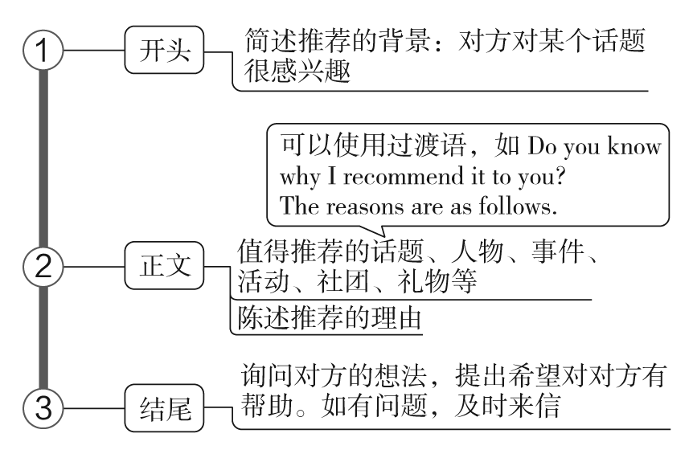
推荐信
1 技法一点通

Slide 43
2 吸引读者的句式
(1)开头常用句
Having received your email saying you want to learn Chinese, I'm writing to you in the hope that I can provide you with some useful information. 收到你的来信说想学习汉语，我写信希望能给你提供一些有用的信息。
Knowing that you're interested in traditional Chinese culture and eager to explore more, I'm more than delighted to share with you some detailed information. 知道你对中国传统文化感兴趣并且渴望探索更多，我非常乐意和你分享一些详细的信息。

Slide 44
(2)正文常用句
As you know, there are a variety of clubs that are worth recommending. Personally, joining Peking Opera Club is a good choice. 如你所知，有很多俱乐部值得推荐。就我个人而言，参加京剧俱乐部是个不错的选择。
As you know, there are a large number of distinguished heroes worth admiring in modern China. 如你所知，在现代中国，有大量的杰出英雄值得赞赏。
I heartily recommend this course to you based on the following reasons. 基于以下原因，我衷心向你推荐这门课程。

Slide 45
If my memory serves me right, you are highly interested in taking photos and photography is also your hobby. 如果我没记错的话，你对拍照很感兴趣，摄影也是你的爱好。
Blessed with a variety of places of interest, Tianjin is a good place to explore, such as Tianjin Ancient Culture Street, Dagu Emplacement.天津有各种各样的名胜古迹，是一个探索的好地方，如天津古文化街、大沽炮台。
(3)结尾常用句
If you want to learn anything more, don't hesitate to contact me. 如果你还想知道什么，尽管联系我。
Hopefully, my introduction can give you some inspirations. 希望我的介绍能给你一些启发。

Slide 46
3 经典例文回放
假设你是红星中学高三学生李华。 英国交换生Jim在给你的邮件中提到他对中国新拍的电影非常感兴趣，打算看一部。他向你征求建议。请给他回邮件，内容包括：
1．推荐的电影名称；
2．电影简介；
3．如何找到该电影。
注意：1.写作词数应为80左右；
2．开头和结尾已给出，不计入总词数。

Slide 47
Dear Jim，
_________________________________________________________________________________________________________________________________________________________________________________________________________________________________________________________________________________________________________________________________
Yours，
Li Hua

Slide 48
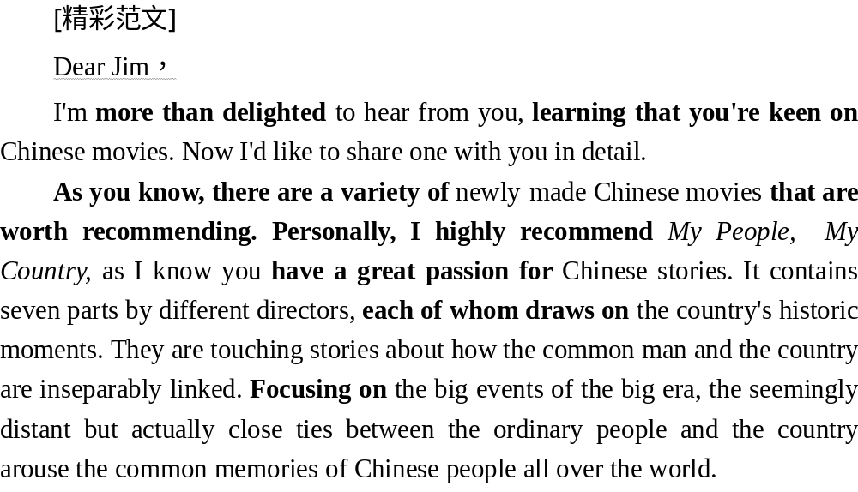
答案

Slide 49
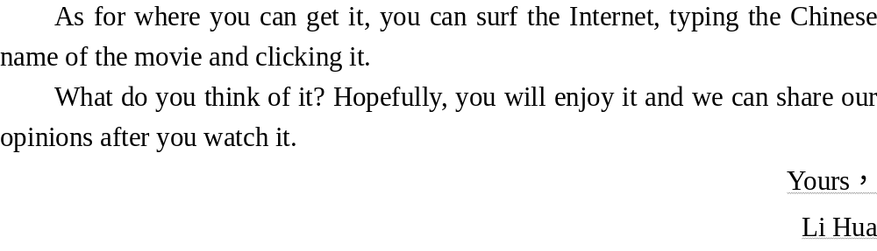
答案

Slide 50
4 实用写作模板
Dear ××，
I'm so delighted to hear from you, knowing that you're interested in ________ (推荐范围). Now, I'm more than willing to share with you some detailed information.
Of all the ________ (推荐范围), a variety of them are worth recommending. Personally, I think ________ (推荐对象) is a better choice. Do you want to know why I recommend it to you? The reasons are as follows. To start with, ________ (理由一). In addition, ________ (理由二). Last but not least, ________ (理由三)．

Slide 51
What do you think of it? Hopefully, what I have mentioned above will be of some help to you. Looking forward to your reply.
Yours，
××

Slide 52
5 仿写演练助提升
假定你是李华，你校的外籍交换生Henry给你发了一封邮件，想让你为他推荐一本词典，用来学习汉语，请你用英语给他回复。内容包括：
1．词典名称；
2．推荐理由；
3．表达祝愿。
注意：1.写作词数应为80左右；
2．可以适当增加细节，以使行文连贯。
_______________________________________________________________________________________________________________________________________________________________________________________________

Slide 53
[精彩范文]
Dear Henry，
Pleased to know your passion for learning Chinese, I'm writing to recommend Xinhua Dictionary to you. As a native speaker, I believe it is a helpful tool, especially for the beginners.
Firstly, it's one of the most widely used dictionaries in China, not only for its wide range of vocabulary but also for its precise explanation of each word. Besides, its reasonable price is undoubtedly an appealing factor.
I hope my suggestion is helpful and wish you great progress in learning Chinese.
Yours，
Li Hua
答案

Slide 54
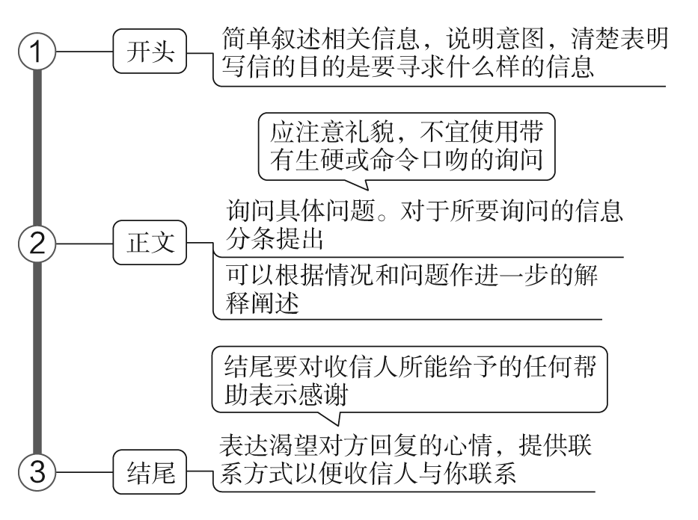
咨询信
1 技法一点通

Slide 55
2 吸引读者的句式
(1)开头常用句
Interested in the English Writing Course, I'm writing to ask for more details. 对英语写作课程感兴趣，所以我写信想了解更多细节。
I've finally made my decision to go to college for further education after high school. Now I need some detailed information concerning the college. 我最后决定高中后去上大学。现在我想要了解大学的一些详细信息。

Slide 56
(2)正文常用句
But I have some worries. For one thing, my English is so limited. For another, I may suffer from culture shock. 但是我也有顾虑。一方面我英语水平有限。另一方面我会遇到文化冲击。
What I'd like to find out is how much I have to pay for the course and whether accommodation is included. 我想要了解的是学费要付多少钱，住宿是否包括在内。

Slide 57
(3)结尾常用句
Would you please do me the favor to offer me some useful information? 你能帮我个忙，给我一些实用信息吗？
Your timely attention to my questions would be highly appreciated. 如能及时关注我的问题，我将不胜感激。
I would greatly appreciate a response from you at your earliest convenience. 请尽早回信，对此我将不胜感激。

Slide 58
3 经典例文回放
假定你是李华，在网上看到美国King's School有关远程教育课程(Distance Learning Course)的信息，你对其中一门课程很感兴趣，决定给该校负责人写一封信，询问这门课程的具体情况。内容包括：
1．课程开设的时间、内容等；
2．课程报名方式。
注意：1.写作词数应为80左右；
2．可以适当增加细节，以使行文连贯。

Slide 59
Dear Sir/Madam，
_________________________________________________________________________________________________________________________________________________________________________________________________________________________________________________________________________________________________________________________________
Yours，
Li Hua

Slide 60
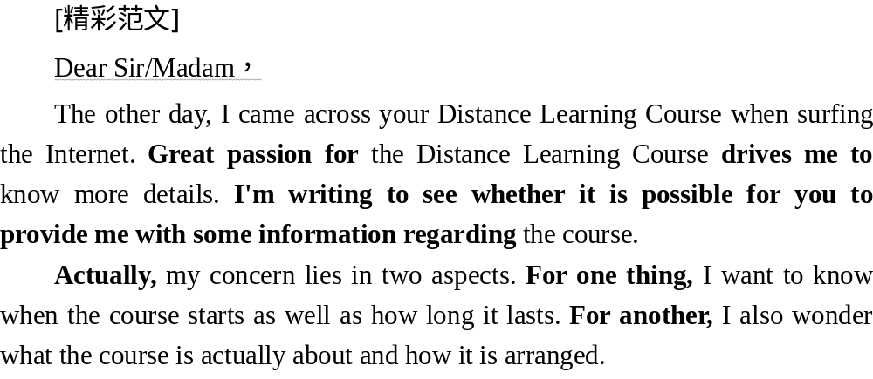
答案

Slide 61
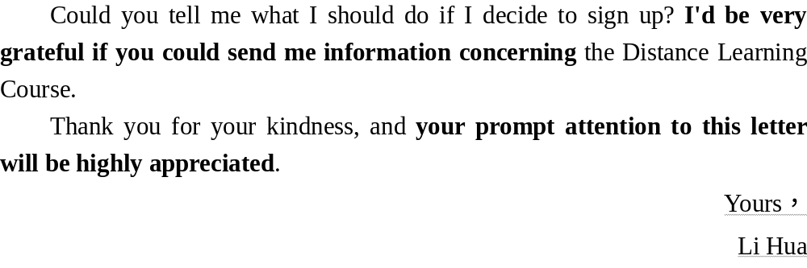
答案

Slide 62
4 实用写作模板
Dear ××，
I am ________ (自我介绍). I would appreciate very much if you can provide me with more details about ________ (要咨询的内容)．
First of all, ________ (要咨询的问题一). Secondly, ________ (要咨询的问题二). Thirdly, ________ (要咨询的问题三). I would also like to inquire ________ (附加问题). Could you be so kind as to send me some relevant booklets on the above­mentioned aspects?
I am expecting your early reply/immediate response.
Yours，
××

Slide 63
5 仿写演练助提升
(2021·全国甲卷改编)假定你是李华。你校计划举办介绍中国传统文化的主题班会，并在英文网站展示。请你写一封邮件给外国朋友Chris，向他了解哪些中国传统文化更吸引外国友人。邮件内容包括：
1．阐明写信事由；
2．征求建议；
3．表示感谢。
注意：1.写作词数应为80左右；
2．可以适当增加细节，以使行文连贯。
_______________________________________________________________________________________________________________________________________________________________________________________________

Slide 64
[精彩范文]
Dear Chris，
How is it going? I am writing to ask some advice from you on what kind of Chinese traditional culture attracts the foreigners most.
Next week, our school is going to hold a class meeting with the theme of Chinese traditional culture and it will be displayed on the English website later. As we all know, Chinese culture is broad and profound. There are various kinds of traditional festivals, calligraphy arts, and painting arts in China. In addition, the traditional delicious food in every place is worth introducing. How do you think about it? What interests you and your friends most?
答案

Slide 65
I would appreciate it if you could tell me more information about the meeting. Looking forward to your early reply.
Yours，
Li Hua
答案

Slide 66
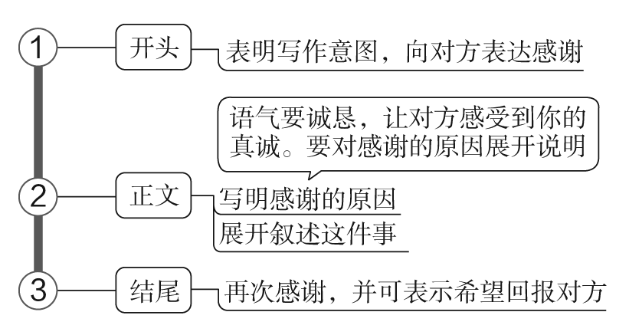
感谢信
1 技法一点通

Slide 67
2 吸引读者的句式
(1)开头常用句
I'd like to take this opportunity to express my sincere gratitude to you for your timely help. 我想借这次机会对您的及时帮助向您表达真诚的感谢。
I'm writing to convey my heartfelt appreciation to you for the warm welcome you extended to my friend Kevin when he visited your school last week. 我的朋友凯文上周去参观贵校的时候受到了您的热情欢迎。为此，我写信向您表达衷心的感谢。
Now I'm writing to extend my gratitude to you on behalf of my school and myself. 现在我写信代表我们学校和自己向您表达感激。

Slide 68
(2)正文常用句
But for your help during my one year's stay in New York, I wouldn't have adapted to it so quickly. 在纽约一年的时间里，要不是你的帮助，我不会如此迅速地适应它。
More importantly, your help and kindness made it easier for me to have a better understanding of British culture and adapt to the life there. 更重要的是，你的帮助和善意使我更容易理解英国文化，并且适应那里的生活。
It was with your generous help and tender care that I had a wonderful time there. 正是您的悉心照顾和慷慨帮助让我在那里度过了美好的时光。

Slide 69
(3)结尾常用句
My gratitude to you is beyond description. 对您的感激之情我无法用语言来表达。
Please accept my sincere gratitude for your participating in today's lecture. 为您能够来参加今天的讲座，请接受我真心的感谢。
I'm grateful to you for your patience, expertise and genuine concern. 我很感激您的耐心、专业知识和真诚的关怀。s

Slide 70
3 经典例文回放
假定你是李华，你的外教Mr Pick回国前向你推荐了American School Life网站，希望你借此提高英语水平。请你用英语给他写一封电子邮件，告诉他你的收获，要点如下：
1．表达思念；
2．上网收获；
3．表示感谢。
注意：1.写作词数应为80左右；
2．可以适当增加细节，以使行文连贯。

Slide 71
Dear Mr Pick，
_________________________________________________________________________________________________________________________________________________________________________________________________________________________________________________________________________________________________________________________________
Yours,
Li Hua

Slide 72
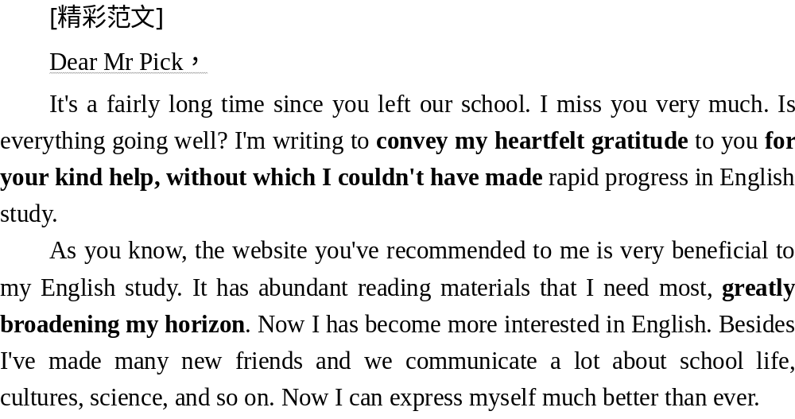
答案

Slide 73
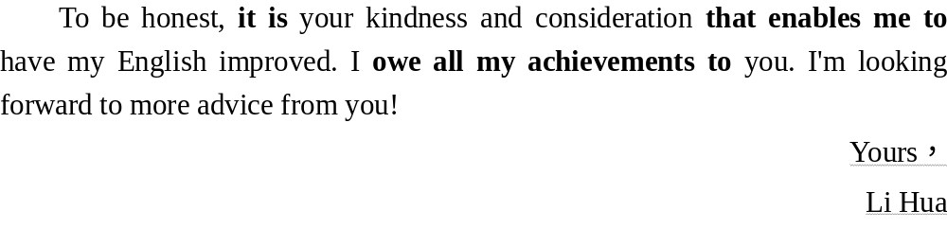
答案

Slide 74
4 实用写作模板
Dear ××，
I am now writing this letter to express my sincere thanks for ________ (直接表达谢意). I'd like you to know how much your ________ (表达出自己非常珍惜对方的付出/礼物) meant to me. You have a positive genius for ________ (对对方一定的赞美). I not only enjoyed ________,_but also ________ (对方的情意对自己的影响)．

Slide 75
I shall ever remember ________ (介绍事件的情形) as one of the most ________ (介绍事件的意义) in my life. I hope to have the opportunity ________ (表达自己回报的心情). Would you kindly let me know ________ (希望有回报的时间). I will feel very honored and pleased if you have time to ________ (提出希望下次见面的愿望)．
How nice it would be to see you again and I am looking forward to seeing you next time! I want to express my thanks again for your ________(再次表达感谢及表达真挚的祝福)．
Yours,
××

Slide 76
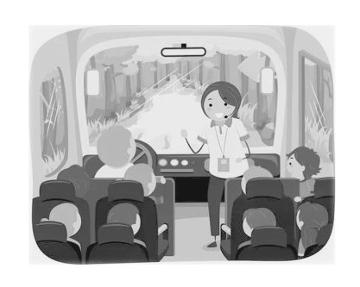
5 仿写演练助提升
(2021·湖南长郡中学高三押题预测卷)假定你是李华，国庆节期间参加了Angela公司的旅游团。你感到该公司的旅行路线物有所值，你对导游Lily的服务感到尤其满意。请给Angela公司写一封感谢信，内容包括：
1．自我介绍；
2．表示感谢。
注意：1.写作词数应为80左右；
2．可以适当增加细节，以使行文连贯。
____________________________________________________________________________________________________________________________________________________________________________________________

Slide 77
[精彩范文]
Dear Angela，
I'm Li Hua. I joined a group tour provided by your company during the National Day holiday.
My experience with the tour is really good. I am particularly impressed with the high standard of service and the attention to detail given to us by your guide Lily. I think it is well worth the money and it is a tour I will never forget. I will be very happy to recommend your company to my friends who want to take a trip to the same attractions.
Thank you.
Yours sincerely，
Li Hua
答案

Slide 78
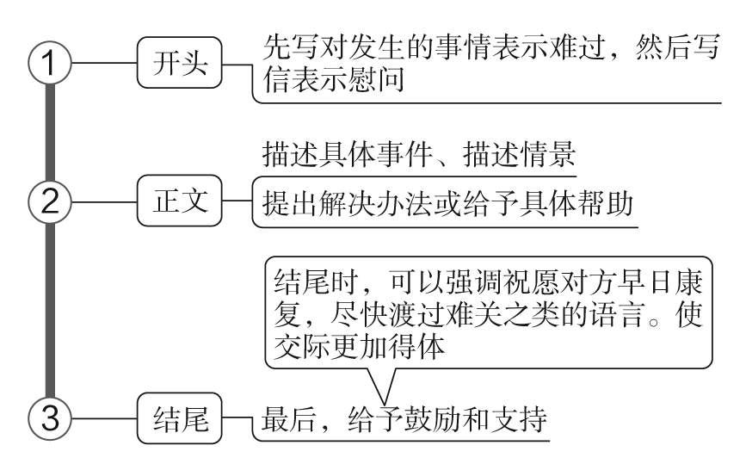
慰问信
1 技法一点通

Slide 79
2 吸引读者的句式
(1)开头常用句
I felt very sorry indeed when I heard of your illness. 得知你生病的消息，我非常难过。
In today's newspaper, I read about the recent events in your hometown and I am writing to extend my deepest condolences. 在今天的报纸上，我看到你们家乡最近发生的事件，特此写信表示慰问。
I am really worried about you and your family, and all your friends there. 我真的很担心你和你的家人及朋友。

Slide 80
(2)正文常用句
Nearly everyone may have one of these periods when everything seems to be going wrong. 几乎每个人都可能有这样一个时期，所有的事情似乎都出了问题。
As we all know, failure is the mother of success. I do hope you won't lose heart and will get ready to try again. 我们都知道，失败是成功之母。我真的希望你不要灰心，做好准备再试一次。
Remember we won't be far away whenever you need any help! 记住：如有需要，我们随时提供帮助！

Slide 81
(3)结尾常用句
May the sorrow you feel in your heart be lightened by the love that surrounds you. 愿你内心的忧伤被周围的爱所抹去。
Don't let it get you down. It will be over very soon. 不要让这件事击垮你。事情很快就会过去的。
Cheer up! Things will work out for the best. 振作点！事情会有好结果的。

Slide 82
3 经典例文回放
假设你是李华，你们班的留学生Bob放学路上出了事故。请你写一封慰问信，通过微信发给他。内容包括：
1．得知路上遭遇车祸；
2．获悉住院要动手术，一周后出院；
3．带鲜花去慰问。
注意：1.写作词数应为80左右；
2．开头和结尾已给出，不计入总词数。

Slide 83
Dear Bob，
_________________________________________________________________________________________________________________________________________________________________________________________________________________________________________________________________________________________________________________________________
Yours，
Li Hua

Slide 84
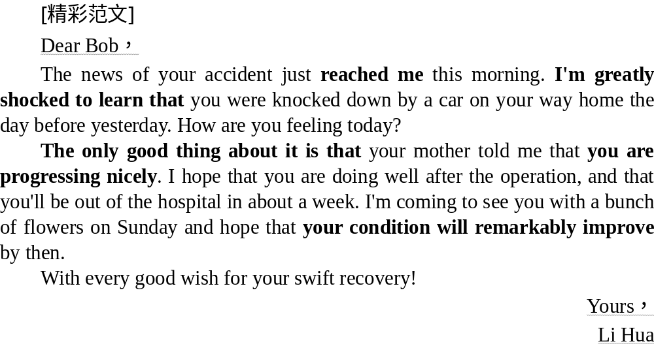
答案

Slide 85
4 实用写作模板
Dear ××，
I read from today's newspaper about recent ________ (事件) and I am writing to extend my deepest condolences.
I am really worried about you and your ________ (对方的遭遇). I am crossing my fingers for you now in hope that ________ (克服困难)．

Slide 86
I can imagine how difficult it must be for you, and I want to let you know that you have my full support. I ________ (所做事情). Please let me know if I can help you with anything else.
I feel extremely sorry for ________ (事件), and I am convinced that you will ________ (表达祝愿)．
Yours，
××

Slide 87
5 仿写演练助提升
(2020·浙江高考)假定你是李华，你校来自爱尔兰的外教Peter因病回国休假。请给他写一封电子邮件，内容包括：
1．询问近况；
2．分享班级最新消息；
3．表达祝愿。
注意：1.词数80左右；
2．可适当增加细节，以使行文连贯。
_______________________________________________________________________________________________________________________________________________________________________________________________

Slide 88
[精彩范文]
Dear Peter，
I am sorry to hear that you have gone back home on sick leave. How are you feeling now?
I hope my good news for you will sweep away the shadow of disease. Last month, an English festival was held in our school, and our class performed a song which you taught us at the festival. As soon as we finished the song, all the audience gave us warm applause. If only you had been there.
We all miss you very much and wish you a quick and complete recovery.
Yours，
Li Hua
答案

Slide 89
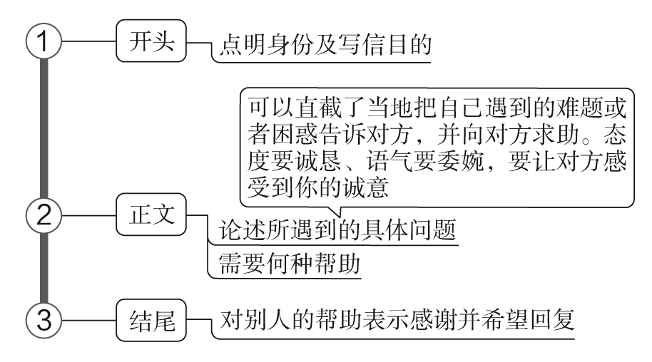
求助信
1 技法一点通

Slide 90
2 吸引读者的句式
(1)开头常用句
I'm sorry to bother you, but I have some difficulties and I need your help.我很抱歉打扰您，但我遇到了一些困难需要您的帮助。
I'm writing to ask your help for our schoolmate. 我给您写信为我们的校友向您求助。
Now I'm writing to ask you for help. During the summer holidays, I'd like to get a job. Would you please do me a favor? 现在我写信向您求助。暑假期间我想找份工作。您能帮我这个忙吗？
I'm a middle school student and I'm writing to tell you my problem which has troubled me. 我是一名中学生，我写信想告诉您一个困扰我的问题。

Slide 91
(2)正文常用句
But this is the first time that I have written an application and the personal resume, so I wonder if there is something to pay attention to. So, I'm writing you the letter, hoping you can do me the favor. 但是这是我第一次写申请和个人简历，所以不知道该注意什么。所以我写信求助，盼望您能帮忙。
I seem not to be able to fit in well with others here. 在这里我很难跟其他人相处。
I don't feel quite accustomed to the life here. 我不太习惯这里的生活。

Slide 92
It is the first time for me to apply for a job, and I'm not quite familiar with the format of the resume and the job application. So would you please do me a favor to correct the mistakes of the words and format in these materials? 这是我第一次申请工作，我对简历以及工作申请的格式不熟悉。所以您能帮我纠正材料中措辞及格式方面的错误吗？
I can't concentrate on my lessons these days, and I failed in the last exam, which worries me a lot. 这几天我不能集中精力上课，上次考试我没及格，这让我很担心。

Slide 93
(3)结尾常用句
I will be very grateful if you can do me the favor. 我将感激不尽，如果您能帮我的忙。
If possible, when can I come to meet you at your earliest convenience? Will Friday afternoon do? 如果可能的话，在您最方便的时候我去见您？星期五下午行吗？

Slide 94
3 经典例文回放
假如你是李华。本学期你校开设了英语口语课，由于你不太适应外教Chris的授课，你决定给她写一封求助信。内容包括：
1．告诉她你的困难；
2．求助的内容；
3．希望得到帮助。
注意：1.写作词数应为80左右；
2．可以适当增加细节，以使行文连贯；
3．开头和结尾已为你写好，不计入总词数。

Slide 95
Dear Chris，
I am Li Hua, one of your students in Oral English class.
_________________________________________________________________________________________________________________________________________________________________________________________________________________________________________________________________________________________________________________________________
Yours，
Li Hua

Slide 96
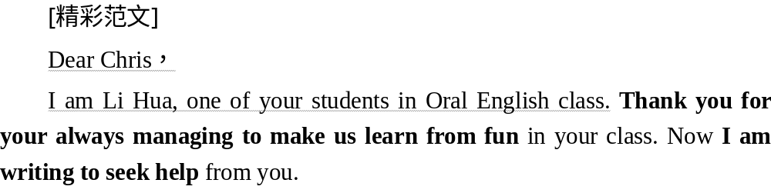
答案

Slide 97
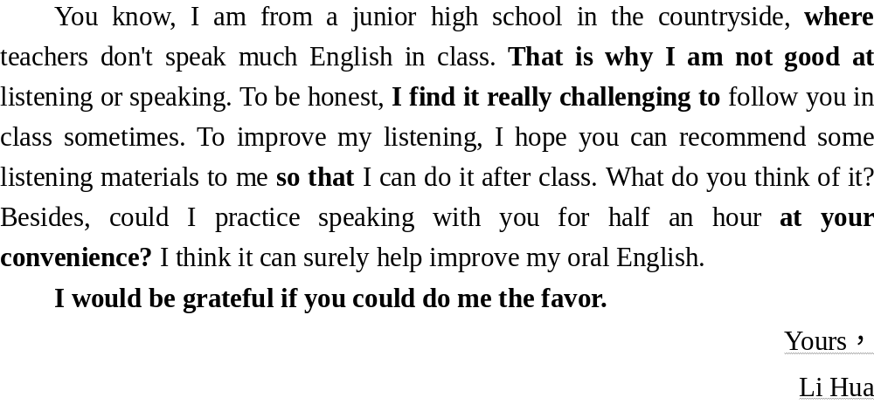
答案

Slide 98
4 实用写作模板
Dear ××，
My name is ________ (自我介绍). I'm writing the letter to you to ask for some help. I have met much difficulty in ________ (困难的事情).
First, I find ________ (困难一). Besides, ________ (困难二). What's more, ________ (困难三). Faced with so much difficulty, I have to ask you for some help. Would you like to introduce me to some good ways to ________ (解决该困难) so that I can deal with it more easily? In the meanwhile, I hope ________ (希望得到的方法一). Also, I would like you to ________ (方法二)．
I will be very grateful if you do me the favor.
Yours，
××

Slide 99
5 仿写演练助提升
(2020·全国卷Ⅲ改编)假定你是李华，你和同学根据英语课文改编了一个短剧。给外教Miss Evans写封邮件，请她帮忙指导。邮件内容包括：
1．剧情简介；
2．指导内容；
3．商定时间地点。
注意：1.写作词数应为80左右；
2．开头和结束语已为你写好，不计入总词数。

Slide 100
Dear Miss Evans，
_________________________________________________________________________________________________________________________________________________________________________________________________________________________________________________________________________________________________________________________________
Looking forward to your early reply. Best regards!
Yours truly，
Li Hua

Slide 101
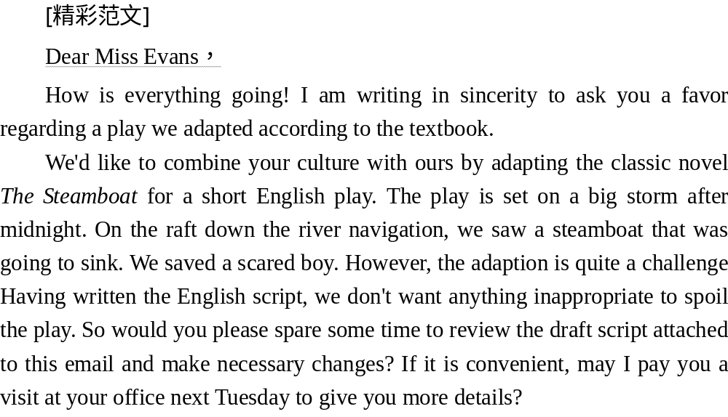
答案

Slide 102
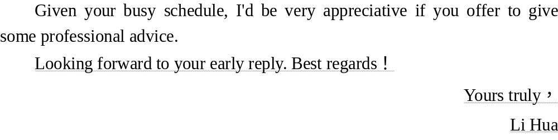
答案

Slide 103
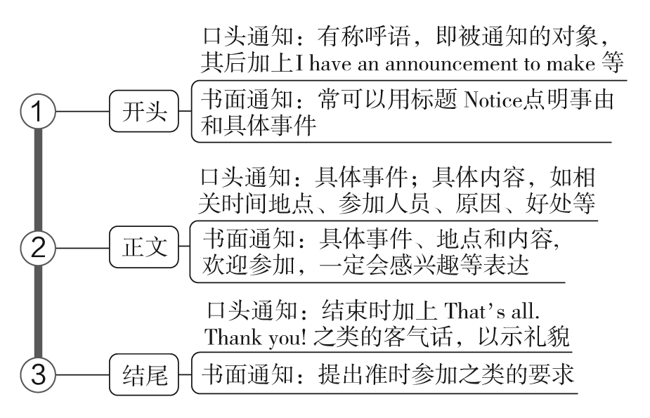
通知
1 技法一点通

Slide 104
2 吸引读者的句式
(1)开头常用句
Attention, please, I have something to tell you. 注意，我有一些事情要通知你们。
Good news for you! In order to help students learn Chinese better, we will hold a series of film presentations. 好消息！为了帮助大家学好汉语，我们将举办一系列电影展。

Slide 105
(2)正文常用句
As scheduled, the lecture is supposed to take place in our lecture hall, at 3：00 on Tuesday afternoon. 按计划，讲座在周二下午三点在报告厅举行。
The whole activity is scheduled to last three hours from six to nine on the evening of 9th, June. 整个活动预计持续三个小时，六月九号晚上从六点到九点。
It has been decided that we'll pay a visit to the Happy Valley. 我们已经决定去游览欢乐谷。

Slide 106
(3)结尾常用句
Your contribution will certainly make the event a huge success. 你的贡献一定会促成本赛事的圆满成功。
Come on, everybody! It's your show time. 来吧，大家一起！表现自己的时间到来了！
If you are interested, please arrive on time. 如果你感兴趣，请按时到场。
All the teachers and students are welcome to attend our English evening. 欢迎所有的老师和学生参加我们的英语之夜。

Slide 107
3 经典例文回放
你受学生会委托为校宣传栏“英语天地”写一则通知，请大家观看一部英文短片Growing Together，内容包括：
1．短片内容：学校的发展；
2．放映时间、地点；
3．欢迎对短片提出意见。
注意：1.写作词数应为80左右；
2．可以适当增加细节，以使行文连贯。

Slide 108
Notice
_________________________________________________________________________________________________________________________________________________________________________________________________________________________________________________________________________________________________________________________________

Slide 109
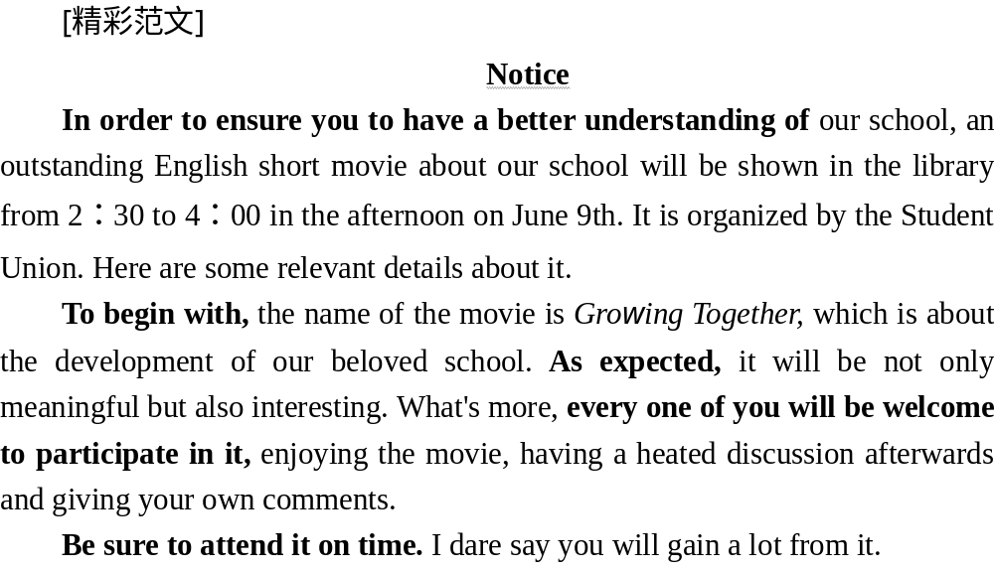
答案

Slide 110
4 实用写作模板
(1)口头通知
May I have your attention, please? I have an announcement to make.
There will be ________ (介绍活动内容). It will ________ (活动的时间、地点等). All ________ (参与人员) are required to attend it. By the way, please ________ (其他注意事项). Please arrive on time and don't be late. I hope ________ (祝愿)．
That's all. Thank you.

Slide 111
(2)书面通知
Notice
________ (主办单位) will organize ________ (活动). The activity aims to ________ (目的). It is planned to begin on ________ (时间). Your main task is to ________ (任务). Anyone who ________ (参加条件) is warmly welcomed. Those who are interested can contact ________ (联系方式) for further information. Looking forward to your active participation.

Slide 112
5 仿写演练助提升
假如你是李华，得知国际部学生很想了解关于丝绸之路的内容，学校举办相关英文讲座。请你通知国际部学生参加，内容包括：
1．时间：周五下午3点；
2．地点：报告厅；
3．内容：大学教授讲授丝绸之路；
4．提示：准时到场；可以提问。
注意：1.写作词数应为80左右；
2．可以适当增加细节，以使行文连贯；
3．开头和结尾已给出，不计入总词数。

Slide 113
Boys and girls，
May I have your attention, please?
_________________________________________________________________________________________________________________________________________________________________________________________________________________________________________________________________________________________________________________________________
That's all. Thank you!

Slide 114
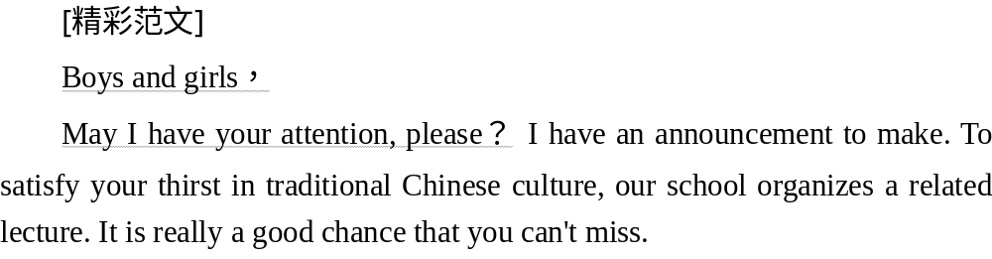
答案

Slide 115
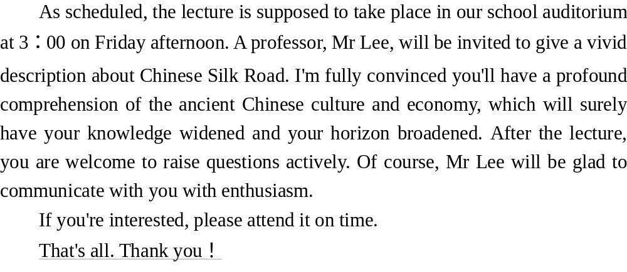
答案

Slide 116
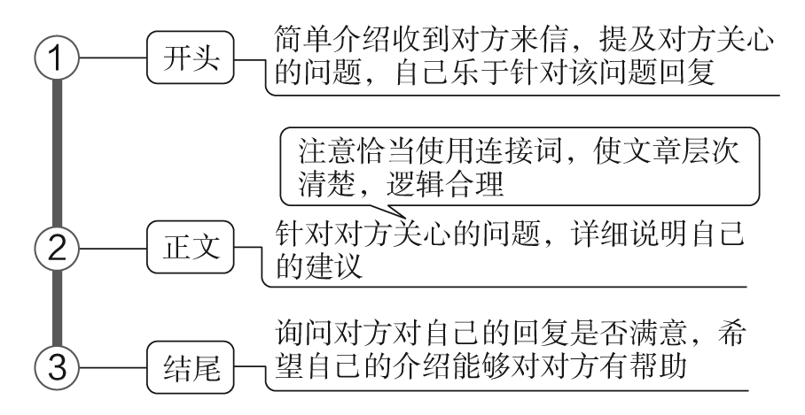
邮件回复
1 技法一点通

Slide 117
2 吸引读者的句式
(1)开头常用句
In your last email, you asked me about the event, and now I'd like to offer you some information. 在上封邮件中，你询问我那次活动，现在我愿意提供一些信息给你。
I wouldn't be more pleased to hear from you, learning that you're interested in the activity. 我很高兴收到你的来信，知道你对这个活动感兴趣。
I'm glad to hear from you, learning that you're planning to come to China. 很高兴收到你的来信，听说你打算来中国。
I'm writing to share with you some information you're interested in. 我写这封信是想告诉你一些你感兴趣的信息。

Slide 118
(2)正文常用句
There is no doubt that people everywhere in China are taking measures to improve the environment. 毫无疑问，中国各地的人们都在采取措施改善环境。
Of all the traditional Chinese arts, Peking Opera should be my favorite. 在所有的中国传统艺术中，京剧应该是我的最爱。
With the intention of making our school life colorful and broadening our horizon, our school launched an activity named Student Talk last week. 为了使我们的学校生活丰富多彩，开阔我们的视野，我们学校上周举办了一个名为“学生讲坛”的活动。

Slide 119
Speaking of anything meaningful, making a time schedule is definitely the one I value most, which ensures me to lead a richer life. 说到任何有意义的事情，制作一个时间表绝对是我最看重的，它能确保我过上更丰富的生活。
The activities mentioned above are quite popular with students, among which my favorite kind of activity is field trips. 上面提到的活动很受学生们的欢迎，其中我最喜欢的一种活动就是实地考察。

Slide 120
(3)结尾常用句
Sounds great? What about the extracurricular activities in your school? 听起来不错？ 那你们学校的课外活动呢？
Do you feel an itch about it? Anyway, you should really go to a Peking Opera performance and experience this typical traditional art. 你是不是很感兴趣呀？不管怎样，你真的应该去看场京剧，体验一下这种典型的传统艺术。
To be honest, I've learned a great deal from this valuable experience. 老实说，我从这次宝贵的经历中学到了很多。

Slide 121
Only through this experience did I realize that making our dream come true is something worth pursuing. 只有通过这次经历，我才意识到，追逐梦想是值得做的事情。
What do you think of it? Do you have anything interesting like this to share with me? Looking forward to your reply. 你觉得怎样？你有什么类似有趣的事情要告诉我吗？期待你的回复。

Slide 122
3 经典例文回放
假如你是李华，你的留学生朋友对最近CCTV报道的“家风(Family Traditions)”节目很感兴趣。请你根据提示写一封邮件。内容要点：
1．家风的作用；
2．你的家风；
3．对你的影响。
注意：1.写作词数应为80左右；
2．开头和结尾已给出，不计入总词数。

Slide 123
Dear Jim，
_________________________________________________________________________________________________________________________________________________________________________________________________________________________________________________________________________________________________________________________________
Yours，
Li Hua

Slide 124
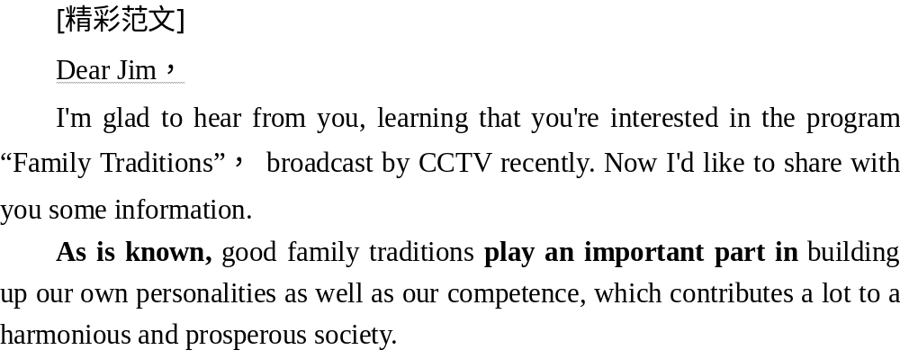
答案

Slide 125
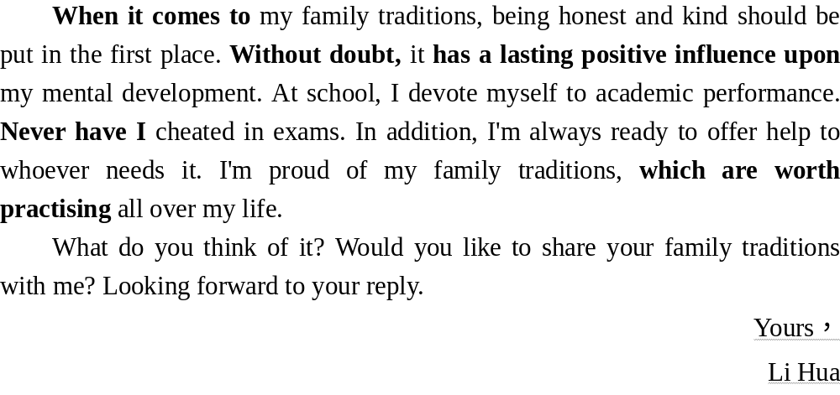
答案

Slide 126
4 实用写作模板
Dear ××，
I'm delighted to hear from you, knowing that you're interested in the ________ (对方提到的内容) our school organized. Now I'm more than willing to answer your questions regarding to the event.
The event took place ________ (介绍回复的内容). It's no doubt that it was an event hard to forget. Through this event, ________ (事件或活动感悟)．
Are there any similar activities in your school and country that you find interesting and meaningful? Please share with me about it. I can't wait to hear from you again.
Yours，
××

Slide 127
5 仿写演练助提升
(2020·天津高考改编)假设你是晨光中学高三学生李津。你校于6月8日举办了成人礼活动，你的英国朋友Chris很想了解该活动。你于当晚给Chris回一封电子邮件，介绍有关情况，内容包括：
(1)成人礼活动内容(成长点滴回顾、观看校友抗疫事迹录像等)；
(2)对活动的感受；
(3)对自己未来的展望。
注意：(1)写作词数应为80左右；
(2)可适当加入细节，使内容充实、行文连贯；
(3)开头和结尾已给出，不计入总词数。
参考词汇：成人礼 the coming­of­age ceremony；新冠肺炎 COVID­19

Slide 128
Dear Chris，
I'm so glad to hear from you.
_________________________________________________________________________________________________________________________________________________________________________________________________________________________________________________________________________________________________________________________________
Yours，
Li Jin

Slide 129
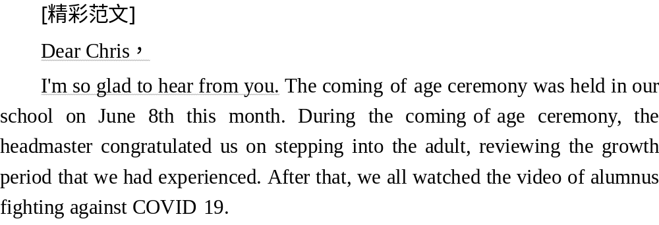
答案

Slide 130
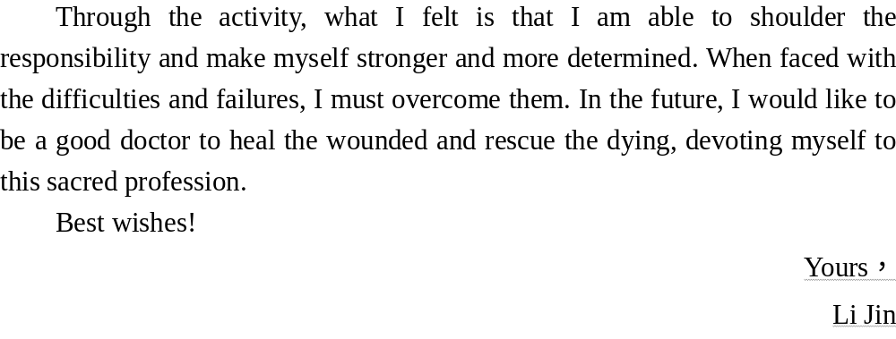
答案

Slide 131
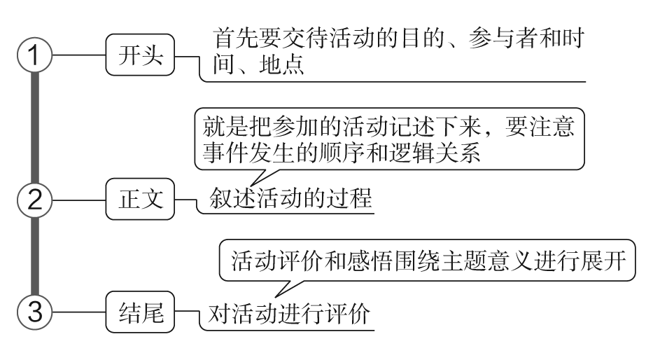
通讯报道
1 技法一点通

Slide 132
2 吸引读者的句式
(1)开头常用句
In order to encourage the students to take outdoor exercise, our school organized a mountain­climbing on April 10th. 为了鼓励学生参加户外活动，我校于4月10日组织了爬山活动。
In order to raise the awareness of protecting our environment, the Student Union of our school organized an activity from June 3rd to June 5th. 为了提高我们的环保意识，我校学生会组织了一次活动，时间6月3日至5日。

Slide 133
(2)正文常用句
At 8：00, we gathered at the foot of the mountain and set out for the top in high spirits. 上午8点钟，我们在山脚下集合，然后兴致盎然地向山顶进发。
Hundreds of students took part in it. 很多同学参加。
We were chatting and laughing all the way, fully enjoying the fresh air and the beautiful scenery. 我们一路上有说有笑，尽情地享受新鲜空气和美丽景色。
About 2 hours later, we all reached the destination. 两小时后，我们到达目的地。
Bathed in the brilliant sunshine, we jumped and cheered with joy. 沐浴在灿烂的阳光下，我们高兴地欢呼雀跃。

Slide 134
(3)结尾常用句
The activity benefited us a lot. 这次活动使我们受益匪浅。
Not only did it get us close to nature and give us relaxation from heavy school work, it also promoted the friendship among us. 它不仅让我们接近自然、从繁重的课业中得到放松，而且提升了我们之间的友谊。
What a wonderful activity! 多么有意义的一次活动啊！

Slide 135
3 经典例文回放
假如你是李华，你们学校上周五举办了“校园书市”的活动。请根据下表提供的信息写一篇报道，介绍活动情况，并谈谈你对此次活动的感想。
注意：1.写作词数应为80左右；
2．可以适当增加细节，以使行文连贯。
参考词汇：校园书市 School Book Fair

Slide 136
Time | last Friday
Place | on the playground
Activities | •buy books •exchange books •send books to the Hope Project schools • ...
_______________________________________________________________________________________________________________________________________________________________________________________________

Slide 137
[精彩范文]
In order to offer the students chances to live a colourful school life, we organized our first School Book Fair in our school last week, which was really interesting.
Last Friday, our first School Book Fair finally opened. It was held on the playground in the afternoon. So many students went there. At the fair, some were selling old books; others were trading books with each other. Price was not too important; we just didn't want to waste the used books. I, for example, traded my Little Prince for Alice in the Wonderland which I had wanted to buy from the bookstore.
答案

Slide 138
The book fair also gave us a chance to contribute our bit to the Hope Project schools. By the time the fair closed, we had donated about two hundred books for schools in western China.
Through this activity, not only did we pass our love and friendship to others, but we also enriched our own school life.
答案

Slide 139
4 实用写作模板
In order to ________ (目的), our school organized an activity on ________ (日期). Hundreds of us took part in it. ______________________ (具体活动过程或内容)．
______________________ (活动感受). What a wonderful time!

Slide 140
5 仿写演练助提升
(2020·新高考Ⅰ卷)假定你是李华，上周日你校举办了5公里越野赛跑活动。请你为校英文报写一篇报道，内容包括：
1．参加人员；
2．跑步路线：从校门口到南山脚下；
3．活动反响。
注意：1.写作词数应为80左右；
2．请按如下格式在相应位置作答。

Slide 141
A Cross­Country Running Race
_________________________________________________________________________________________________________________________________________________________________________________________________________________________________________________________________________________________________________________________________

Slide 142
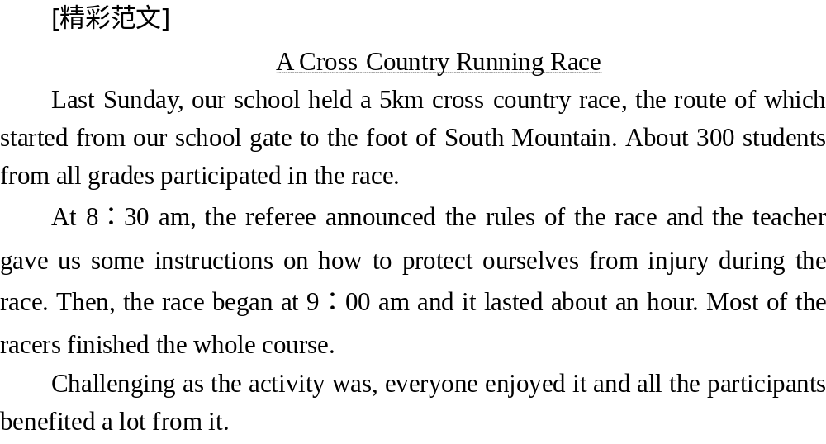
答案

Slide 143
本课结束

