Slide 1
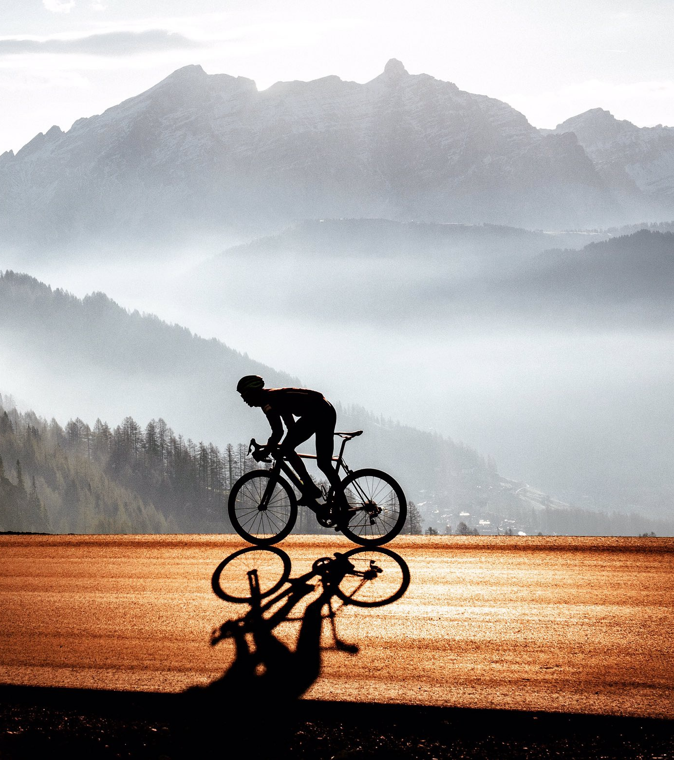
PROJECT SEMINAR: APP FOR TRAINING ANALISYS
Andraž Anderle & Jan Jovan
Menthor: prof. Branko Kavšek

Slide 2
outline
About authors
Project idea
Project requirements
Tools
Other apps
Work plan

Slide 3
authors
Andraž Anderle
Team lead, project lead
Native iOS/Android dev
Jan Jovan
Backend developer
AI engineer

Slide 4

Project idea
Mobile app (Android/iOS)
User can analyze trainings
Form tracking, intervals, training plan,…
Cycling, possible other sports

Slide 5

Project requirements
Simple to use
Easy to understand
Powerful tool
Many functions

Slide 6
Training analysis
Training upload from 3rd party apps
Various data fields
Graphs
Coaching option

Slide 7
TOOLS
Mobile app:
UI: Figma
?: Flutter
Backend: ?
…
Training data processing:
Python
Libraries: *

Slide 8
TOOLS
Version control: GitHub
Task management: Notion
*

Slide 9
Other apps
Strava
Garmin Connect
TrainingPeaks
Free software: Intervals.icu

Slide 10
Work plan
tba

