Slide 1
Docker for Developers

Slide 2
Agenda
Introduction to Docker
Docker Basic Commands
Lab 1
Dockerfile Basics
Build, Publish
Lab 2
Lab 3
Dockerfile Best Practices
Docker Stack
Lab 4
Utility Containers
UCP and DTR overview
Pipeline Example
Docker Entities

Slide 3
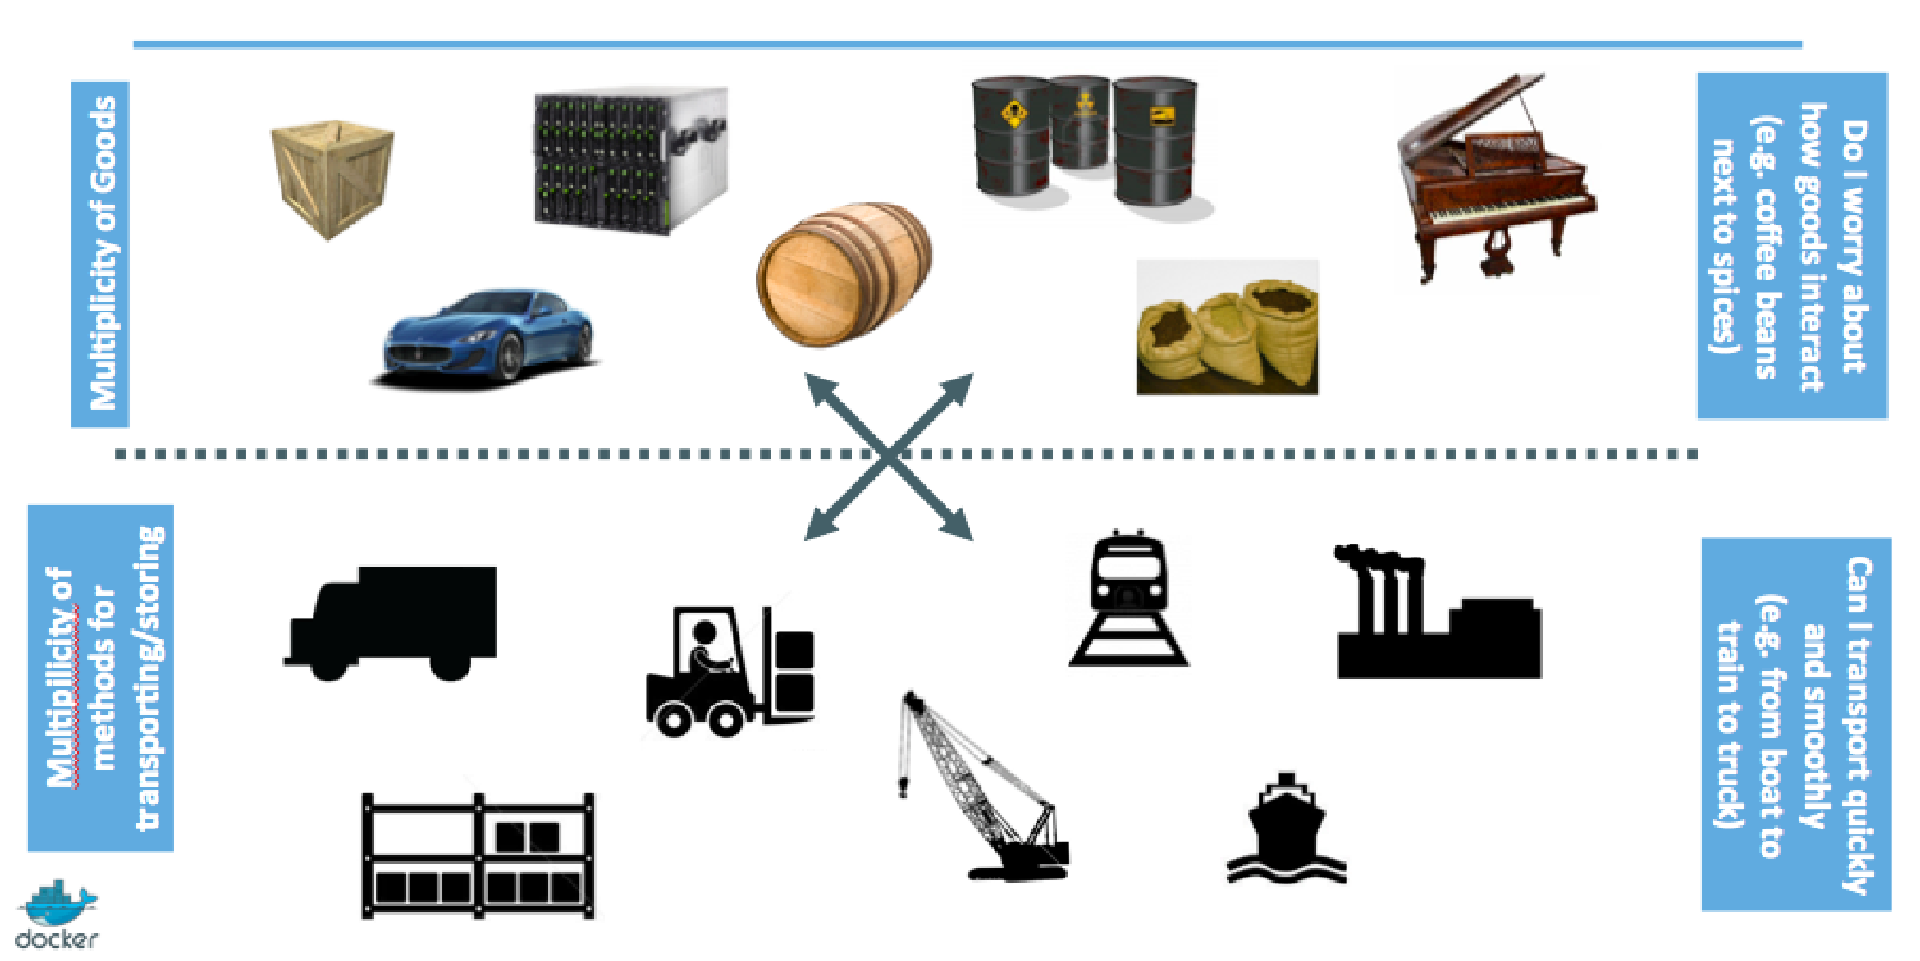
History of Containers

Slide 4
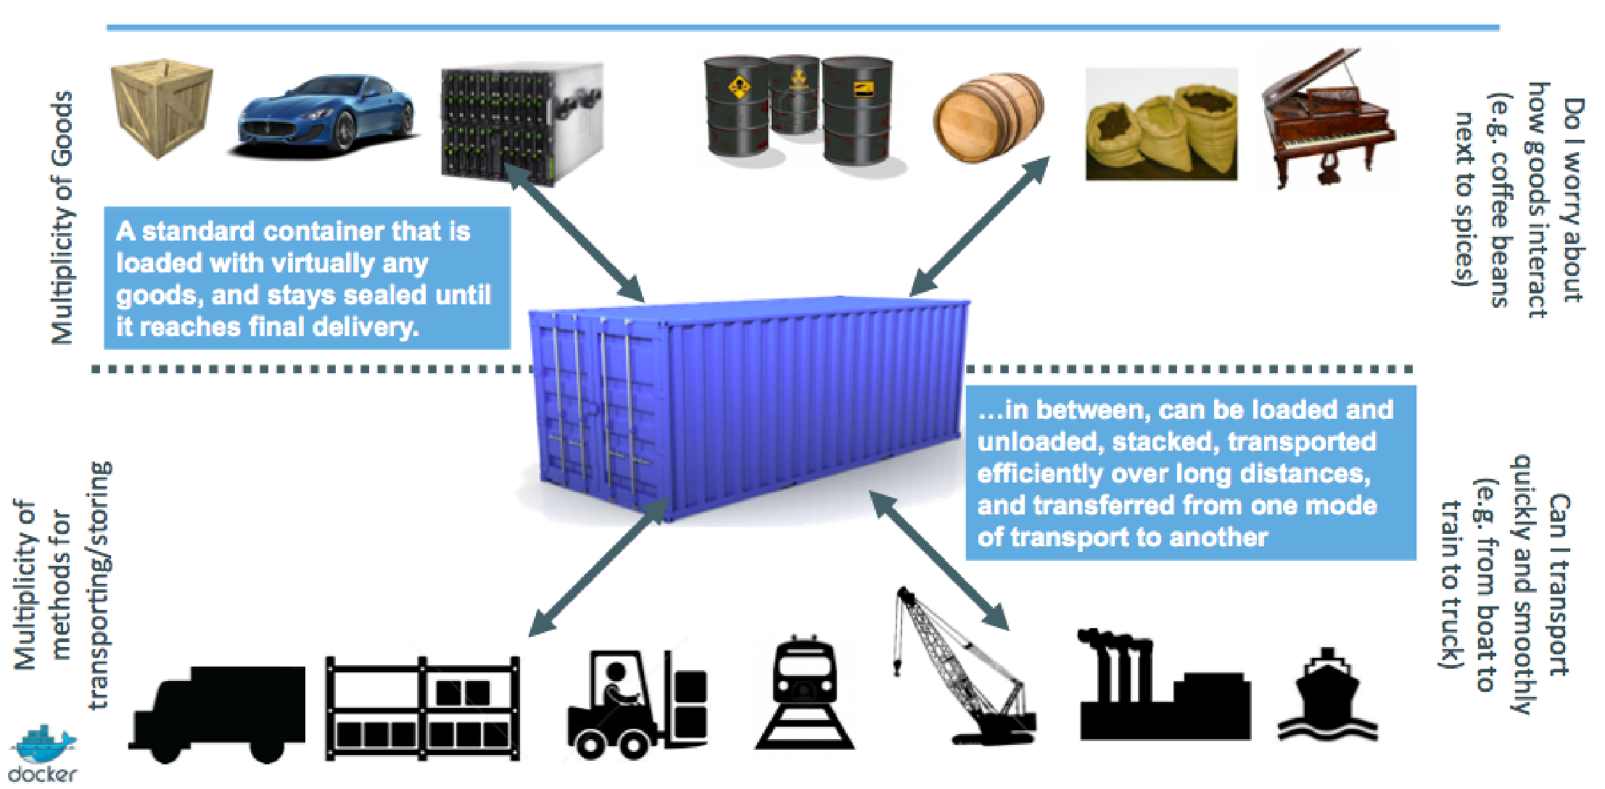
History of Containers

Slide 5
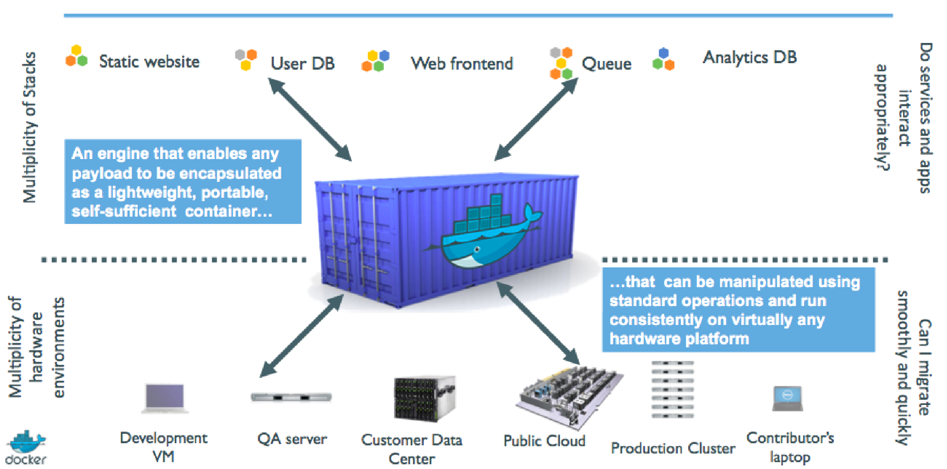
History of Containers

Slide 6
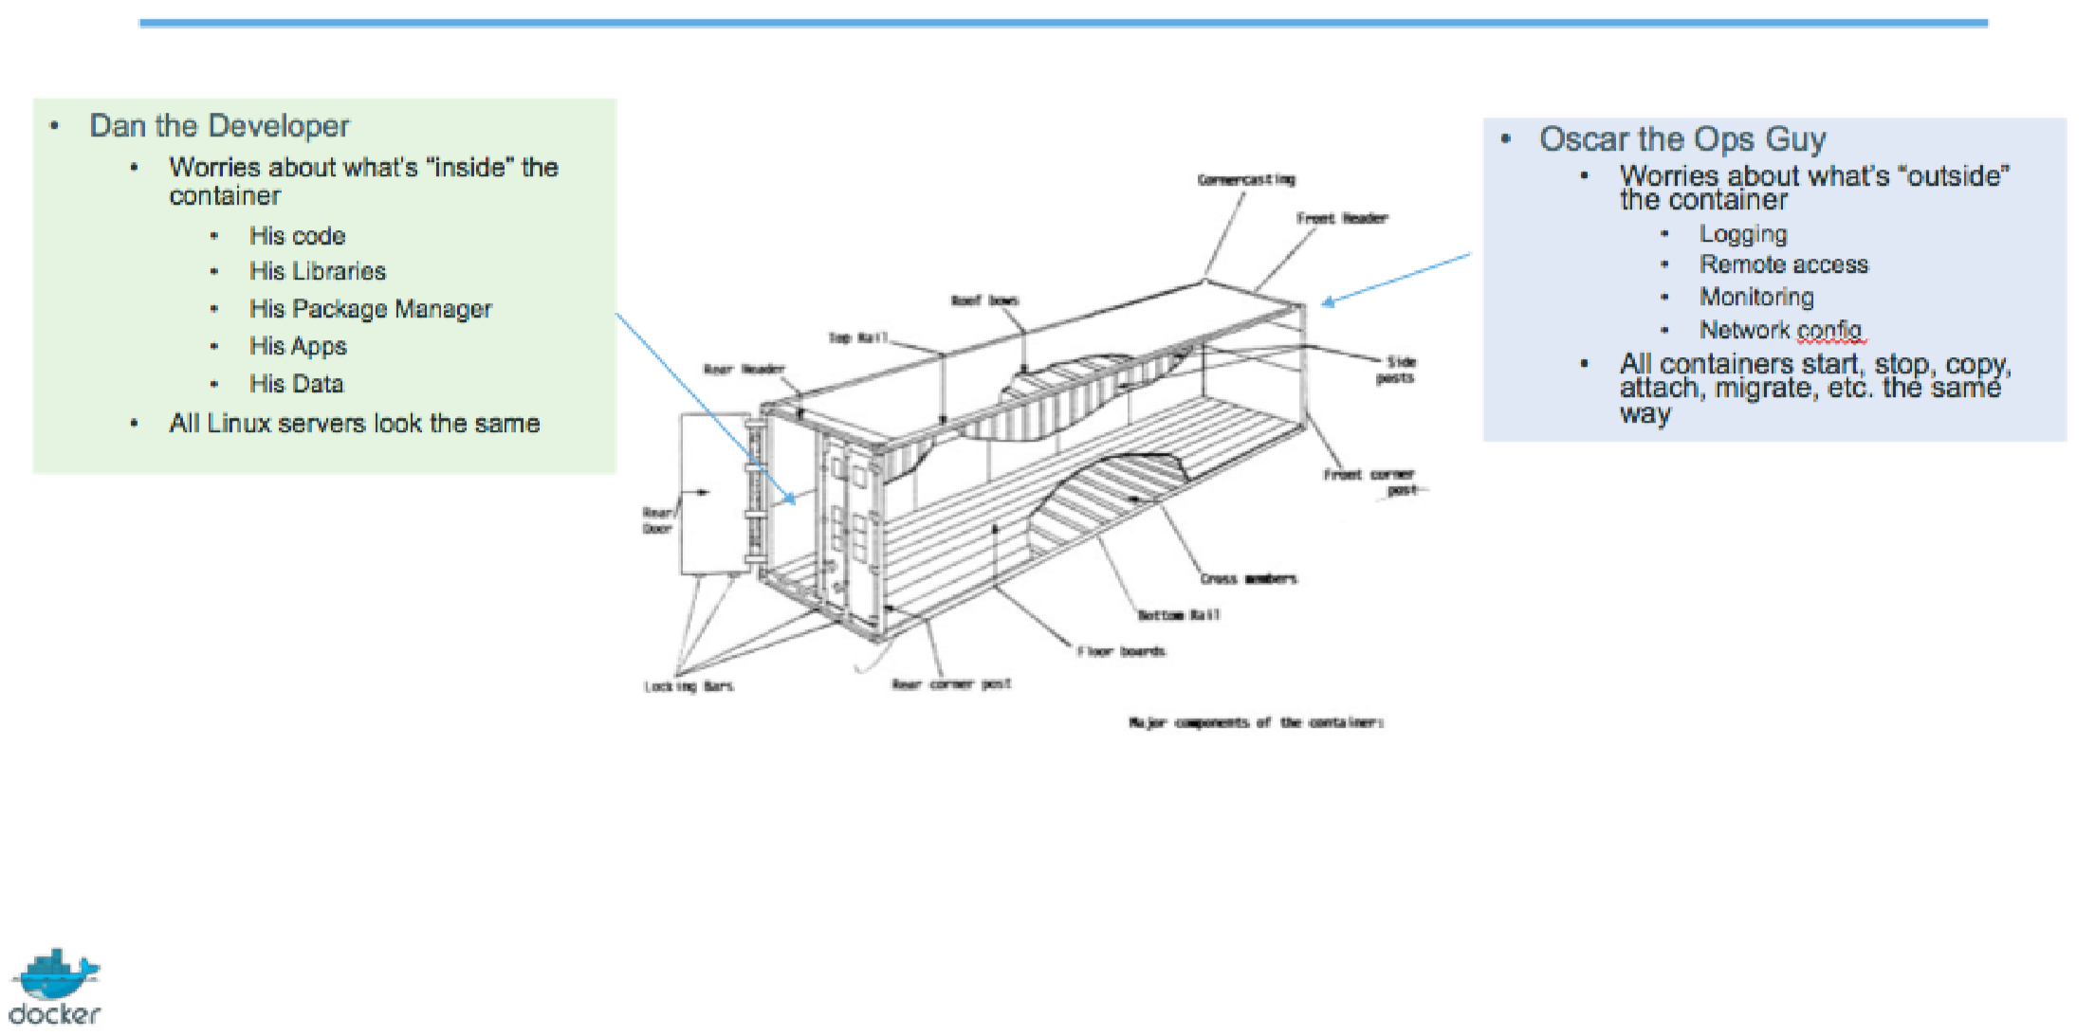
History of Containers

Slide 7
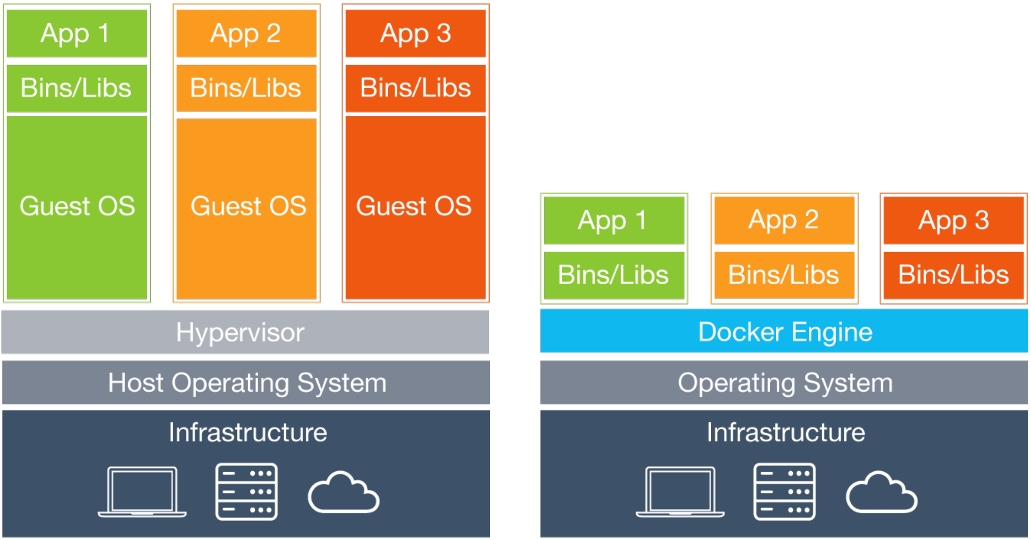
Container vs. Virtual Machine

Slide 8
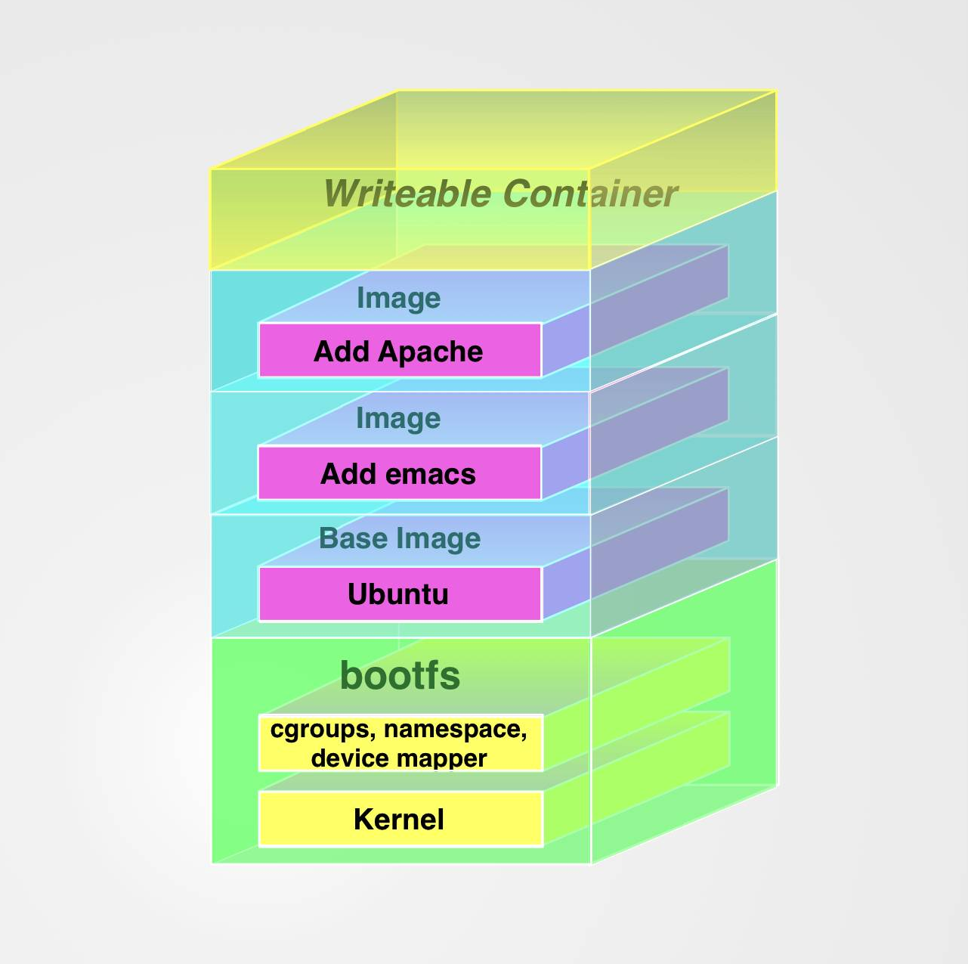
Images
The major difference between a container and an image is the top writable layer.
All writes to the container that add new or modify existing data are stored in this writable layer.
When the container is deleted the writable layer is also deleted. The underlying image remains unchanged.

Slide 9
Docker Basics Commands
docker version
docker login [OPTIONS] [SERVER]
docker run [OPTIONS] IMAGE [COMMAND] [ARG...]
docker run –d –it –rm –p8080:8080 tomcat:8 bash
docker image ls [OPTIONS] [REPOSITORY[:TAG]]
docker container COMMAND
docker container ls
> docker container ls
CONTAINER ID IMAGE COMMAND CREATED STATUS PORTS NAMES
70834af719ee tomcat:8 "catalina.sh run" 52 seconds ago Up 49 seconds 0.0.0.0:8080->8080/tcp festive_lamarr
docker container ls -a
docker container rm [OPTIONS] CONTAINER [CONTAINER...]
docker container rm $(docker container ls –aq)
docker image rm [OPTIONS] IMAGE [IMAGE...]

Slide 10
Docker Basics Commands
docker exec [OPTIONS] CONTAINER COMMAND [ARG...]
> docker exec -it 70834af719ee bash
root@70834af719ee:/usr/local/tomcat# ls
LICENSE NOTICE RELEASE-NOTES RUNNING.txt bin conf include lib logs native-jni-lib temp webapps work
docker inspect [OPTIONS] NAME|ID [NAME|ID...]
docker logs [OPTIONS] CONTAINER
https://docs.docker.com/engine/reference/commandline

Slide 11
Hands ON LABS
https://github.com/CapstoneConsultingInc/docker-training-labs/tree/master/Docker-for-Developers
There are 4 labs – Lab 1, Lab 2, Lab 3 and Lab 4

Slide 12
Lab 1
Perform Lab 1
15 minutes

Slide 13
Review Lab 1
Show docker version and settings info
From the taskbar
Click on the show hidden icon (“^”)
Click on the docker symbol (Moby) choose option of interest.
From the cmd line
docker version
docker –help
Login to hub.docker.com
You will have to have an account in docker hub to pull images from.
docker login
Run hello-world
docker run hello-world

Slide 14
Review Lab 1
Show docker image
docker image ls
Show docker containers
docker container ls
docker container ls -a
Start tomcat:8.0 container
docker run –d –p8080:8080 –name tomcat tomcat
List container get id
Exec into container
docker exec –it <container id> bash
List “/” and log directories in container
exit

Slide 15
Review Lab 1
Inspect container
docker inspect <container id>
Look at docker logs

Slide 16
Dockerfile Basics
FROM docker-dtr.company.com/company/jdk:8u131-jre
RUN mkdir /data /ade
COPY ./install/lib/* /ade/jars/
EXPOSE 8443
ENTRYPOINT [ "java", "-cp", "/ade/jars/*" ]
CMD [ "-Xmx3g", "-showversion", \
"com.company.gsa.gap.rating.testharness.AdeTestHarnessMonitor", \
"TDTEST", "C_GAP_R_TB", "C_GAP_ADEUR_TB", "C_GAP_SBXC5", …, "10"]

Slide 17
Dockerfile Basics
FROM
Choose minimal image (and enterprise trusted)
Remove unnecessary packages and files
For Java apps use OpenJDK
https://store.docker.com/images/openjdk
Alpine vs Debian
Docker imposes ndots:0 in current resolv.conf. This conflicts with dns search and prevents containers from finding nodes in an intranet using short names.
musl libc vs glibc

Slide 18
Dockerfile Basics
EXPOSE
Expose - designates which network ports will be exposed by the container.

Slide 19
Dockerfile Basics
RUN
RUN mkdir /data /ade
RUN yum install my-special-util
COPY or ADD
COPY ./install/lib/* /ade/jars/
Preferred - only supports basic copying of local files into the container
ADD rootfs.tar.xz /
Local tar file auto-extraction into the image
Bad
ADD http://example.com/big.tar.xz /usr/src/things/
RUN tar -xJf /usr/src/things/big.tar.xz -C /usr/src/things
RUN make -C /usr/src/things all
Good
RUN mkdir -p /usr/src/things \
&& curl -SL http://example.com/big.tar.xz | tar -xJC /usr/src/things \
&& make -C /usr/src/things all

Slide 20
Dockerfile Basics
ENTRYPOINT
Two formats – exec vs shell
ENTRYPOINT [ "java", "-cp", "/ade/jars/*" ]
ENTRYPOINT java –cp /ade/jars/*
Allows image to be run as though it was that command
docker run ade:v1 AdeResetTables param1
docker run ade:v1 AdeRun param1 param2 paramN
CMD
Used by itself instead of ENTRYPOINT
CMD [ "/my-static-binary" ]
Used as parameters to ENTRYPOINT
CMD [ "-Xmx3g", "-showversion", "com.company.gsa.gap.rating.testharness.AdeTestHarnessMonitor", ...
Two formats – exec vs shell

Slide 21
Build
Build
docker build –t noop:1.1 .
docker image ls
REPOSITORY TAG IMAGE ID CREATED SIZE
noop latest f7f9041de214 40 seconds ago 1.13 MB
busybox latest efe10ee6727f 5 days ago 1.13 MB
nicolaka/netshoot <none> ae5da1e3feb2 3 months ago 37.3 MB
docker-dtr.company.com/actuarial/adebaseline v3 8e3ec2f8d3ab 3 months ago 745 MB
docker build -t docker-dtr.company.com/company/noop:1.1 .

Slide 22
Build, Publish
Publish
docker image tag noop:1.1 docker-dtr.company.com/company/noop:1.1
REPOSITORY TAG IMAGE ID CREATED SIZE
docker-dtr.company.com/company/noop 1.0 f7f9041de214 3 minutes ago 1.13 MB
noop latest f7f9041de214 40 seconds ago 1.13 MB
busybox latest efe10ee6727f 5 days ago 1.13 MB
nicolaka/netshoot <none> ae5da1e3feb2 3 months ago 37.3 MB
docker-dtr.company.com/actuarial/adebaseline v3 8e3ec2f8d3ab 3 months ago 745 MB
docker push docker-dtr.company.com/company/noop:1.1
The push refers to a repository [docker-dtr.company.com/company/noop]
08c2295a7fa5: Pushed
1.0: digest: sha256:1ffc8abe7e8282ba6c220c22a043771092b083c5ac78ba343dfafca5279e3bae size: 527

Slide 23
Lab 2
Create Dockerfile to use tomcat:8.0
Expose 8443
Add certs
Change config file to use 8443
Execute image with port 8443 exposed.

Slide 24
Review Lab 2
from tomcat:8.0
copy server.xml /usr/local/tomcat/conf/
copy ssl.crt /usr/local/tomcat/conf/ssl.crt
copy ssl.key /usr/local/tomcat/conf/ssl.key
EXPOSE 8443

Slide 25
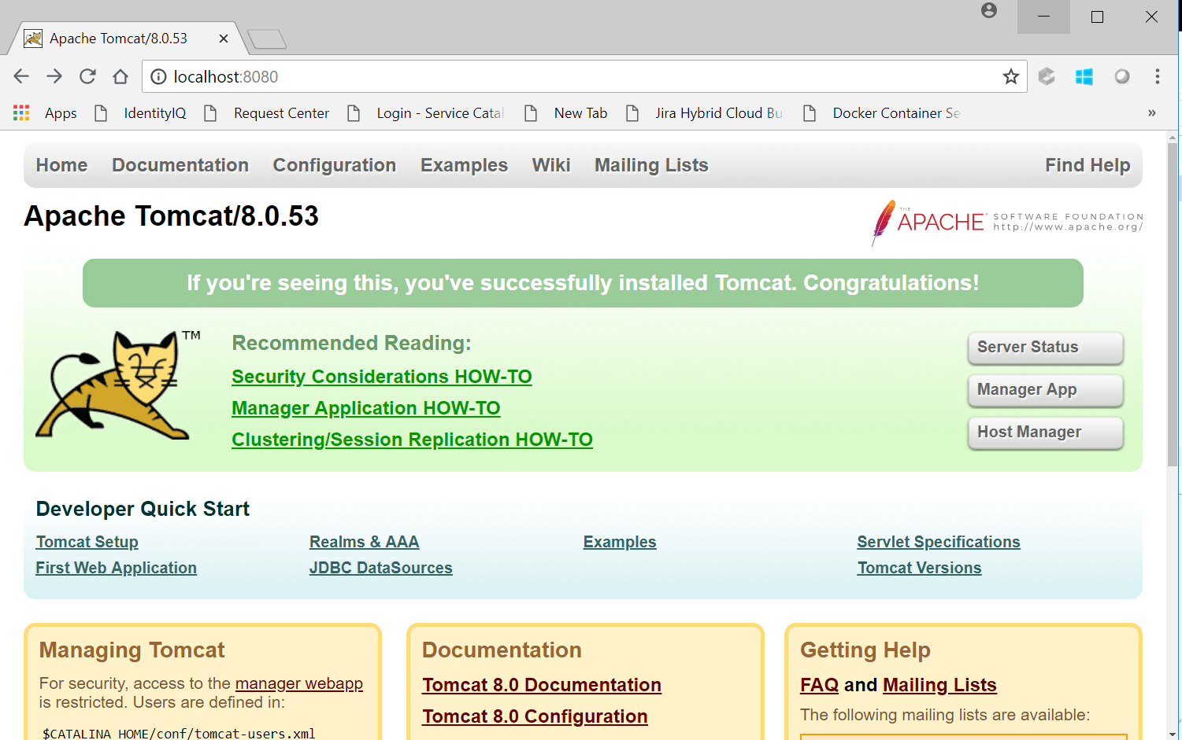
Review Lab 2

Slide 26
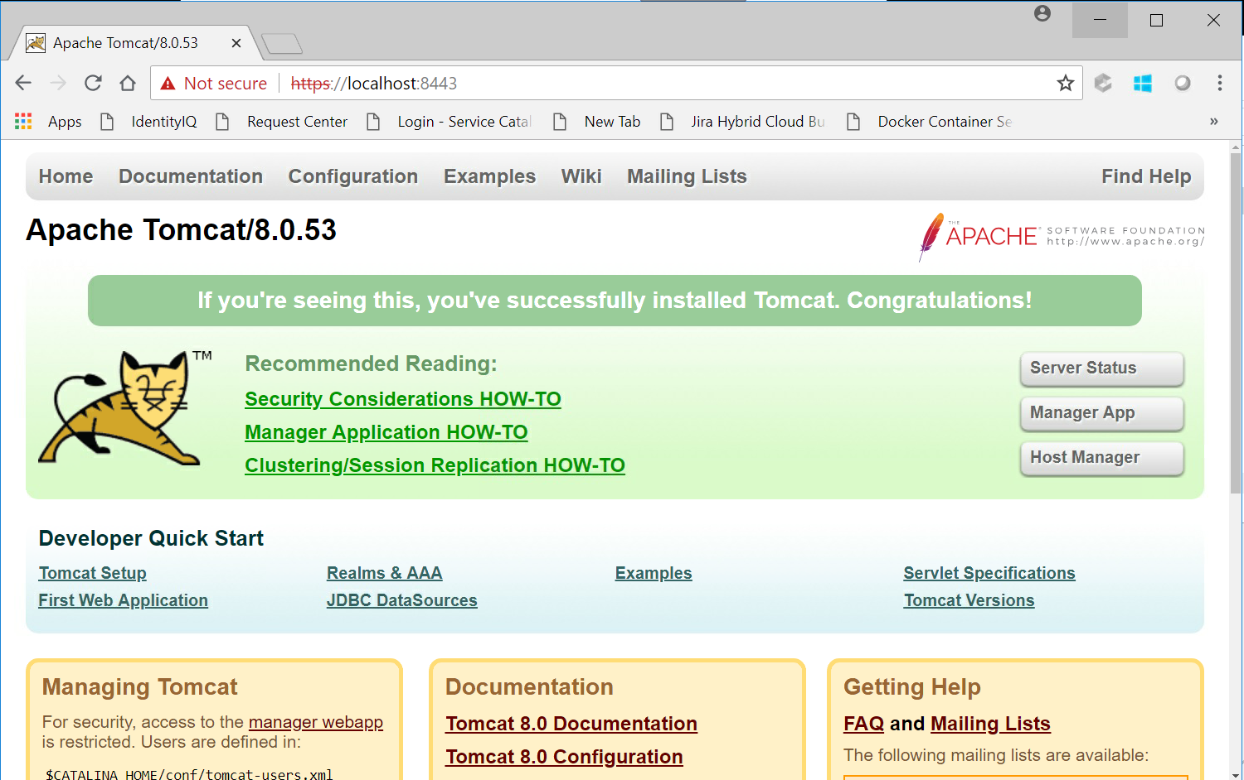
Review Lab 2

Slide 27
Lab 3
The object of this lab is to take an application and dockerize it.
In this case the app is a simple “greeting” spring-boot app.
Build the app
Create a Dockerfile and build an image
Run the Docker image
Validate the app is working

Slide 28
Review Lab 3
## Stage 1 - compile code and build jar
FROM openjdk:8 as builder
RUN mkdir /opt/complete
WORKDIR /opt/complete
COPY ./complete /opt/complete
RUN ls -lt /opt/complete
RUN ./gradlew build
RUN ls -ltR /opt/complete/build
## Stage 2 - copy jar and configure runtime
FROM openjdk:8
WORKDIR /root/
COPY --from=builder /opt/complete/build/libs/gs-spring-boot-0.1.0.jar .
#ENTRYPOINT ["tail", "-f", "/dev/null"]
ENTRYPOINT ["java", "-jar", "/root/gs-spring-boot-0.1.0.jar"]

Slide 29
Review Lab 3
> curl http://localhost:8080
StatusCode : 200
StatusDescription :
Content : Greetings from Spring Boot!
RawContent : HTTP/1.1 200
Content-Length: 27
Content-Type: text/plain;charset=UTF-8
Date: Fri, 03 Aug 2018 15:36:32 GMT
Greetings from Spring Boot!
Forms : {}
Headers : {[Content-Length, 27], [Content-Type, text/plain;charset=UTF-8], [Date, Fri, 03 Aug 2018 15:36:32 GMT]}
Images : {}
InputFields : {}
Links : {}
ParsedHtml : mshtml.HTMLDocumentClass
RawContentLength : 27

