Slide 1
Docker Swarm Stacks
Deploying Multiple Services
Where They Need to Be

Slide 2
Docker Stack Terminology
A stack is a group of interrelated services that share dependencies, and can be orchestrated and scaled together.
A single stack is capable of defining and coordinating the functionality of an entire application.
A stack file is a file in YAML format that defines the services and the resources are used by the services.
Stack files use compose file format, documented in detail at https://docs.docker.com/compose/compose-file/
Notes:
Note that this format is also used by docker-compose, and some of the features listed in the docs are not supported by Docker stacks (and vice-versa)
If you use features in a stack file that are not supported, they will be ignored instead of explicitly throwing an error

Slide 3
Docker Stack Deploy vs docker-compose
Docker-compose was intended to allow starting and running multiple containers together on a single machine
Docker stack deploy is used to deploy a stack on a Docker swarm, allowing the services in the stack to span multiple machines
Docker stack deploy only works in Docker Swarm Mode
With current versions of Docker, you can initialize a swarm on a single dev (desktop) machine and use docker stack deploy in that environment
Don’t use docker-compose if you are developing for a Docker Swarm environment
Notes:
If you are prototyping a stack on your local dev machine, use docker stack deploy, not docker-compose so that you use the options that are applicable to the Swarm environment
Note: Many examples you may find on the Internet used docker-compose features, or use legacy Docker features. Check that the features / instructions are supported for Swarm and for the Compose version you are using.

Slide 4
Simple Stack
When running Docker Engine in swarm mode, you can use docker stack deploy to deploy a complete application stack to the swarm. The deploy command accepts a stack description in the form of a Compose file.
version: ‘3.3’
services:
helloworld:
image: dockercloud/hello-world:latest
helloworld
secret
networks:
- hellonetwork
volume
volumes:
- hellodisk:/data
secrets:
- hellosecret
network
networks:
hellonetwork:
volumes:
hellodisk:
secrets:
hellosecret:

Slide 5
Docker Stack Command Line
Description | CLI Action
Deploy your application stack | docker stack deploy –c hello-stack.yml hello
Review all running stacks | docker stack ls
Review running processes | docker stack ps hello
Remove my running stack | docker stack rm hello

Slide 6
Multi-Service Stack
A stack is a logical grouping of related services that are usually deployed together and require each other to work as intended.
version: ‘3.3’
services:
helloworld:
image: dockercloud/hello-world:latest
networks:
- hellonetwork
helloworld
nosql:
image: mongo:latest
networks:
- hellonetwork
nosql
volumes:
- hellodisk:/data
networks:
hellonetwork:
volume
volumes:
hellodisk:

Slide 7
Multi-Stack Collaboration
version: ‘3.3’
networks:
hellonetwork:
version: ‘3.3’
services:
helloworld:
image: dockercloud/hello-world:latest
networks:
- hellonetwork
networks:
hellonetwork:
external: true
helloworld
version: ‘3.3’
services:
nosql:
image: mongo:latest
networks:
- hellonetwork
volumes:
- hellodisk:/data
networks:
hellonetwork:
external: true
volumes:
hellodisk:
nosql
volume

Slide 8
HTTP Routing Mesh (HRM) - Ingress Network
helloworld:
image: dockercloud/hello-world:latest
networks:
- hellonetwork
- ucp-hrm
deploy:
labels:
- com.docker.ucp.mesh.http.1=external_route=http://hello.capstonec.net,internal_port=8001
networks:
hellonetwork:
ucp-hrm:
external: true
ucp-hrm Ingress Network
helloworld
nosql
volume

Slide 9
Service Replicas & Placement
version: ‘3.3’
services:
helloworld:
image: dockercloud/hello-world:latest
Omaha (on premise)
Azure
. . .
deploy:
replicas: 2
east
west
helloworld
helloworld
placement:
constraints:
- node.labels.datacenter=azure
preferences:
- spread: node.labels.zone

Slide 10
Stack Benefits
docker stack lets you manage a suite of Docker containers through Docker Swarm
docker stack vs docker service
docker service create commands with huge list of arguments
docker stack files (docker-compose YAML files)
Simplifies those long commands with a simple docker stack deploy
Storing YAML in code repositories produces Infrastructure as Code (IAC)
We can track changes, do code reviews, share with others, and so on.
declarative State
ensure the state of a service is up to date
“I want the state of the service like this, if the service doesn’t exist then create it and if it does exist make sure the state matches what I want”
Essentially self healing
docker stack is a great addition to the Swarm Mode

Slide 11
Allowable Syntax
Sequence
Short Syntax
environment:
- RACK_ENV=development
- SHOW=true
ports:
- "8080:80"
Long Syntax
Mapping
ports:
- target: 80
published: 8080
protocol: tcp
mode: host
environment:
RACK_ENV: development
SHOW: 'true'

Slide 12
What else can you use in a stack file?
pass environmental variable into the container
restart_policy
update_config
healthcheck
secrets
configs
resource limits
resource reservations
and more, see https://docs.docker.com/compose/compose-file/

Slide 13
Variable Substitution in Stack Files
You can use variable substitution in stack files.
Variable values from the shell environment from which docker stack deploy is executed are used
If an environment variable is not set, the substitution uses an empty string
Both $VARIABLE and ${VARIABLE} syntax are supported
Example: image: "postgres:${POSTGRES_VERSION}"
You can use a $$ (double-dollar sign) for a literal dollar sign
Variable substitutions in network names in the top-level networks section currently do not work until later compose versions

Slide 14
Docker stack commands
docker stack ls – List stacks
docker stack ps – List the tasks in the stack
docker stack deploy – deploy a new stack or update an existing stack
docker stack deploy –c docker-stack.yml johns_stack
docker stack rm – remove one or more stack
docker stack service – list the services in the stack
https://docs.docker.com/engine/reference/commandline/stack/

Slide 15
Lab 4
Create a swarm on the desktop/laptop
docker swarm init
docker swarm node ls
Create docker stack file
Create a docker stack file that will deploy a tomcat service and expose port 8080 and 8443
Deploy your app

Slide 16
Review Lab 4
version: '3'
services:
tomcatTest:
image: tomcat8-lab2
ports:
- "8080:8080"
- "8443:8443"
deploy:
mode: replicated
replicas: 1

Slide 17
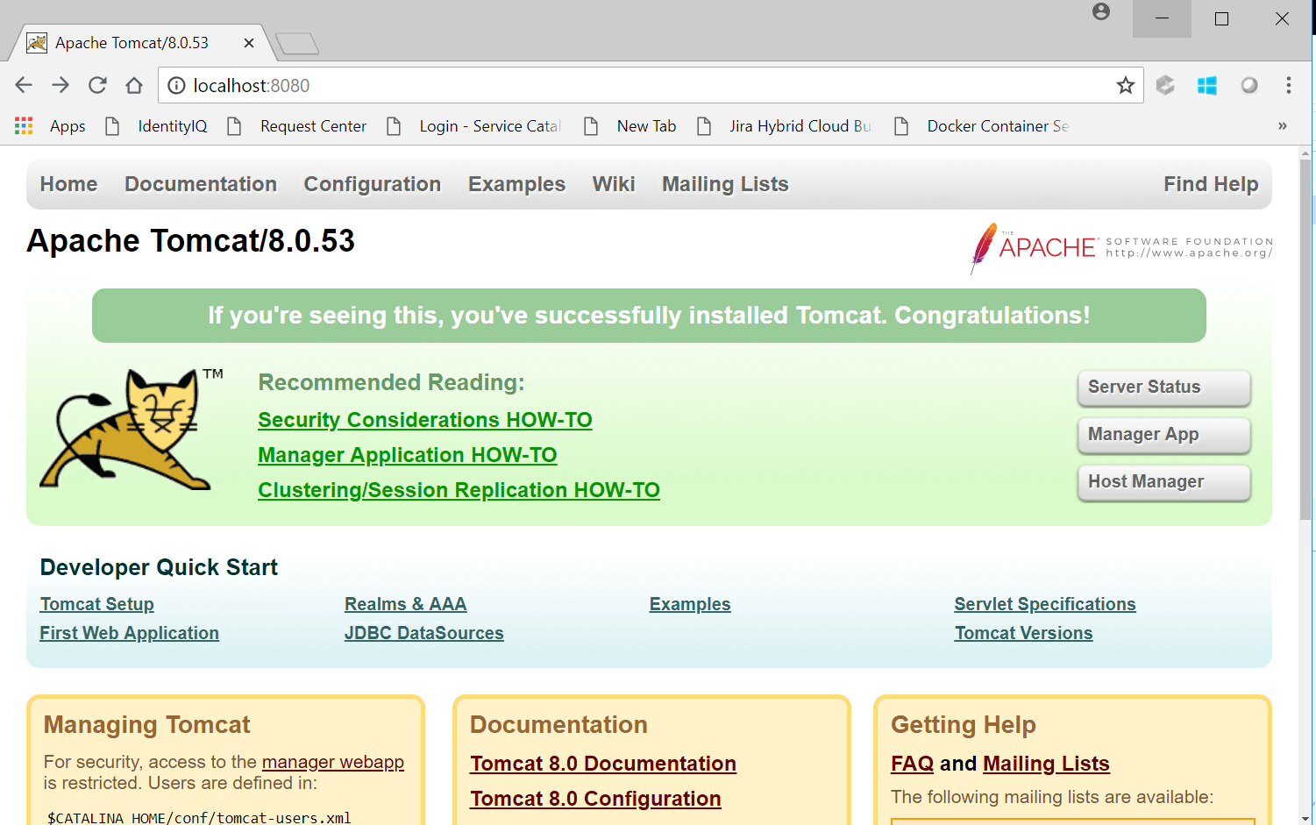
Review Lab 4

Slide 18
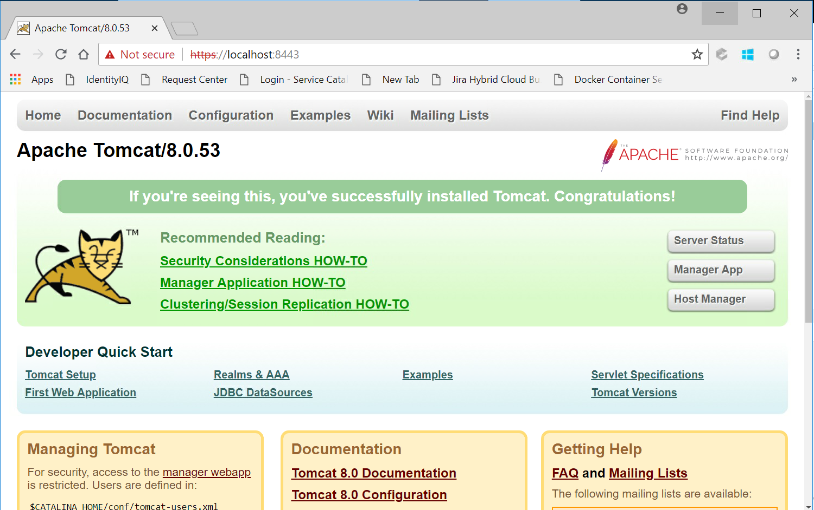
Review Lab 4

