Slide 1
Enterprise Developers

Slide 2
Utility Containers
Prototyping or simple base image
Busybox, Alpine
Small Linux with various tools
docker run --rm busybox du -h -s /
1.1M /
Simple Custom Container
FROM busybox
COPY ./my-static-binary /my-static-binary
CMD [ "/my-static-binary" ]
docker run –d my-image

Slide 3
Utility Containers
No-Op Container, Keep container alive
Dockerfile
FROM alpine
ENTRYPOINT tail –f /dev/null
Running
docker run –d noop
docker container ps
docker exec –it ab12xy3445 sh
Useful for trouble-shooting connectivity to other containers in stack

Slide 4
Utility Containers
Netshoot
A Docker network trouble-shooting swiss-army container
https://github.com/nicolaka/netshoot
Container troubleshooting
docker run -it --net container:<container_name> nicolaka/netshoot
Host network troubleshooting
docker run -it --net host nicolaka/netshoot

Slide 5
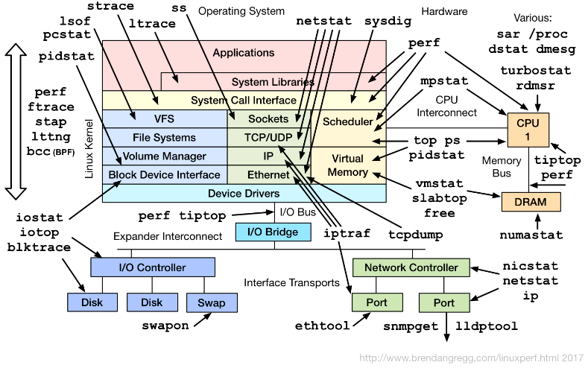
Utility Containers

Slide 6
UCP and DTR Demonstration

Slide 7
On Boarding Process
https://confluence.mutualofomaha.com/confluence/display/PC/On-boarding+Process

Slide 8
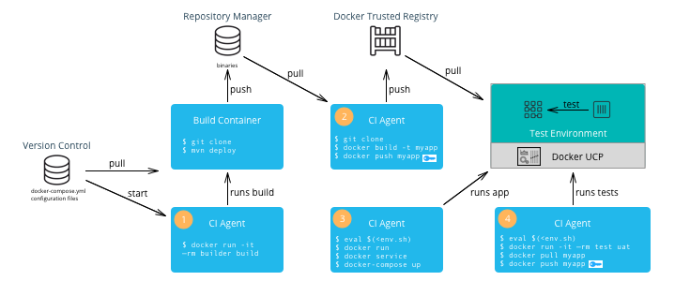
Pipeline

Slide 9
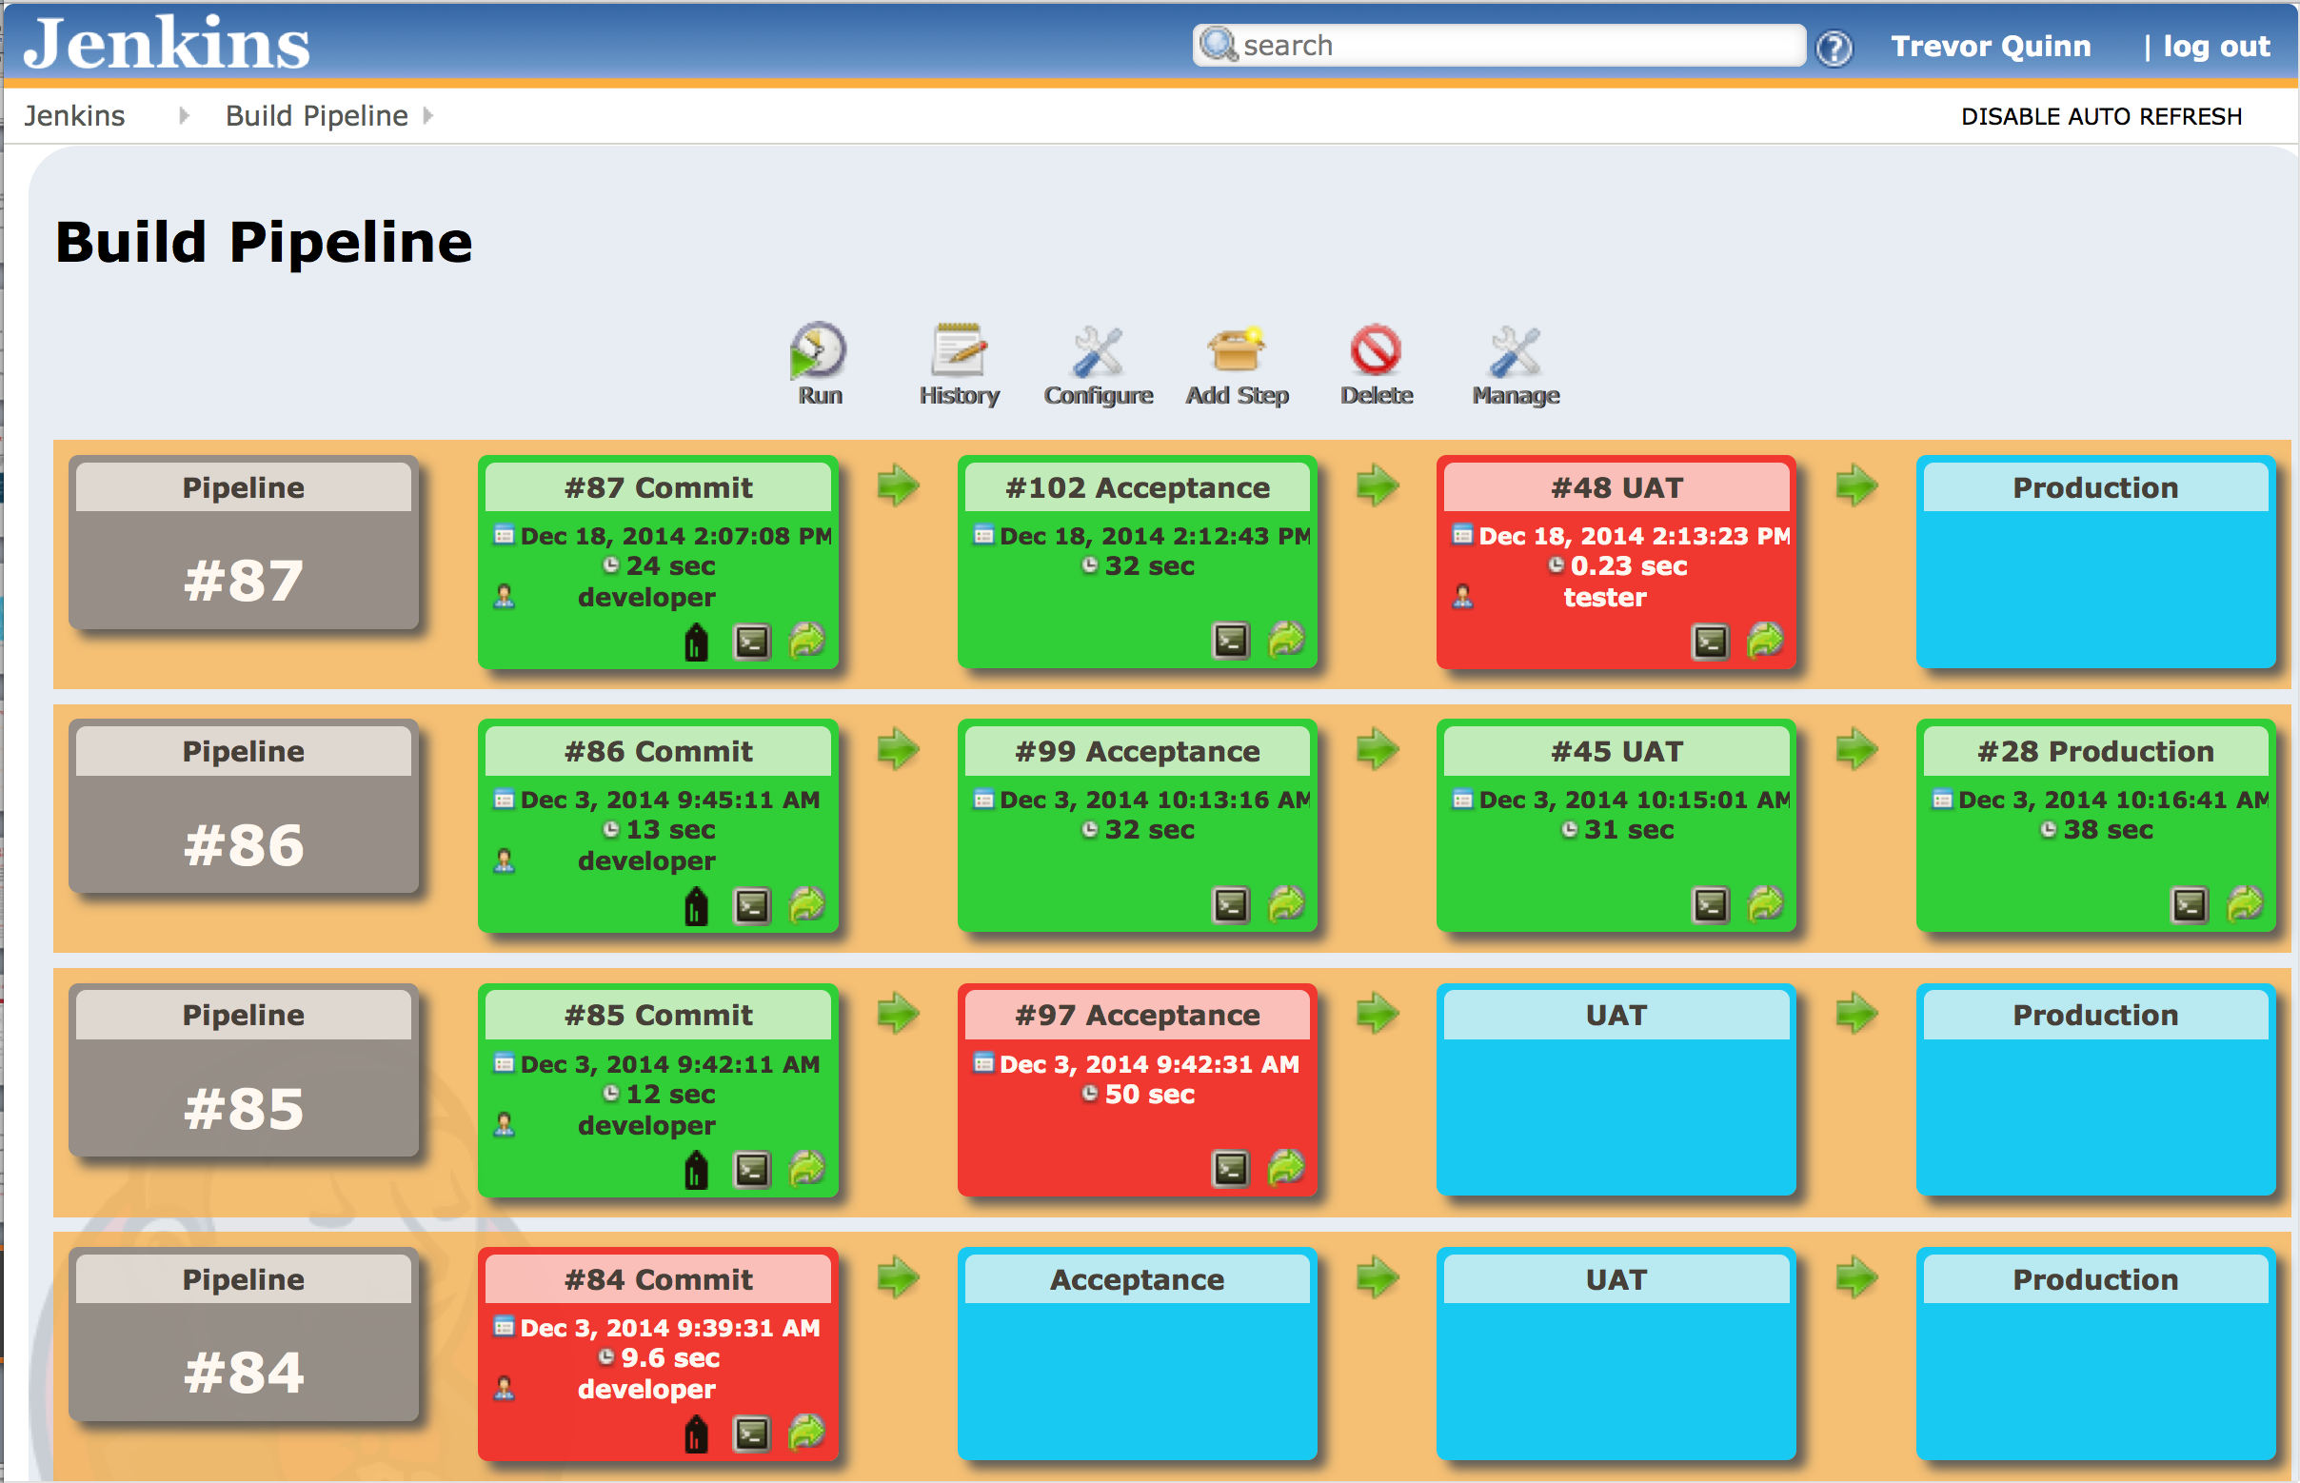
Pipeline

Slide 10
Pipeline
Info structure Convention
Init
Build
Publish-snapshot
Deploy-snapshot
Promote image to cat
Promote image to prod
Demo

Slide 11
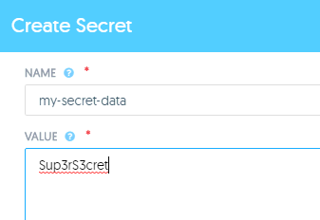
Docker Entities
Secrets
Useful for protecting database passwords, etc.
UCP, CLI, and Compose options
Mounted in container /run/secrets/my_secret_data
$ echo "This is a secret" | docker secret create my_secret_data –
$ docker service create --name redis --secret my_secret_data redis:alpine

Slide 12
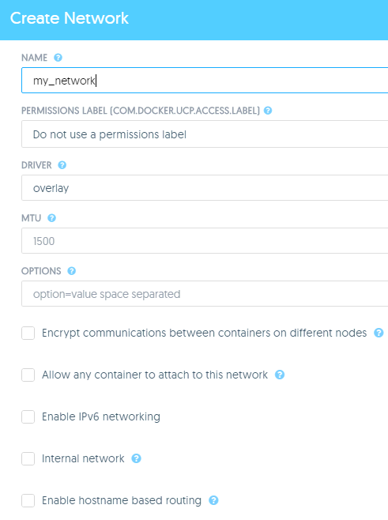
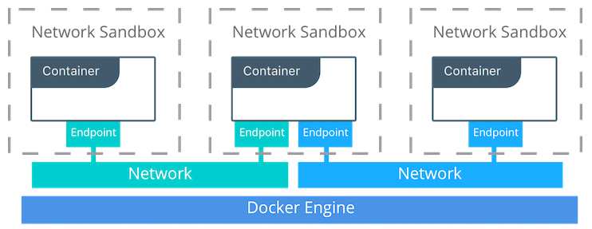
Docker Entities
Network
Useful for isolating service traffic
UCP, CLI, and Compose options
Overlay, Ingress, HRM or Interlock overlay network, docker internal network types
$ docker network create --driver overlay my-network
$ docker network inspect my-network [ {
"Name": "my-network",
"Id": "fsf1dmx3i9q75an49z36jycxd",
"Created": "0001-01-01T00:00:00Z",
"Scope": "swarm",
"Driver": "overlay", …

Slide 13
Docker Entities
Volumes
Persist data independent of the container’s lifecycle
Initialized when a container is created.
Can be shared and reused among containers.
Changes to a data volume are made directly.
Changes to a data volume will not be included when you update an image.
Data volumes persist even if the container itself is deleted.
$ docker run -d -P --name web -v /webapp training/webapp python app.py

