Slide 1
Image to text
Ayesha ahmad

Slide 2
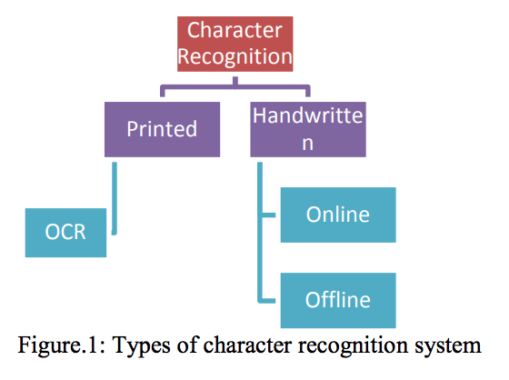
Optical character Recognition
Optical Character Recognition (OCR) is a piece of software that converts printed text and images into digitized form such that it can be manipulated by machine, i.e. image to text .
Two kinds of character recognition-
Machine Printed- Simple due to uniformity in dimensions, font, etc.
Handwritten- Complex due to variety of writing styles.

Slide 3
Major phases of OCR
Acquisition
Segmentation
Feature Extraction
Pre-processing
Classification
Post- processing
Phase | Description | Approaches
Acquisition | The process of acquiring image | Digitization, binarization, compression
Pre-processing | To enhance quality of image | Noise removal, Skew removal, thinning, morphological operations
Segmentation | To separate image into its constituent characters | Implicit Vs Explicit Segmentation
Feature Extraction | To extract features from image | Geometrical feature such as loops, corner points Statistical features such as moments
Classification | To categorize a character into its particular class | Neural Network, Bayesian, Nearest Neighborhood
Post- processing | To improve accuracy of OCR results | Contextual approaches, multiple classifiers, dictionary based approaches

Slide 4
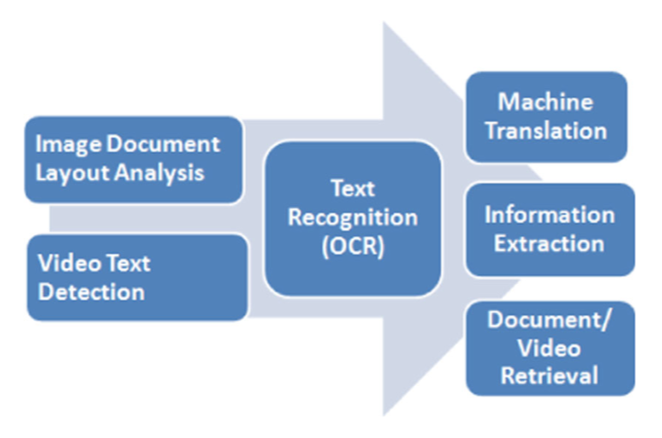
NLP + OCR
OCR is often error prone
(Jinying Chen1 · Huaigu Cao2 · Premkumar Natarajan) Integrating natural language processing with image document analysis: what we learned from two real-world applications is a paper that presents an approach to combine the efforts of image recognition with natural language processing
After retrieving text from OCR, Machine translation (MT), Information extraction, document video retrieval are key steps in analyzing text and requires sentence-level processing.
Conditional random field (CRF)-based sentence boundary detector using rich features from automatic image layout and linguistic analyses. Is described in this paper

Slide 5



BEST Software Available
Google Goggles
Microsoft Lens
Adobe Scan: PDF Scanner, OCR

Slide 6
Google googles
Google goggles is a Google product which scans an image, feeds it to multiple discrete "recognition disciplines.”
Discrete entities help classify the image by using a voting system, passes off to goggle root
Goggle root ranks the different classification and shows the output to user.
Eg. If a user scans a picture of the Taj Mahal, the Google Goggles will return information about when it was built, why it was built and monuments that are similar to the Taj Mahal.
Demo available at https://www.youtube.com/watch?v=Hhgfz0zPmH4

Slide 7
Microsoft Lens
Office Lens trims, enhances, and makes pictures of whiteboards and docs readable.
Office Lens allows users to take pictures of receipts, business cards, whiteboards, sticky notes and save them to OneNote, Microsoft's note-taking app.
These image notes get converted to text.
Demo available on https://www.youtube.com/watch?v=jzZ3WVhgi5w

Slide 8
Adobe Scan: PDF Scanner, OCR
Adobe Scan automatically captures and cleans picture-perfect images of anything — receipts, forms, pictures, business cards, notes.
Using built-in optical character recognition (OCR), it transforms them into smart PDFs, available in Adobe Document Cloud.
This makes it easy to search and share the PDFs from anywhere. Users can find keywords, add comments, sign, or send for review.
And because Adobe Scan works perfectly with Adobe Acrobat, users can even edit, send for signature, or export them into Microsoft Office.
Demo available on https://www.youtube.com/watch?v=L2_-jwiIbL0

Slide 9
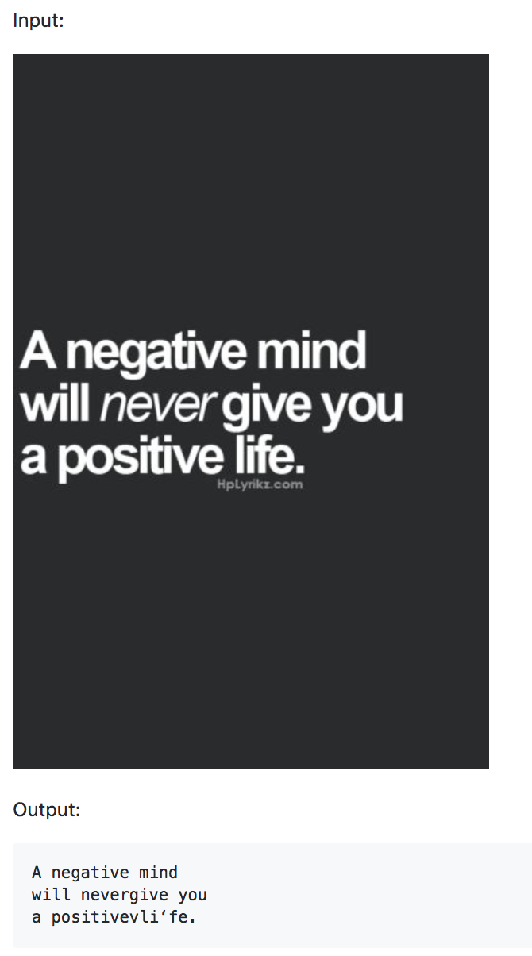
Implementation using OPEN source
https://github.com/ayesha92ahmad/NLP-image-to-text
A command line application has been coded and
Language used: Python
Main libaries used:
Opencv (Image preprocessing)
Pytesseract (OCR)

Slide 10
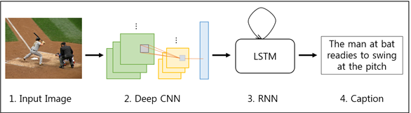
FUTURE SCOPE
Work is constantly being done to improve the accuracy and infer valuable data from images.
Deep learning techniques are being applied along with NLP to achieve far better results.
Convolutional Neural networks along with Recurrent Neural Network have changed the way data was handled.
Researchers aim to create real time system for image description and incorporate state of the art methods for large-scale category recognition.
Producing human-like and relevant descriptions will be a key factor for enabling accurate and satisfying image retrieval result.

Slide 11
References
(Noman Islam, Zeeshan Islam, Nazia Noor) A Survey on Optical Character Recognition System
(Jinying Chen1 · Huaigu Cao2 · Premkumar Natarajan) Integrating natural language processing with image document analysis: what we learned from two real-world applications
https://spectrum.ieee.org/tech-talk/consumer-electronics/portable-devices/google-goggles-does-not-do-face-recognition
https://www.cnet.com/how-to/getting-started-with-microsoft-office-lens/
http://www.tramvm.com/2017/05/recognize-text-from-image-with-python.html
(Google Brain, Technische Universität München) Better Text Understanding Through Image-To-Text Transfer

