Slide 1
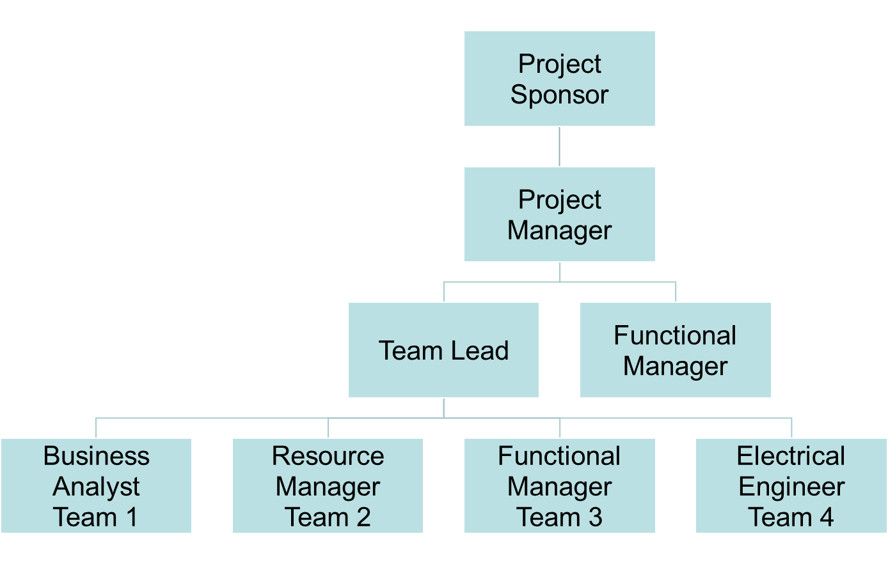
LI-ON Power Pack Organizational Chart
Date: 5/29/2021
Internal Stakeholder
External Stakeholder

