Slide 1

X and O Game
TERM PROJECT - PROPOSAL
YASHWANTH REDDY YELUGURI PATCHA SRENITHA

Slide 2
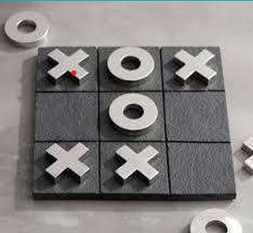
ABSTRACT
The game, typically played on a 3x3 grid, involves players alternately marking empty cells with either "X" or "O" in an attempt to line up three of their marks horizontally, vertically, or diagonally.
This Game is developed using the minimax algorithm, a decision-making process that explores all possible game states and selects the move that maximizes its chances of winning while minimizing the opponent.

Slide 3

OBJECTIVE
▶ Implementing of X’s and O’s using multiple agents.
▶ Organizing a tournament within these agents.
▶ Agent forming the quickest sequence and remaining undefeated till the end is declared as winner.
Training Agents->Conducting Tournament->Winner

Slide 4
APPROACH
▶ Designing a layout which is 3x3 grid.
▶ Agent training about the game play atmosphere using Minimax, Expectimax and QLearning algorithms.
▶ Define the agent which minimizes our utility and develop a counter strategy for our self to maximize our utility.
▶ The limitations of minimax can be overcome by using expectimax which further expands our utility.
▶ Further, we add a choice node to study actions of the agent and use Q learning algorithm to get the maximum utility.

Slide 5
DELIVERABLES
Algorithms developed to train agents using programming(.py files)
Documentation manual mentioning about game implementation about various models.
Presentation on project overview.
Youtube video demonstrating the game implementation and slides.
GitHub link for the project.

Slide 6
EVALUATION METHODOLOGY
Agent Implementation: Evaluated on the correct implementation of all agents.
Accuracy with Random Inputs: Agents must produce accurate results for various random inputs.
Constraint Satisfaction: Output must meet all defined constraints.
Tournament Outcome: The agent providing the best result is declared the winner.

Slide 7
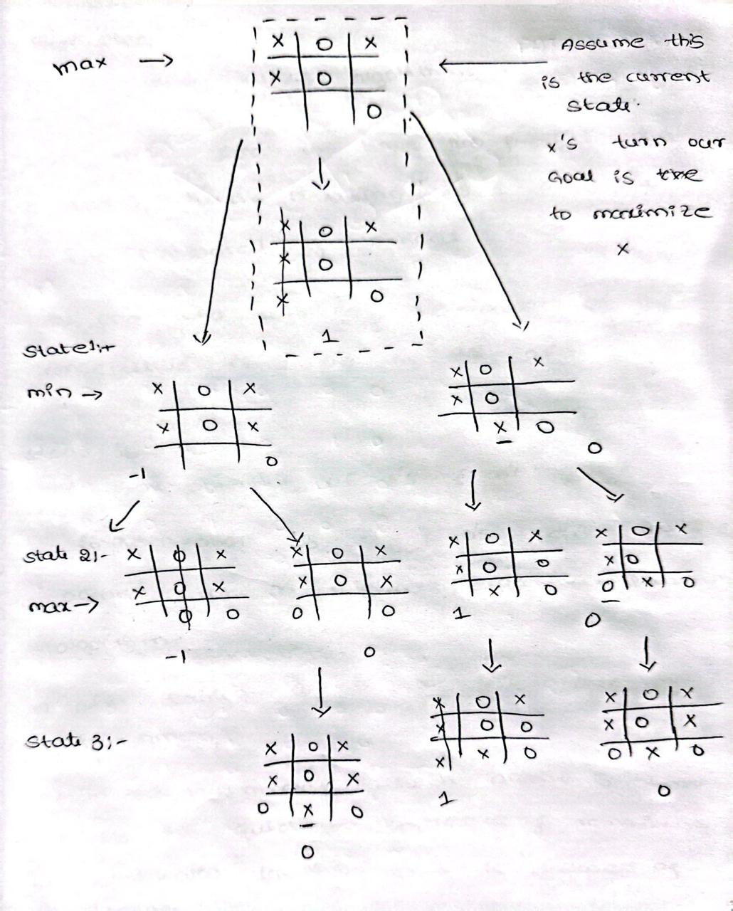

Slide 8


