Slide 1



Home Guards Data Source: https://www.data.gov.in/ Dataset: Home guards acutal strength for moths in 2025 Email: kswathireddy1611@gmail.com Phone :7386202188 LinkedIn : www.linkedin.com/in/swathi-reddy-594125358
Indian Government Dataset Analysis
Bharadwaj Kollepara

Slide 2
Introduction
Introduction
This presentation analyzes the Home Guards dataset, focusing on:
Personnel allocation
Gender distribution
Vacancies
Staffing efficiency for April 2024

Slide 3
Dataset Overview
The dataset provides:
Home guard strength across districts
Allotted and actual personnel details
Vacancies and gender breakdown
Insights into staffing levels and workforce planning

Slide 4
Key Analysis
Identified:
Highest and smallest vacancy districts
Strength of Bengaluru and Udupi districts
Allotted vs. actual personnel deployment
Districts with maximum and minimum allotted strength

Slide 5
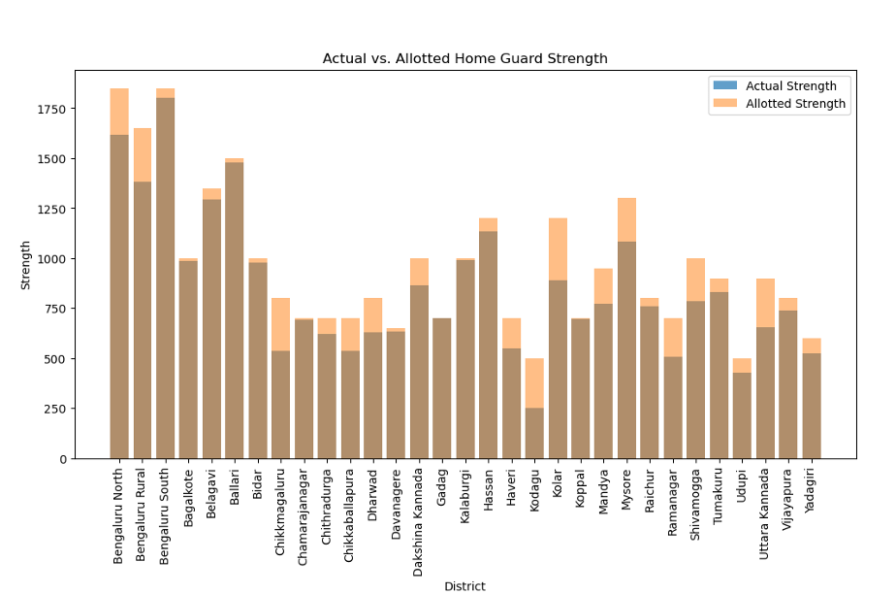
Actual vs Allotted home guard strength

Slide 6
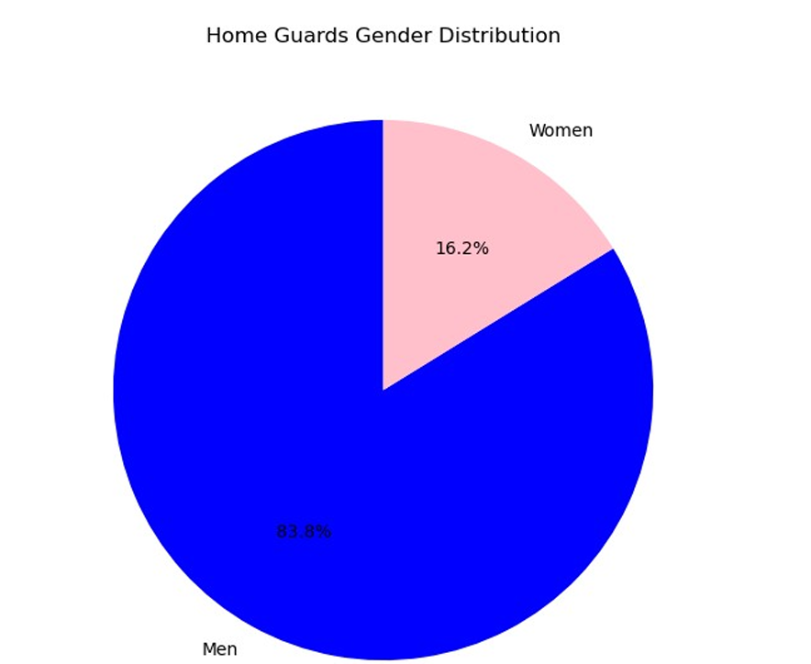
Distribution of Home Guards Gender
The boxplot shows the variation in prices by year, highlighting market volatility.

Slide 7
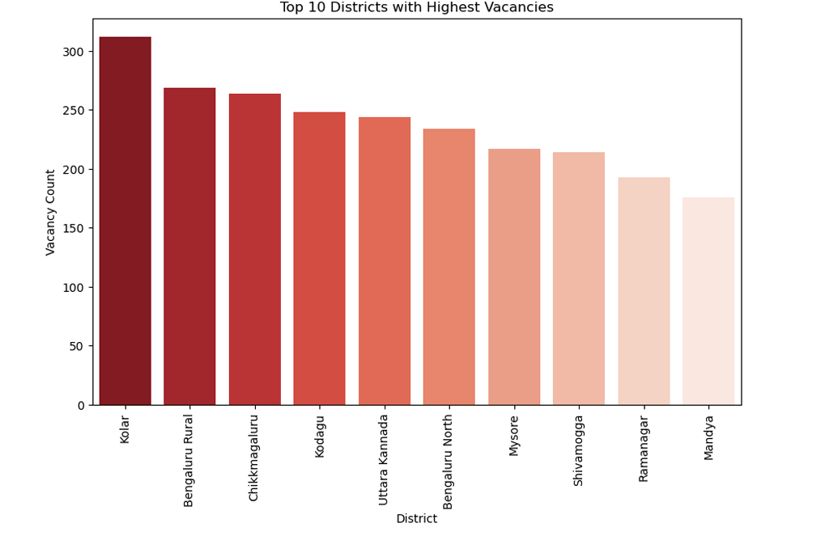
Top 10 Districts with Highest Vacancies

Slide 8
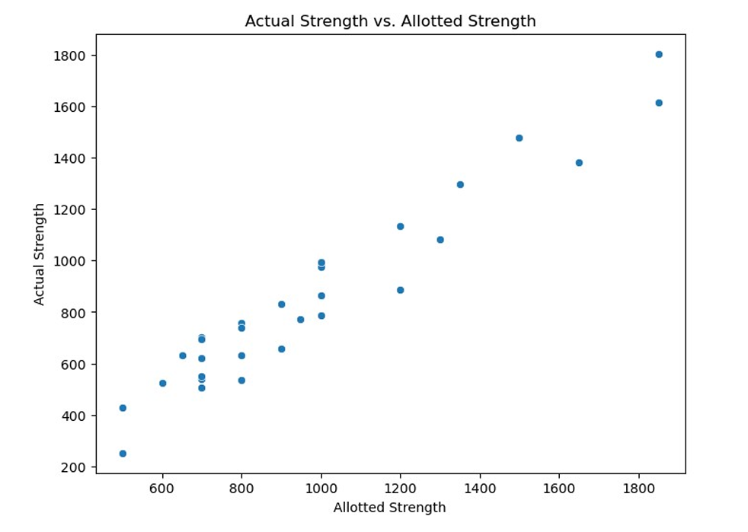
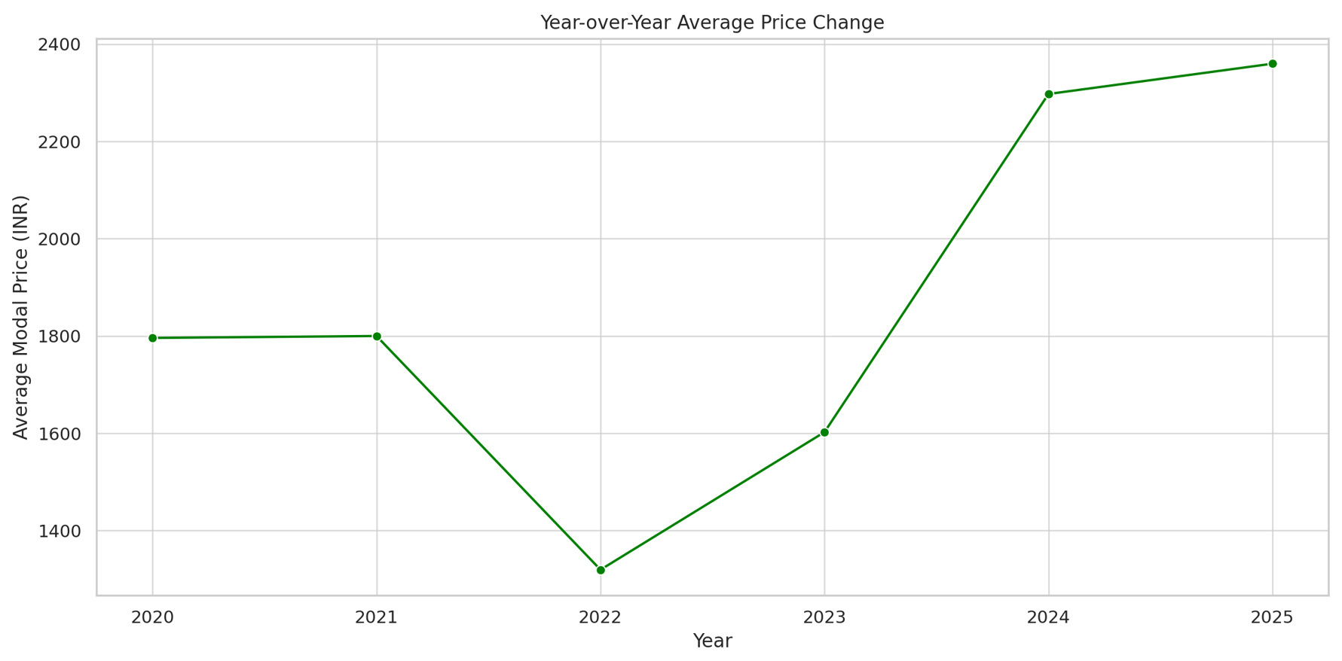
Allotted strength
This line plot shows how the average onion price has changed year over year.
It helps visualize overall market growth or decline trends.

Slide 9
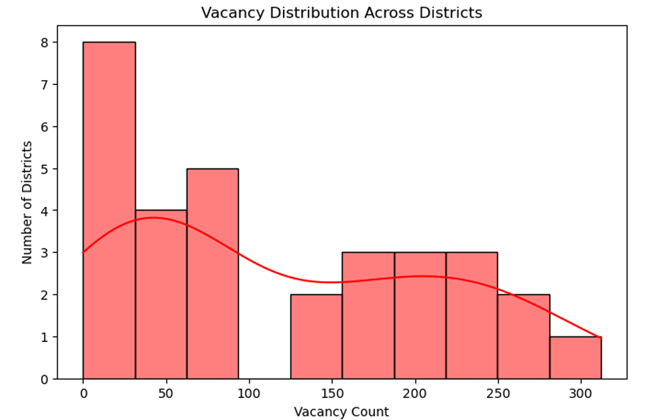

Slide 10
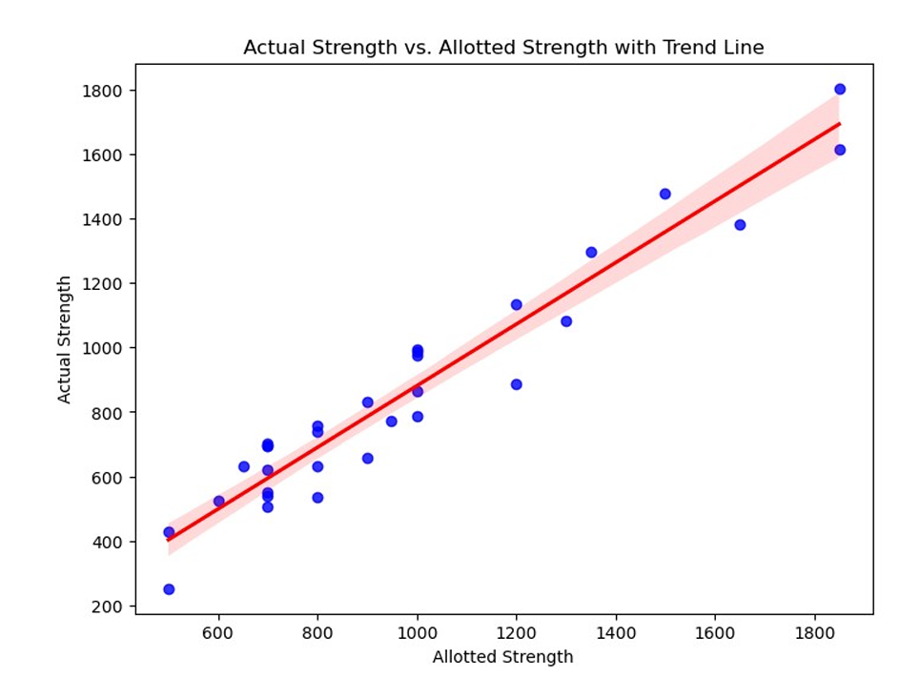

Slide 11
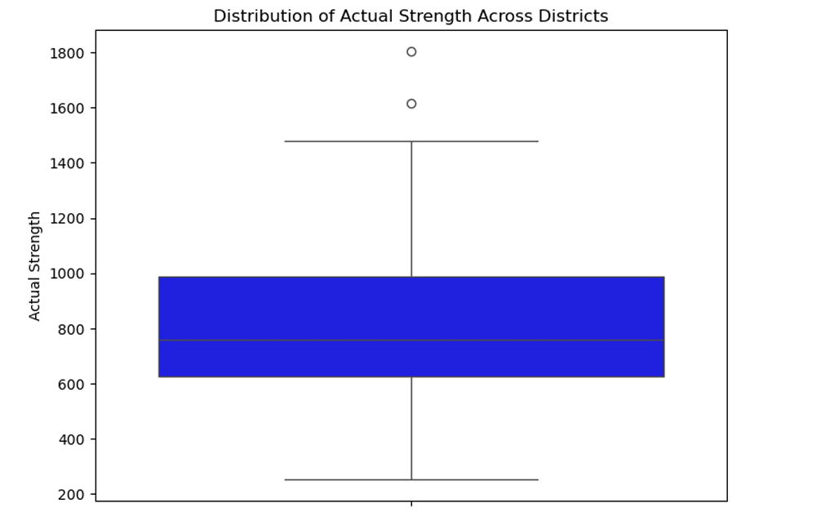
Market Distribution
This pie chart displays the top 10 most frequent markets in the dataset.
It shows the market distribution share.

Slide 12
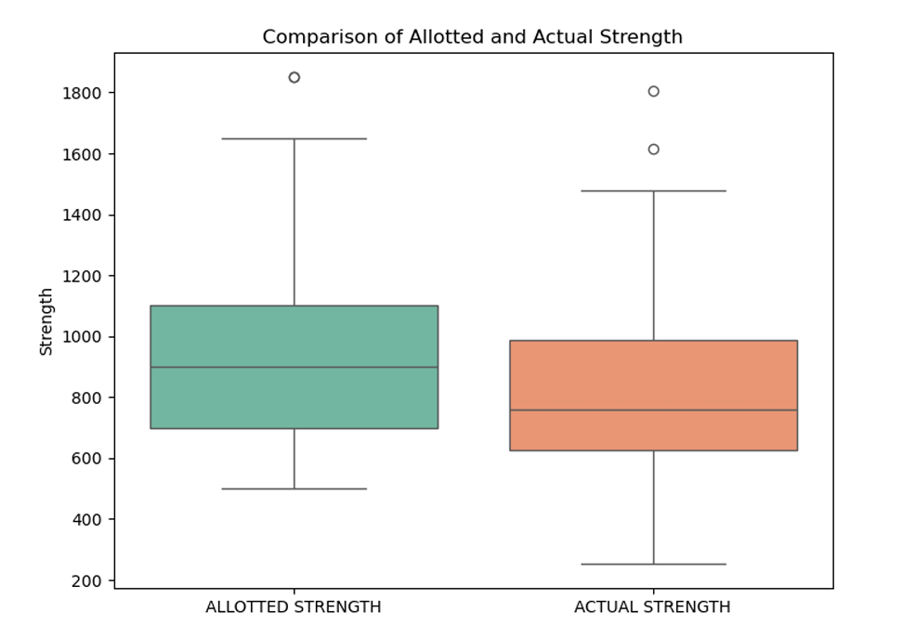
This bar plot shows the frequency of onion arrivals by month.
It helps identify which months have the most arrivals.

Slide 13
Dataset Observation
Findings include:
Disparities in actual vs. allotted strength
Fewer female personnel in the workforce
Uneven vacancy distribution with critical shortages in some districts

Slide 14
Conclusion
The analysis reveals:
Staffing disparities and gender imbalances
A need to optimize deployment and address vacancies for better efficiency

