Slide 1
Home Guards Data k.swathi 2211cs010318 group-4
Indian Government Dataset Analysis

Slide 2
Introduction
Introduction
This presentation analyzes the Home Guards dataset, focusing on:
Personnel allocation
Gender distribution
Vacancies
Staffing efficiency for April 2024

Slide 3
Dataset Overview
The dataset provides:
Home guard strength across districts
Allotted and actual personnel details
Vacancies and gender breakdown
Insights into staffing levels and workforce planning

Slide 4
Key Analysis
Identified:
Highest and smallest vacancy districts
Strength of Bengaluru and Udupi districts
Allotted vs. actual personnel deployment
Districts with maximum and minimum allotted strength

Slide 5
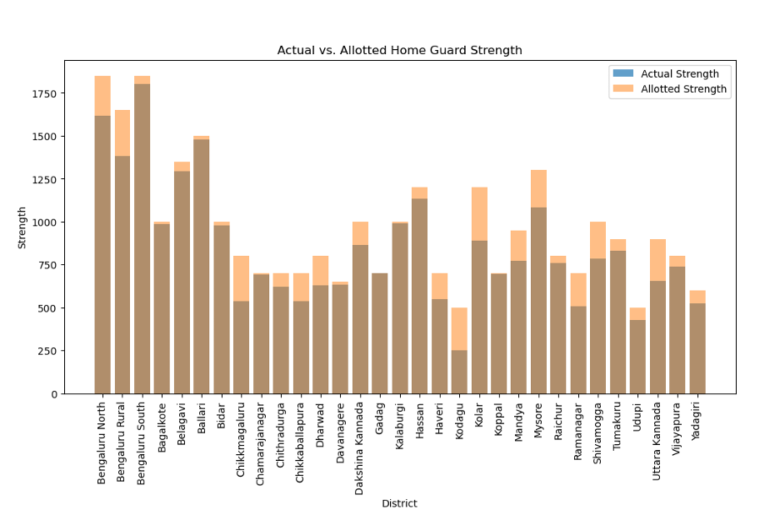
Actual vs Allotted home guard strength
Across almost all districts, the actual strength of home guards is consistently lower than the allotted strength, suggesting a widespread shortage of home guards compared to the planned or required numbers.

Slide 6
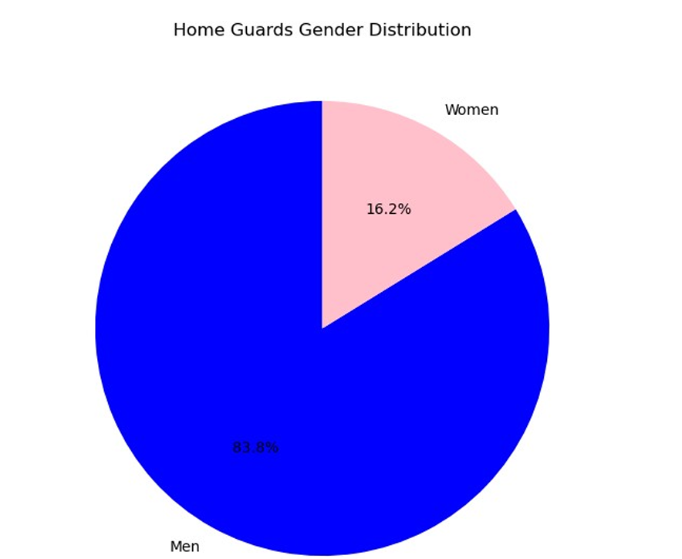
Distribution of Home Guards Gender
This pie chart provides a straightforward visual representation of the gender distribution, highlighting the underrepresentation of women in the home guard workforce

Slide 7
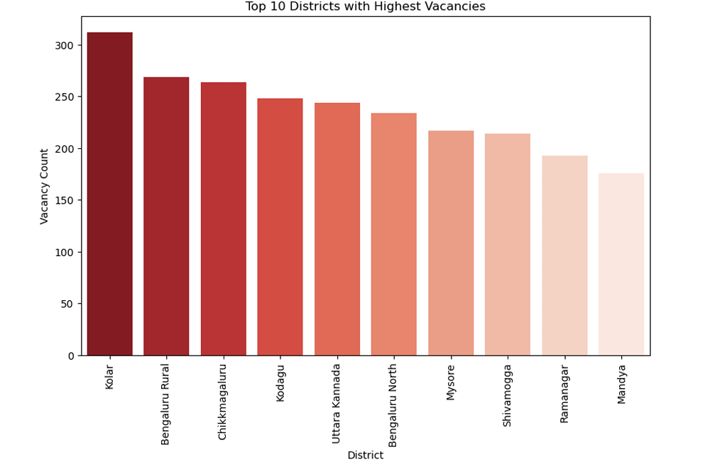
Top 10 Districts with Highest Vacancies
This chart highlights the districts with the most pressing need for home guard recruitment, with Kolar facing the most substantial shortfall

Slide 8
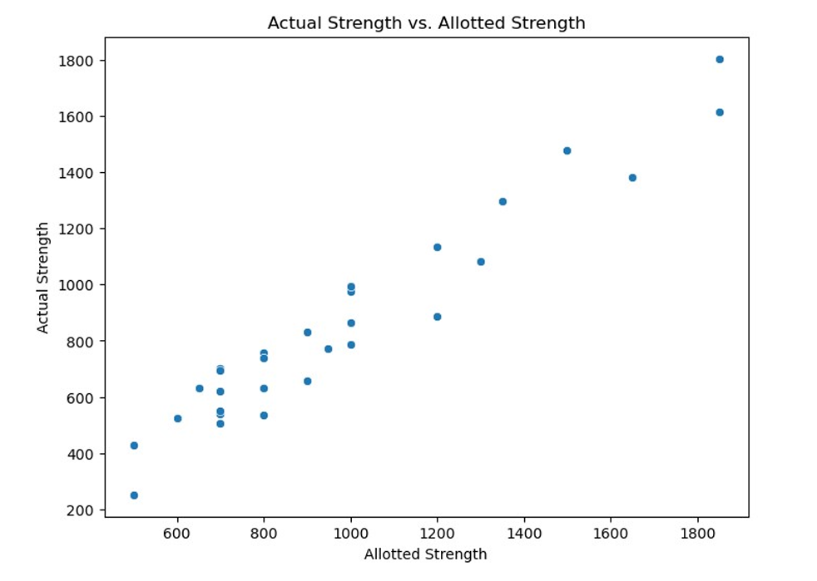
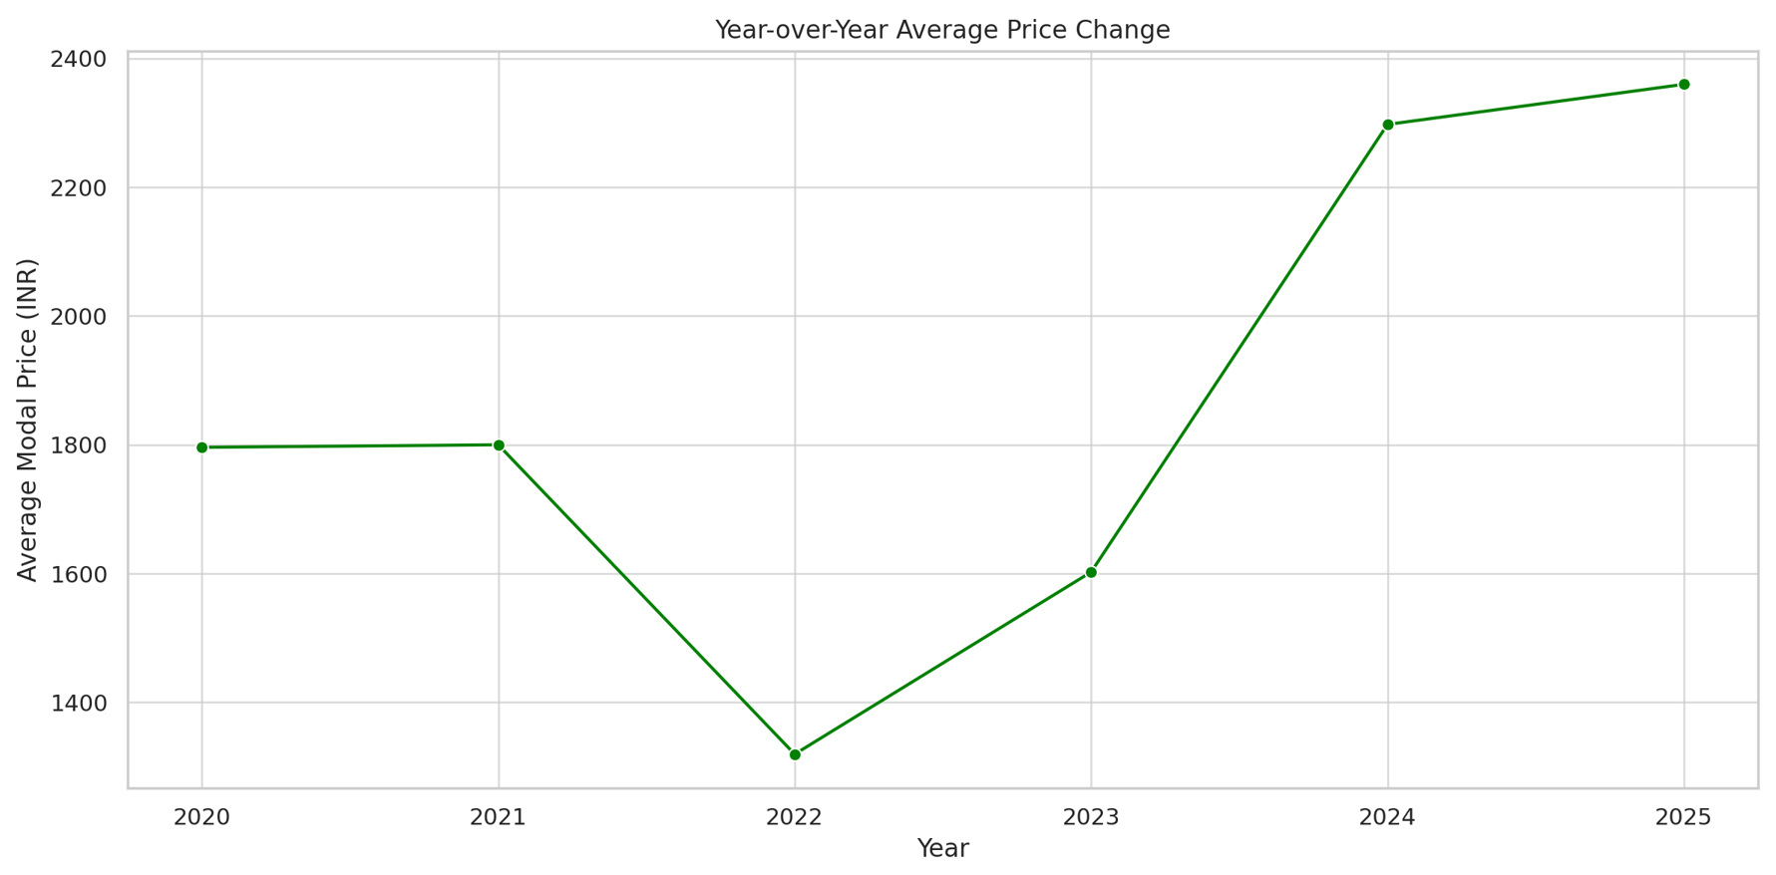
Allotted strength
The image is a scatter plot titled "Actual Strength vs. Allotted Strength," comparing the actual number of home guards (y-axis) to the allotted number of home guards (x-axis) across various districts.

Slide 9
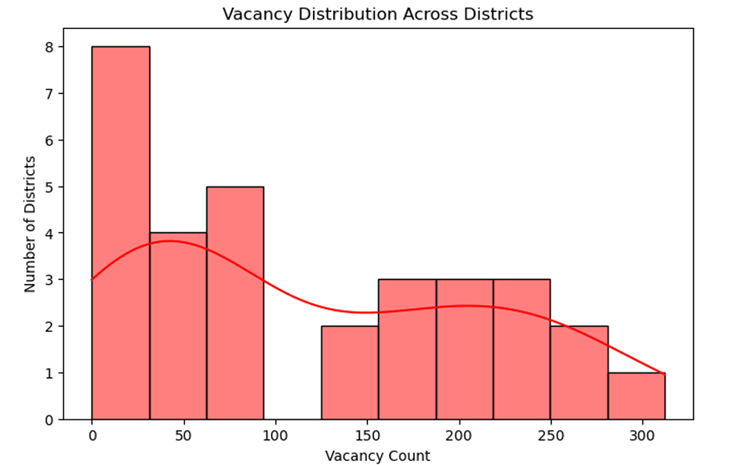
The image is a histogram titled "Vacancy Distribution Across Districts," showing the distribution of home guard vacancies across various districts. The x-axis represents the vacancy count, ranging from 0 to 350, while the y-axis represents the number of districts, ranging from 0 to 8.

Slide 10
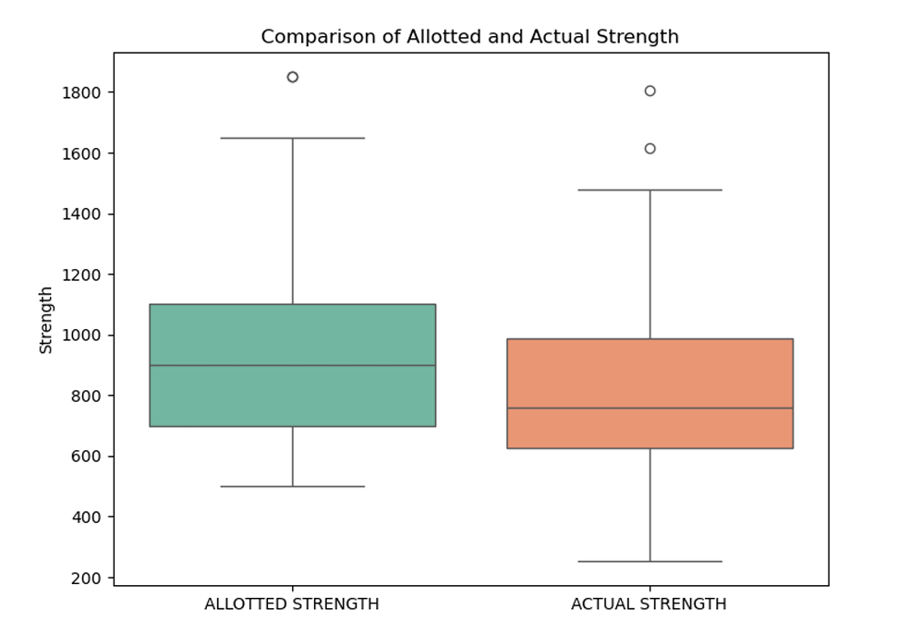
The image is a box plot titled "Comparison of Allotted and Actual Strength," comparing the distribution of allotted and actual home guard strengths across districts. The x-axis has two categories: "Allotted Strength" and "Actual Strength," while the y-axis represents the strength, ranging from 200 to 1800.

Slide 11
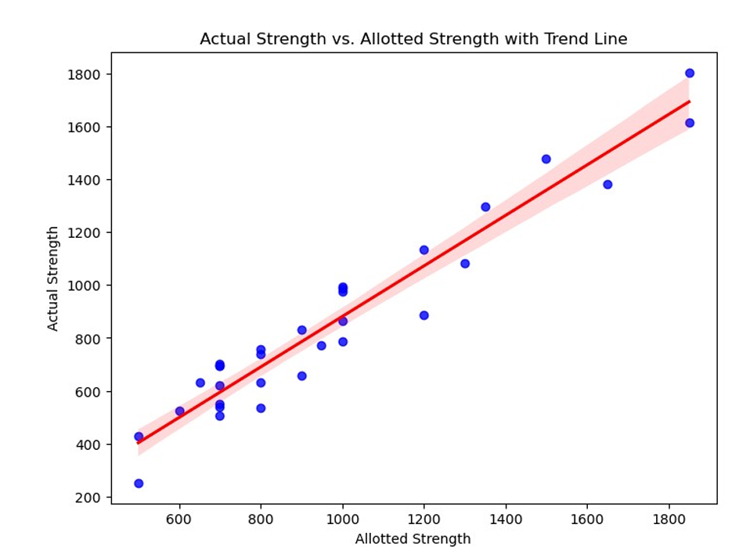
Dataset Observation
Findings include:
Disparities in actual vs. allotted strength
Fewer female personnel in the workforce
Uneven vacancy distribution with critical shortages in some districts

Slide 12
Conclusion
The analysis reveals:
Staffing disparities and gender imbalances
A need to optimize deployment and address vacancies for better efficiency

