Slide 1
Project Title - Car Market Trends Analysis with Car Dekho Data
AICTE STU ID : STU6a5fa4510cde41784652881
MEESALA CHINNA REDDAIAH

Slide 2


PROBLEM STATEMENT
Used-car prices can differ according to vehicle age, present price, fuel type, seller type, transmission and usage. This project analyzes the supplied Car Dekho dataset to identify observable price patterns and communicate them through clear visualizations.
Key questions
Which factors are associated with selling price?
Which categories have higher average selling prices?
How closely does present price relate to selling price?

Slide 3
Project Description The project uses Python to clean, explore and visualize the supplied Car Dekho CSV dataset. Duplicate records are removed, data quality is checked, and derived measures are created to support resale-price analysis.
301
2
299
0
Original records
Duplicate rows
Unique records
Missing values
Key measures
• Average selling price: ₹4.59 lakh
• Median selling price: ₹3.51 lakh
• Car age uses 2018, the latest year in the supplied dataset
• Findings are descriptive and limited to the supplied data

Slide 4

WHO ARE THE END USERS?
Used-car buyers — compare broad price patterns across categories.
Used-car sellers — understand factors associated with resale prices.
Dealers — review inventory-level price patterns.
Data analysts and students — practice cleaning, grouping, correlation and visualization.
Academic evaluators — assess a complete and reproducible analytics workflow.

Slide 5

Technology Used
Python — primary programming language
Pandas — data loading, cleaning and aggregation
NumPy — numerical operations
Matplotlib — charts and visual analysis
Jupyter Notebook— interactive analysis
Git & GitHub — version control and project publishing

Slide 6
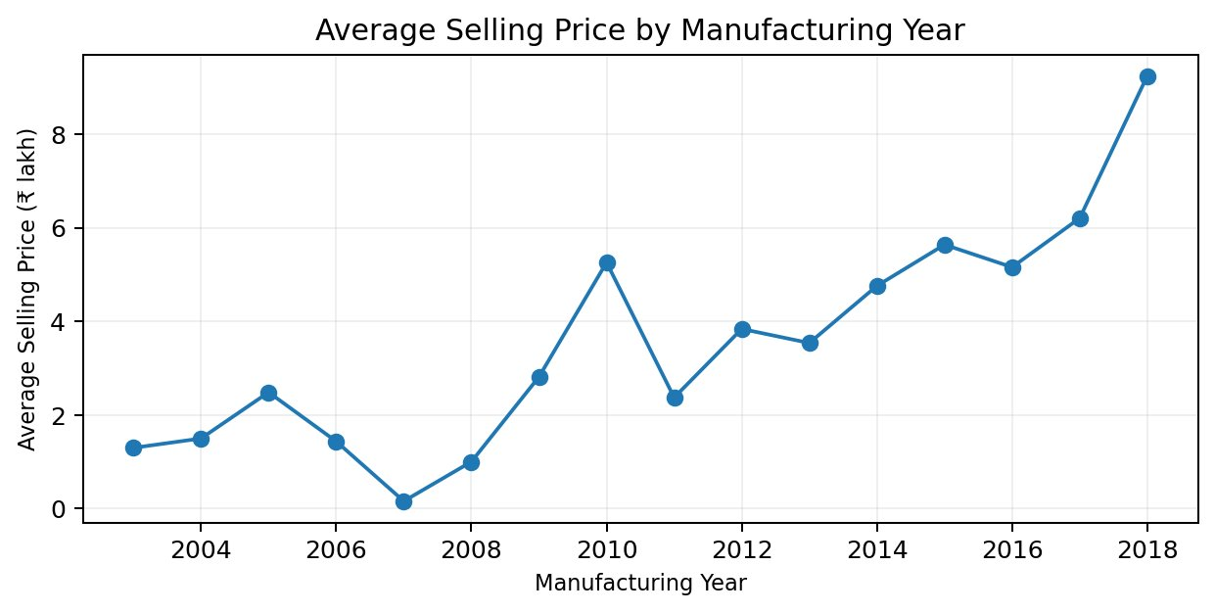
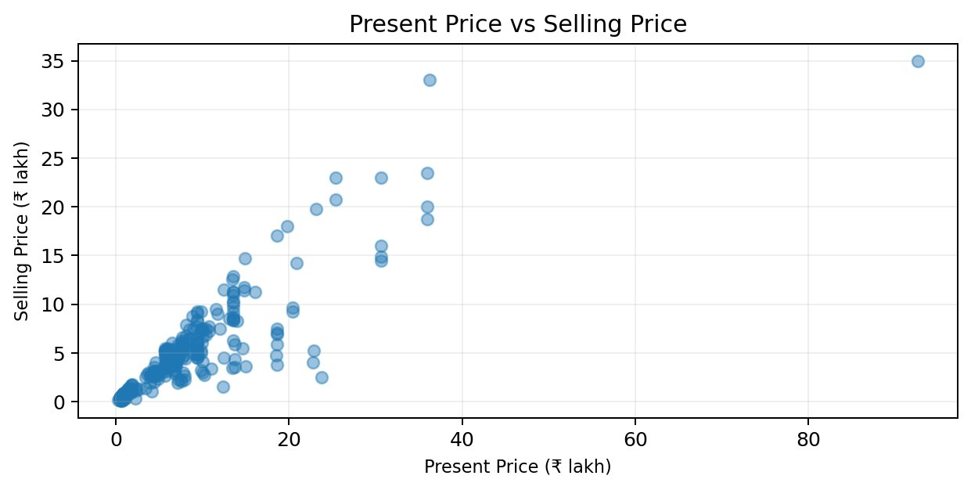
RESULTS
• Present price vs selling price: r = 0.88
• Diesel average: ₹10.10 lakh
• Petrol average: ₹3.26 lakh
• Dealer average: ₹6.63 lakh
• Individual average: ₹0.87 lakh
Interpretation: present price is strongly and positively associated with selling price in this dataset.
Demo Link

Slide 7
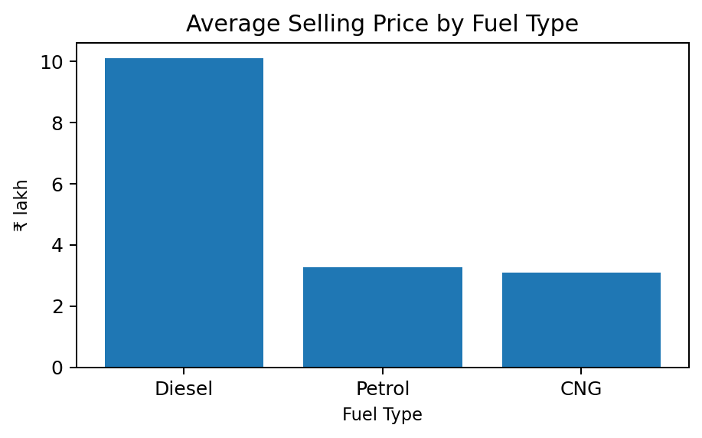
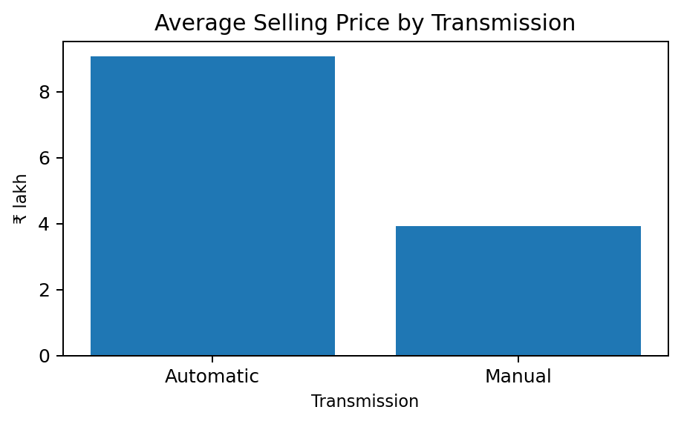
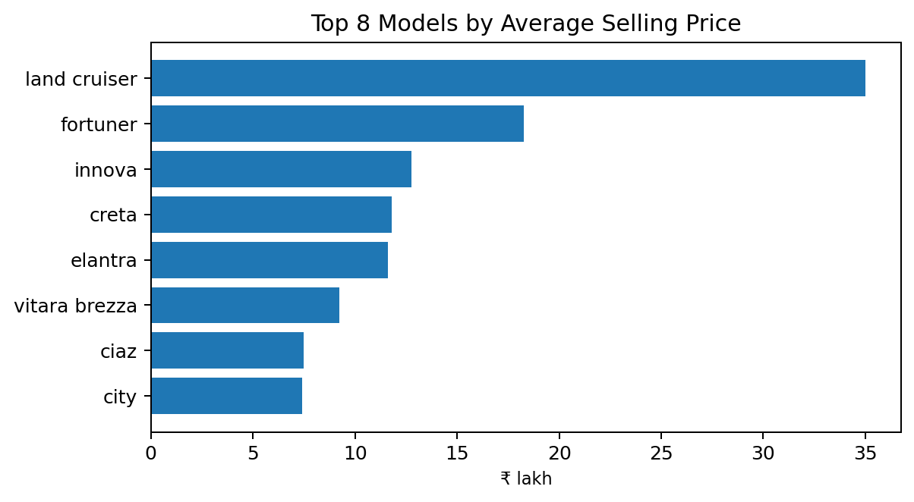
RESULTS
data = df.drop_duplicates().copy()
data["Car_Age"] = 2018 - data["Year"]
data.groupby("Fuel_Type").Selling_Price.mean()
data.groupby("Transmission").Selling_Price.mean()
data.Selling_Price.corr(data.Present_Price)
Category averages
Automatic: ₹9.07 lakh | Manual: ₹3.92 lakh
Demo Link

Slide 8
Thank you
MEESALA CHINNA REDDAIAH
.
.
Car Market Trends Analysis with Car Dekho Data

