Slide 1
ASRRAD All Dashboards

Slide 2
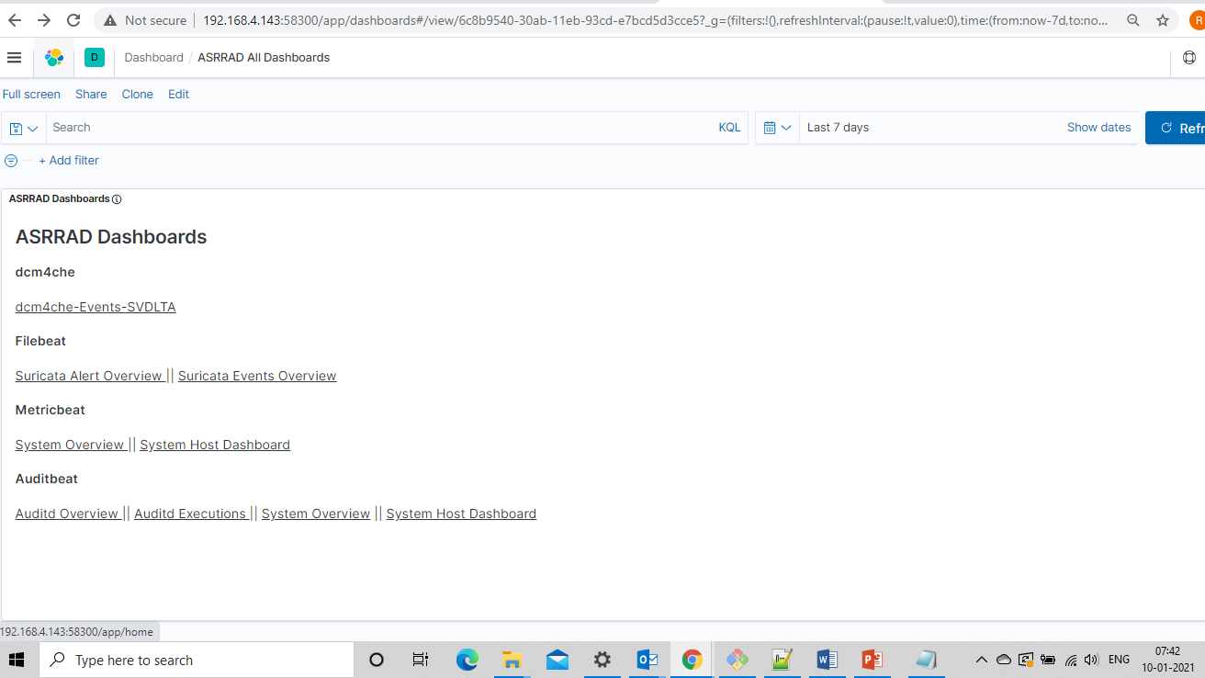
ASRRAD All Dashboards - Dashboard

Slide 3
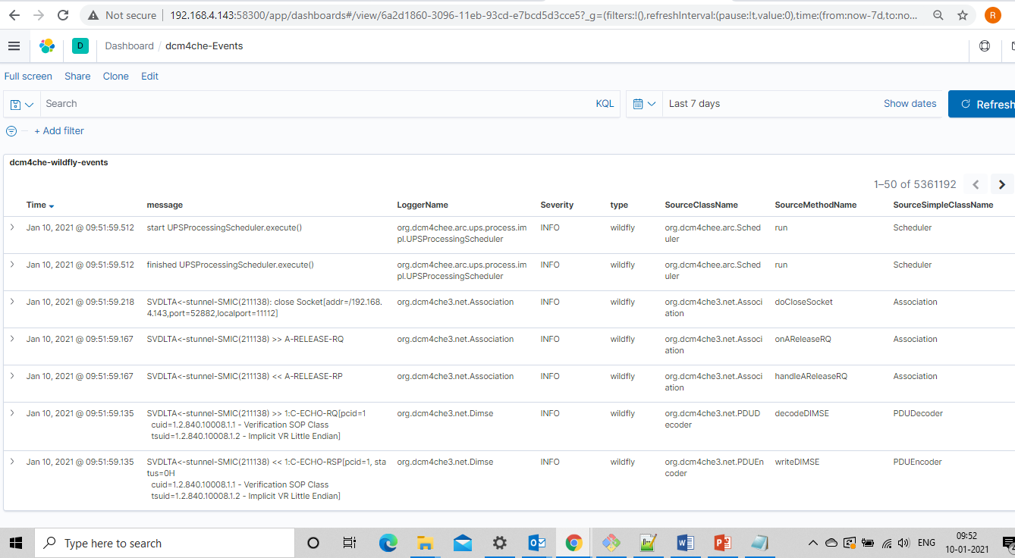
dcm4che-Events dashboard

Slide 4
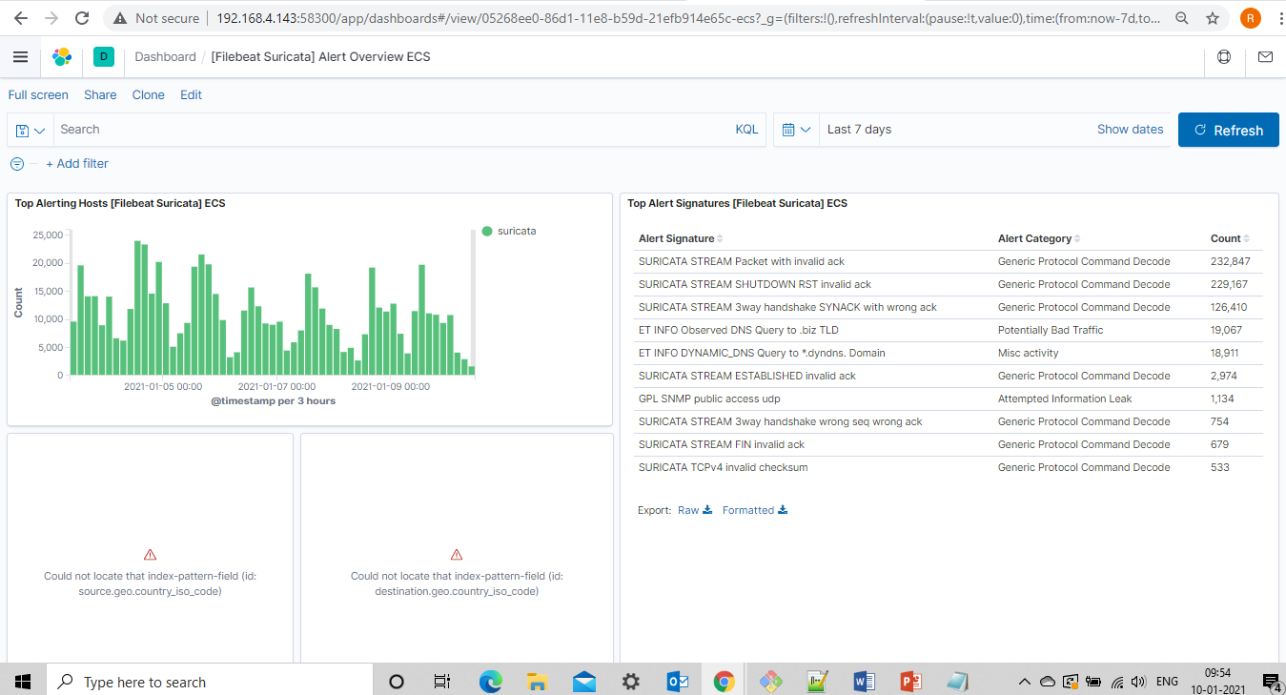
Suricata Alerts Overview dashboard

Slide 5
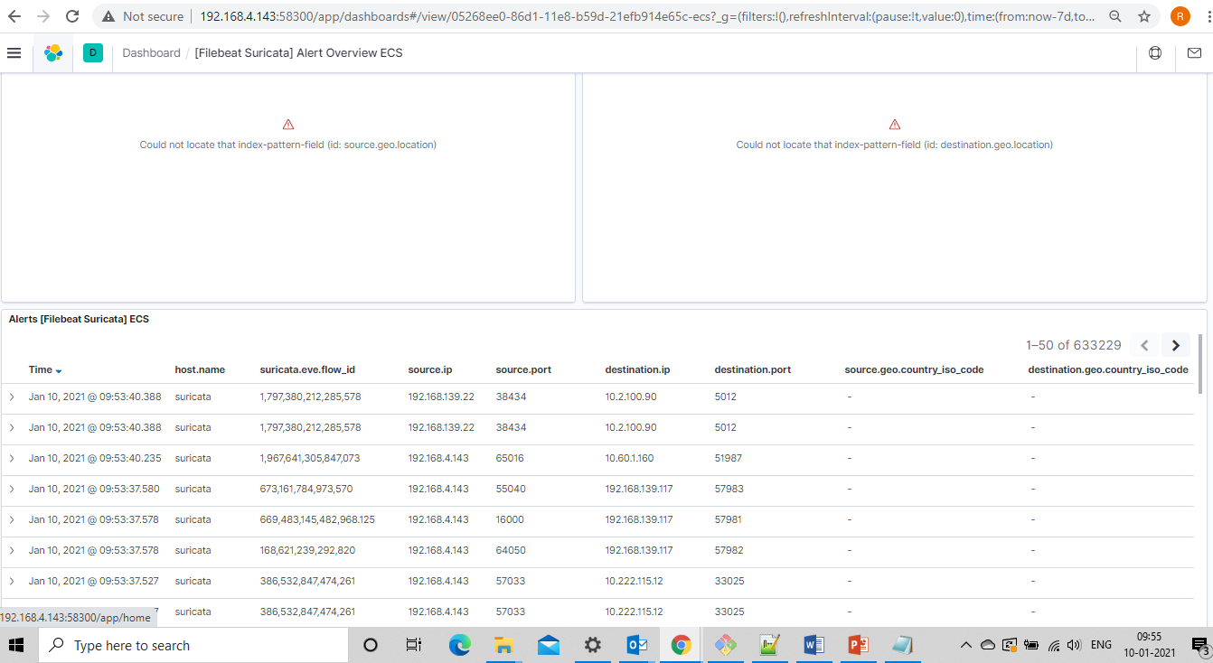
Suricata Alerts Overview dashboard

Slide 6
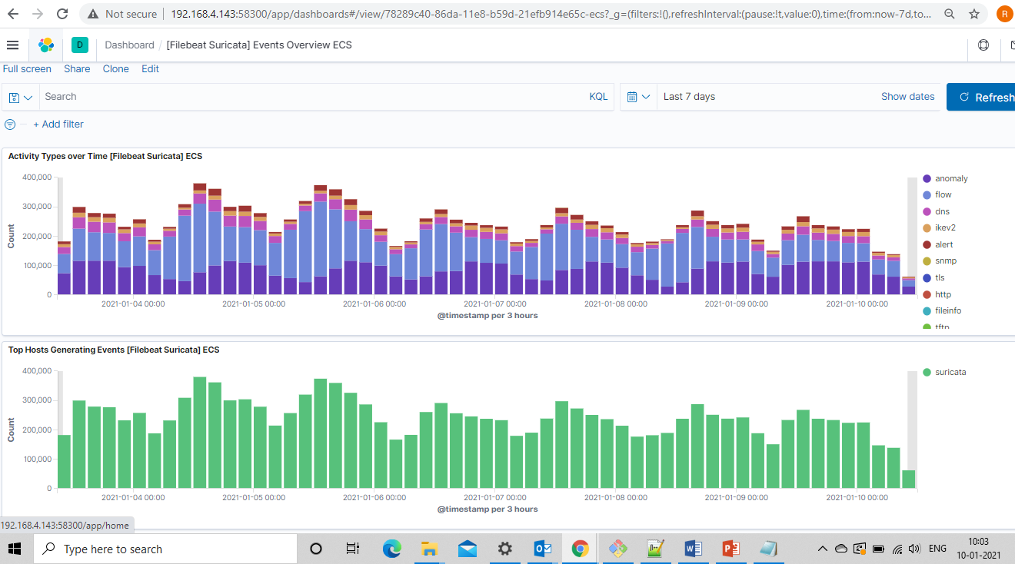
Suricata Events Overview dashboard

Slide 7
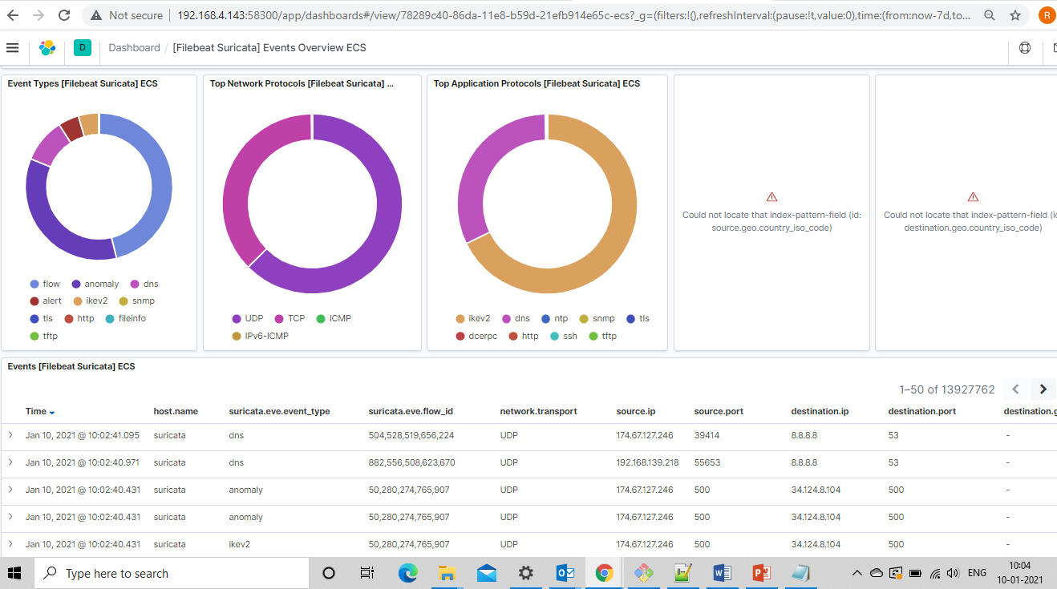
Suricata Events Overview dashboard

Slide 8
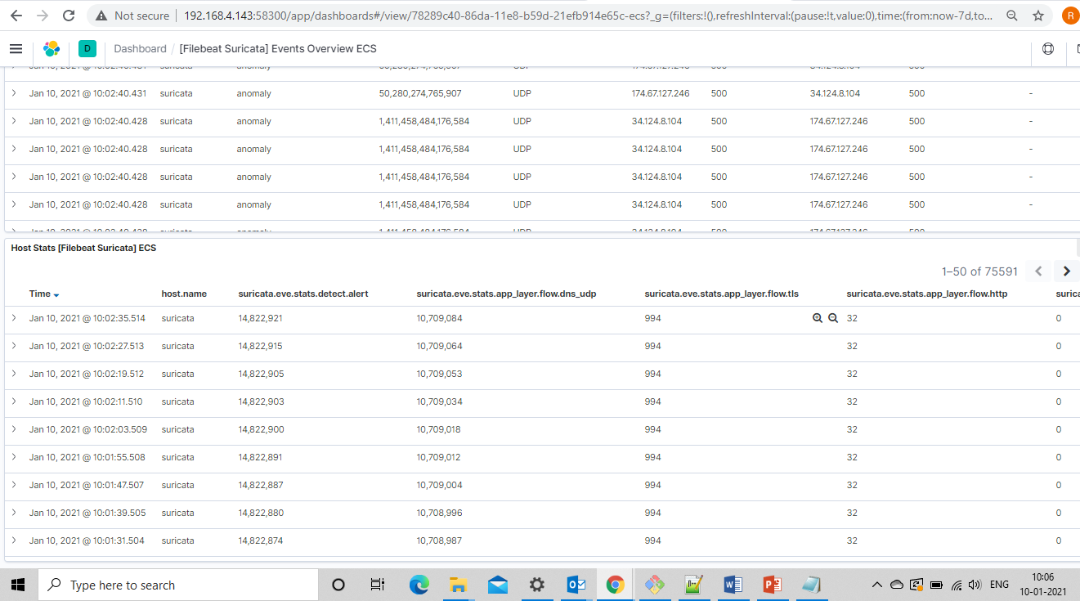
Suricata Events Overview dashboard

Slide 9
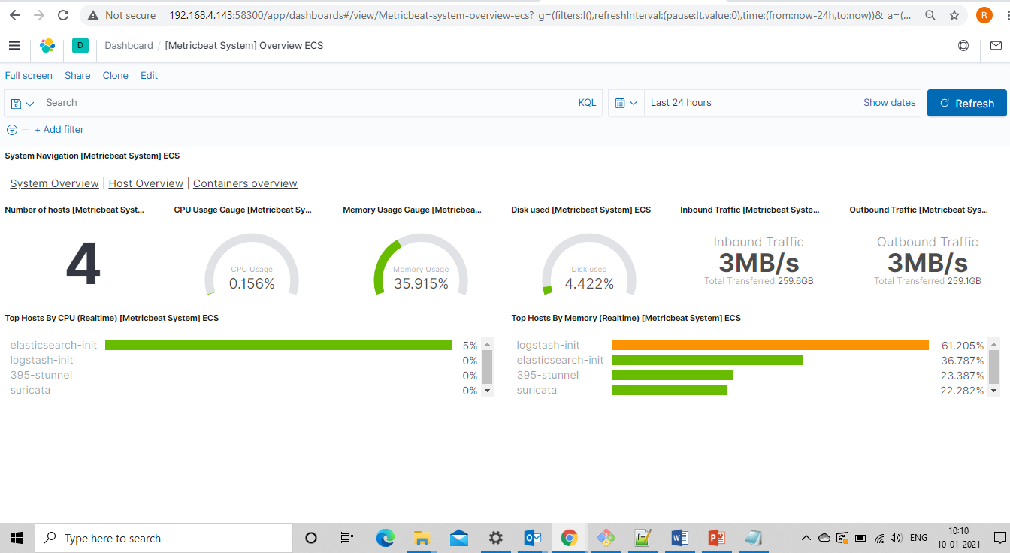
Metricbeat System Overview dashboard

Slide 10
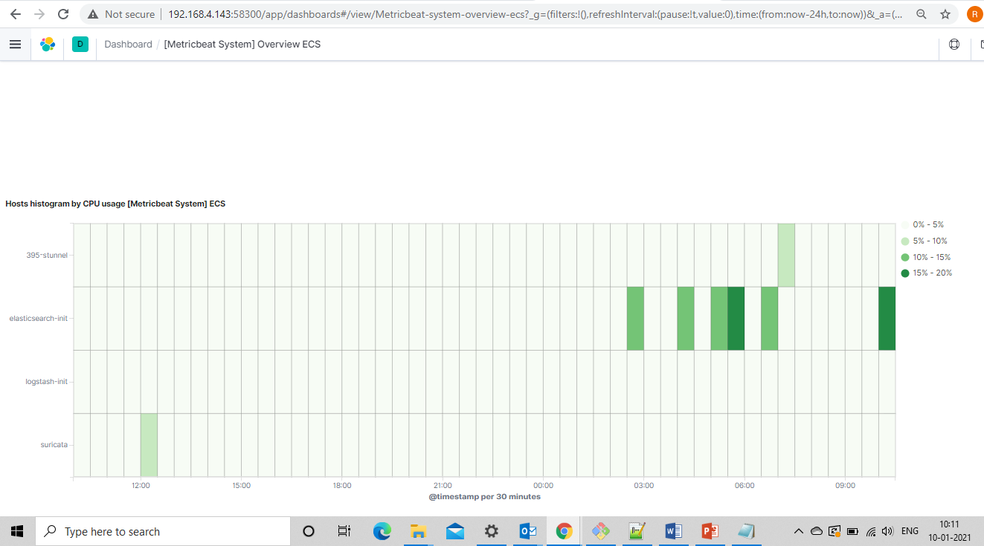
Metricbeat System Overview dashboard

Slide 11
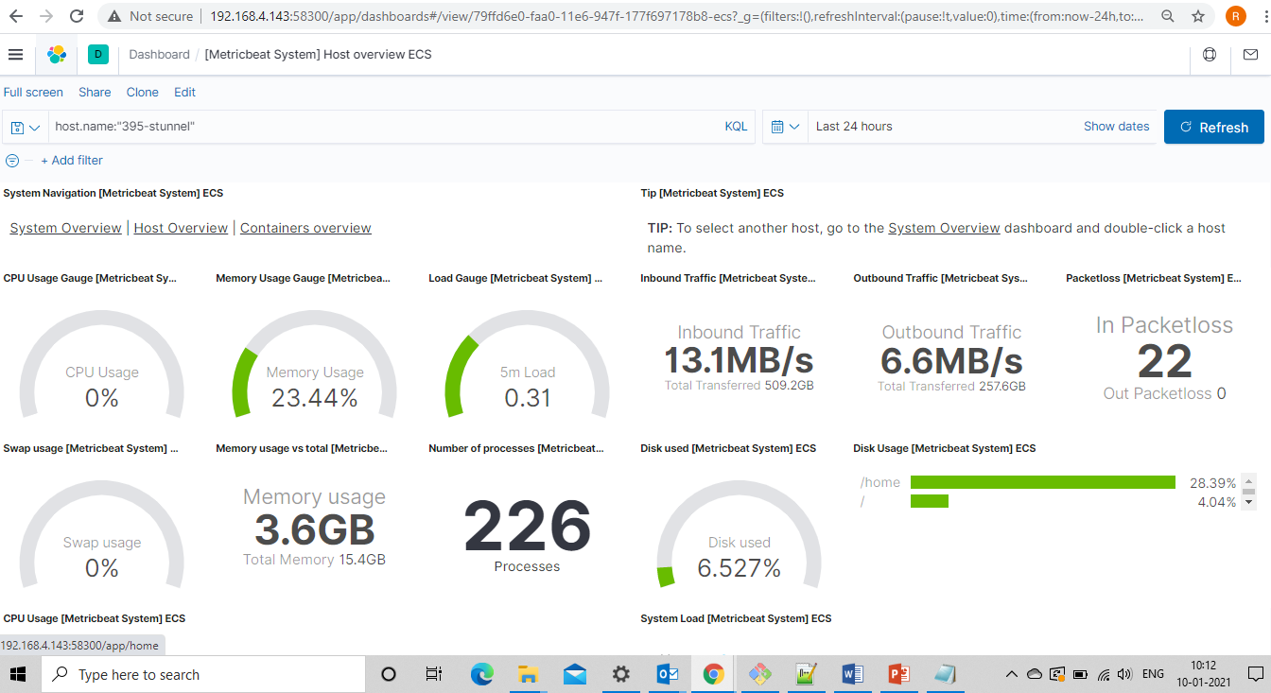
Metricbeat System Host Overview dashboard

Slide 12
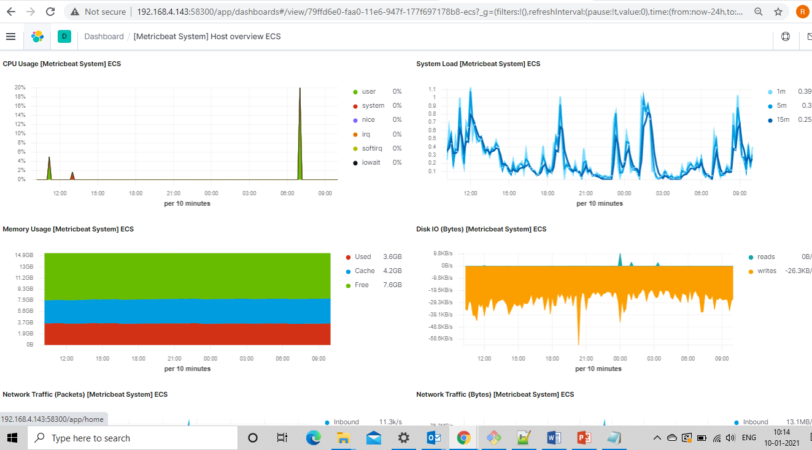
Metricbeat System Host Overview dashboard

Slide 13
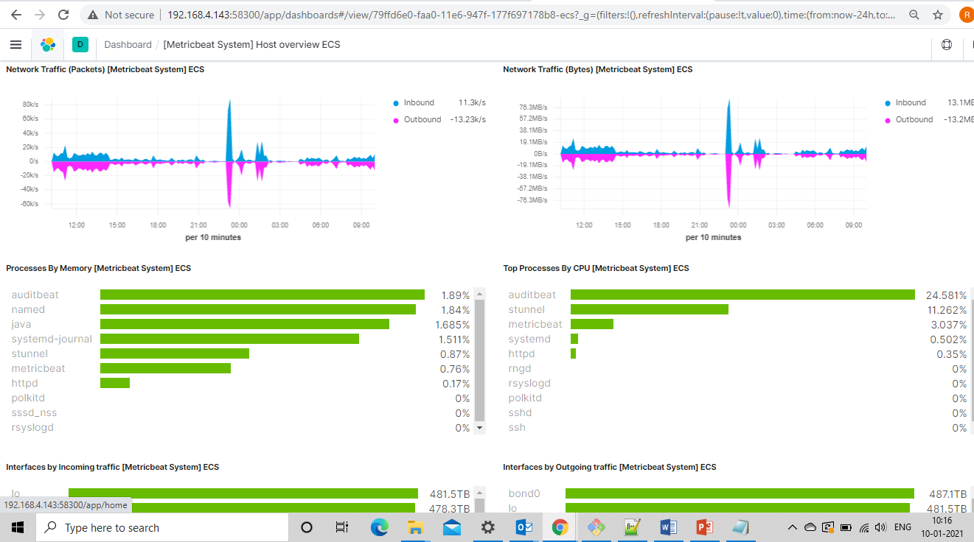
Metricbeat System Host Overview dashboard

Slide 14
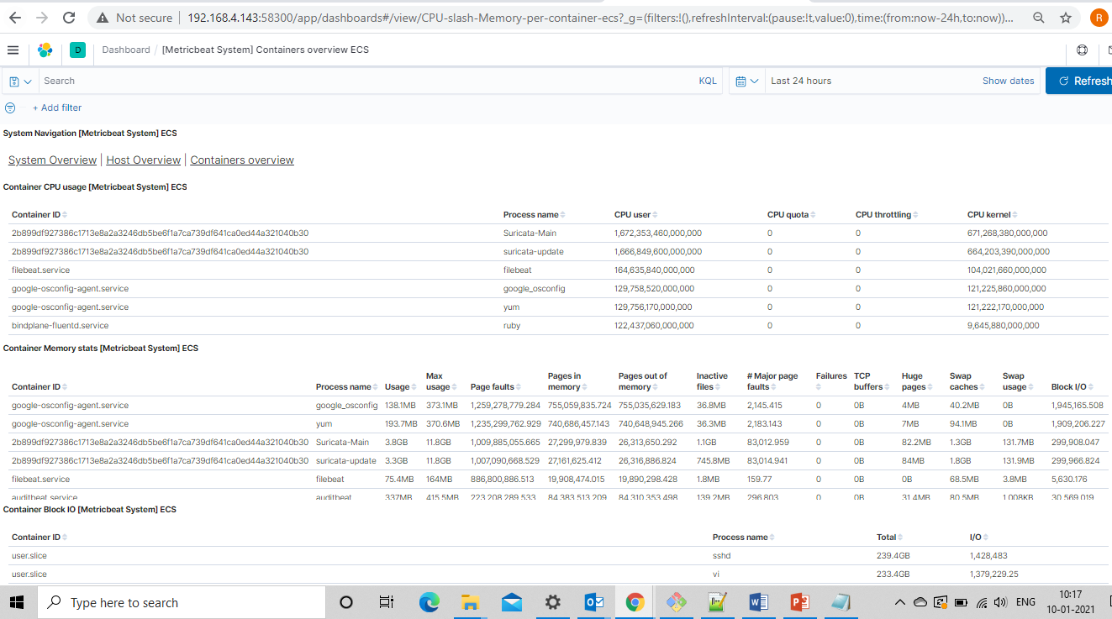
Metricbeat System Containers Overview dashboard

Slide 15
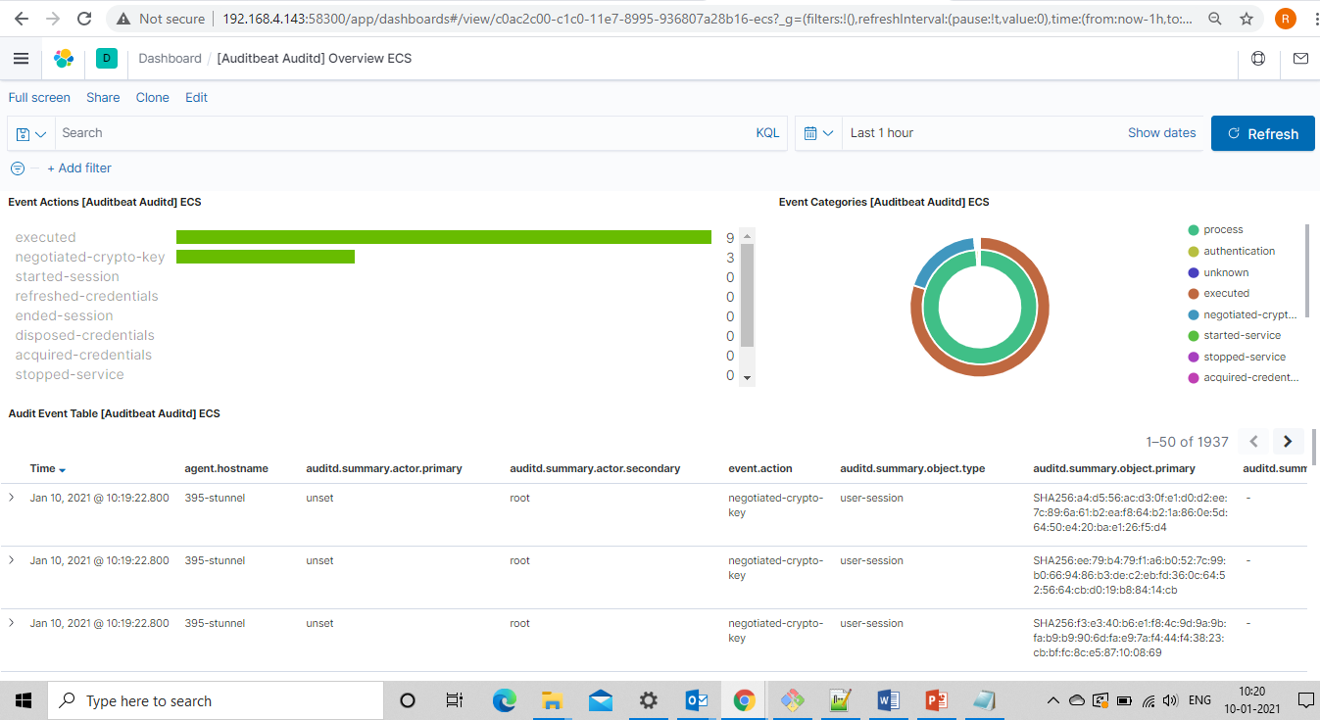
Auditbeat Auditd Overview dashboard

Slide 16
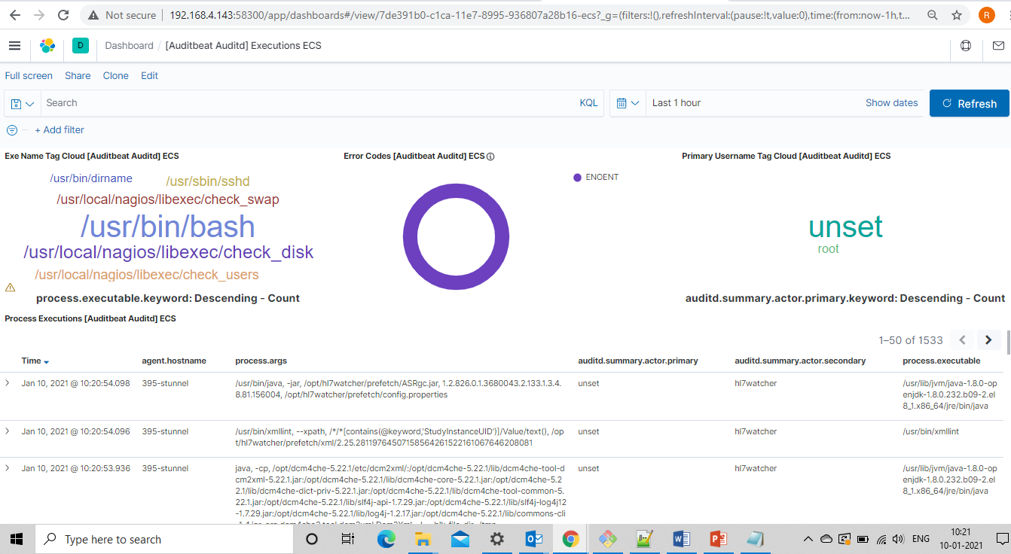
Auditbeat Auditd Executions dashboard

Slide 17
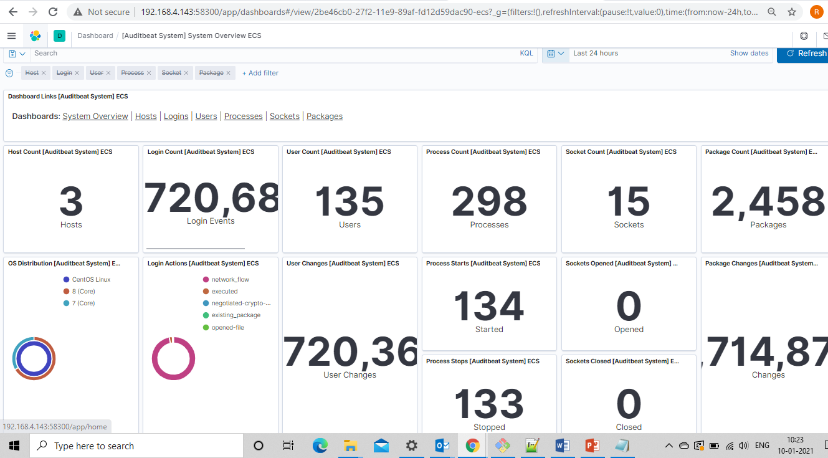
Auditbeat System Overview dashboard

Slide 18
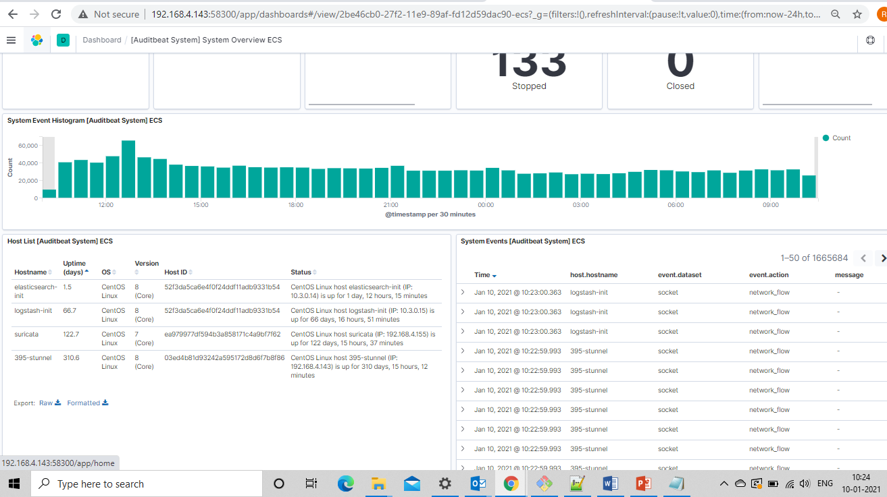
Auditbeat System Overview dashboard

Slide 19
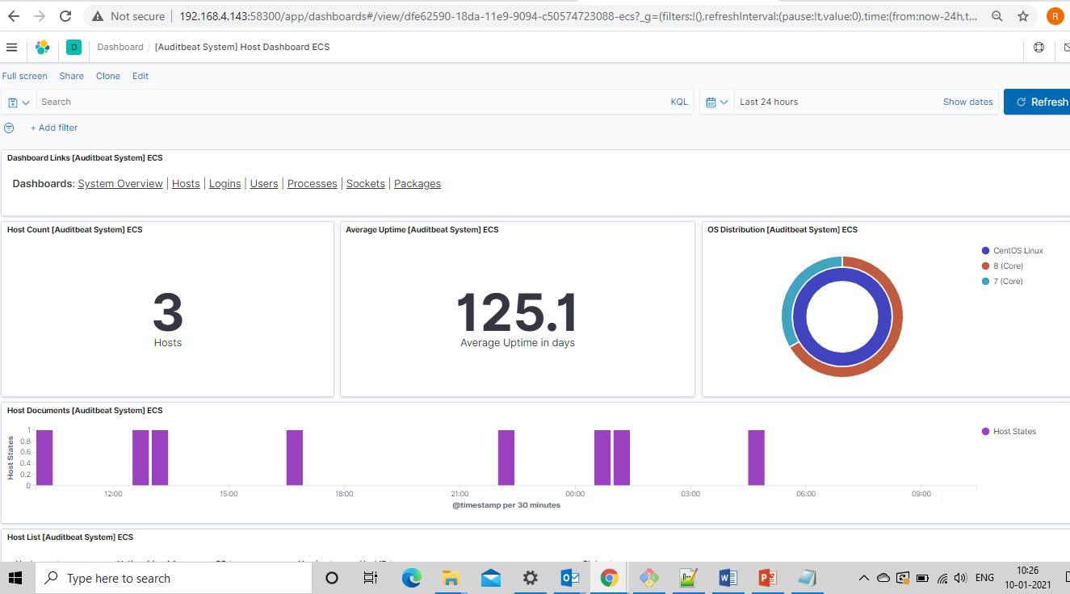
Auditbeat System Host Overview dashboard

Slide 20
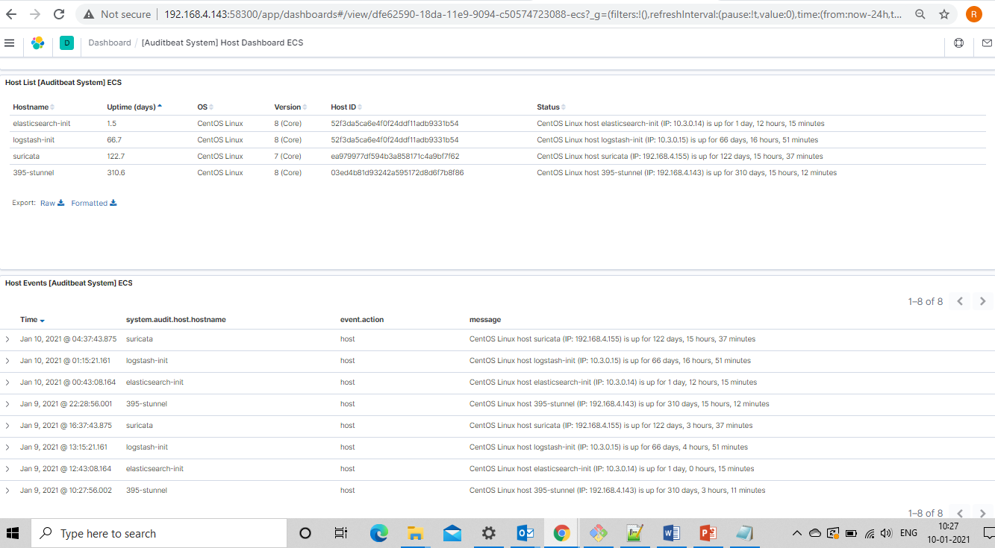
Auditbeat System Host dashboard

Slide 21
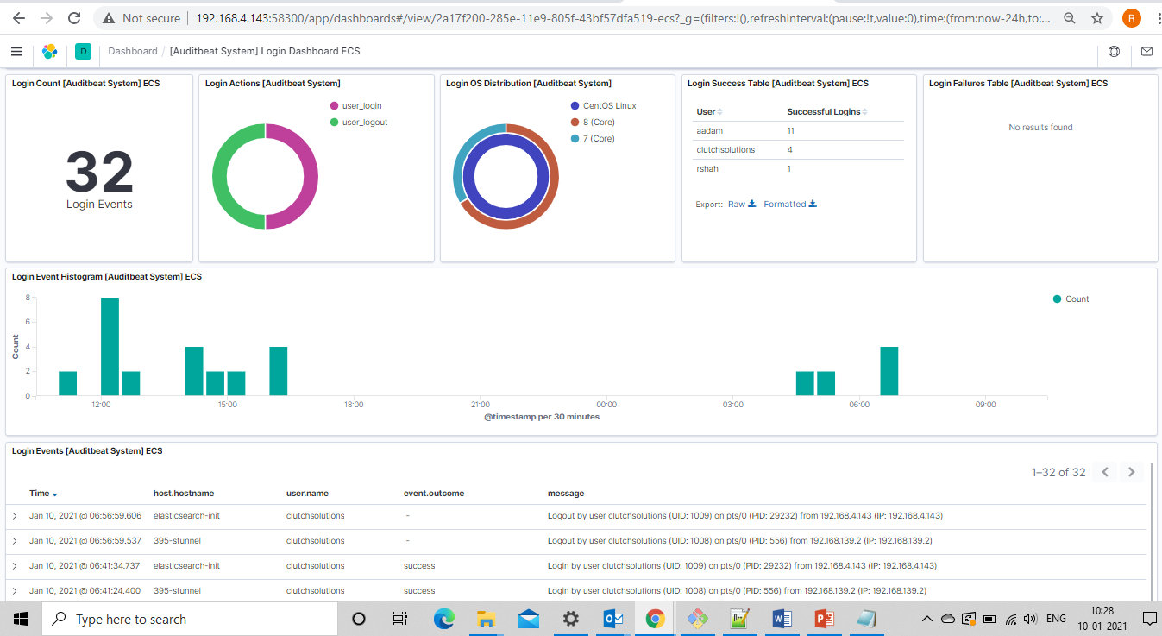
Auditbeat System Logins dashboard

Slide 22
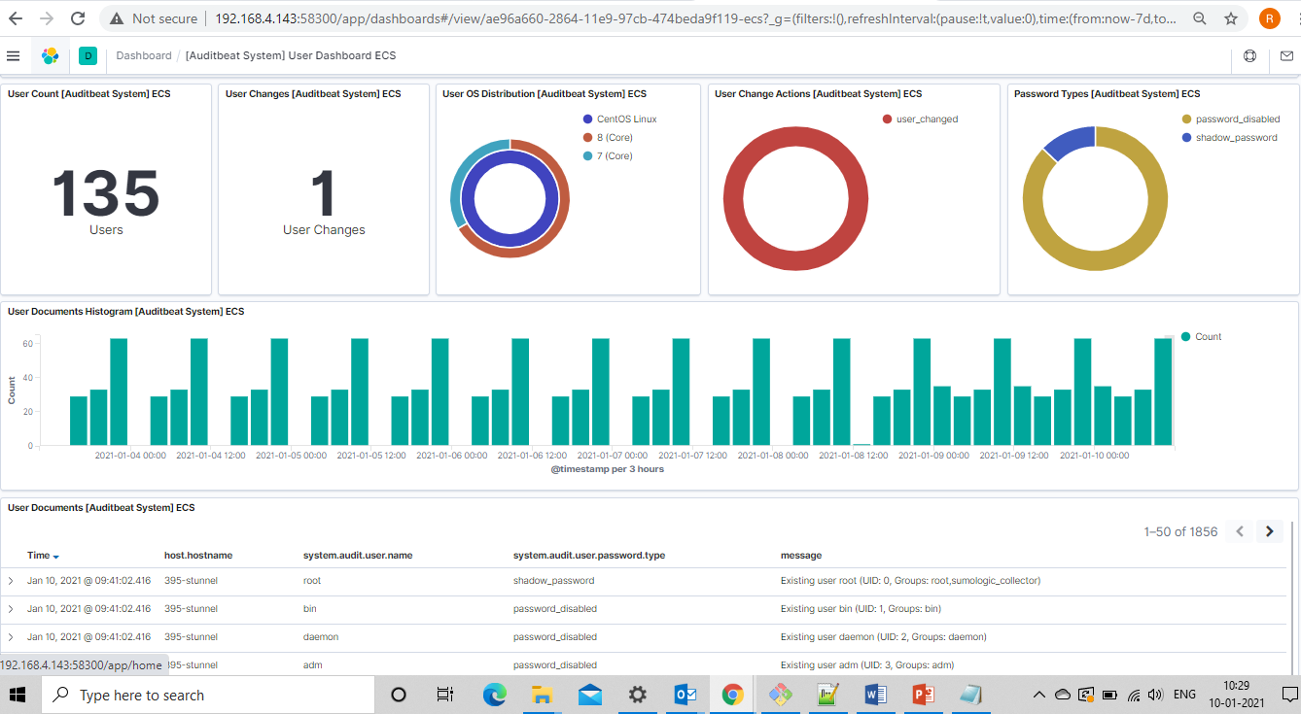
Auditbeat System User dashboard

Slide 23
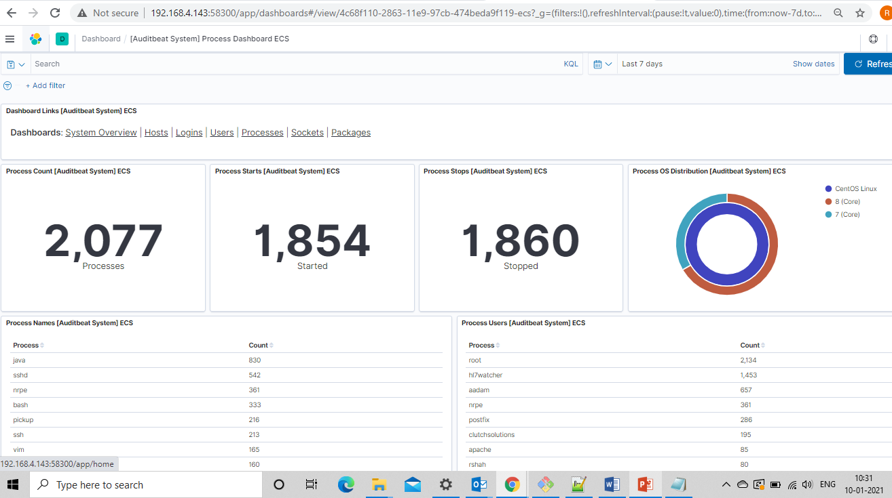
Auditbeat System Process dashboard

Slide 24
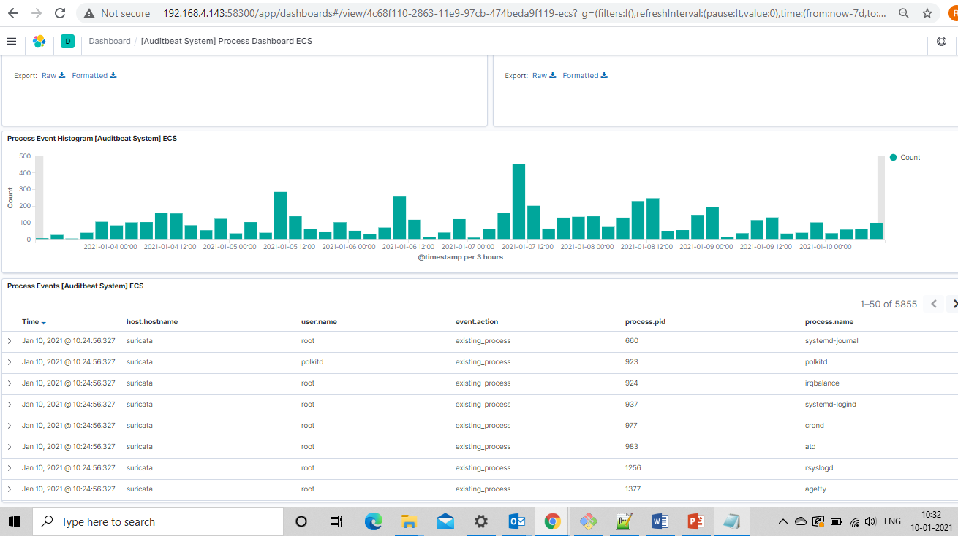
Auditbeat System Process dashboard

Slide 25
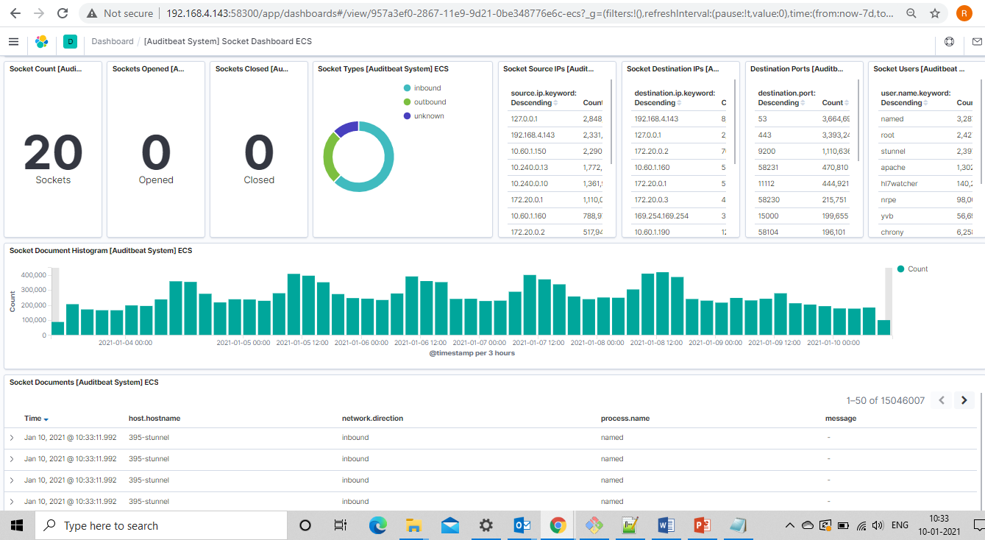
Auditbeat System Socket dashboard

Slide 26
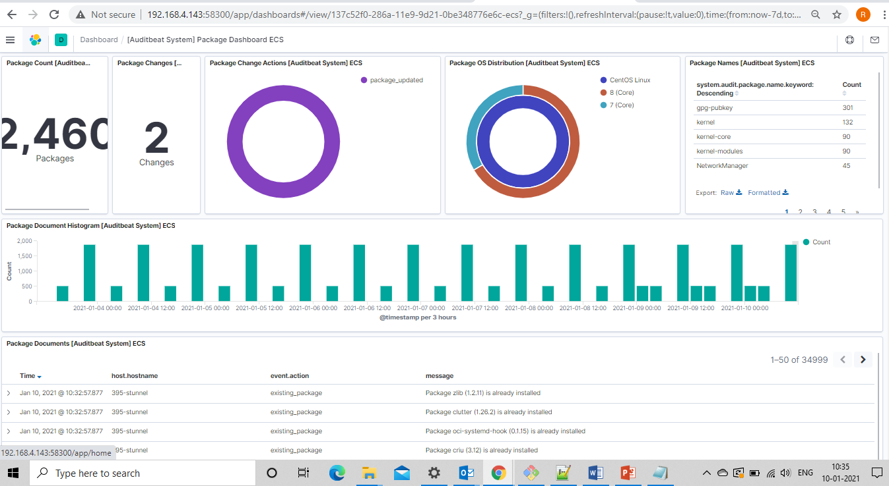
Auditbeat System Package dashboard

Slide 27
Procedure to import dashboards
Download asrrad-dashboards.7z file (which contains “.ndjson” files) attached with this slide and keep it ready to import from Kibana.
In Kibana, go to “Home -> Saved Objects”
Then select “Type” as “dashboard”
Click on “Import”. Select the required dashboard “.ndjson” file from your system local directory.
Incase if it gives error as not recognized index, select the corresponding index pattern from drop down provided and then click on “done”.
Go to Home -> Dashboard. Search for respective dashboard from list of dashboards.

