Slide 1
Treasure Hunt Theme GD-02
Prof – Sean Harrington
Reddy Balaji Madha
Ritesh Barapatre
Sami Almalki
Aryan Desai

Slide 2
Agenda
Introduction
Game Overview
Game Initialization
Game Execution
Visualizing the Board
Sound Effects
Game Statistics
Code explanation
Conclusion

Slide 3
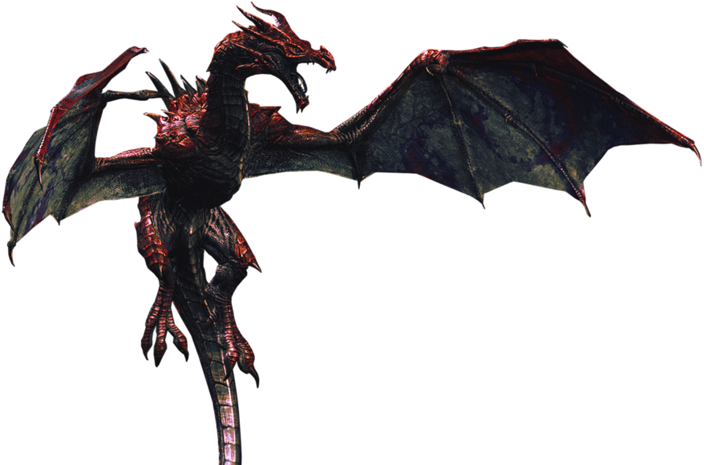
Introduction
Welcome to the Treasure Hunt game set in the Amazon jungle.
Explore hidden passages and avoid harmful pits to find the treasure!
Supports 1-4 players
Each player is assigned a unique color
Uses a random dice roll
Animates the movement and uses sound effects

Slide 4
Primary goals
Entertainment
Interactivity
Skill Development
Competition
Data Visualization
Statistical Insight

Slide 5
Game Initiations
Blue Adventurer “Bala”
Green Adventurer “Sami”
"I'm diving into this treasure hunt with the determination of the deepest ocean. The treasure won't escape me, even if I have to swim through quicksand!"
"In this jungle, I'll be greener than the leaves and bolder than the vines! Nothing will stop me from finding that treasure!"
Red Adventurer “Rite”
Orange Adventurer “Aryan”
"The treasure is just a red dot on the horizon, but I'm like a roaring volcano ready to erupt with excitement! Let the hunt begin and may the lava of victory flow in my favor!"
"I've got a zest for adventure and a splash of wild courage. With each step, I'm painting the jungle with my vibrant spirit. Brace yourselves, treasure, because I'm about to create a masterpiece of victory!"

Slide 6
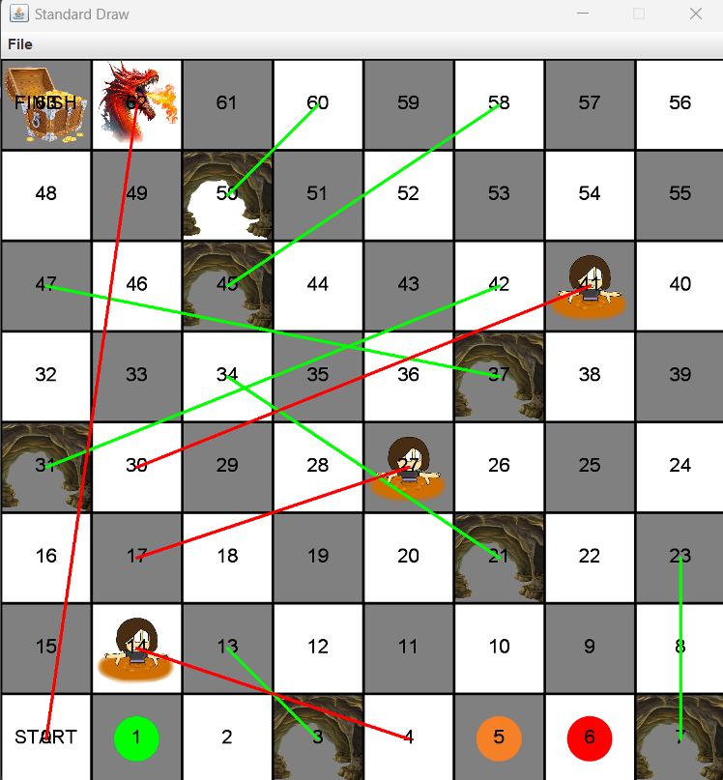
Game Execution
Game loop iterates until a player finds the treasure.
On each iteration, a player takes a turn, rolls the die, and advances.
Players may encounter QuickSand, Caves, or ancient Dragon named SMAUG, who’s been protecting the treasure ever since he was BORN.
The board is drawn to reflect the current state of the game.

Slide 7
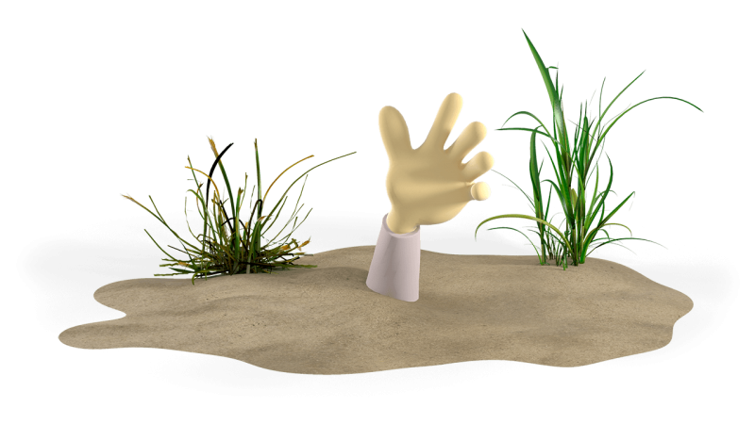
Game Visualization
The treasure hunt winner gets to keep the ANCIENT TREASURE worth billions of $.
StdDraw
The game uses StdDraw library for visual representations.
Grids
Divided into grid cells representing SPACES.
Design
Each player is represented by a coloured circle on their current space.
Sand Dunes, Caves and Dragon are displayed as Red and Green
Goal
Obstacles and Bonuses

Slide 8

Sound Effect
The game incorporates sound effects for an immersive experience.
A dice roll sound is played when a player rolls the die.
Pit Fall, Hidden Passages, and Dragon sounds are played when players encounter them.
A game win sound is played when a player finds the treasure.

Slide 9
Game Statistics
Total die rolls for the game and each player.
Common die rolls for the game.
Total Passages found by any adventurer.
Total number of secret Caves each adventurer went to.
Number of QuickSand (trap) adventurer fell into.

Slide 10
Code Explanation
Methods :
Main method
drawboard method
getPlayerColorName method
animateMovement method
StdAudio method
Other :
Random numbers - java.util.Random lib
Digraph method from - edu.princeton.cs.algs4.Digraph
Colours method is been used on the lib java.awt lib

Slide 11
Conclusion

Slide 12
Thank you
Reddy Balaji Madha
Ritesh Barapatre
Sami Almalki
Aryan Desai

