Slide 1
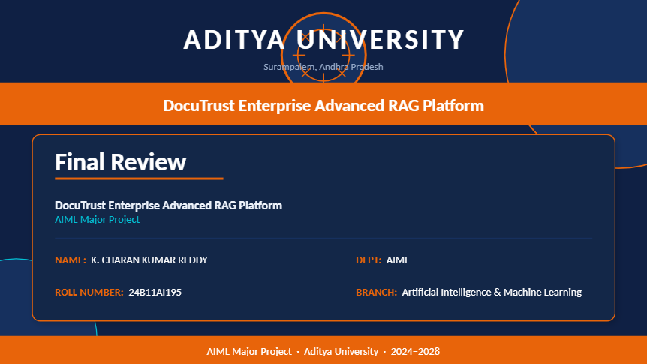

Slide 2
DocuTrust
Enterprise Advanced RAG Platform
with Automated Self-Correction
LangGraph / CrewAI
FastAPI
MongoDB
CRAG Pipeline
Self-correcting · Citation-enforced · Hallucination-free

Slide 3
The Problem
Why basic AI document search fails enterprises
Hallucinations
No Citations
Basic LLM pipelines generate confident but factually wrong answers not grounded in source documents.
Answers are unsourced, making traceability and compliance audits impossible.
Poor Retrieval
Zero Transparency
Keyword-based or low-quality vector search returns irrelevant chunks that pollute generation.
Users cannot see how or why an answer was produced, destroying trust in regulated environments.

Slide 4
The Solution
DocuTrust: A self-correcting Corrective RAG (CRAG) platform
What DocuTrust Does
CRAG
1. Validates retrieval quality BEFORE generating answers
2. Grades every document chunk with a cross-encoder model
3. Automatically rewrites queries & falls back to the web when local knowledge is insufficient
4. Enforces strict citations — every answer traces back to its source
5. Streams real-time agent evaluation logs for full transparency
Design Pattern
100%
Cited Answers
0
Hallucinations

Slide 5
Technology Stack
Enterprise-grade components powering DocuTrust
AI / Agent Layer
Backend Layer
LangGraph / CrewAI (CRAG pipeline)
Cross-Encoder (relevance grading)
Text Embedding Model
Web Search Fallback API
FastAPI + Uvicorn
PDF Parsing & Chunking
Vector Similarity Search
Citation Mapping Service
Database Layer
Frontend Layer
MongoDB (client profiles)
Document Metadata Store
Structural Index Lists
Interaction Trace Logs
HTML / CSS / JavaScript
Split-Pane Corporate UI
Drag-and-Drop PDF Upload
Real-Time Agent Log Stream

Slide 6
System Architecture
End-to-end CRAG pipeline data flow
PDF
Upload
Chunk &
Embed
Retriever
Agent
Grading
Agent
Generator
+ Cite
▶
▶
▶
▶
Web Fallback
(Query Rewriter)
↑ if grade FAIL
FastAPI Backend
MongoDB
Frontend UI
Orchestrates pipeline, handles upload endpoints, manages embedding and citation services.
Stores client profiles, document metadata, structural indexes, and interaction trace logs.
Split-pane interface: PDF upload left, real-time agent logs center, cited answer right.

Slide 7
Corrective RAG Agent Pipeline
Three intelligent agents working in sequence
01
Retriever Agent
Runs semantic vector similarity search
Ranks chunks by cosine similarity score
Returns top-K structural document chunks
▼
02
Grading Agent
Cross-encoder model scores each chunk
Compares query-chunk pair directly
Rejects chunks below relevance threshold — triggers fallback
▼
03
Query-Rewriter Agent
Activates when Grading Agent signals FAIL
Reformulates query for better web search
Merges validated web content with local findings

Slide 8
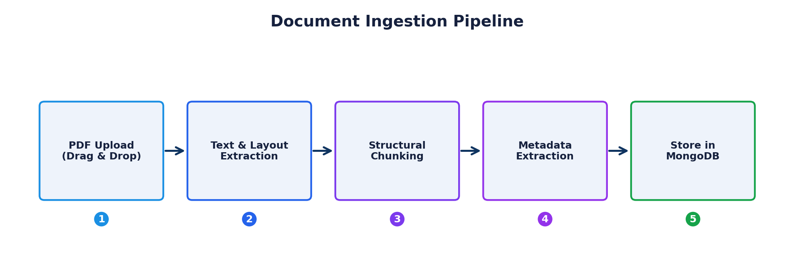
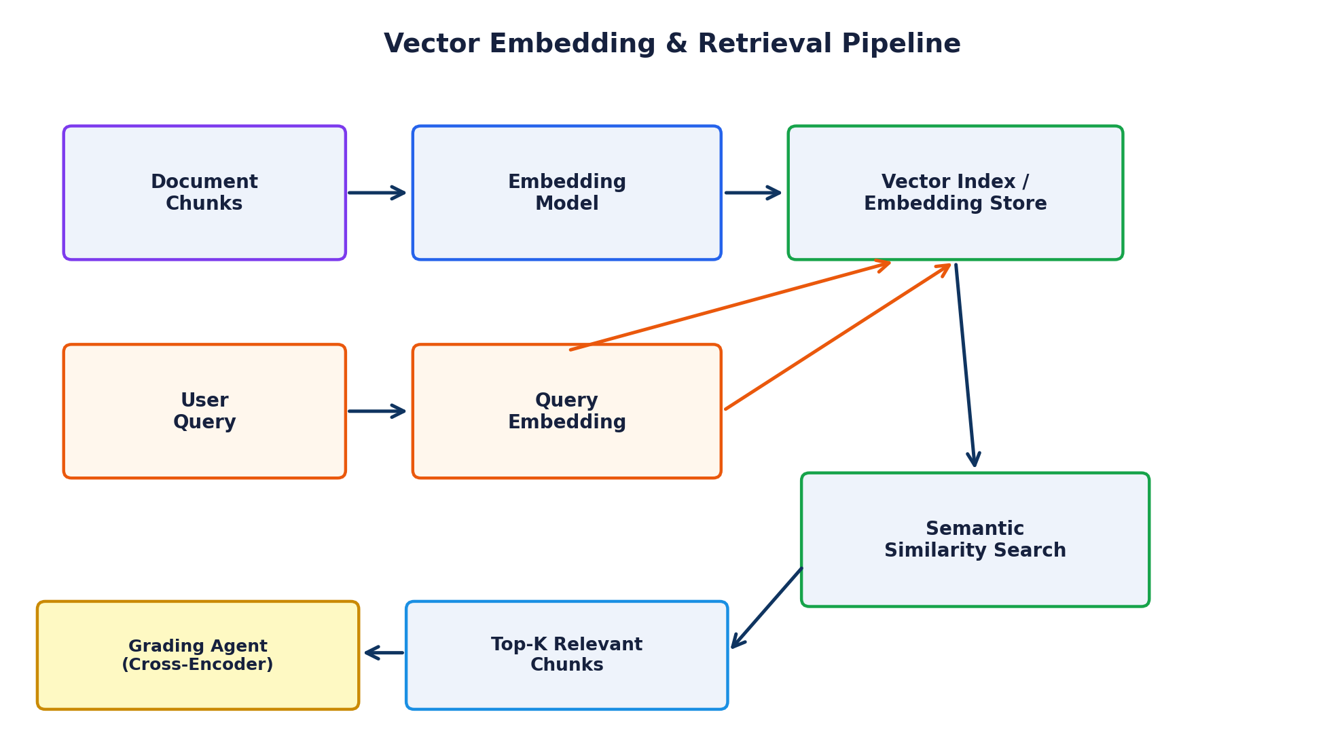
Document Ingestion & Vector Pipeline
How PDFs are processed into searchable vector embeddings
Document Ingestion Pipeline
Vector Embedding & Retrieval Pipeline

Slide 9
Key Features
What makes DocuTrust enterprise-ready
Self-Correcting CRAG
Strict Citation Enforcement
Web Fallback Search
Grades retrieval quality before generation — prevents hallucinated answers at the source.
Every answer is mapped to exact document source and section — full auditability.
Intelligent query rewriter activates when documents can't answer — no dead ends.
Real-Time Agent Logs
MongoDB Audit Trail
Multi-Page PDF Ingestion
Split-pane UI streams live agent evaluation steps — full transparency on every query.
Per-client profiles and interaction trace logs stored for compliance and review.
Structural chunking with metadata extraction supports large, complex policy documents.

Slide 10
Application Scenarios
Real-world enterprise use cases
01
Policy Q&A with Validated Answers
HR teams upload corporate policy PDFs. Users ask natural-language questions. DocuTrust retrieves, grades, and returns answers with paragraph-level citations — never an unsourced claim.
02
Automatic Web Fallback on Knowledge Gaps
When uploaded documents don't cover a query, the Query-Rewriter Agent reformulates and fetches supplementary web content, clearly flagging external sources in the audit trail.
03
Compliance Review with Full Transparency
Compliance officers watch every retrieval and grading step in real time via the agent log panel before trusting answers — full pipeline visibility for regulated environments.

Slide 11
Why DocuTrust?
The only RAG platform that grades before it speaks.
No Hallucinations — Cross-encoder grading prevents any unvalidated content from reaching the user.
Full Transparency — Live agent logs let enterprises verify every step of the pipeline.
Always an Answer — Web fallback ensures no query goes unanswered, with clear source attribution.
Built for Compliance — MongoDB audit trail and strict citations satisfy regulated industry requirements.
DocuTrust · Enterprise CRAG Platform

Slide 12
