Slide 1
INTELLIGENT
LINUX TERMINAL
A smarter and more user-friendly command-line experience
Lakshith : 2510030332
Ranadeep : 2510030337
Rahul : 2510030322

Slide 2
1. The Problem
Why a better command-line experience is needed
• Users need to remember many commands and options.
• Small typing mistakes can cause failed commands.
• Beginners may find system messages difficult to understand.
• Frequently used commands often have to be typed again.
• A simple, helpful interface can reduce unnecessary effort.
Difficulty
Remembering commands takes time, especially for new users.
Typing Errors
A single missing or incorrect character can interrupt a task.
User Experience
Clear guidance can make the terminal easier to learn and use.
2

Slide 3
2. Our Solution
An intelligent terminal focused on speed, guidance and convenience
User enters a command
Terminal understands the request
Helpful suggestion or correction
Command is carried out
• The goal is not to replace the terminal — it is to make everyday terminal use easier.
• The design supports both beginners and experienced users.
3

Slide 4
3. Key Features
The main intelligent capabilities proposed in the project
Command History
Auto-Suggestions
Quickly revisit commands that were used earlier.
Offer likely commands while the user is working.
Typo Correction
Error Guidance
Recognize common mistakes and suggest the intended command.
Explain problems in a clearer and more useful way.
Example: pythn → python • “Try this command instead?”
4

Slide 5
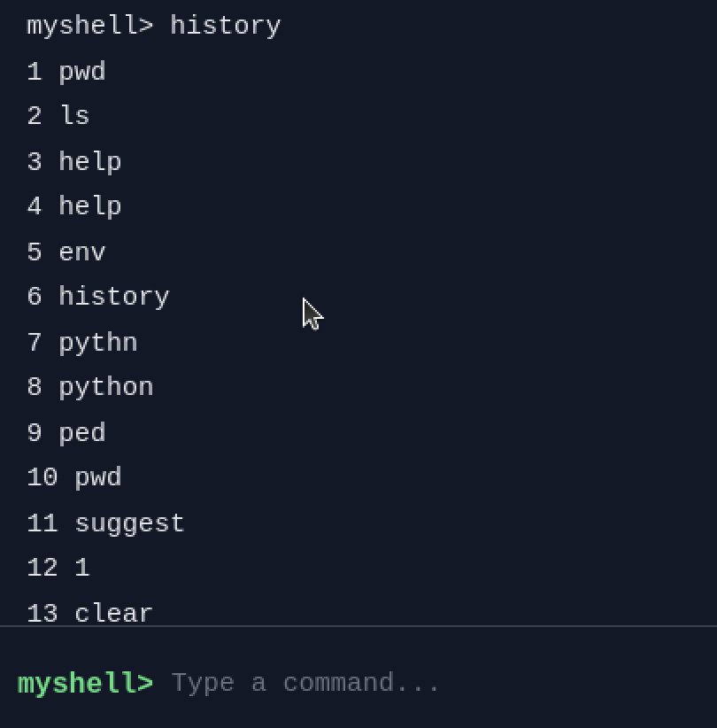
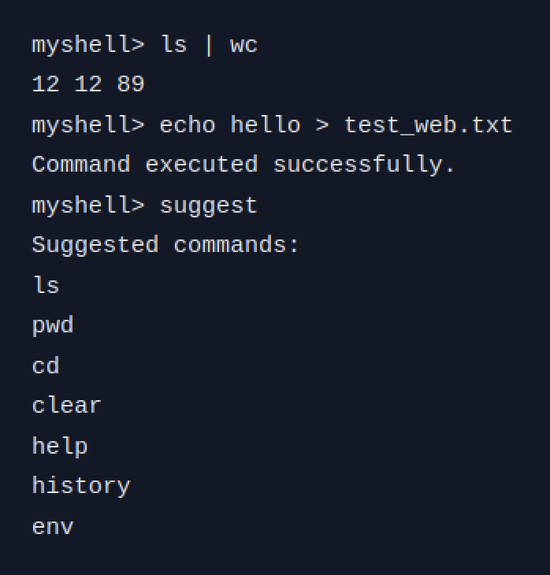
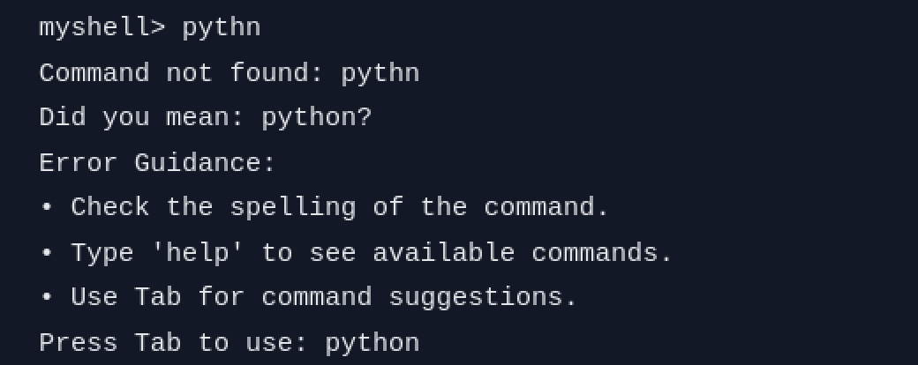
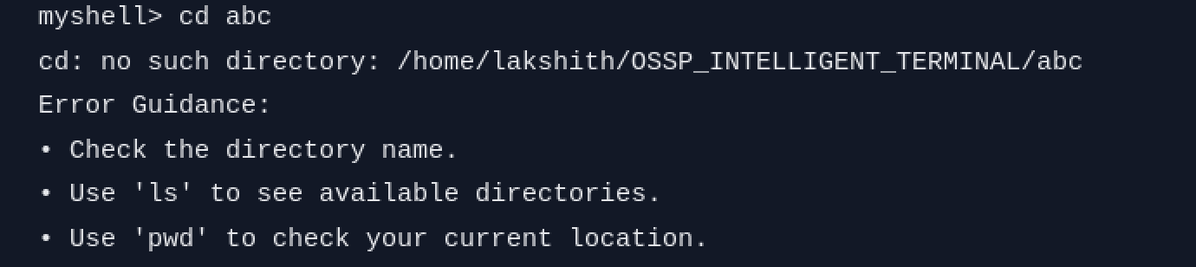
4. Working Prototype
Screenshots from our running ShellForge terminal
Typo Correction
pythn gets “Did you mean: python?” plus guidance and a Tab shortcut.
Command History
The history command lists earlier commands so they can be reused.
Suggestions & Execution
Pipes and redirection run normally; suggest lists likely commands.
Error Guidance
Clear next steps appear after a failed cd.
Real output from the working ShellForge prototype
5

Slide 6
5. Normal vs Intelligent Terminal
How our terminal improves everyday command-line use
Feature | Normal Terminal | Intelligent Linux Terminal
Execute Linux commands | ✓ | ✓
ls, pwd, cd, etc. | ✓ | ✓
Command history | Basic shell history | ✓ Integrated history
Auto-suggestions | Usually limited / configurable | ✓ Built-in
Typo detection | ✗ | ✓
Typo correction suggestions | ✗ | ✓ pythn → python
Error guidance | Mostly raw error messages | ✓ Explains what to do
Beginner friendly | Moderate | Higher
Web interface | ✗ | ✓ Available
Intelligent assistance | ✗ | ✓
6

Slide 7
6. Objectives
What the project aims to achieve
Easy to use
Faster work
Fewer mistakes
Reduce the effort needed to work with Linux commands.
Help users reach frequently used commands quickly.
Detect common typing problems before they waste time.
Better learning
Reliable execution
Practical impact
Give beginners useful guidance instead of confusing failures.
Maintain a dependable experience for normal command-line tasks.
Build a useful tool that can support real users.
7

Slide 8
7. How the User Experience Works
Simple flow from input to useful action
01
02
03
04
05
Enter
Understand
Assist
Execute
Learn
User types a command
The terminal checks the input
History, suggestion or correction can help
The requested action is performed
Clear feedback helps the user improve
• The experience is designed to feel familiar while adding helpful assistance at the right moment.
8

Slide 9
8. Accuracy & Reliability
How the project can be evaluated fairly
Correct commands
Common typos
Normal commands should execute as expected.
Known mistakes should produce a useful correction or suggestion.
Repeated tasks
Invalid input
Previously used commands should be easy to retrieve.
The terminal should respond clearly instead of leaving the user confused.
Evaluation principle: correct output + useful guidance + consistent behavior
9

Slide 10
9. Innovation & Sustainability
Why the idea can remain useful beyond the first version
Innovation
Sustainability
Future Growth
Combines a familiar terminal experience with assistance features that respond to the user's previous activity and mistakes.
A lightweight software solution can improve productivity without requiring additional physical infrastructure.
The concept can be expanded with better suggestions, richer guidance, accessibility support and more personalized assistance.
• Designed to evolve through incremental improvements rather than replacing the whole workflow.
10

Slide 11
10. Utility to Society
Who benefits and how
Students
Beginners
Learn Linux more comfortably and spend less time memorizing commands.
Receive clearer guidance when a command is unfamiliar or mistyped.
Developers
System Users
Reduce repetitive typing and quickly reuse common commands.
Get a more approachable interface for everyday Linux tasks.
Social value: less frustration • faster learning • better productivity
11

Slide 12
11. Conclusion & Review 4 Highlights
A practical project with clear scope and room for meaningful improvement
Accuracy
Reliable command behavior
and clear feedback
Competence
Functional terminal
experience
Innovation
History + suggestions +
correction + guidance
Utility
Helpful for students,
beginners and users
Presentation
Simple problem → solution
→ impact story
• The project focuses on making Linux command-line work easier, faster and more approachable.
• Next focus: strengthen intelligent assistance, testing and demonstration quality.
12

