Slide 1
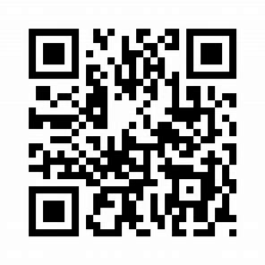
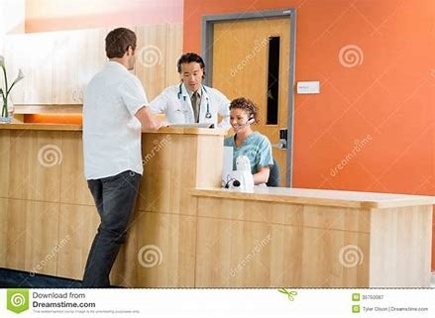
Visiting patients made better!
Visitor’s Access Device
Get the Generated QR code providing details.
Scan the QR code to enter the patients general ward!
Sends an SMS to visitor about start time of visiting.
Makes an Automated voice-call to user after visiting time.

Slide 2

Reduces paper work!(Eco-friendly too)
QR will be sent to visitor’s phone number.
In worst case, Hard copy will be provided.
Improves Quality of business
Technology helps reduce Man power.
Reduced cost of maintenance.

Slide 3

Tech Stack / Architecture / API
Twilio API
Used Automated SMS services.
Used Automated voice-call services.

