Slide 1

Department of Electrical and Electronics Engineering
SOLAR WIRELESS POWER TRANSFER SYSTEM FOR ELECTRIC SHIPS
Project group
DEEPTI: (1NT22EE024)
HARSHITHA D R :(1NT22EE034)
MEGHANA B S: (1NT22EE053)
MONIKA REDDY: (1NT22EE057)
SRIVIDYA: (1NT22EE060)
Guide
DR.RAJARAJAN
ASSISTANT PROFESSOR
Dept. of EEE,NMIT
Co- Guide
DR.Singaravelan A
ASSISTANT PROFESSOR
Dept. of EEE,NMIT
Major Project Phase-II (22EEP81)

Slide 2
Content
Motivation / Introduction – Why this problem is important.
Literature Survey – Table/diagram comparing existing works vs proposed work.
Problem Statement – In one clear slide.
Objectives – Bullet points.
Proposed Methodology – Flowchart/block diagram.
Work Done So Far
Expected Outcomes – Bullet list (performance improvement, design prototype, simulation, etc.).
Work Plan / timeline chart – Semester-wise timeline.
Team Role Distribution – Who handles what part.
References – IEEE format.

Slide 3
Introduction
The increasing adoption of electric vehicles (EVs) has created the need for charging systems that are efficient, safe, and sustainable. Traditional wired charging stations face challenges such as long charging times, safety risks, and dependency on grid electricity, which is often generated from fossil fuels. To address these issues, this project develops a solar-powered wireless power transfer (WPT) system based on magnetic resonance coupling for EV charging. The system integrates a photovoltaic (PV) source with a resonance-based WPT circuit to provide contactless, eco-friendly, and reliable charging. A complete model is designed and simulated in MATLAB/Simulink, analyzing factors such as coil alignment, air-gap variations, and efficiency. A low-power prototype validates the simulation, showing efficient energy transfer over practical coil distances. The results demonstrate the feasibility and scalability of combining renewable energy with wireless charging, while also highlighting challenges like misalignment sensitivity and reduced efficiency at larger gaps.
The system also supports real-time monitoring using an ESP32 WiFi module. Users can monitor voltage, current, power, and battery charging status directly on a mobile phone.

Slide 4
Literature Survey
Sl. No. | Details of the Paper | Methodology | Outcome
1 | Design and Implementation of Resonance based Wireless Power Transfer System. | This paper implements a resonance-based WPT system using series–series compensation to achieve efficient power transfer over an air gap. A high-frequency inverter excites the transmitter coil, and experimental results are used to validate system efficiency. | The study demonstrated successful wireless power transfer using resonance, achieving improved efficiency over a practical air gap. The results confirmed that series–series compensation enhances power transfer performance.
2 | Comprehensive Mathematical Modelling andE xperimental Analysis of a Wireless Power Transfer System for Neighborhood Electric Vehicles Merugu Kavitha1, Phaneendra Babu Bobba2, Dinkar Prasad3Department of Electrical Engineering, Shiv Nadar University, Gautam Buddha Nagar, UP, India.mk508@snu.edu.in1, phaneendra.bobba@snu.edu.in2,dinkar.prasad@snu.edu.in3 | This work develops a mathematical model of a magnetic resonance WPT system and validates it using MATLAB/Simulink simulations. The simulated results are experimentally verified to study efficiency variation with frequency and coil distance. | The mathematical model and MATLAB/Simulink simulations closely matched experimental results. The system achieved higher efficiency at optimal resonant frequencies and shorter coil distances.
3 | Floating solar wireless power transfer system for electric ships: Design and laboratory tests*Khalifa Aliyu Ibrahim a, Timoth ´e Le Mar´ echal a, Patrick Luk a, Qing Qina, Luofeng Huanga,Ying Xie b, Patrick Verdin a, Zhenhua Luo aa Faculty of Engineering and Applied Sciences, Cranfield University, Cranfield MK430AL, UKb Faculty of Business and Management, Cranfield University, Cranfield MK430AL, UK | This paper integrates floating solar photovoltaic systems with wireless power transfer for maritime applications. Simulation using electromagnetic tools and laboratory testing are carried out to evaluate system performance under practical conditions. | The integration of floating solar with wireless power transfer enabled sustainable, off-grid charging. Experimental results showed reliable power transfer with high efficiency under laboratory conditions.

Slide 5
Problem Statement
What’s the Issue?
The maritime sector needs sustainable charging for electrification and decarbonization .Conventional wired systems face safety, corrosion ,and handling issues. Wireless Power Transfer enables contactless charging but struggles with misalignment ,air gaps and wave motion. Integrating floating solar offers off-grid ,green energy, yet intermittency and efficiency optimization remain key challenges.
Challenges
intermittent solar supply
Coil misalignment and gap losses
Resonance detuning
High setup cost
Scalability and EMI issues
Problem to solve
Develop a reliable, efficient, and sustainable charging system for electric ships by integrating floating solar energy with resonance-based wireless power transfer, overcoming challenges like solar intermittency, coil misalignment, air –gap variations, and resonance detuning to enable scalable and safe marine charging solutions.

Slide 6
Objectives
Design a floating solar- powered WPT system for ships
Analysis efficiency under varying coil alignment and air – gap conditions
Optimize system for reliability, low losses, and scalability
Integrate soler energy for sustainable, off- grid charging
a floating solar- powered WPT system for ships
• Implement ESP32 WiFi monitoring for real-time parameter display on mobile phones.
• Develop multiple charging modes including wireless charging, onboard solar charging, and hydrogen fuel cell backup.

Slide 7
Methodology
Step | Description
Literature Review
System Design | Solar DC–AC source for variations. Measure/Rx coil design for ship decks and floating docks. Resonance compensation via S–S or S–P networks. Safety features: temperature, overcurrent, and foreign object detection
Algorithm Development | Create control algorithm to maintain voltage and frequency stability. Implement alignment and load compensation algorithms for varying ship positions. Develop monitoring logic for efficiency, coil misalignment, and thermal management.
Simulation & Testing | Simulate system using MATLAB/Simulink or equivalent positions. Develop power transfer efficiency, resonance tuning, and effect of misalignment/air-gap. Optimize coil design and control parameters before prototype development.
Prototype Development | Build scaled WPT prototype with Tx-Rx coils and solar power source. Test under different air-gap distances, alignment conditions, and load variations. Measure output power, efficiency, thermal performance, and reliability
Result Analysis | Compare experimental results with simulation for validation and optimization.

Slide 8
Work Done So Far
The Solar Wireless Power Transfer for Electric Ships project has reached approximately 90% completion. The hardware components have been successfully developed and integrated, and the coding for the system has been fully implemented. The wireless charging station has been designed and developed, and the electric boat prototype has also been successfully fabricated. Overall, the system has been implemented and is currently in the final stage of testing and validation
Additionally, two ship models were developed. One ship was integrated with a WiFi-enabled ESP32 board to connect with a mobile phone. Using a transmitter and receiver setup, wireless power transfer between the two ships was successfully demonstrated.
Two ship models were developed successfully. One ship was integrated with a WiFi-enabled ESP32 board to connect with a mobile phone. Real-time voltage, current, power, and charging levels can be monitored through the phone. Wireless power transfer between the ships was demonstrated using transmitter and receiver coils.

Slide 9
Expected Outcomes
The expected outcome of this project is to demonstrate a solar-based wireless power transfer system for charging an electric boat. When the boat comes near the transmitting coil at the charging station, power is transferred wirelessly to the receiving coil in the boat, initiating the charging process.
The charging efficiency increases when the transmitting and receiving coils are properly aligned or placed very close to each other. During power transfer, the system displays the voltage, current, and power values on the display module, allowing real-time monitoring of the charging process.
The project develops a functional prototype consisting of a solar-powered charging station and an electric boat model, demonstrating a safe, contactless, and eco-friendly charging method suitable for marine applications.
The system is expected to support three charging modes:
1. Wireless charging from the solar-powered charging station.
2. Direct charging using solar panels mounted on the ship.
3. Backup charging using a hydrogen fuel cell.
The system also enables real-time mobile monitoring through ESP32 WiFi communication.

Slide 10
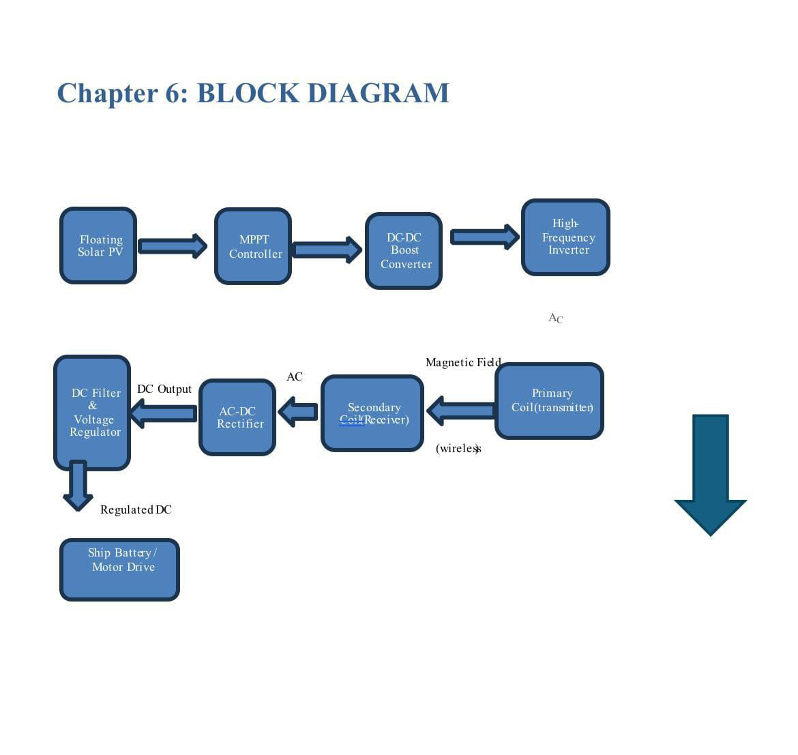
31/01/2026

Slide 11
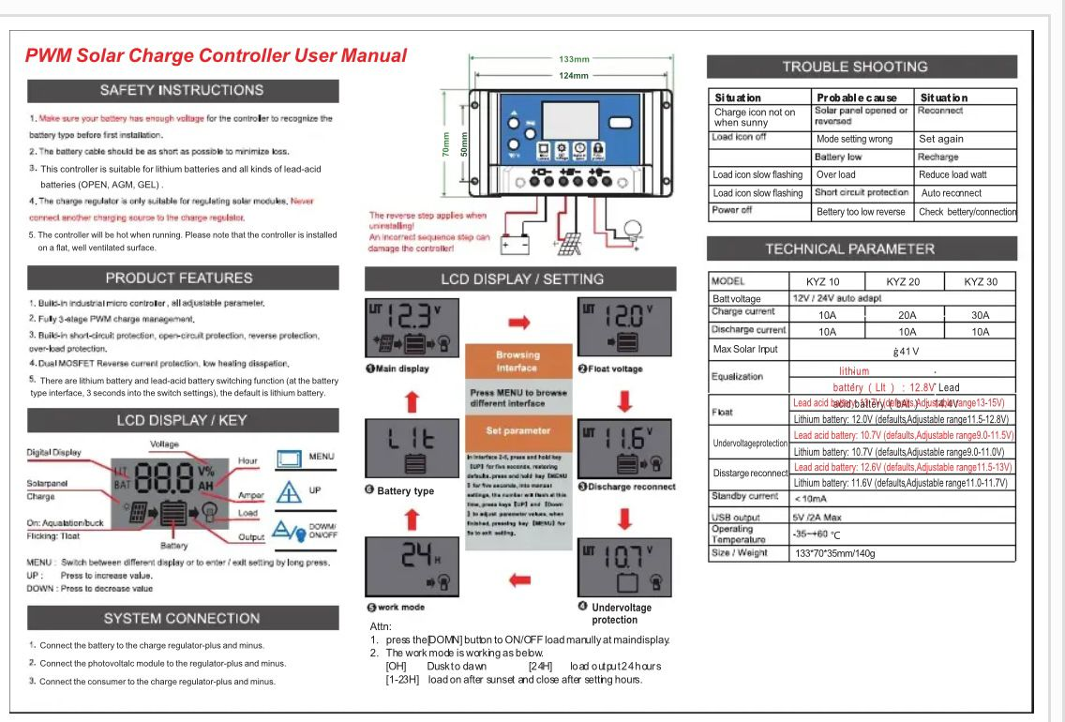
MPPT

Slide 12
Components required
12V Li-ion Battery Stores electrical energy and provides a stable 12V DC supply to power the system . It is rechargeable and commonly used for portable and renewable energy projects.
Solar Panels (2 Nos.)Convert sunlight into electrical energy using photovoltaic cells . They are used to charge the battery and power the circuit in an eco-friendly way.
Wireless Charging Coil Set (Transmitter & Receiver)Transfers power wirelessly through electromagnetic induction without physical contact .It is used to charge devices safely and conveniently over short distances.
Toy Ship Acts as the base or body of the project for demonstration purposes . It helps in practical implementation and visualization of the system.

Slide 13
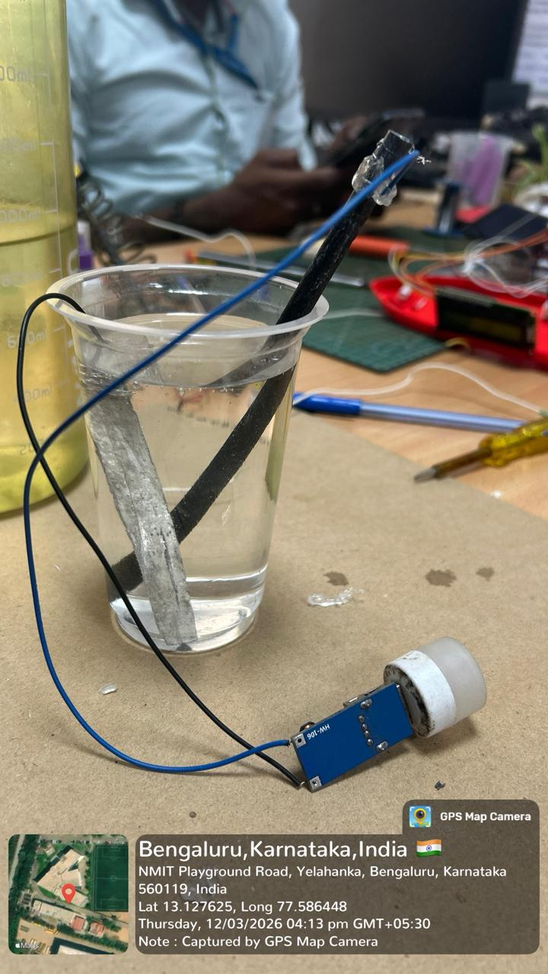
Components required
MPPT Board (Maximum Power Point Tracking)Optimizes the power extracted from solar panels for maximum efficiency . It regulates charging and protects the battery from overcharging.
LED Strip Provides illumination using low power and high efficiency LEDs . Used for indication, decoration, or lighting in the project setup.
Battery stores electrical energy and supplies power to the boat’s electrical system when required
Charging module regulates and manages the safe charging of the battery from the wireless power transfer system

Slide 14
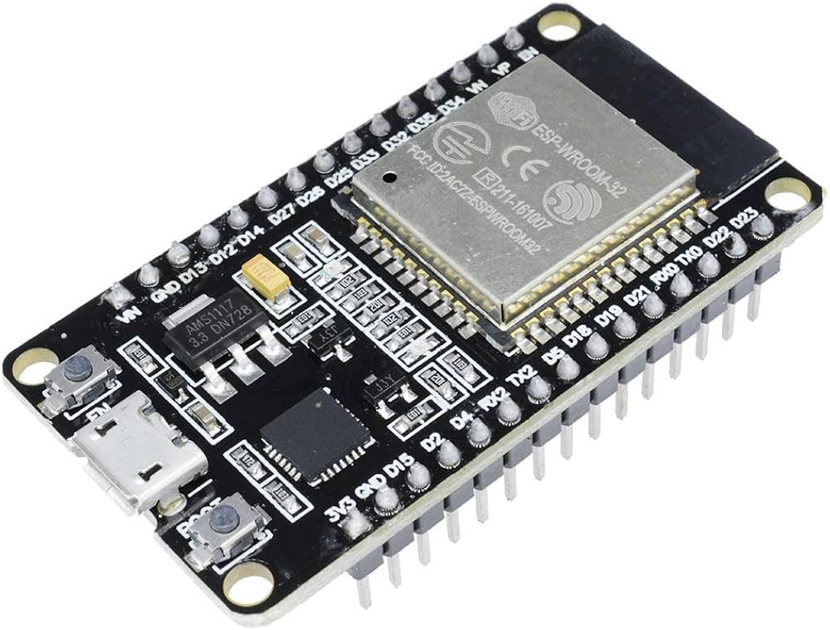
HYDROGEN FUEL CELL
A hydrogen fuel cell is used as an additional energy source in the system, where hydrogen obtained from the seashore environment is converted into electrical energy to support the power requirements of the boat. It generates electricity through an electrochemical reaction between hydrogen and oxygen, producing water as a by-product. In this project, a magnesium rod and graphite electrode dipped in an electrolyte solution are used to imitate the operation of a hydrogen fuel cell and demonstrate how chemical reactions can produce electrical power.

Slide 15
ESP 32
ESP32 is a powerful microcontroller used to control and monitor the entire system. The program code for the project is uploaded (dumped) into the ESP32, which allows it to process signals from the wireless power transfer system. It reads the voltage, current, and power values from the sensors and displays them on the display module. It also helps in managing communication between the charging station and the boat, ensuring proper monitoring and control of the charging process.

Slide 16
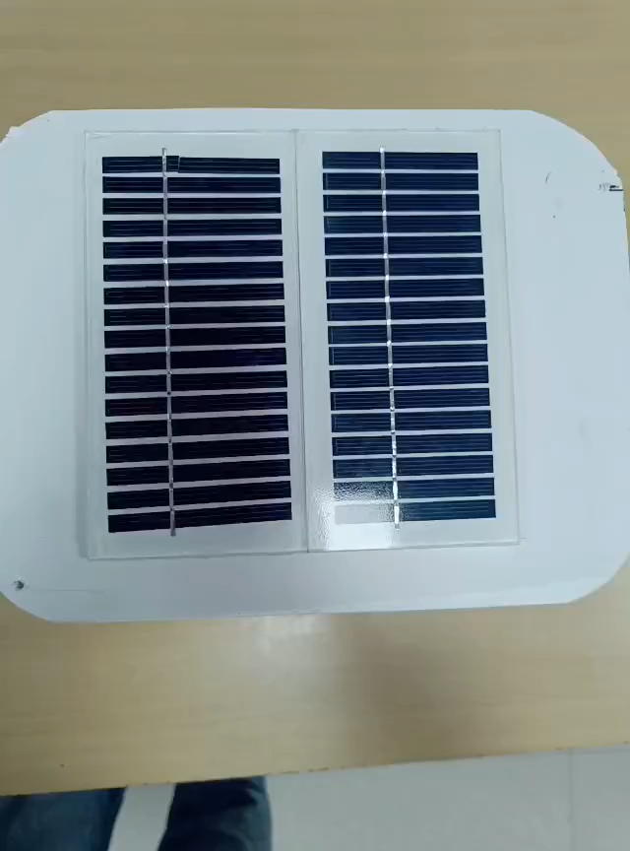
HARDWARE DEVELOPMENT OF CHARGING STATION

Slide 17
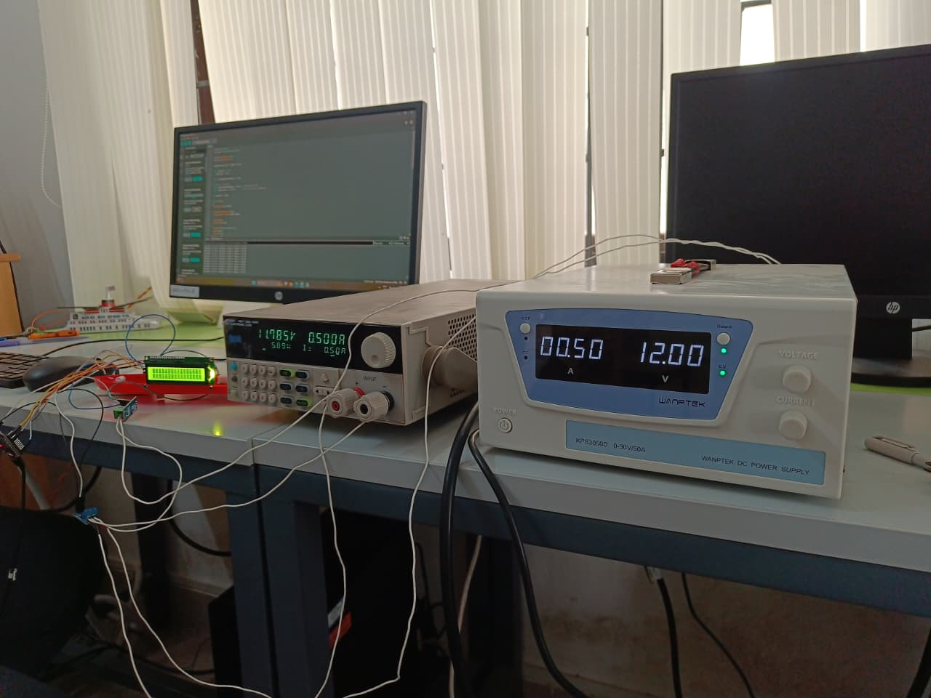
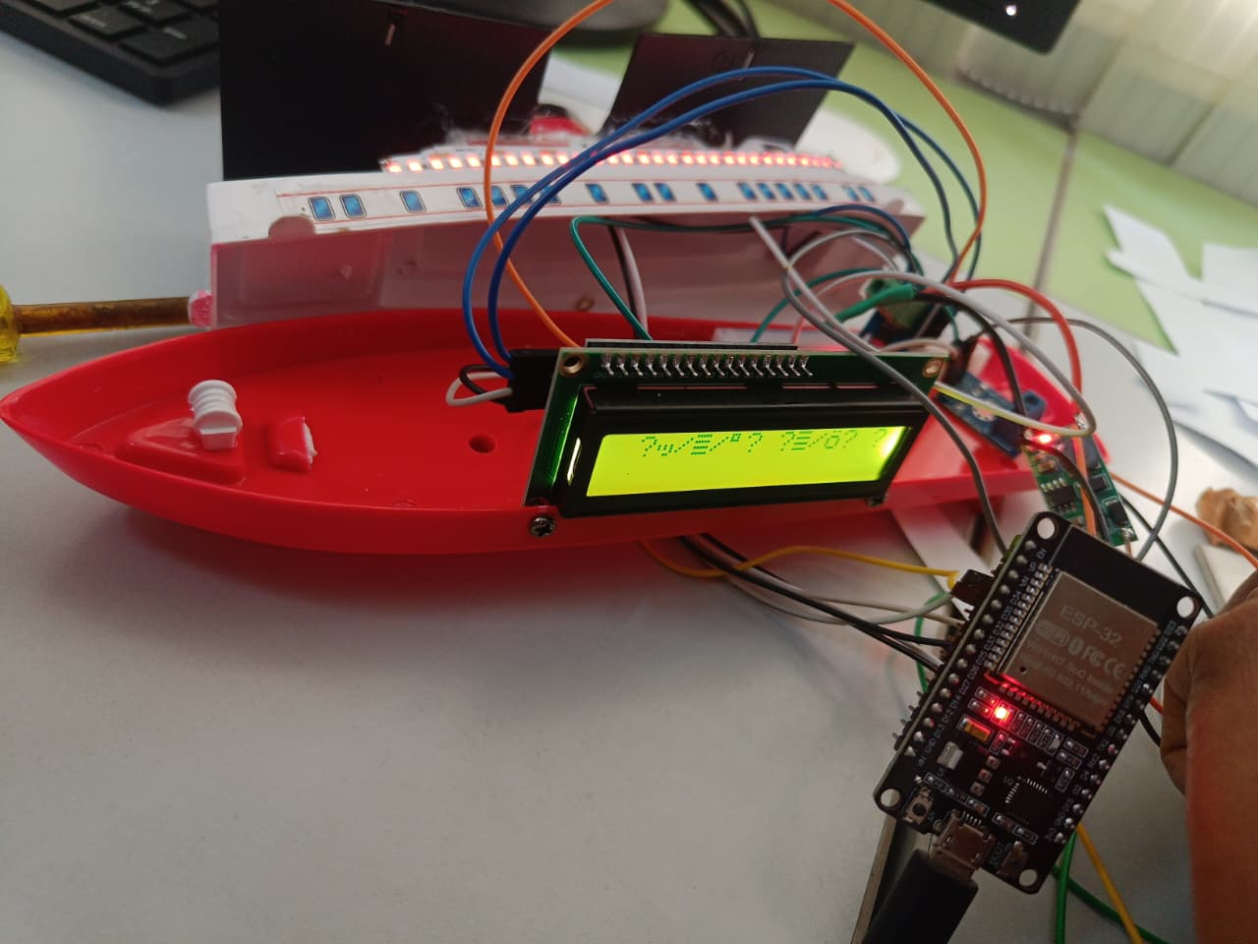
HARDWARE DEVELOPMENT OF SHIP

Slide 18
HARDWARE DEVELOPMENT OF SHIP

Slide 19
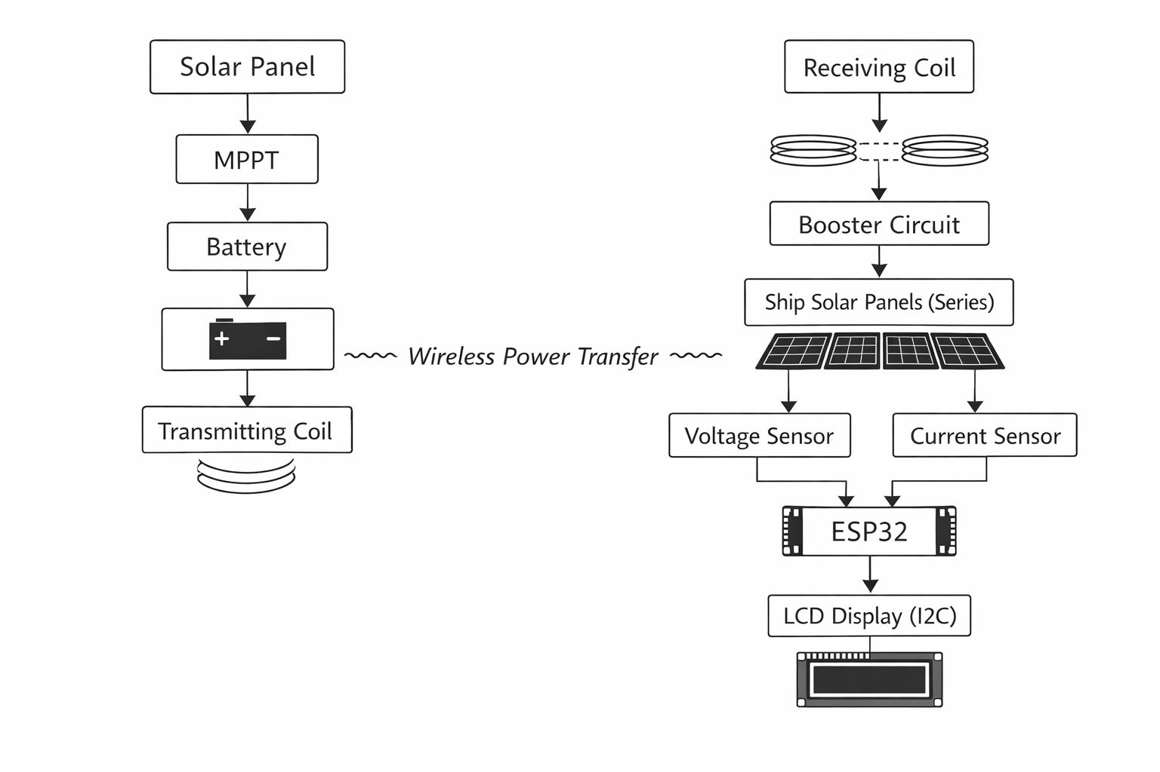
SINGLE LINE DIAGRAM FOR SHIP

Slide 20
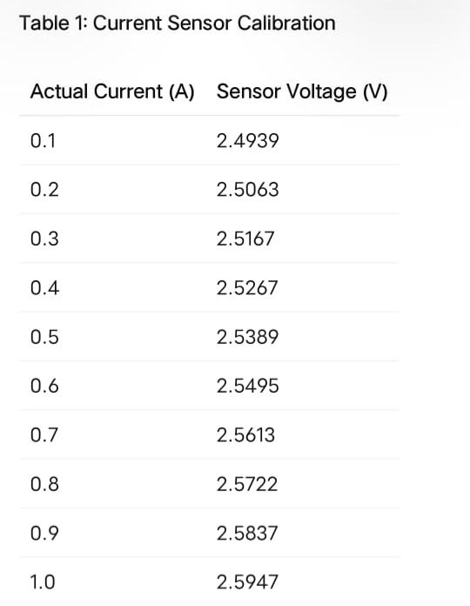
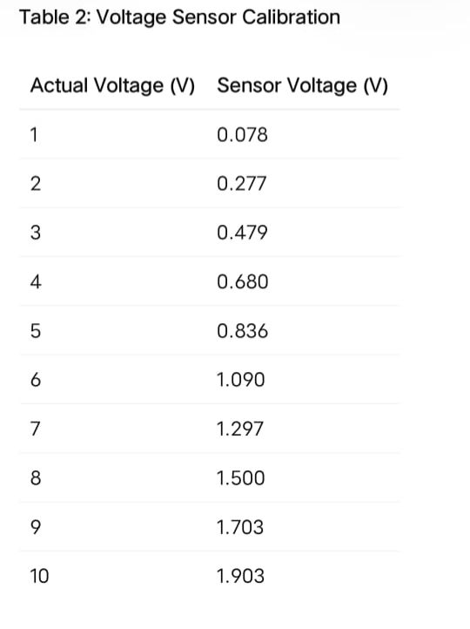
Theoretical Calculations

Slide 21
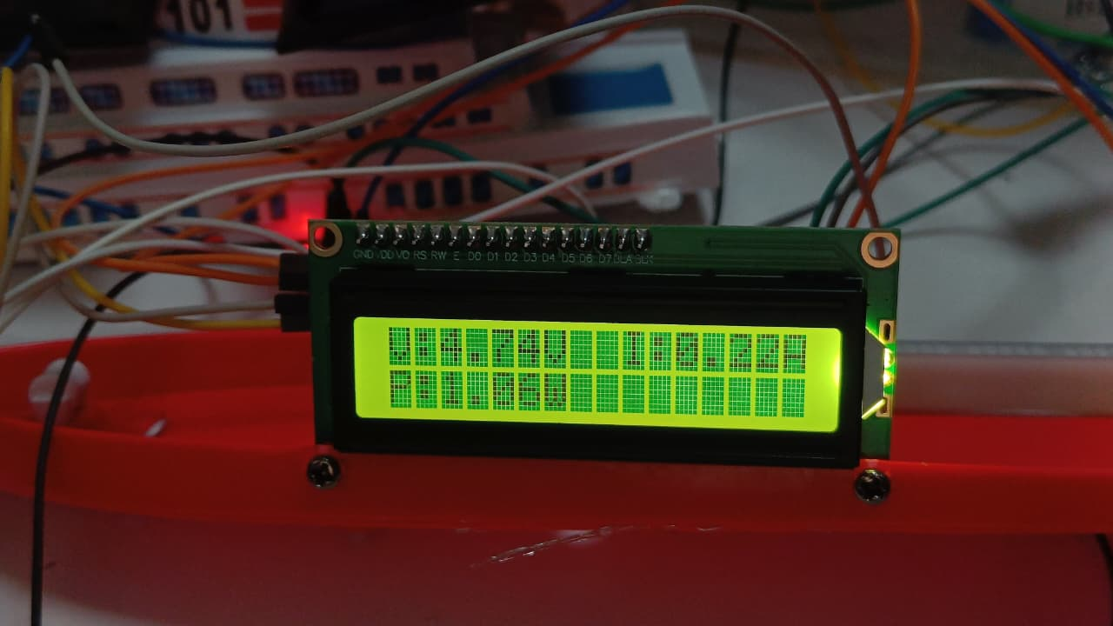
Results and Conclusion
The final results of the project demonstrate the successful implementation of the solar wireless power transfer system for electric ships.
When the transmitting and receiving coils are brought close to each other, wireless power transfer takes place and the charging process begins.
During this process, the system continuously monitors and displays important electrical parameters such as voltage, current, and power on the display module.
This real-time display confirms that power is being successfully transferred and utilized for charging.
The developed prototype therefore validates the feasibility of a safe, efficient, and contactless charging method for marine applications.
In real-time operation, solar panels placed on the charging station generate energy and charge the battery. The electrical grid is also connected as a backup supply. When the ship comes near the transmitter coil, wireless power transfer takes place through magnetic induction.
The ship can also charge using solar panels mounted on top of the ship itself. In addition, a hydrogen fuel cell provides backup power support. The ESP32 WiFi module allows users to monitor charging parameters such as voltage, current, and power directly on a mobile phone.

Slide 22
Work Plan / timeline chart
The following is a sample table. Please replace it with the actual project schedule table
as per the academic calendar.
Task / Month | Sept/Oct | Nov/Dec | Jan | Feb | March
Topic Selection | Done
Literature Survey |  | Done
Problem Definition |  | Done
Methodology Design |  |  | Done
Simulation / Modeling / Hardware |  |  |  | 70% Done | 95% done
Report Writing (Phase–2) |  |  |  |  | Done

Slide 23
Team Role Distribution
The project work was successfully carried out through effective coordination among all team members.
Deepti and Monika were responsible for the hardware connections, system implementation, and overall development of the prototype.
Harshitha handled the preparation of the PowerPoint presentation for the project. Srividya was responsible for compiling and preparing the detailed project report. Meghana B.S. was assigned the task of drafting and finalizing the conference paper related to the project.

Slide 24
References
K. A. Ibrahim, T. Le Maréchal, P. Luk, Q. Qin, L. Huang, Y. Xie, P. Verdin, and Z. Luo, “Floating solar wireless power transfer system for electric ships: Design and laboratory tests,” Energy Conversion and Management, vol. 332, Article 119738, 2025.
A. Author et al., “Comprehensive mathematical modelling and experimental analysis of a wireless power transfer system for neighbourhood electric vehicles,” IEEE Transactions on Transportation Electrification, pp. xx–xx, Year.
B. Author et al., “Design and implementation of resonance-based wireless power transfer system,” International Journal of Power Electronics and Drive Systems, vol. xx, no. x, pp. xx–xx, Year.
C. Author et al., “5-kW, 96.5% efficiency capacitive power transfer system with a five-plate coupler: Design and optimization,” IEEE Transactions on Power Electronics, vol. xx, no. x, pp. xx–xx, Year.
31/01/2026

Slide 25
Thank You
31/01/2026

