Slide 1
Online Payment Fraud Detection
Key Results
RXT-J / EARN Based Deep Learning Pipeline for Fraud Detection
Accuracy: 0.80
Recall: 1.00
AUC-ROC: 0.96
F1: 0.48
Project presentation generated from the RXT-J fraud detection pipeline

Slide 2
Problem Statement & Objectives
Why this project matters
• Digital payment systems handle high transaction volume and fraud risks.
• Fraud patterns are sparse, imbalanced, and evolve over time.
• A robust detector must minimize false negatives while preserving usable precision.
• The goal is to create a practical model pipeline that can train, evaluate, and score transactions reliably.
Build a modular fraud detection pipeline
Preprocess transaction data with missing-value and category handling
Generate sequence-aware features for temporal modeling
Train a deep learning classifier and compare performance using held-out metrics

Slide 3
Data Preparation & Feature Engineering
From raw transactions to model-ready sequences
• Drop redundant identifiers and irrelevant columns
• Impute missing numeric values and retain all feature columns
• Standardize numerical variables for stable optimization
• Encode categorical fields via one-hot transformation
• Generate temporal transaction windows for sequence modeling
• Apply SMOTE only to training data to reduce class imbalance
Dataset: synthetic PaySim-like financial transactions
Binary target: isFraud
Sequence length: configurable, default = 10
Sorting based on step / transaction time when present
Output bundle includes preprocessing + model weights + metadata

Slide 4
Model Architecture
RXT-J / EARN hybrid deep learning approach
Tabular preprocessing
Missing value handling, scaling, one-hot encoding, feature selection
EARN Feature Extractors
Autoencoder latent features + ResNet projection + PCA / anomaly signals
RXT-J Classifier
Temporal GRU-based classifier with Jaya-driven hyperparameter search

Slide 5
Training Strategy
Optimization and validation design
• Train/validation/test split with held-out final evaluation only
• Jaya search selects learning rate, batch size, weight decay, and GRU units
• Validation-based model selection minimizes overfitting risk
• SMOTE is applied only to the training sequence set to preserve realistic evaluation
Best validation AUC: 1.00
Best batch size: 104
Learning rate: 0.00137
Weight decay: 0.00086
GRU units: 96

Slide 6
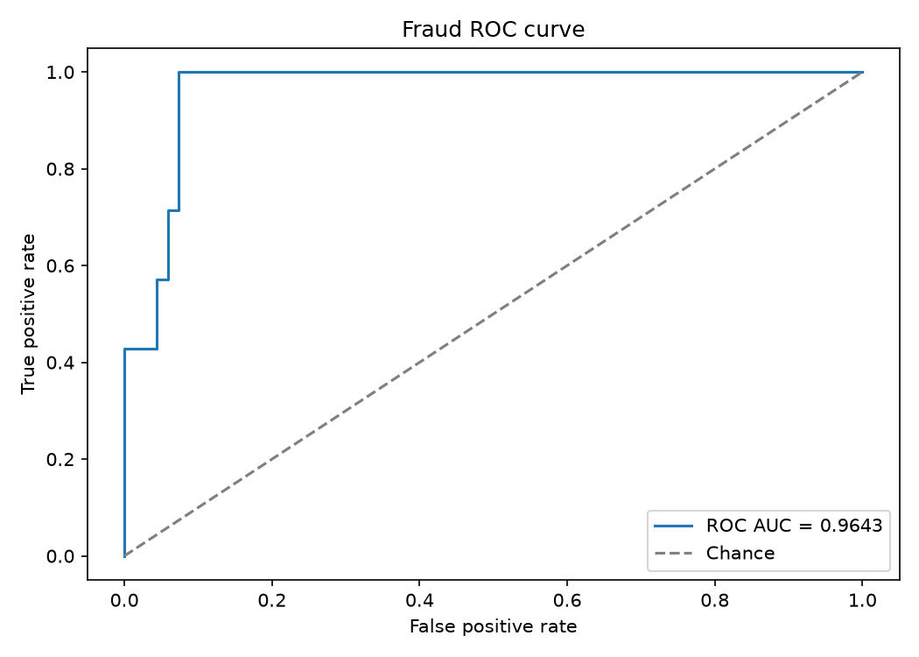
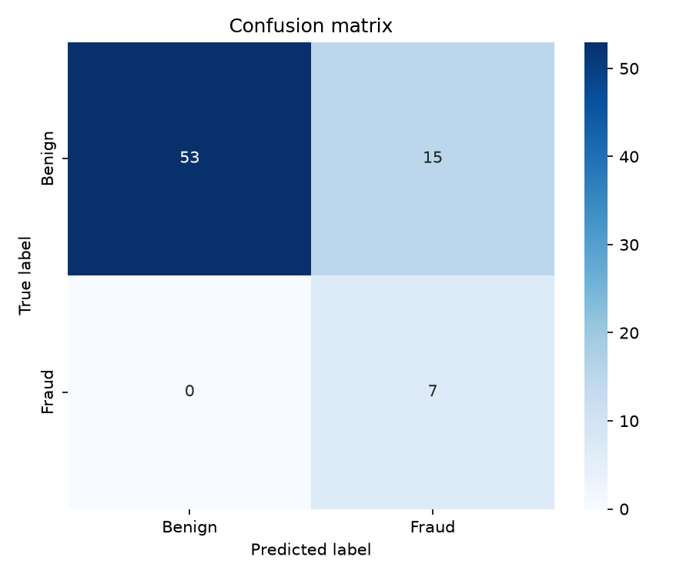
Evaluation Metrics
Held-out test performance
Accuracy: 0.8000
Precision: 0.3182
Recall: 1.0000
F1 Score: 0.4828
MCC: 0.4980
Log Loss: 0.6384
AUC-ROC: 0.9643
ROC Curve
Confusion Matrix

Slide 7
Deployment & Practical Use
How the pipeline is used in practice
• Train with: py train.py
• Score new transaction CSVs with: py predict.py
• Launch the web app with: py web_app.py
• Load trusted model bundles only; bundle includes joblib objects and Keras models
• Use a meaningful transaction-time ordering for sequence-aware inference
• CSV-based batch scoring
• Single-row interactive form
• Model bundle persistence
• Sequence-aware inference workflow

Slide 8
Conclusion
Project outcome and next steps
This project successfully builds a complete fraud-detection workflow from preprocessing through deployment-ready inference.
The hybrid RXT-J / EARN design combines tabular modeling, sequence learning, and optimization to handle class imbalance and temporal patterns.
Future improvements could include real dataset benchmarking, explainability, hyperparameter tuning at scale, and deployment in a monitored production environment.

