Slide 1
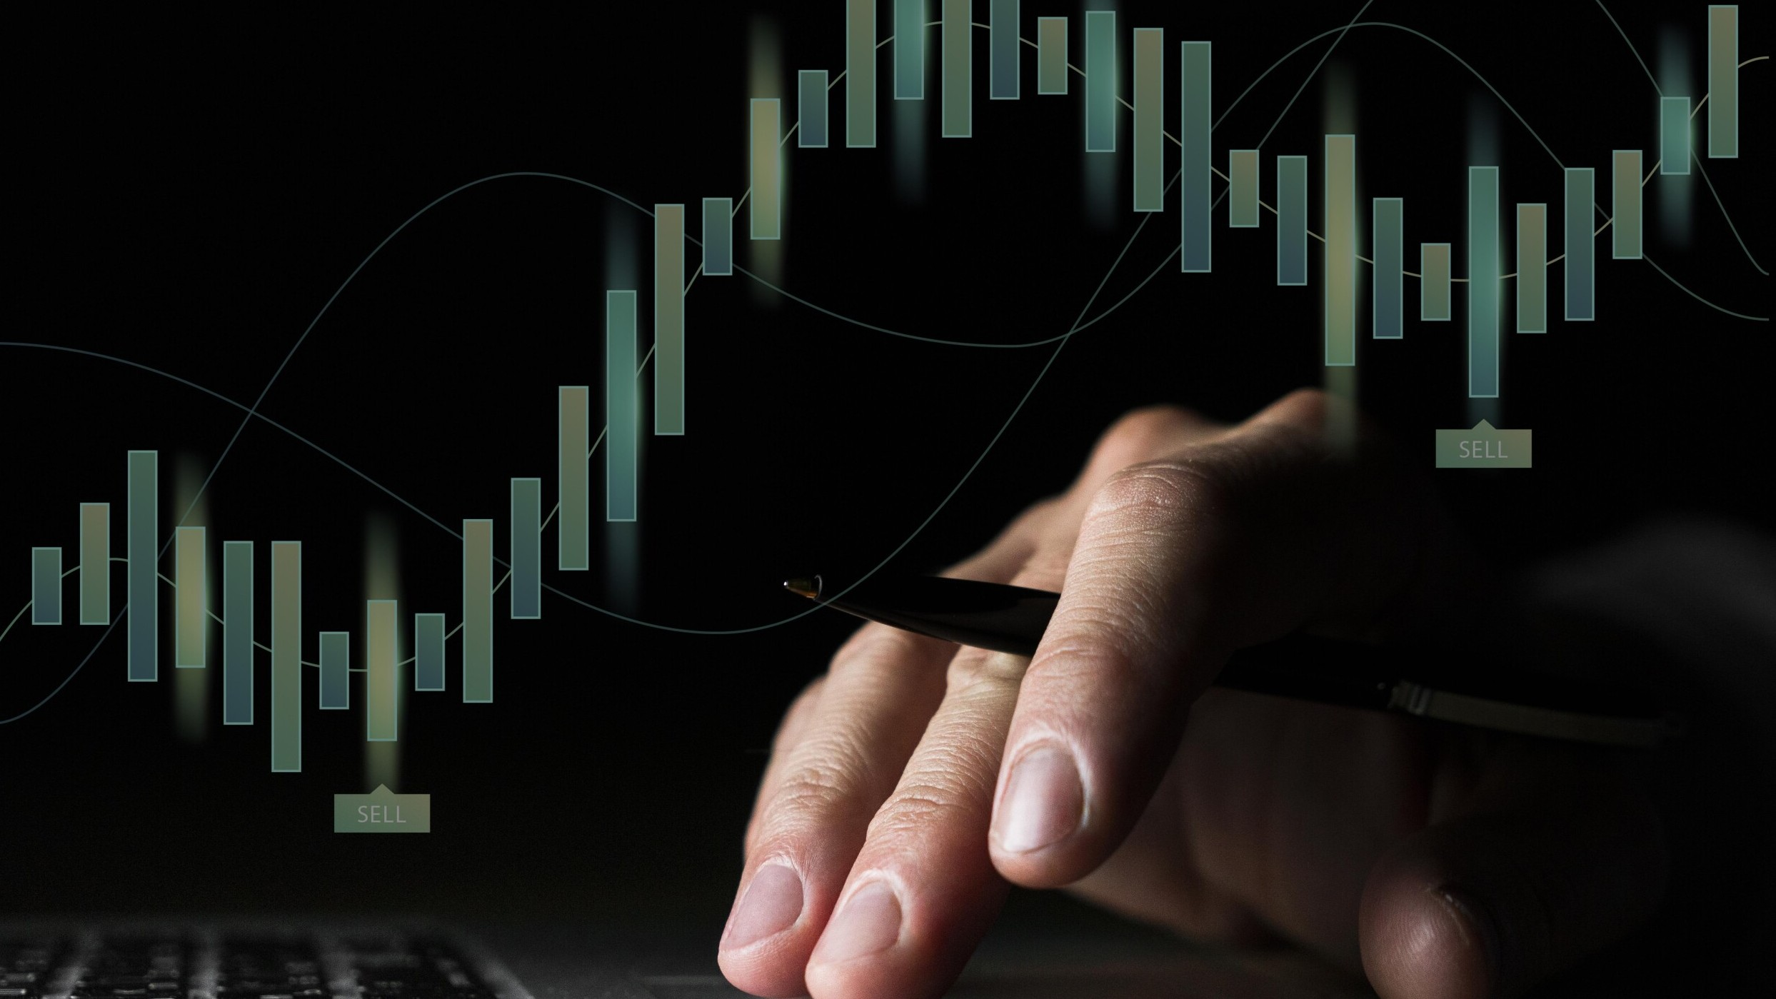
STOCK MARKET PREDICTION THROUGH MACHINE LEARNING

Slide 2

Introduction
Machine learning is revolutionizing the stock market prediction landscape. In this presentation, we will explore the potential of this technology and how it can be used to improve market predictions.

Slide 3
The Problem with Traditional Stock Market Predictions
Traditional stock market predictions rely on human analysis and are often subject to bias. Machine learning can overcome these limitations by analyzing large amounts of data and identifying patterns that humans may not be able to recognize.

Slide 4

How Machine Learning Works
Machine learning algorithms learn from existing data and use this knowledge to make predictions on new data. These algorithms can be trained to identify patterns and trends in stock market data, which can lead to more accurate predictions.

Slide 5

There are three types of machine learning algorithms: supervised, unsupervised, and reinforcement learning. Each type has its own strengths and weaknesses when it comes to stock market prediction.
Types of Machine Learning Algorithms

Slide 6

Machine learning can be used to predict stock prices, market trends, and company performance. It can also be used to identify anomalies in the market and detect fraud.
Applications of Machine Learning in Stock Market Prediction

Slide 7

Conclusion
Machine learning has the potential to revolutionize the stock market prediction landscape. By using this technology, we can improve accuracy and reduce bias in our market predictions.

Slide 8
Thank you!
Do you have any questions?

