Slide 1
Affordable Care Act Analysis - using Big Data technologies Big Data – Summer 2017 Praneeth Reddy
Big Data Engineering - Summer 2017
Praneeth Reddy

Slide 2
Executive Summary
Analysis of the medical insurance dataset ranging from 2014 to 2016 that includes Rates, Plan Attributes, BenefitsSharing, ServiceArea and Network of various medical insurance plans across the country.
To analyze the trends in the healthcare insurance sector against the backdrop of pros and cons of ACA (Affordable Care Act).
Factual Data based on various factors and twitter Sentiment Analysis to get a sense of what people actually feel about that.

Slide 3
Process to Analyze and Conclude
Average Time Allocation
1
Data Pre-processing: Once we have dataset with us, we need to clean the data and apply various methods to fill the data.
1 Minute
2
Feature Selection: Based on the objective of the analysis come up with a list of variables that you need to conclude the objective.
110 Minutes
3
Apply the Technologies: Apply the tools and technologies based on the use case to help the deduction of the data.
10 Minutes
4
Visualize: Visualize the data and come up with meaningful analysis.
1 Minute
Average Time Per Case:
120 Minutes
Notes:
~120 minutes per case, +90% is spent chasing documentation

Slide 4
By the bullets…
Investment
Return
Data
11 csv files
8 GB of data(Approx.)
Big Data concepts.
Technologies Used
Hadoop HDFS Framework
PIG/Hive
Map-Reduce
Apache Flume
Power BI
RStudio
List of Analysis
Plans and their rates across states and years.
Total plans in terms of count across states and years.
How did strict tobacco policies during Obama era effect the insurance company policies.
How many Metal Level plans by volume exist in each state and how did they vary over the years.
How many Metal Level plans exist by age exist in each state and how did they vary over the years.
What is the effect of ACA(Affordable Care Act) on critical illnesses. Example : Cancer

Slide 5
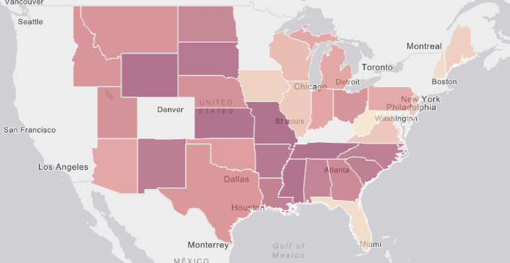
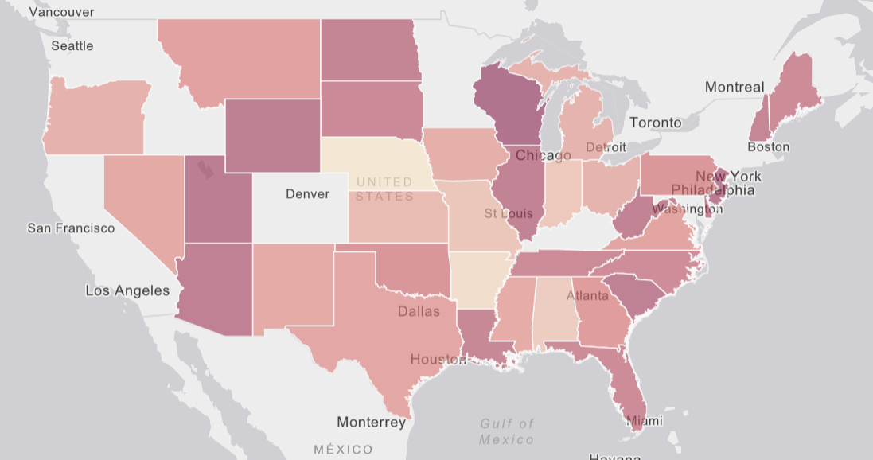
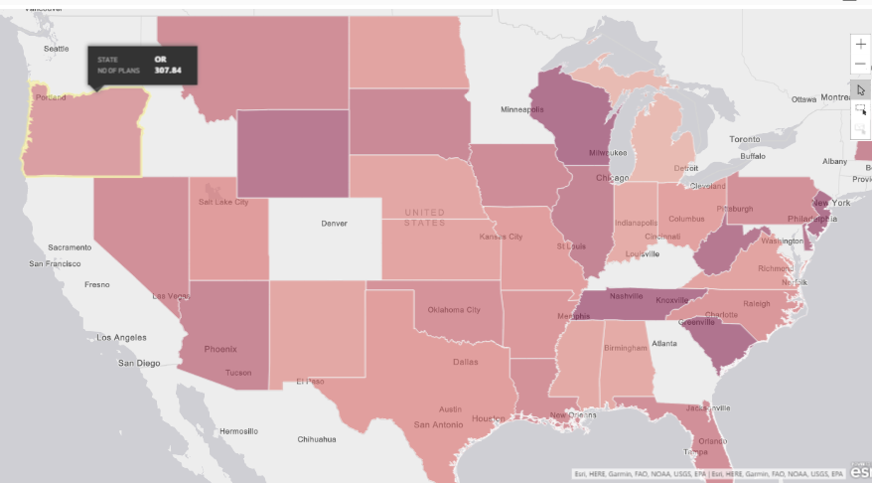
Analysis 1: Plans vs Costs
2014
2015
2016

Slide 6
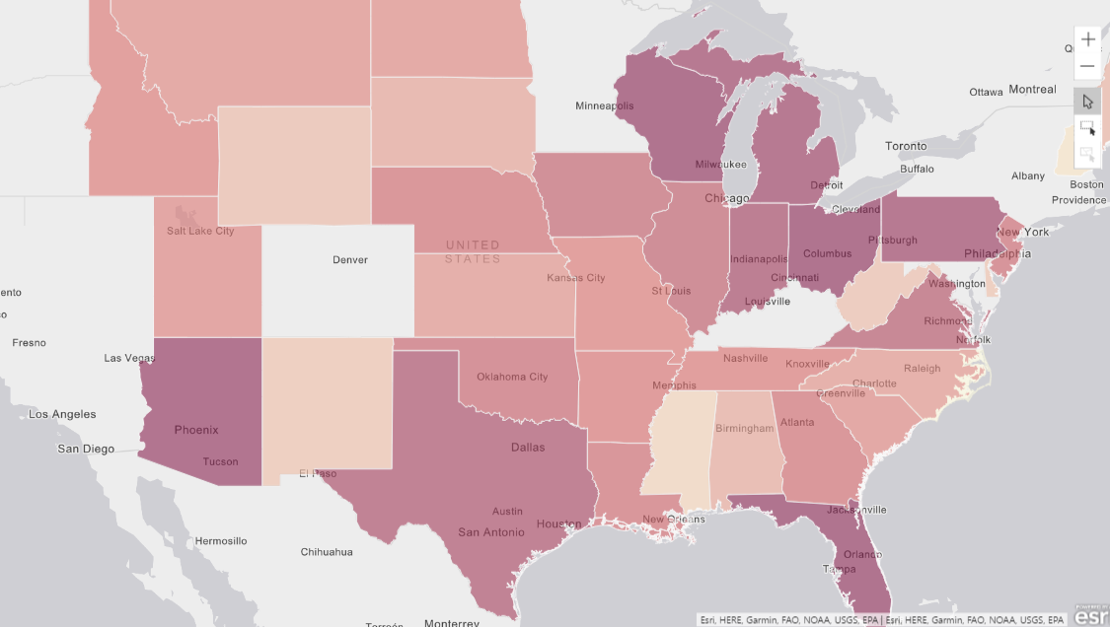
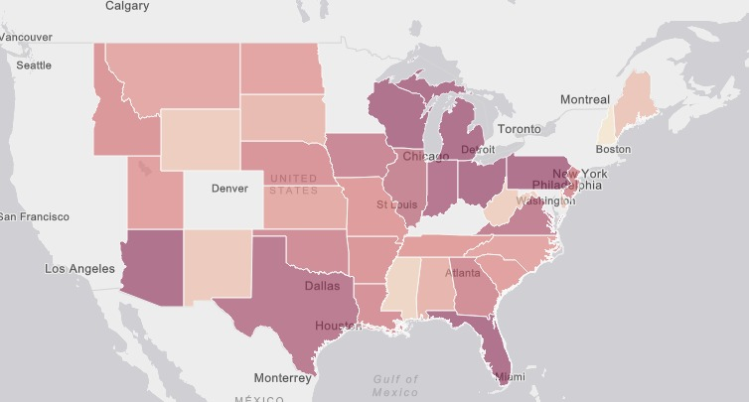
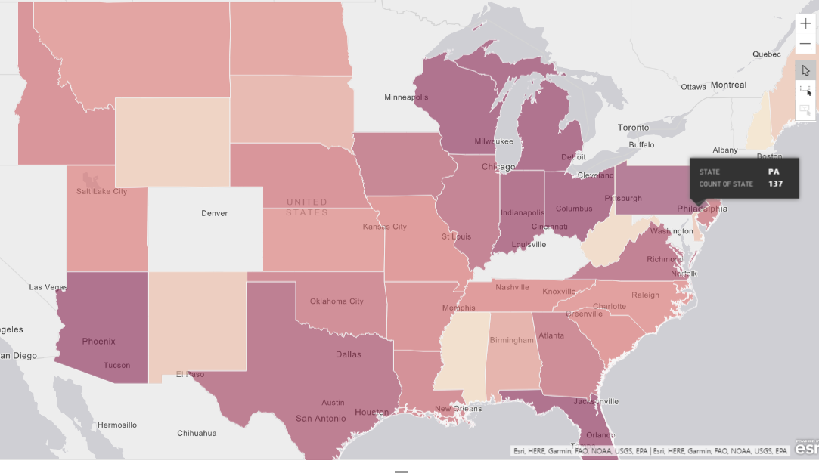
Analysis 2: States vs # of Plans
2014
2015
2016

Slide 7
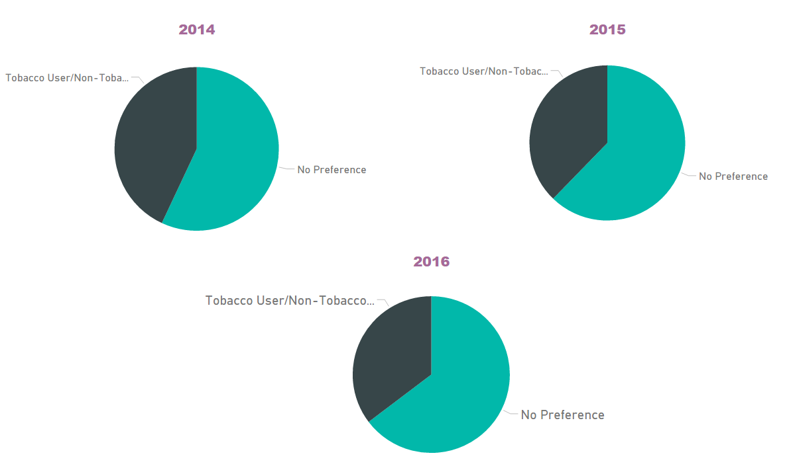
Analysis 3: Plans vs Tobacco

Slide 8
Analysis 4 – By Age (Year 2015)
Legend(Age): A - 0 to 25 B - 26 to 50
C - 51 and above

Slide 9
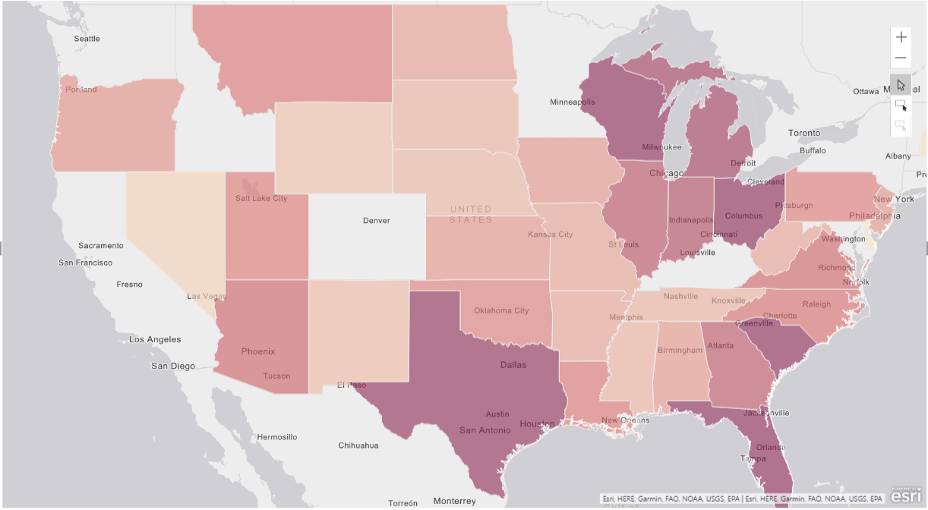
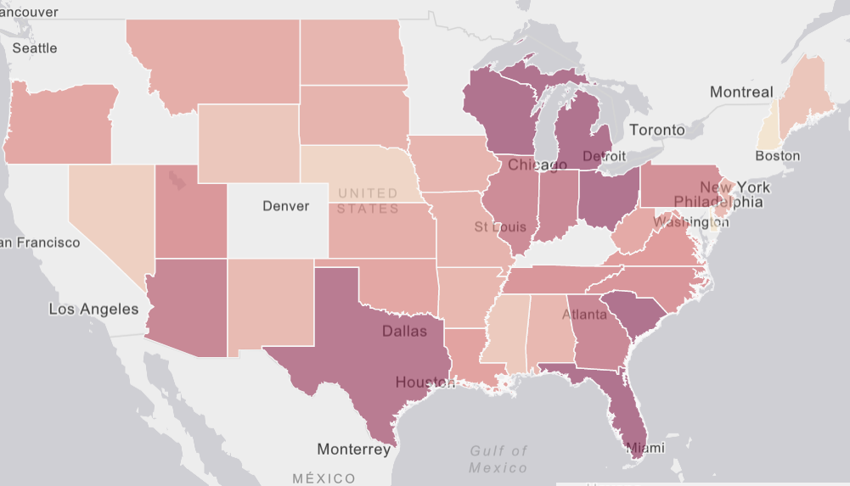
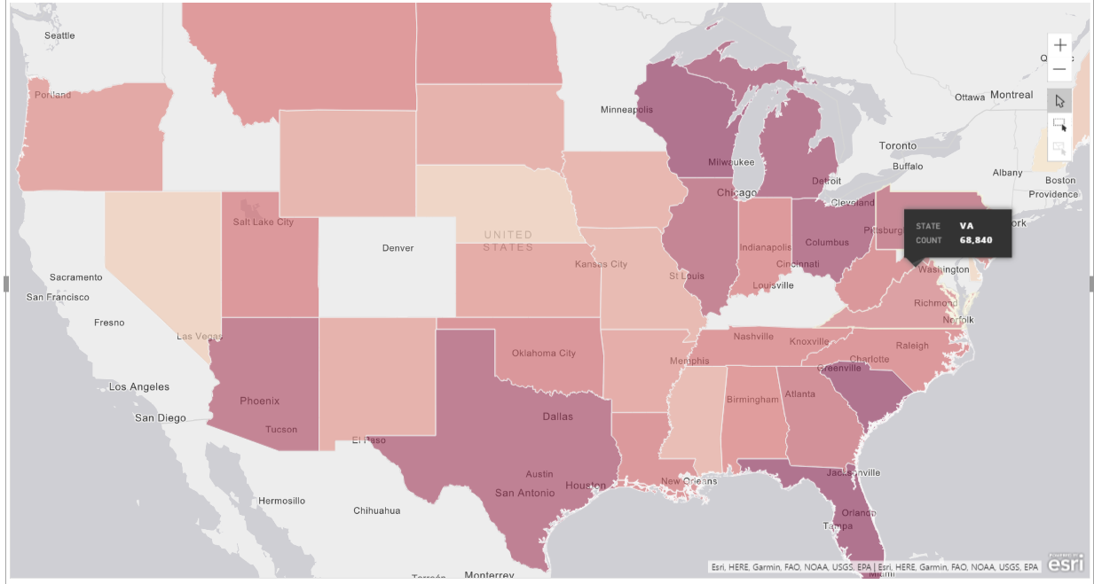
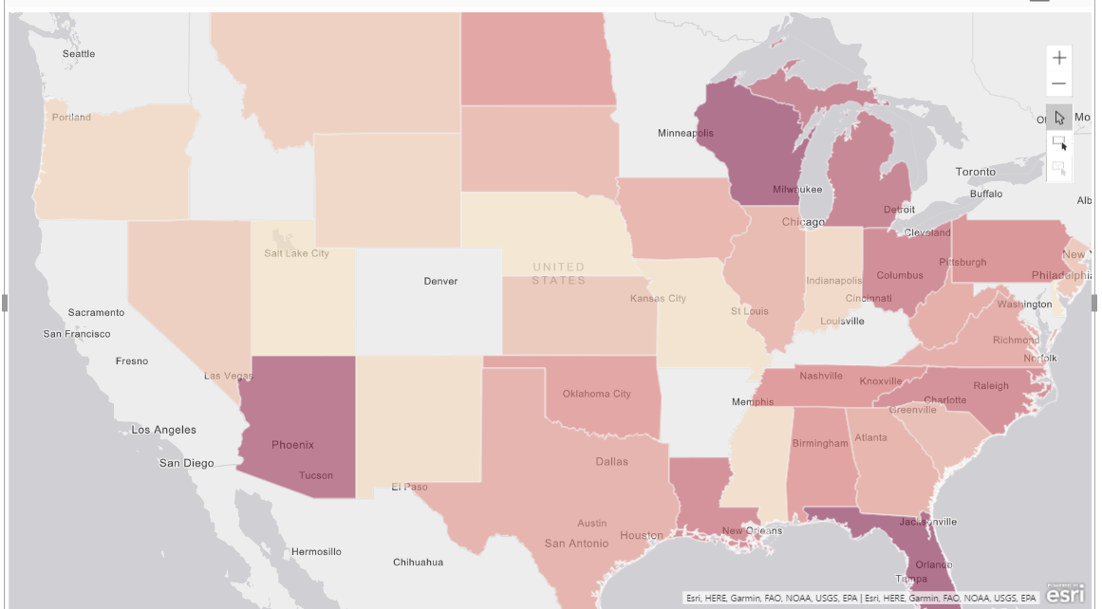
Analysis 5 – By State
Bronze
Silver
Gold
Platinum

Slide 10
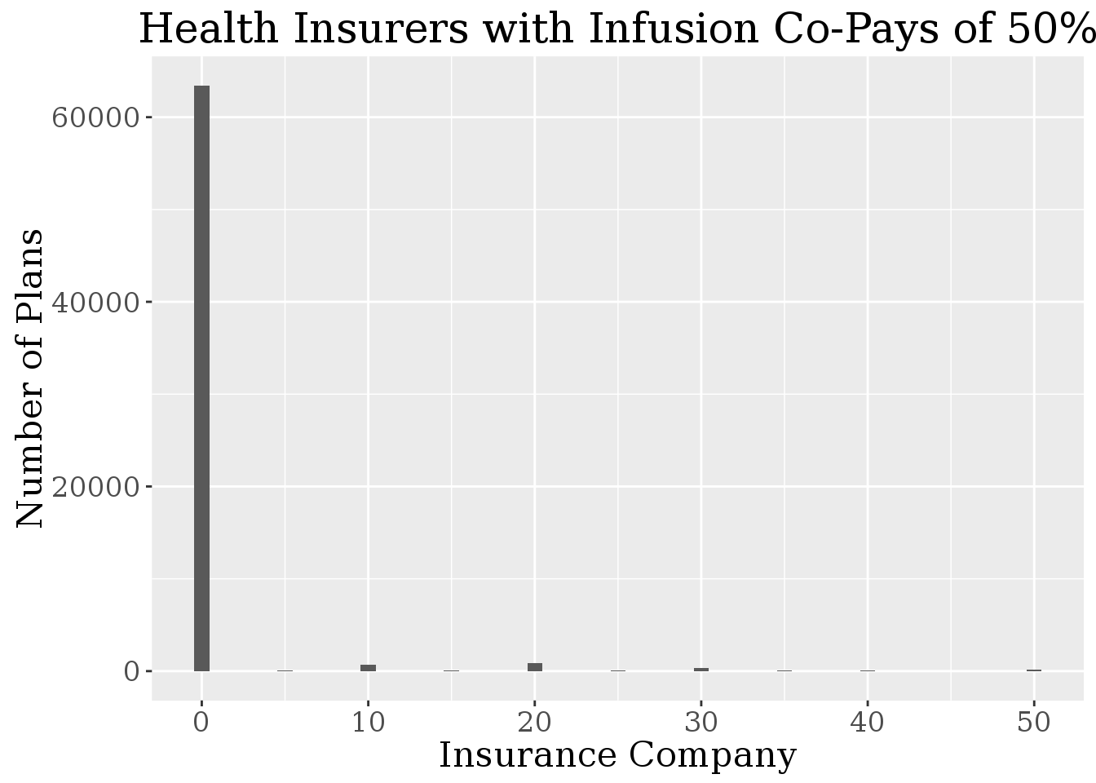
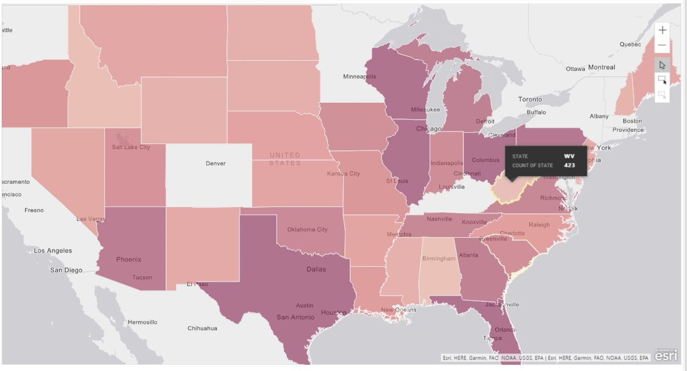
Analysis 6 – Cancer vs ACA
No. of plans that offer insurance therapy?
How states fare in terms of Co-Pay?

Slide 11
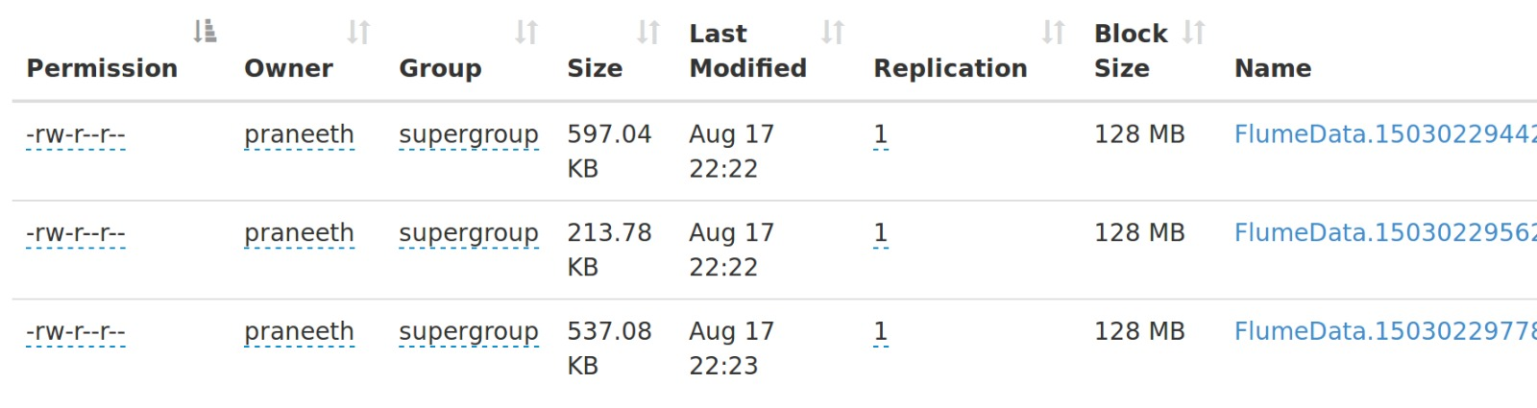
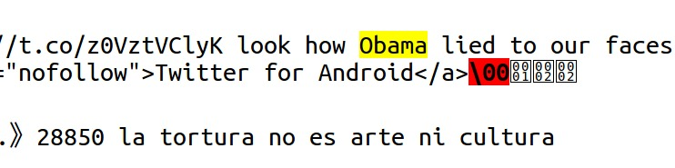
Analysis 6 – Twitter Sentiment Analysis
Step 1 :
Use Apache Flume to get the required tweets from twitter. Keywords Used: ‘AffordableCareAct’, ‘Obamacare’, ‘ACA’..
Step 2 :
Use Hive to get the Sentiment score from the analyzed tweets.

