Slide 1

Section 1 · 1950 Proposal
Can machines think?
Turing replaces contested definitions with an operational question of intellectual performance.
A. M. Turing · Computing Machinery and Intelligence, Mind (1950)
Notes:
Introduce Turing’s opening move in Section 1 ("The Imitation Game"): rather than debating dictionary definitions of "machine" and "think," which invites endless semantic disagreement, he proposes replacing the question with an operational test based on observable intellectual performance.

Slide 2
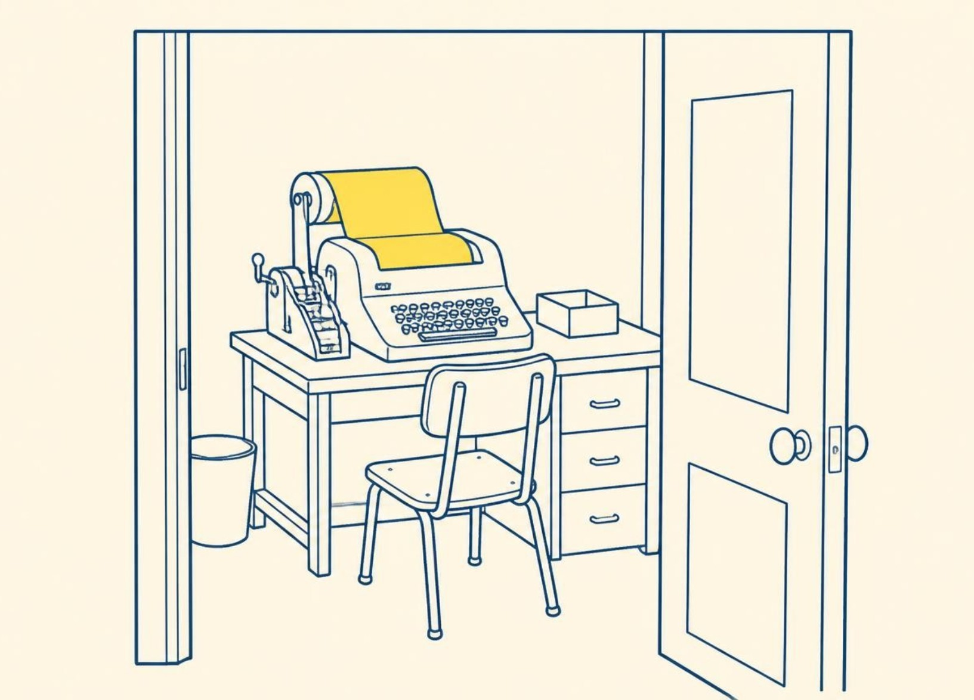
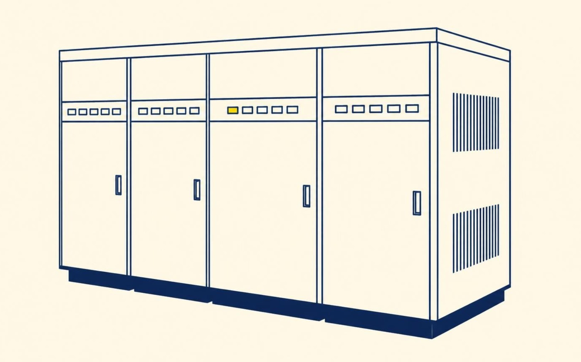
The imitation game changes the question
Section 1 · Replacing the man with a machine
The original party game
Man replaced by a digital computer
The mechanical substitution
An interrogator questions a man and a woman in separate rooms to identify their sexes correctly.
→
A digital computer replaces the man. Does the interrogator err as often when a machine plays?
Baseline setup
Turing's new question
Notes:
In Section 1, Turing defines the imitation game. Originally, an interrogator (C) communicates via teletype with a man (A) and a woman (B). The man tries to deceive while the woman helps. Turing then asks: "What will happen when a machine takes the part of A in this game? Will the interrogator decide wrongly as often... as when the game is played between a man and a woman?"

Slide 3

Conversation isolates intellectual performance
Section 2 · Critique of the new problem
A separated interrogator exchanges typed questions and answers with a human and a machine.
Without appearance, voice tone or biological identity, the test evaluates conversational mental capacity without requiring human physical embodiment.
Pure symbolic inquiry
Notes:
Section 2 explains the purpose of the teleprinter: to maintain a strict separation between physical capacities and intellectual capacities. A machine should not be penalized for lacking human flesh, hair, or vocal cords, nor rewarded for cosmetic resemblance. The focus is strictly linguistic and intellectual competence.

Slide 4
One computer can imitate many machines
Section 4 · Digital computers and universality
Store
Executive unit
Control
Information capacity holding instructions, tables, and working intermediate variables.
The central mechanism carrying out individual elementary operations in sequence.
The system ensuring operating instructions execute strictly according to programmed order.
→
→
Universal imitation
Notes:
In Section 4 ("Digital Computers"), Turing outlines the tripartite division into store, executive unit, and control. He demonstrates universal property: a universal digital computer, given sufficient storage capacity and operating speed, can simulate any discrete-state machine. Thus, we do not need distinct custom machines for each mental faculty.

Slide 5
Turing predicted progress, not proof
~50 years
conjectured timeframe from 1950 to reach this benchmark
70%
109 bits
projected storage capacity required for the machine
maximum expected accuracy for an average interrogator after five minutes of questioning
Conjecture
Section 6: a stated belief about future performance, not a mathematical certainty
Notes:
In Section 6 ("Opinions on the Main Question"), Turing explicitly labels his famous benchmark as an opinion: "I believe that in about fifty years’ time it will be possible to programme computers, with a storage capacity of about 10^9, to make them play the imitation game so well that an average interrogator will not have more than 70 per cent. chance of making the right identification after five minutes of questioning." Emphasize that this was an informed conjecture, not mathematical proof.

Slide 6
Mathematical limits do not settle the debate
Section 6(3) · The Mathematical Objection
Provable machine limitations
Unproved human superiority
Gödel's theorem and Turing's halting results show discrete-state systems cannot resolve every formal statement.
Turing observes it has not been proved that human intellect is free from comparable internal limitations.
Formal limits exist
Turing's counterpoint
Notes:
Section 6(3) addresses the mathematical objection grounded in Gödel’s theorem and related undecidability results. Turing concedes that any particular machine has limitations, but replies that humans frequently make errors and fall victim to fallacies; nobody has established that human intellect is exempt from comparable theoretical bounds.

Slide 7
Consciousness remains an open mystery
Solipsist impasse
"The only way to know that a machine thinks is to be the machine and to feel oneself thinking."
Turing notes demanding subjective experience leads to solipsism: we credit other humans with thought by communication, not direct introspection.
Professor Jefferson's Lister Oration (1949), quoted by Turing in Section 6(4)
Section 6(4)
Notes:
Section 6(4) discusses the Argument from Consciousness (notably championed by Prof. Geoffrey Jefferson). Turing notes that if we demand first-person phenomenal awareness as proof of thinking, the strictly logical conclusion is solipsism. In everyday life, we attribute thinking to other people based solely on linguistic and behavioral exchange.

Slide 8
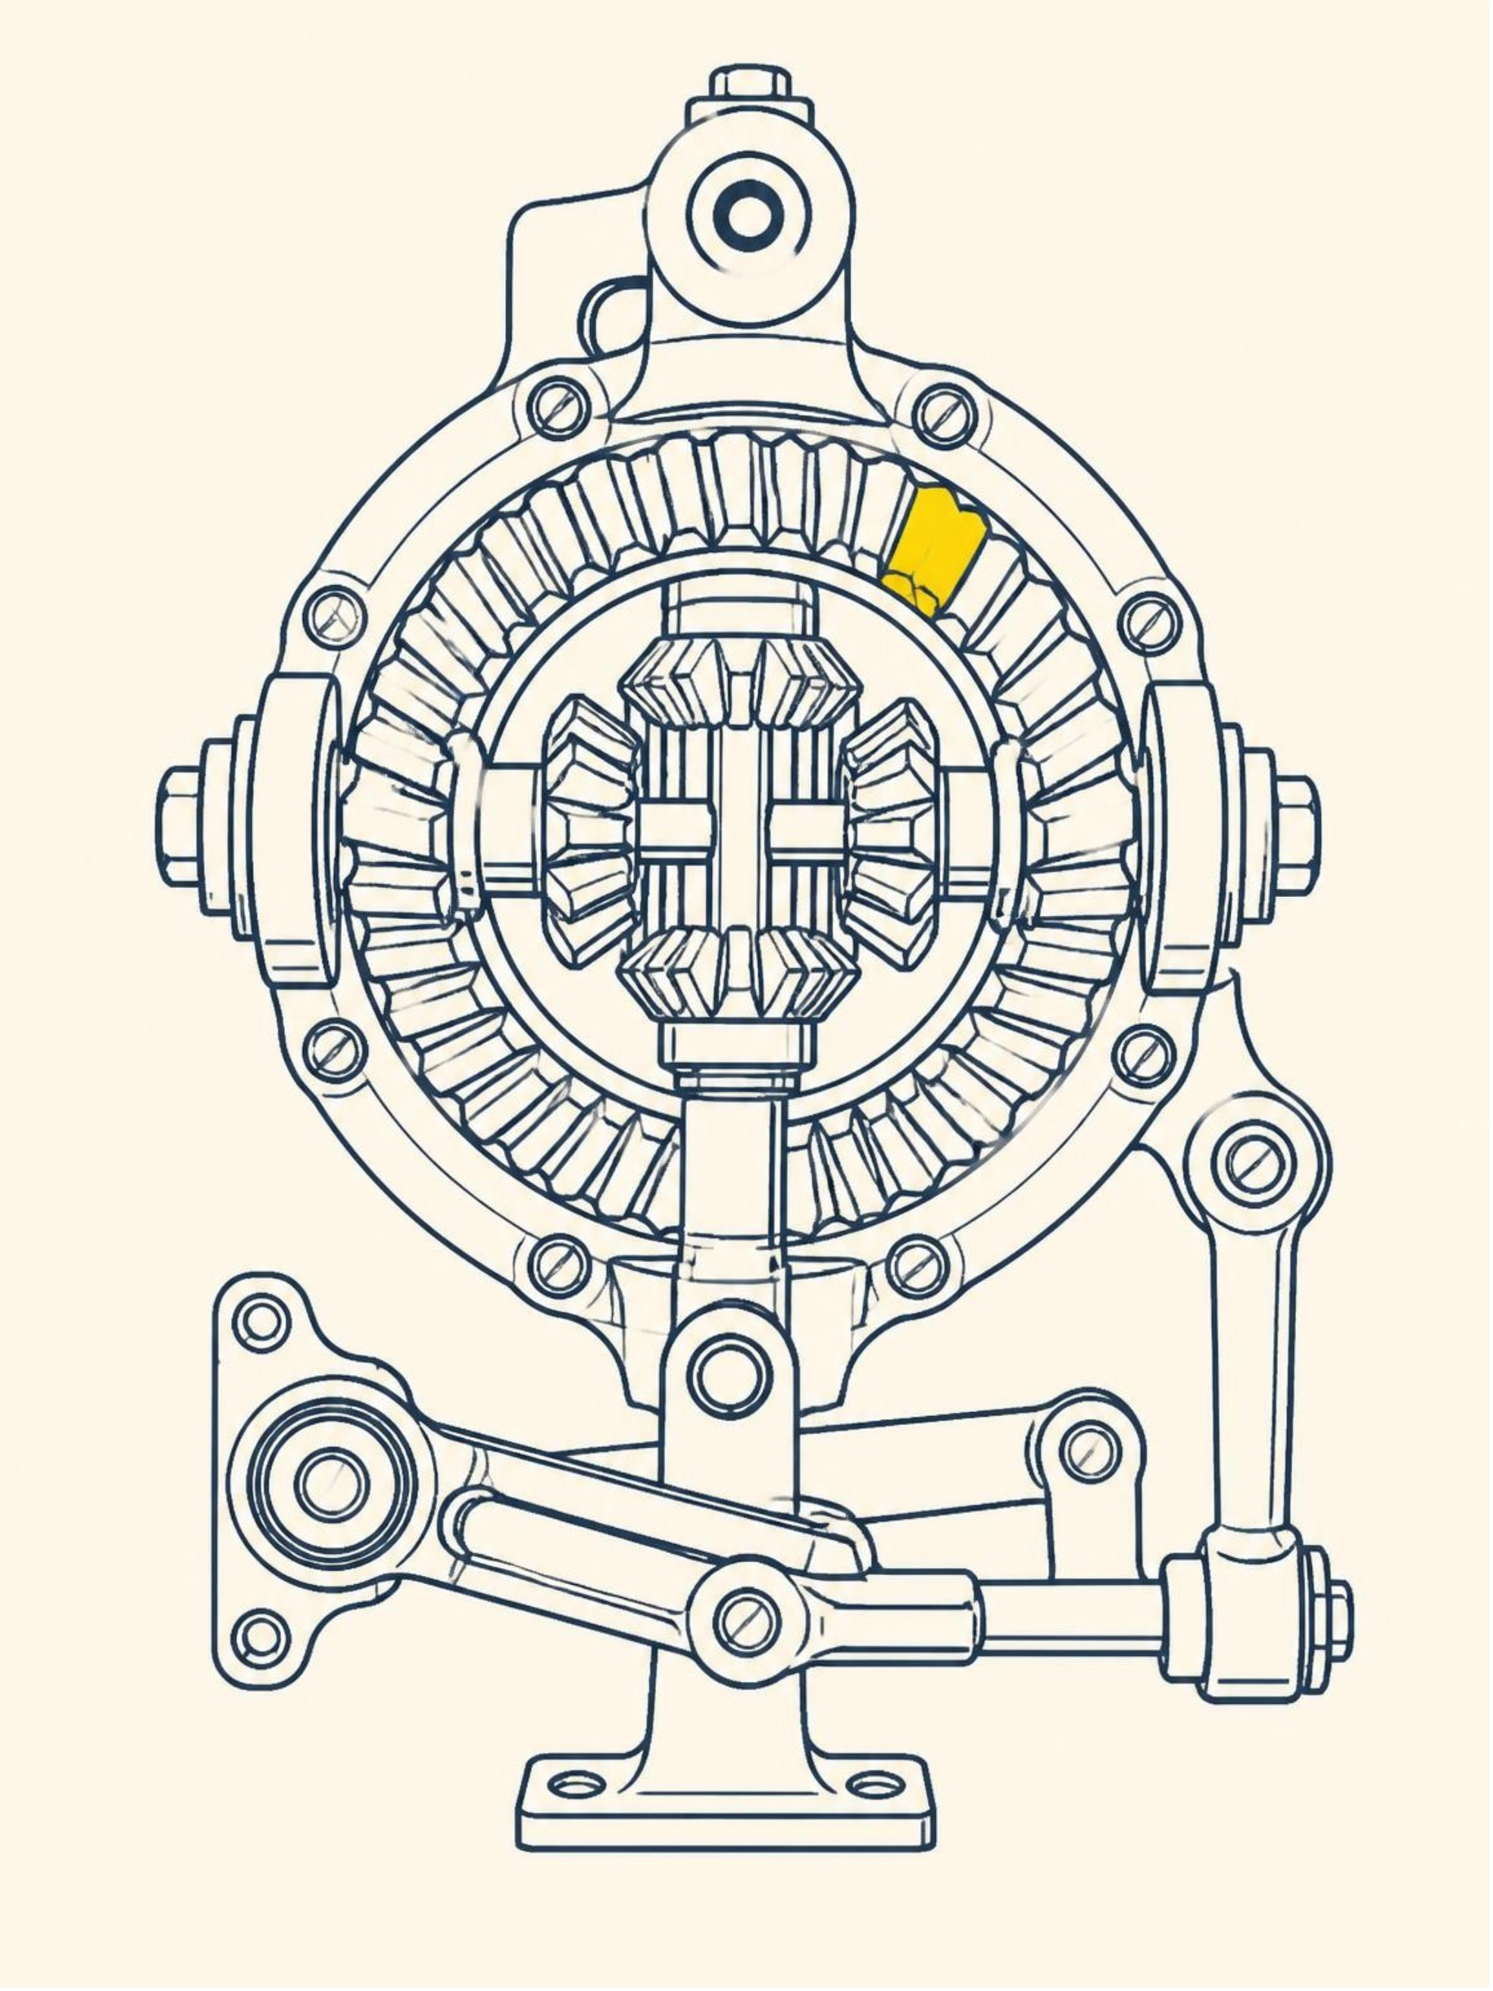
Machines may surprise their makers
Section 6(6) · Lady Lovelace’s objection
Lady Lovelace claimed the Analytical Engine had no pretensions to originate anything, executing only programmed commands.
Turing replies that machines continually surprise their operators by yielding consequences not consciously foreseen.
Unexpected behavior
Notes:
Section 6(6) examines Lady Lovelace’s famous objection (from her 1842 memoir on Babbage’s Analytical Engine) that machines can only do what we know how to order them to do. Turing responds that machines regularly produce surprising results because tracing all logical consequences of a large set of rules outstrips human working memory. He notes surprise does not prove creative soul, but refutes the claim of trivial predictability.

Slide 9
Teach a child machine rather than program an adult
Section 7 · Learning machines and developmental architecture
Child programme
Education and trial
Altered rules
1
2
3
Construct a simple initial mechanism with minimal fixed knowledge and high plasticity.
Subject the machine to experience, rewards, punishments, and systematic feedback.
Learned rules change internal behavior while underlying machine constitution remains fixed.
Evolutionary learning
Notes:
In Section 7 ("Learning Machines"), Turing introduces his practical proposal: rather than programming an adult mind directly, program a child mind and educate it. He draws an analogy to evolution (hereditary structure = child machine; mutations = experimenter changes; natural selection = teacher judgment). Crucially, the machine’s physical constitution is fixed, but its operative subroutines alter through training.

Slide 10

Section 7 · Conclusion
An experiment and an open agenda
Turing proposed empirical investigation rather than dogmatic proof, urging work on chess and language learning.
"We can only see a short distance ahead, but we can see plenty there that needs to be done."
Notes:
Turing concludes Section 7 not with triumphant proof that machines think, but with an open empirical research agenda. He recommends two parallel experimental avenues: abstract formal games like chess, and teaching language comprehension. The paper closes with his celebrated remark: "We can only see a short distance ahead, but we can see plenty there that needs to be done."

