Slide 1
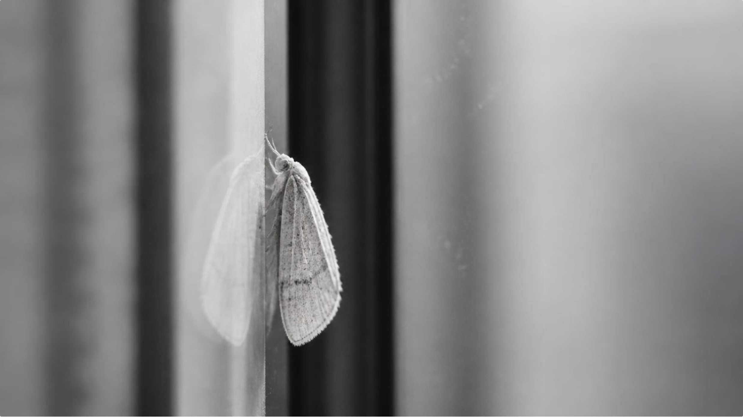
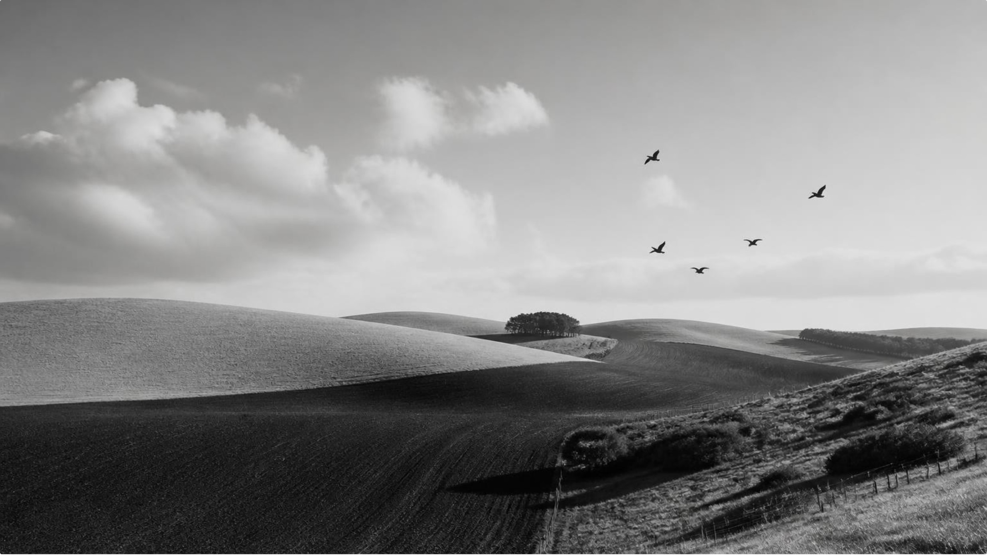
VIRGINIA WOOLF · 1942
The Vitality of Life
In Woolf’s “The Death of the Moth,” a day-moth shares the life energy of the September countryside.
The Windowpane
The Wide Fields
A frail speck fluttering corner to corner, pure energy confined within glass.
Rooks wheeling over Sussex downs and horses plowing the earth in the same vitality.
Notes:
Introduce Virginia Woolf and her posthumous essay 'The Death of the Moth' (written 1927, published 1942). Note how Woolf establishes a qualitative equivalence between the microscopic moth and the vast countryside: the moth is not a lesser life, but life itself in its purest, most concentrated particle.

Slide 2
AN OBSERVATIONAL SEQUENCE
The Struggle Against Death
Watching the moth's vitality ebb reveals the profound vulnerability binding all living creatures.
Vigorous flight
The final righting
Dashing tirelessly across the windowpane, imbued with unthinking zest.
Legs convulse in one immense, heroic effort to turn upright.
Failed attempts
Stillness
Fluttering slides into exhaustion; slipping repeatedly to the sill.
The tiny body straightens uncomplaining; struggle yields to silence.
A qualitative progression of life encountering its limit.
02
Notes:
Walk through the observational sequence. Woolf watches with a pencil poised to assist, but realizes no human intervention can alter this natural passage. Emphasize that this is a qualitative unfolding rather than a measurable metric: vitality confronts its inevitable physical boundary.

Slide 3
THE UNIVERSAL LAW
The Universal Triumph of Death
100%
“death is stronger than I am.”
WOOLF’S IMAGINED CONFESSION FOR THE MOTH
Death stands not as a cruel foe, but as an overwhelming, indifferent certainty that triumphs over every living particle.
INEVITABILITY · AN IMPERSONAL POWER
Notes:
Conclude with Woolf's central insight: death is an impersonal, elemental power against which no individual form of life can prevail. Clarify that the quote 'death is stronger than I am' represents Woolf projecting consciousness onto the dying moth, acknowledging the sublime, inescapable triumph of natural law.

