Slide 1
視訊通訊Final
B04902021陳弘梵
B04902086呂英弘

Slide 2
Motivation
更流暢的影片
慢速播放
幀數太少、卡頓
減少傳輸時檔案大小
減少frame rate

Slide 3
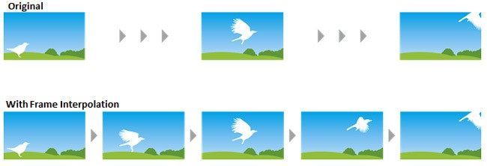
Problem definition
實作 Motion Interpolation:
在frame之間內插新的frame
[1]https://www.144hzmonitors.com/wp-content/uploads/2015/04/Frame-interpolation.jpg

Slide 4
Algorithm(1)
Assumption: [2]
Any motion between two consecutive original frames is rectilinear and uniform
Task:
Evaluating motion vector by averaging or weighting
Problem:
Some motion vector has odd components
The choice of the candidate motion vectors directly affects the range of motion speeds that can be estimated with the algorithm

Slide 5
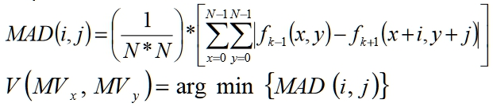

Algorithm(1)
Conventional Motion Compensation frame interpolation
Linear motion compensated interpolation : [3]
→ averaging two frames using motion vectors

Slide 6
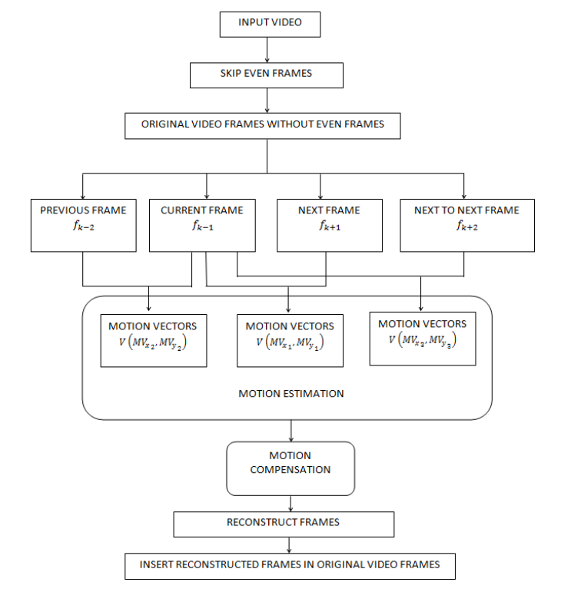
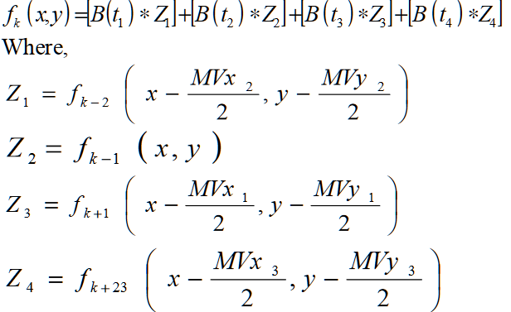
Algorithm(2)
Cubic Motion Compensated Frame Interpolation
B(t) -> Data position on B-spline function

Slide 7

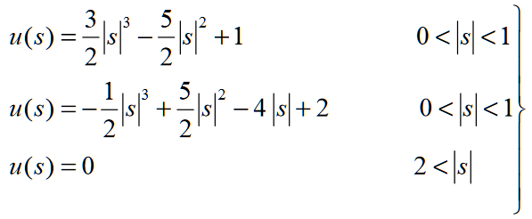
Algorithm(2)
Cubic Motion Compensated Frame Interpolation
-> Ck = f(Xk)

Slide 8
Expected results
Successfully detach all the frames from the input video
Working on the motion vectors to pick which to interpolate
Insert calculated vectors and compensators
Output video

Slide 9
Expected results
Upgrade frame rate
At least 1.5x up
Implement at least one of the algorithm
Evaluate the performance/quality of our program

Slide 10
reference
[1]https://www.144hzmonitors.com/wp-content/uploads/2015/04/Frame-interpolation.jpg
[2] http://citeseerx.ist.psu.edu/viewdoc/download?doi=10.1.1.476.2108&rep=rep1&type=pdf
[3]https://pdfs.semanticscholar.org/0e40/60eb774f36d891a0a622544d2ab7655cc382.pdf

